Slide 1




Slide 2

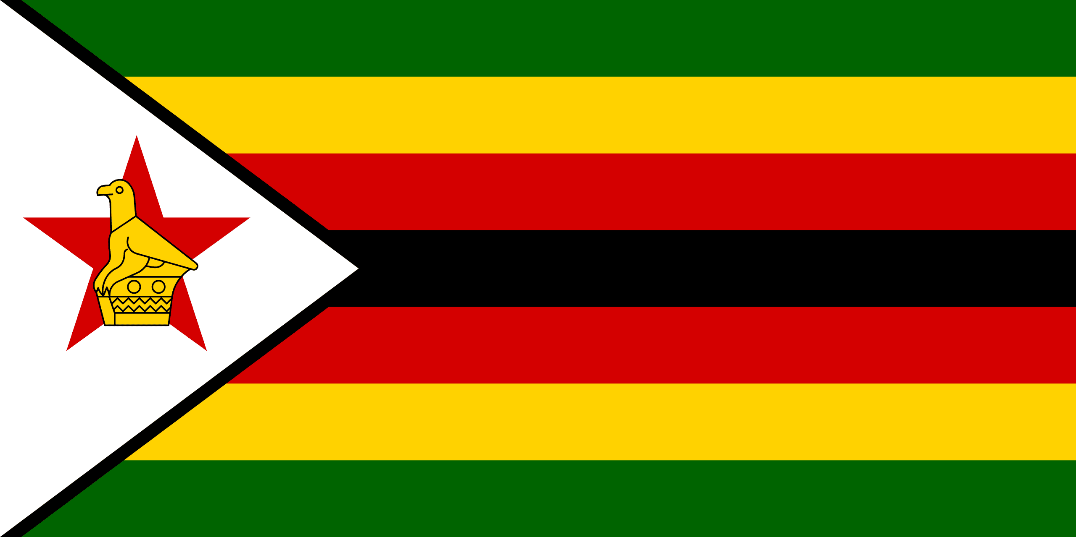
PRAYING FOR
ZIMBABWE

Slide 3
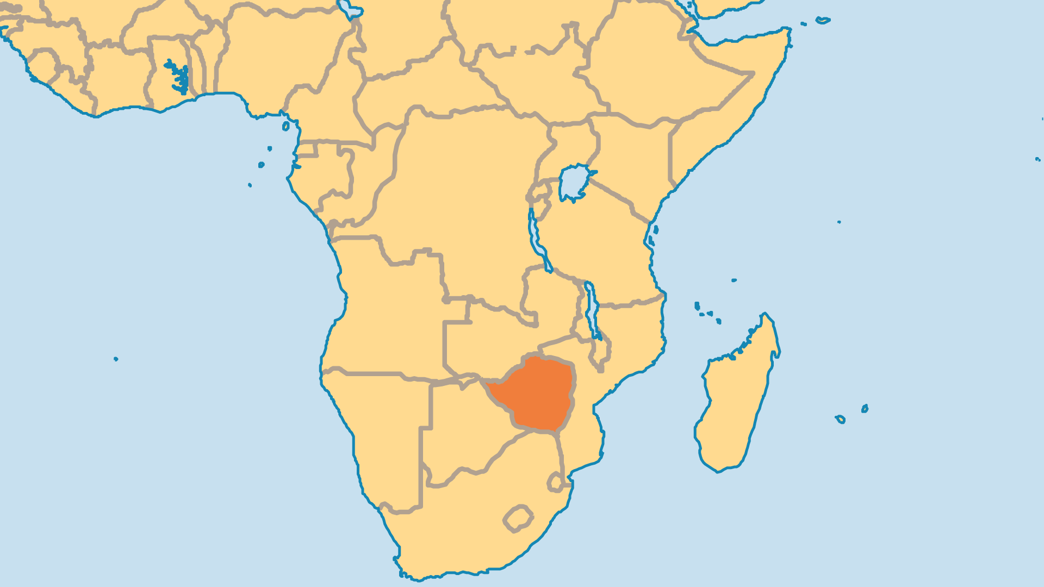
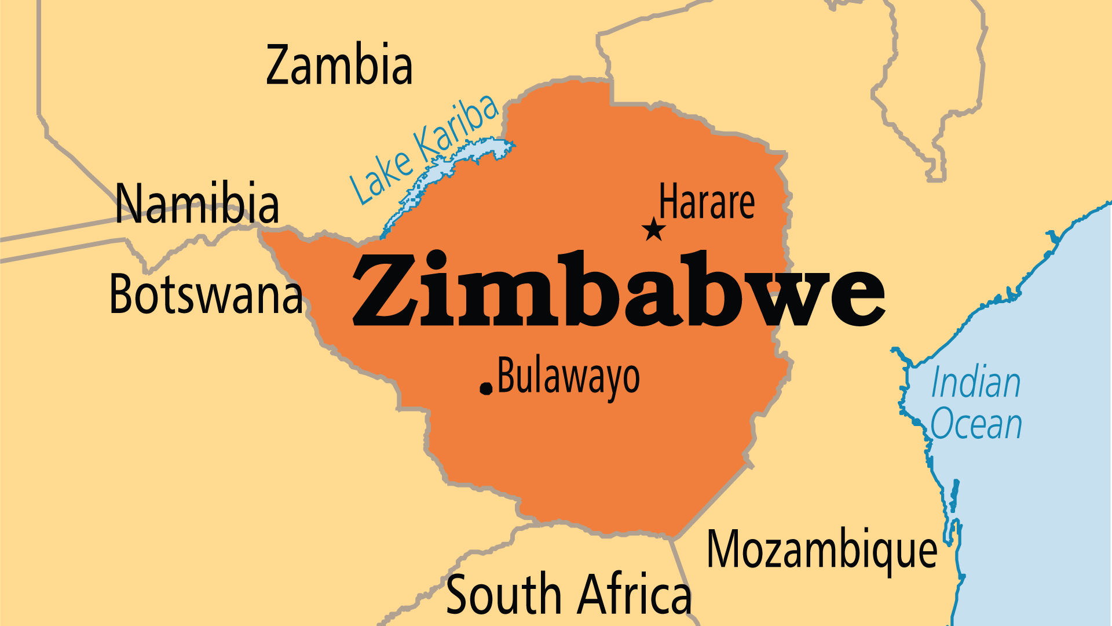
KEY STATS
Capital: | Harare
Population: | 16,950,795
Official Language: | Shona, Ndebele, English and 13 minority languages
Literacy Rate: | 87 %
Life Expectancy: | 59.3 yrs (225th/236)
Christian: | 78 %
Evangelical: | 30.9 %
People Groups: | 41
Unevangelized: | 1 %

Slide 4

FOR PRAYER
Zimbabwe faced years of national emergencies, wrought by the corruption and ineptitude of its own ruling party. Once a food exporter, its agricultural sector has been deeply damaged. Hyperinflation rendered Zimbabwe's currency effectively worthless. Millions left the country to seek a better life elsewhere, including many leaders in education, business, healthcare, and the church. Poverty grips millions who remain. The education system has been gutted by brain drain and poverty - a quarter of parents cannot afford to send their children to school. Pray for God to restore this once-prosperous land and to use His people to bring relief to the decades of suffering.

Slide 5
FOR PRAYER
The exodus of literally countless millions from Zimbabwe to neighbouring African nations and beyond. This "brain drain" includes much of academia, the business community, opposition politicians and spiritual leaders. Their emigration, even temporary, is a serious loss to Zimbabwe. Pray for the swift and safe return and reconciliation of these people to help rebuild a nation on its knees. Pray for strength of community among the Zimbabwean Church in diaspora and for unity befitting their role in reconstruction.
Want to know more? Go to www.operationworld.org

