Slide 1




Slide 2


PRAYING FOR
ZAMBIA

Slide 3
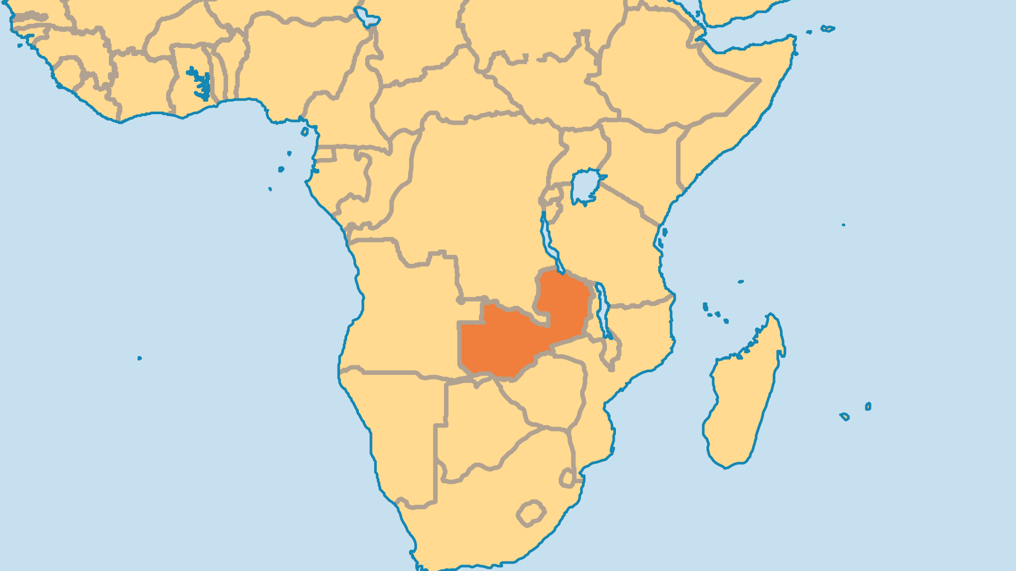
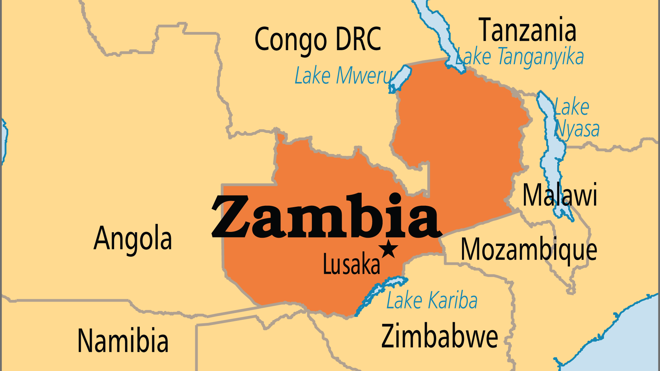
KEY STATS
Capital: | Lusaka
Population: | 21,913,874
Official Language: | English
Languages: | 72
Literacy Rate: | 63 %
Life Expectancy: | 61.2 yrs (214th/236)
HDI Ranking: | 154/193
% Christian: | 87 %
% Evangelical: | 25.7 %
People Groups: | 77

Slide 4

FOR PRAYER
Zambians widely accept Christianity, even in public institutions and the media. Evangelicals grew from 3.8% in 1960 to more than 25% today. Zambians practice freedom of all religions. Zambia enjoys a legacy as a stable and peaceful nation surrounded by countries troubled by war and unrest. But national transformation along biblical lines still has not come. Too few know the Word of God, or how to live a Christian life. Superstitions and occult practices open the door for the enemy to work evil in people's lives. Pray for Christians to live pure and holy lives that depend on God alone for spiritual power and blessing. Pray that Zambia will truly be a nation that honours God.

