Slide 1




Slide 2

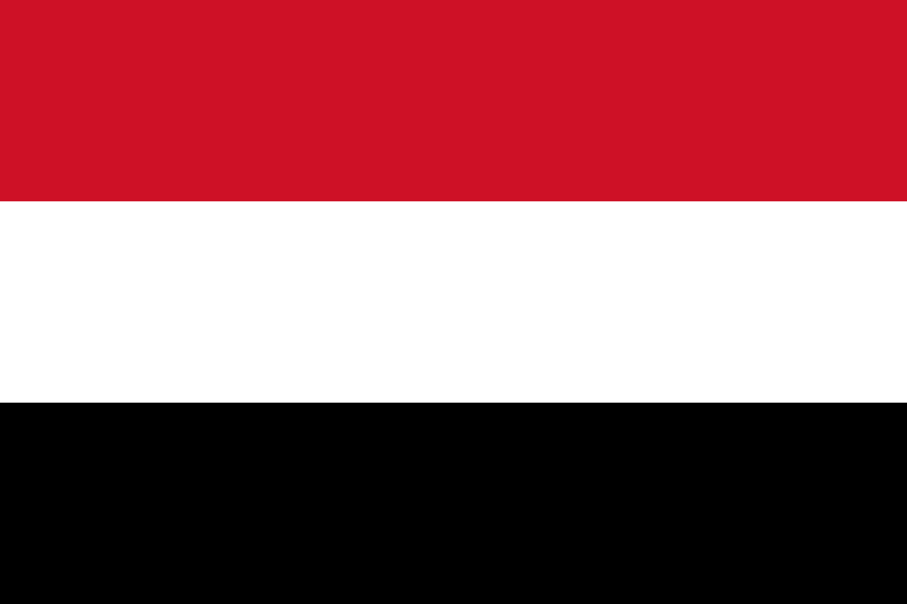
PRAYING FOR
YEMEN

Slide 3
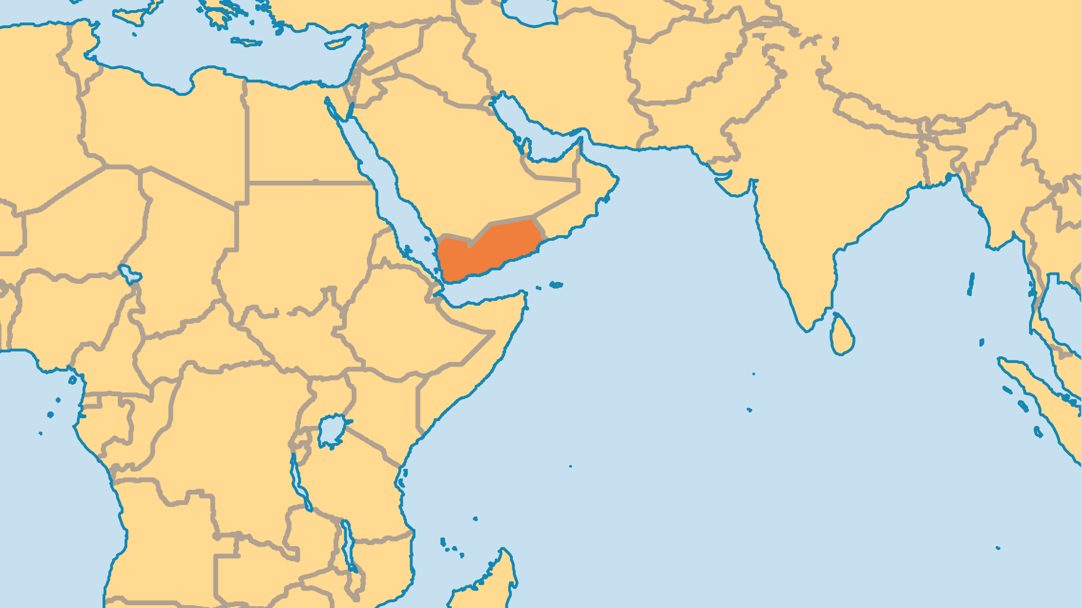
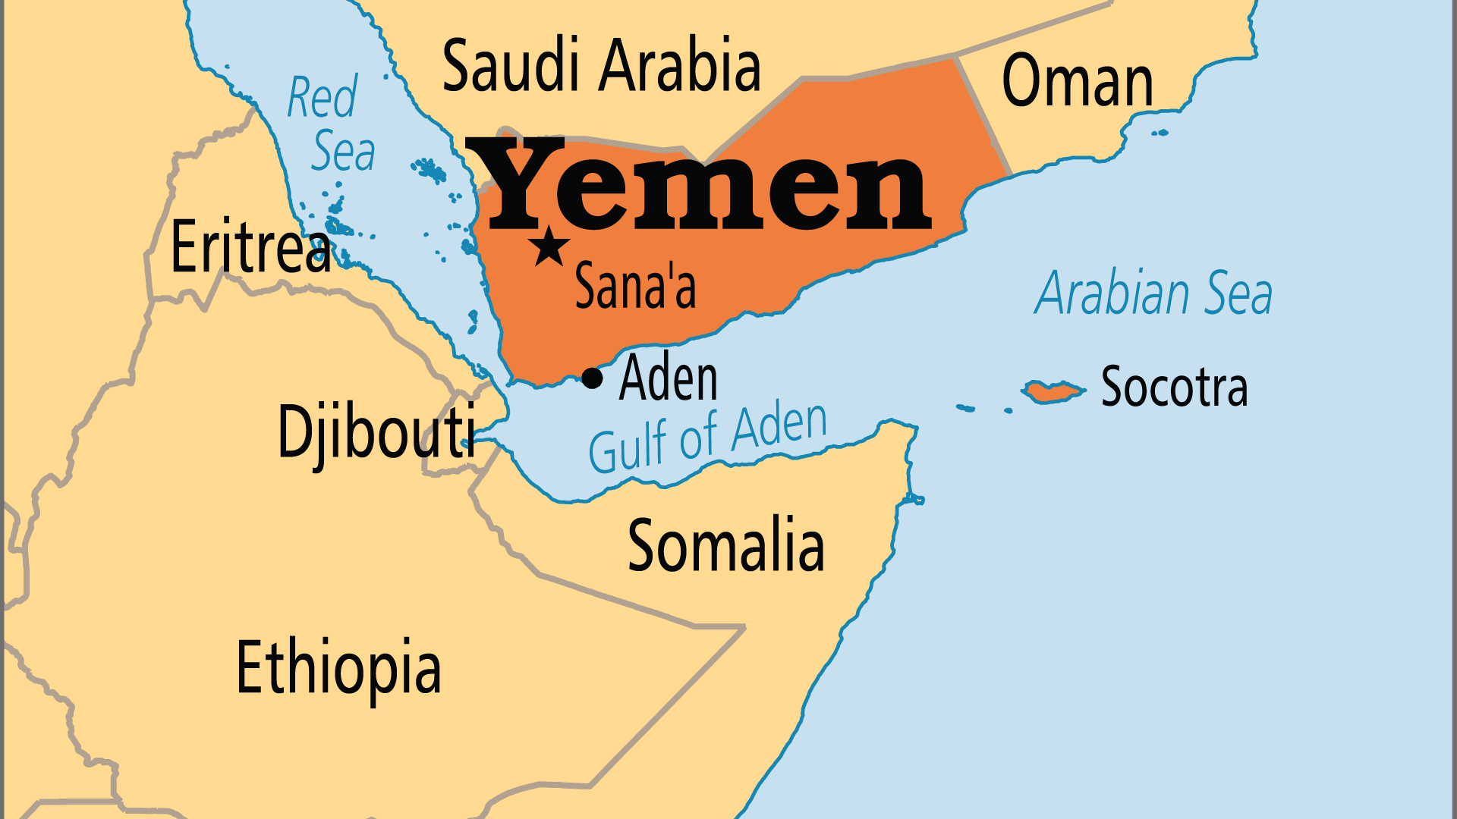
KEY STATS
Capital: | Sana'a
Population: | 41,773,878
Official Language: | Arabic
HDI Ranking: | 183/193
% Christian: | 0.1 %
Largest Religion: | Muslim
% Largest Religion: | 99.9 %
% Unevangelized: | 64 %
Persecution Ranking: | 3/50

Slide 4

FOR PRAYER
Amidst the terrible suffering, Yemenis are finding life in Christ through radio, Bible distribution, careful witness, and dreams and visions from the Lord! Believers meet secretly and only in small groups. They often face dangerous opposition. Praise God for these followers of Jesus. Pray for them as they learn how to honour their culture and family while faithfully serving the Lord. There may be more Yemeni followers of Christ than all the other indigenous groups in the Arabian Peninsula combined!
Want to know more? Go to www.operationworld.org

Slide 5
FOR PRAYER
Yemen has suffered in recent decades from three civil wars, tribal conflicts, and war in nearby countries. Currently Yemen is divided between Shi'a Houthi rebels who control much of the country and Sunni forces supporting the ousted President. Radical Islamist groups, neighbouring countries, and Western governments (through arms sales) have all contributed to the violence. Many have died in bombings, including in schools, hospitals, and prisons. As a result, much of the population has faced food shortages and even starvation in recent years. Few children can regularly go to school and fewer adults have a reliable income. May the God of peace and justice bring both to this land of great suffering.

