Slide 1




Slide 2


PRAYING FOR
WALLIS & FUTUNA ISLANDS

Slide 3
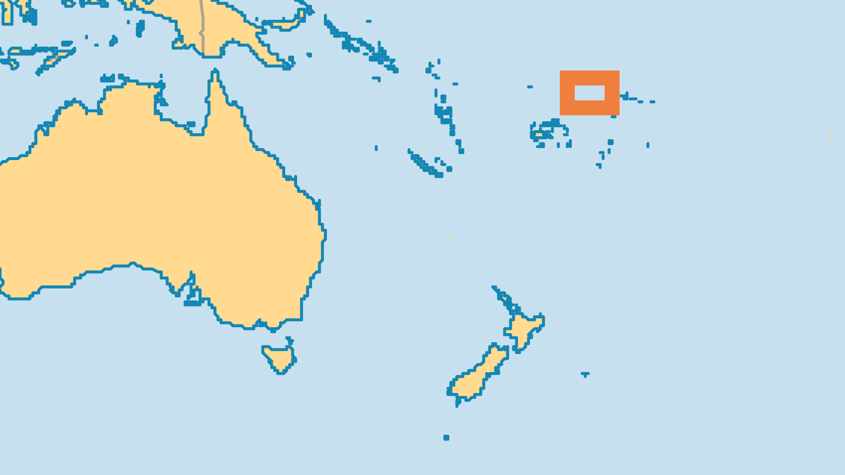

KEY STATS
Capital: | Mata-Utu
Population: | 11,194
% Urban: | 0 %
Official Language: | French, Uvean, Futunan
Languages: | 3
Literacy Rate: | 50 %
Life Expectancy: | 78.4 yrs (59th/236)
% Christian: | 99 %
% Evangelical: | 1 %
% Unevangelized: | 1 %

Slide 4

FOR PRAYER
Evangelical numbers are increasing through the missionary efforts of Pentecostals from New Caledonia. Action Missionaire Calédonienne has sent several New Caledonian missionaries to Wallis and Futuna, yielding dozens of new believers. Pray for a greater growth of this wonderful development - Pacific Islanders reaching cross-culturally to other Pacific Islanders.
Want to know more? Go to www.operationworld.org

