Slide 1




Slide 2


PRAYING FOR
US VIRGIN ISLANDS

Slide 3
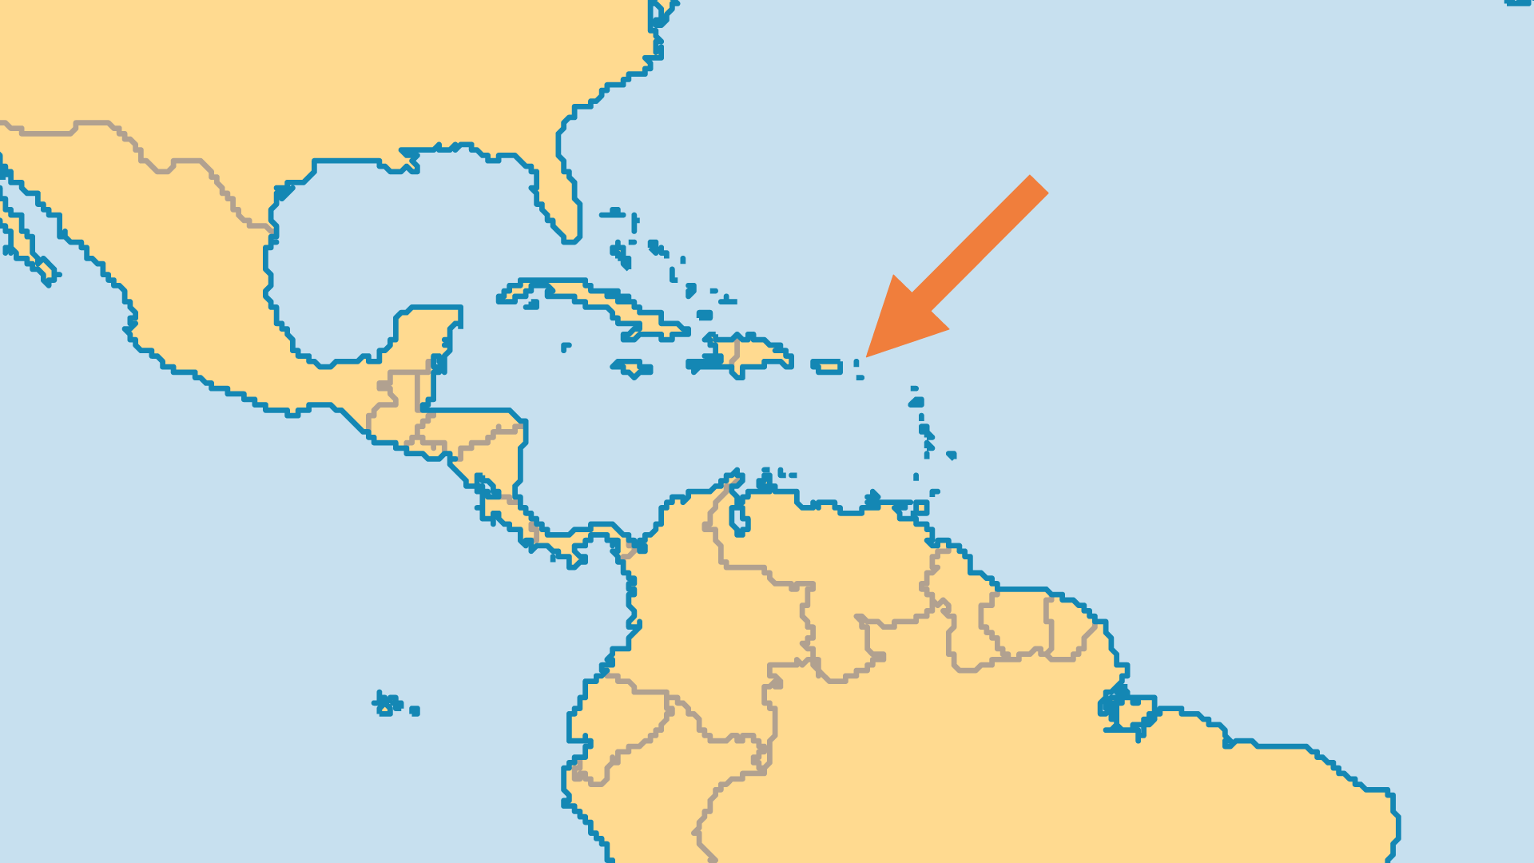
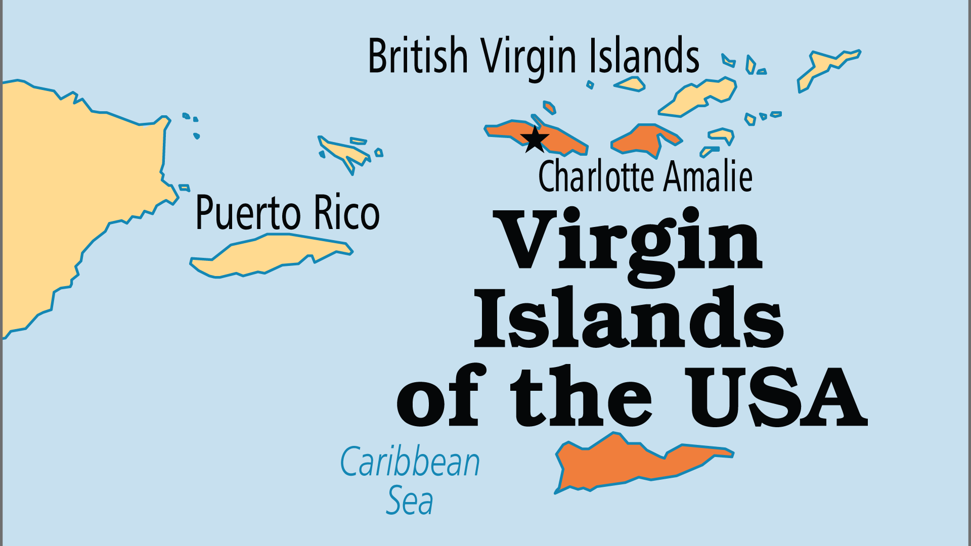
KEY STATS
Capital: | Charlotte Amalie
Population: | 84,139
% Urban: | 96.4 %
Pop Under 15 Yrs: | 19.5 %
Official Language: | English, but Spanish widely spoken
Life Expectancy: | 74.7 yrs (95th/236)
% Christian: | 95 %
% Evangelical: | 23.8 %
% Unevangelized: | 1 %

Slide 4

FOR PRAYER
Tourism and the influx of wealth affect society profoundly, corroding its moral fabric. Pray that the gospel might impact society, personal lifestyles and family life.
Want to know more? Go to www.operationworld.org

