Slide 1




Slide 2


PRAYING FOR
VIETNAM

Slide 3
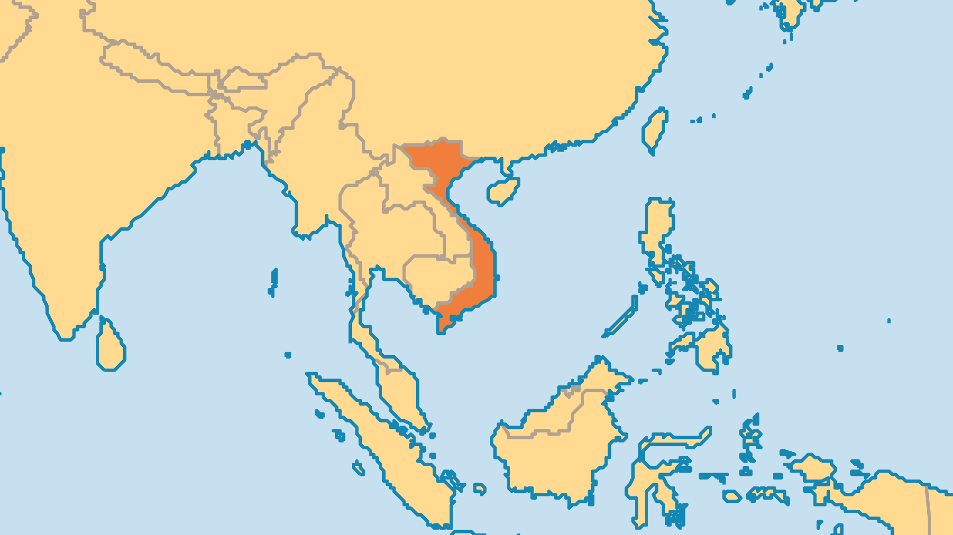
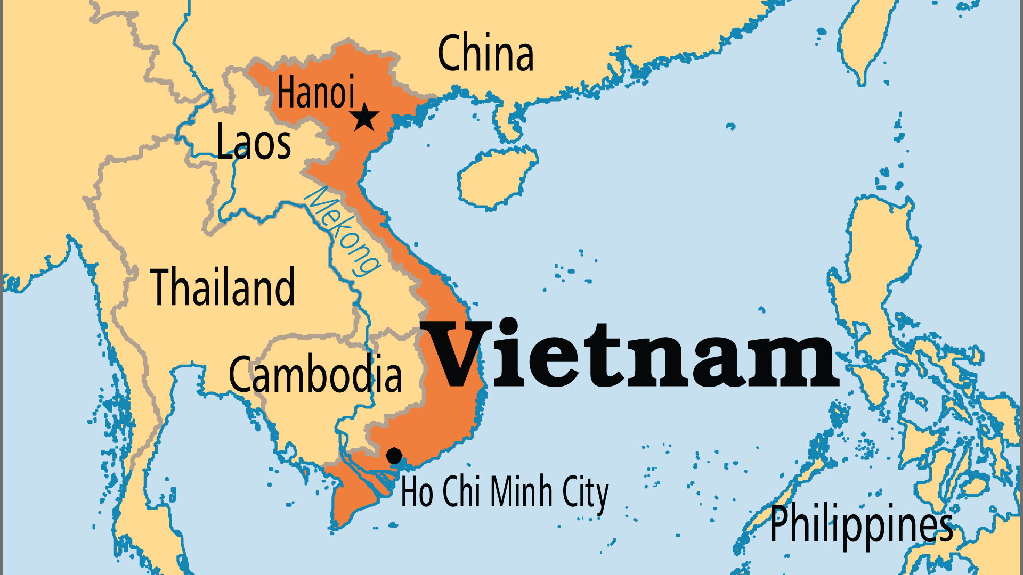
KEY STATS
Capital: | Hanoi
Population: | 101,598,527
Official Language: | Vietnamese
Languages: | 106
% Christian: | 9.4 %
% Evangelical: | 1.8 %
Largest Religion: | Buddhist
% Largest Religion: | 52.5 %
% Unevangelized: | 27 %
Persecution Ranking: | 44/50

Slide 4

FOR PRAYER
Vietnam is a single party state, although it has employed capitalistic economic principles to fuel recent growth. This land has known great violence in past decades, and although peace now prevails, much division and mistrust exist among its peoples. The deepest spiritual loyalty in Vietnam is to the worship of ancestors, more than to Communism or the mixture of Buddhism, Taoism, and Confucianism practised by most Vietnamese. Rapidly emerging materialism may now be the greatest passion of most Vietnamese. Christians face hard questions as they try to handle these issues biblically. Pray that the light of the gospel will banish all darkness and provide hope and purpose to all those who are lost.

Slide 5
FOR PRAYER
A growing, witnessing Church is emerging from years of persecution. Catholic and Protestant, new expression and old, a significant turning to God is occurring in different places, in both registered and unregistered churches, and among different people groups. The Vietnamese diaspora is also seeing many become believers. These converts then bring the gospel back to Vietnam with them. There is even a fast-growing missionary vision spreading among the churches of Vietnam! Pray for the Holy Spirit to keep fanning these flames of spiritual passion, all for the maturation of the Vietnamese Church and so that Jesus might be known through the entire nation.

