Slide 1




Slide 2

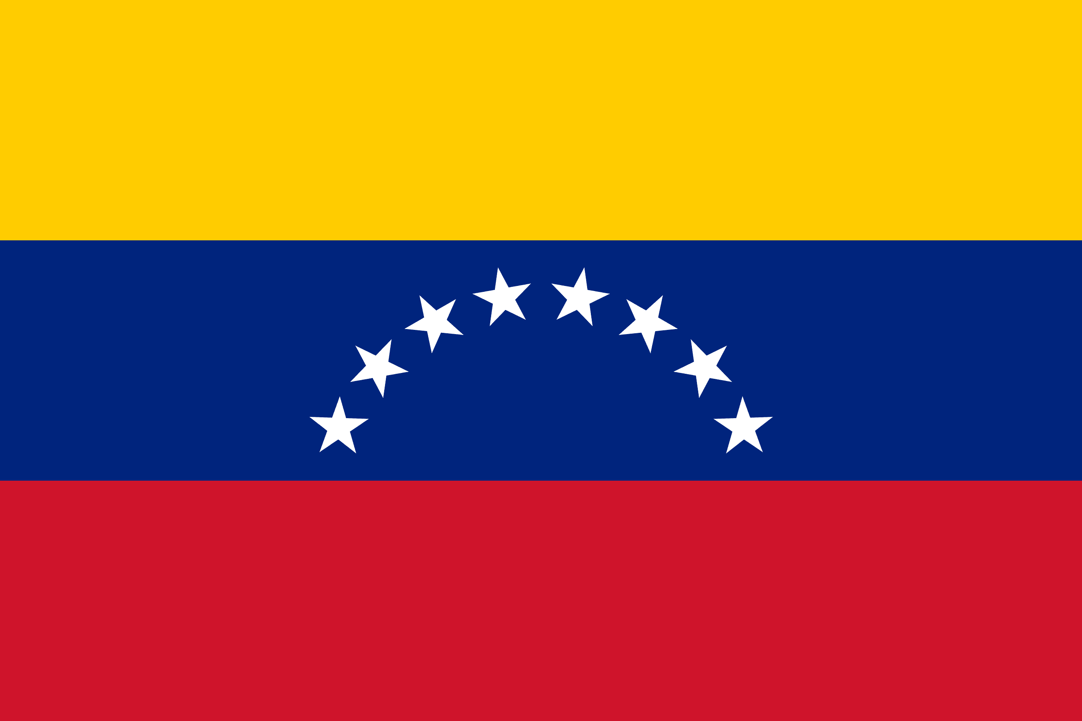
PRAYING FOR
VENEZUELA

Slide 3
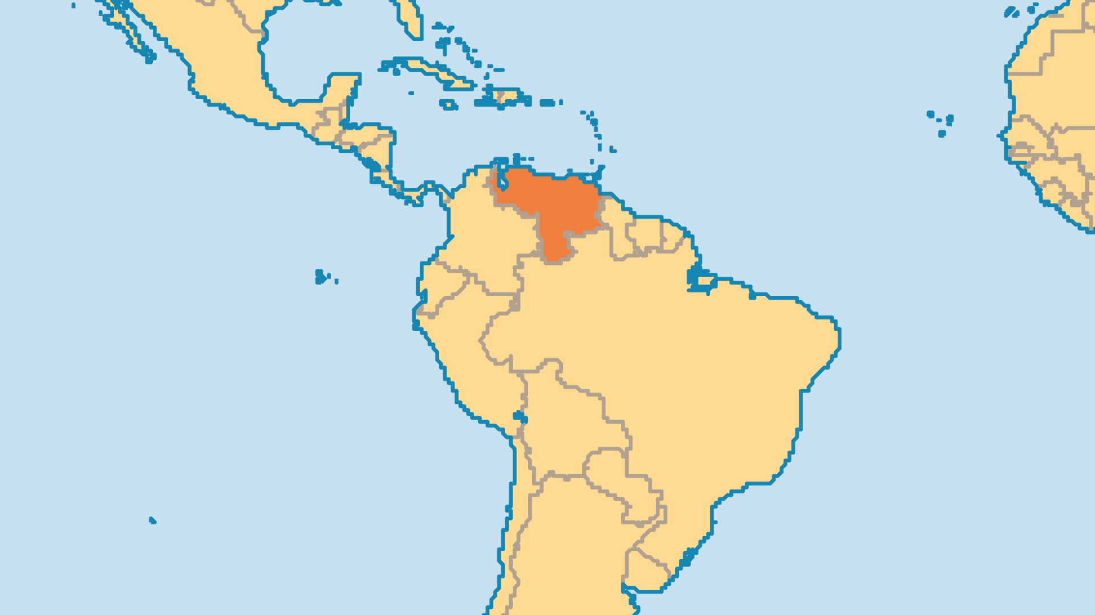
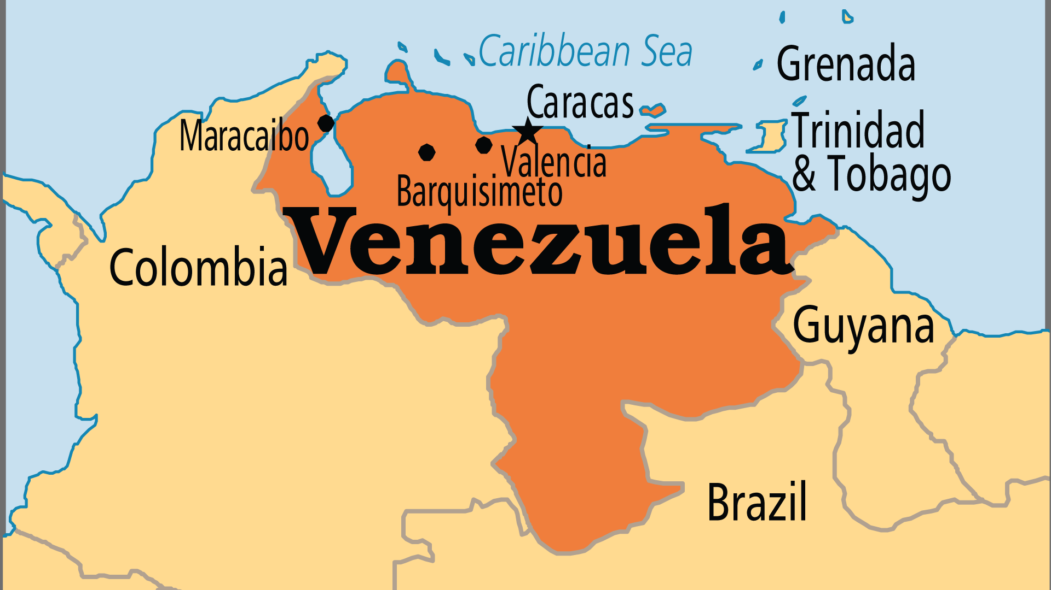
KEY STATS
Capital: | Caracas
Population: | 28,516,896
Official Language: | Spanish
Languages: | 47
Literacy Rate: | 95 %
HDI Ranking: | 120/193
% Christian: | 84.5 %
% Evangelical: | 10.8 %
People Groups: | 66
% Unevangelized: | 1 %

Slide 4

FOR PRAYER
Venezuela has unravelled before our eyes in the past few years. Recent leaders have driven the country to economic ruin, despite vast oil reserves. Even before, corruption and poverty were widespread. 60% of city dwellers live in slums. Venezuela ranks as the 2nd most corrupt nation in Latin America (after Haiti). Health care crises, massive food shortages, and hyperinflation have caused millions of Venezuelans to flee the country, desperately seeking survival and opportunity elsewhere. Children, the elderly, or pregnant women, are all at risk of exploitation by unscrupulous traffickers and criminals. Pray for their protection. Pray for God to bring relief to the suffering of the Venezuelan people.

Slide 5
FOR PRAYER
Spiritual forces battle in Venezuela. Both rich and poor visit witch doctors in the thousands of spiritist and occult shops. One animist cult (Maria Lionza) has 500,000 followers. Only 10% of Catholics attend mass. Fewer people go to church in Venezuela than in any other Latin American nation. Millions of former Catholics chose evangelical faith or no religion at all. New Age spirituality attracts the educated and rich. Satanists actively try to destroy the Church. Caracas has Latin America's largest mosque. Pray for the Holy Spirit to bind all the powers that blind Venezuelans to Truth, and to reveal Christ to all.
Want to know more? Go to www.operationworld.org

