Slide 1




Slide 2


PRAYING FOR
UZBEKISTAN

Slide 3
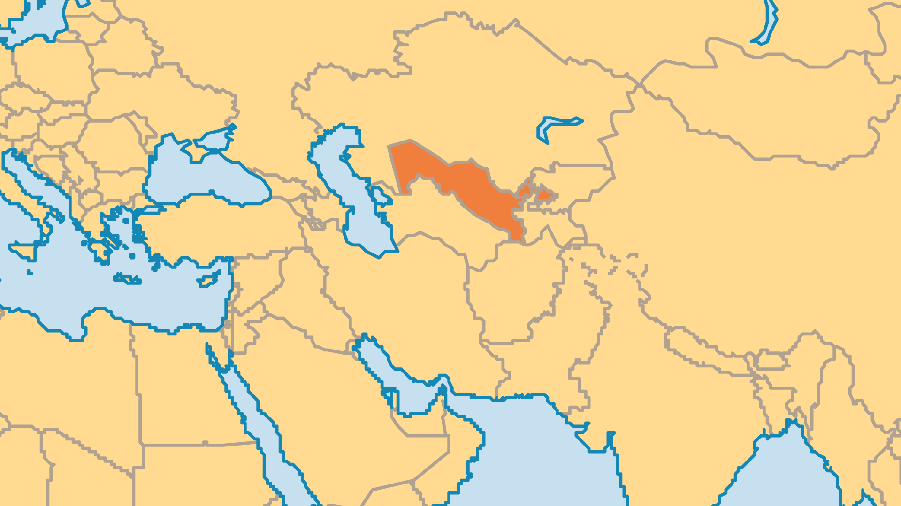
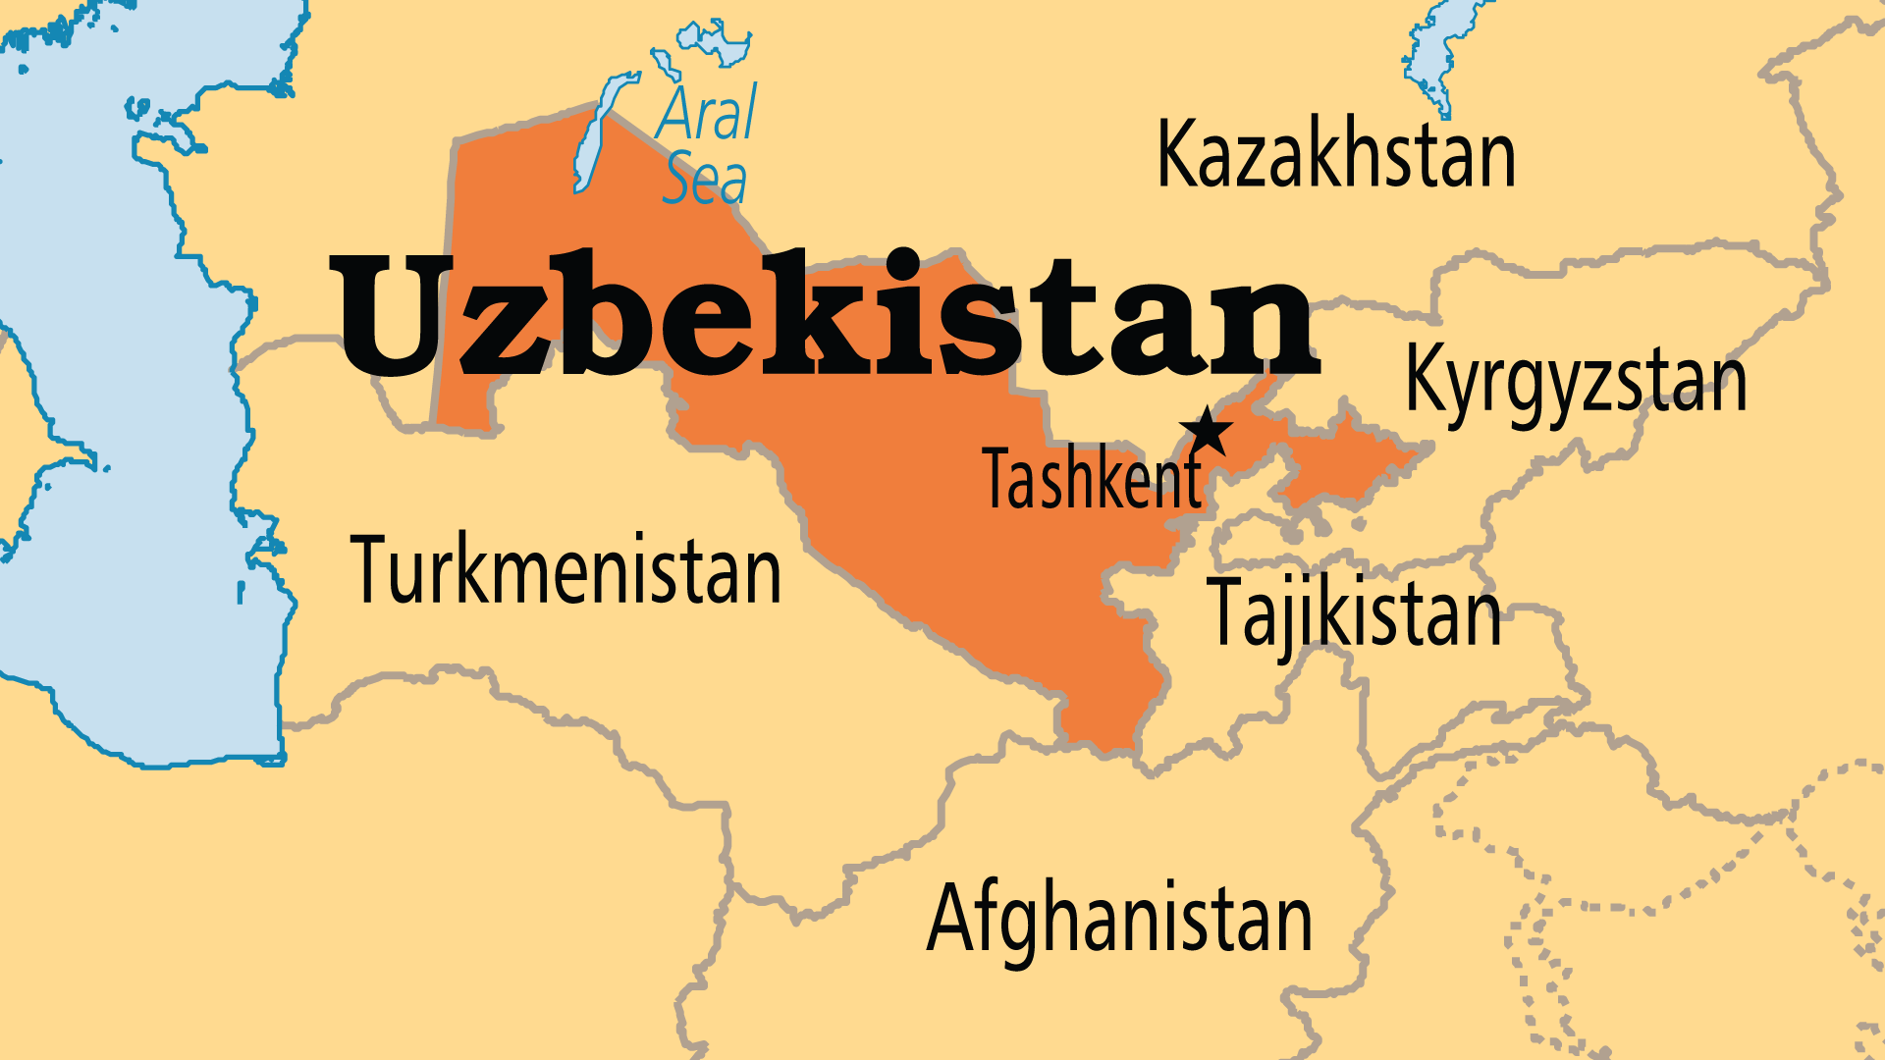
KEY STATS
Capital: | Tashkent
Population: | 37,053,428
Languages: | 39
% Christian: | 0.8 %
% Evangelical: | 0.3 %
Largest Religion: | Muslim
% Largest Religion: | 84.9 %
% Unevangelized: | 50 %
Persecution Ranking: | 25/50

Slide 4

FOR PRAYER
Uzbekistan is the strategic key for all of Central Asia, and tensions remain high between the post-Soviet regime and the Islamist movements (most radical in the Fergana Valley). Much of the population is tired of poverty, corruption, and failure to make economic progress, and Islamists attract jobless young men. Economic prospects have improved recently, as both tourism and employment opportunities for women have improved. Pray for positive change that lasts, and leadership that governs for the sake of the people. Pray for the true peace only Jesus can give.

Slide 5
FOR PRAYER
Uzbek believers continue to increase despite great opposition. The prospect of retribution from three sides - the government, local Muslim leaders and the community (family and neighbours) - has not halted growth. There are now probably more than 10,000 Uzbek believers, where there were possibly none only a generation ago. But much prayer is still needed:
Want to know more? Go to www.operationworld.org

