Slide 1




Slide 2

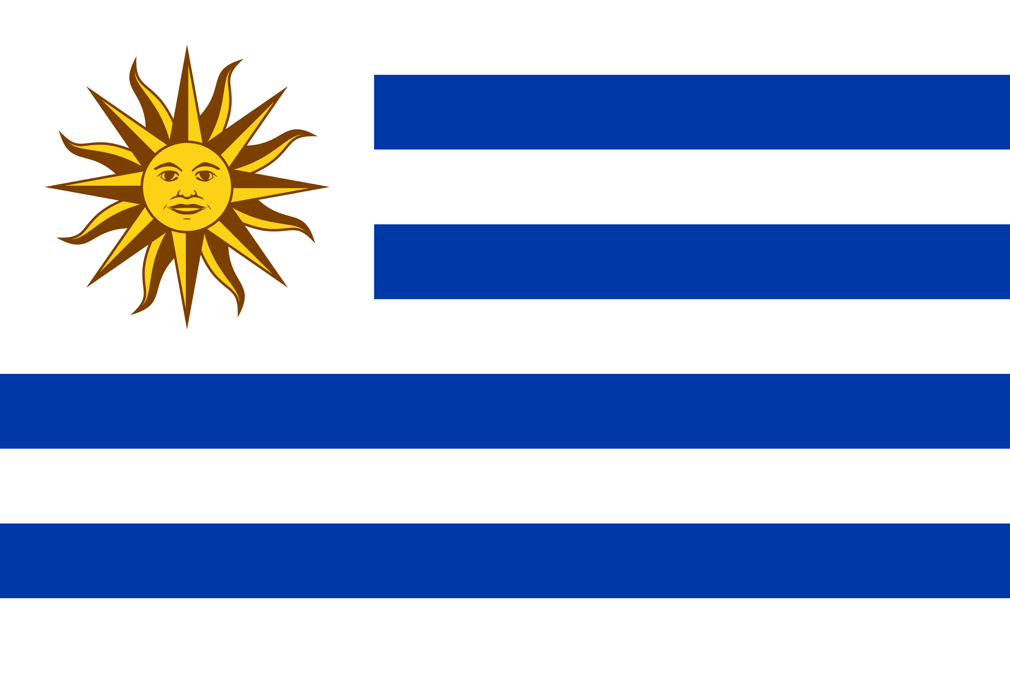
PRAYING FOR
URUGUAY

Slide 3
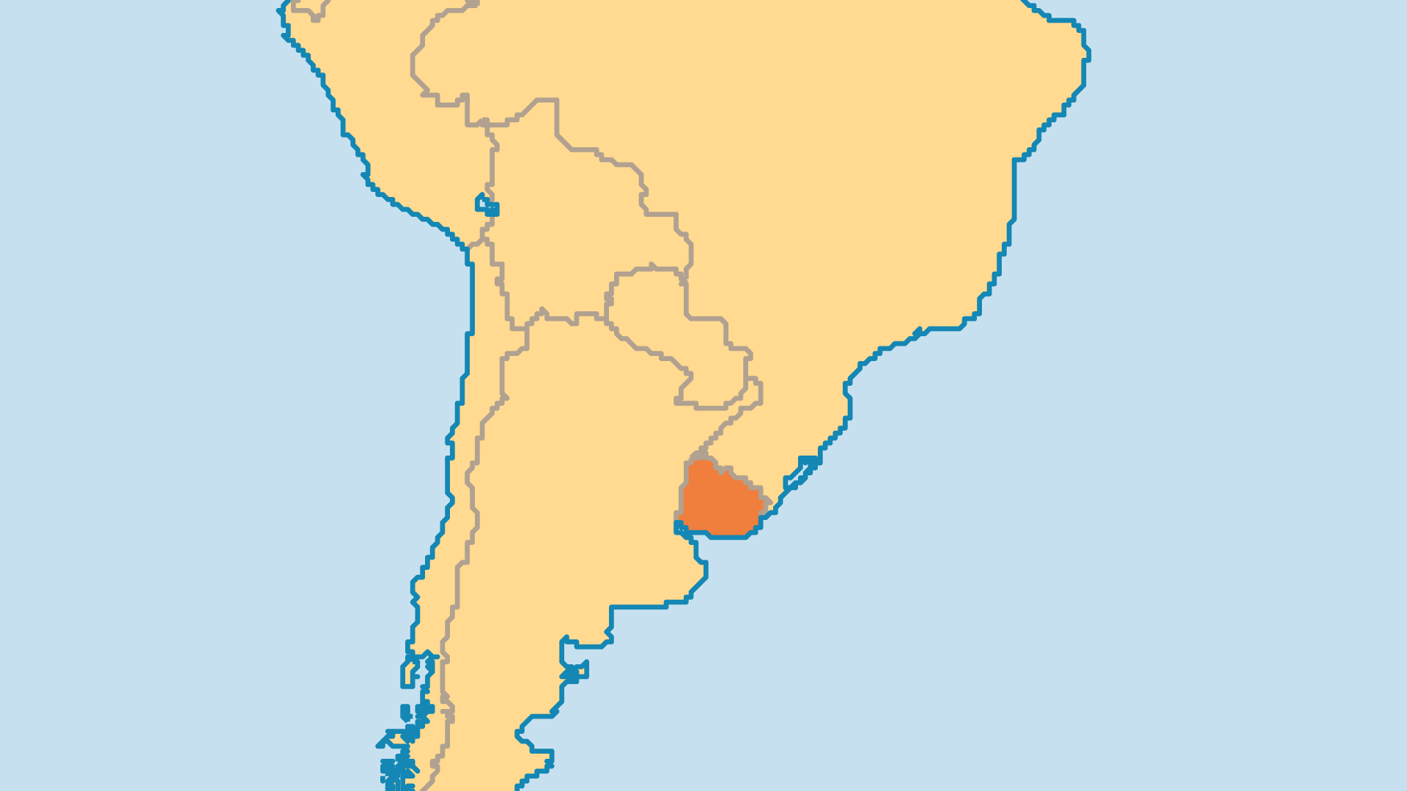
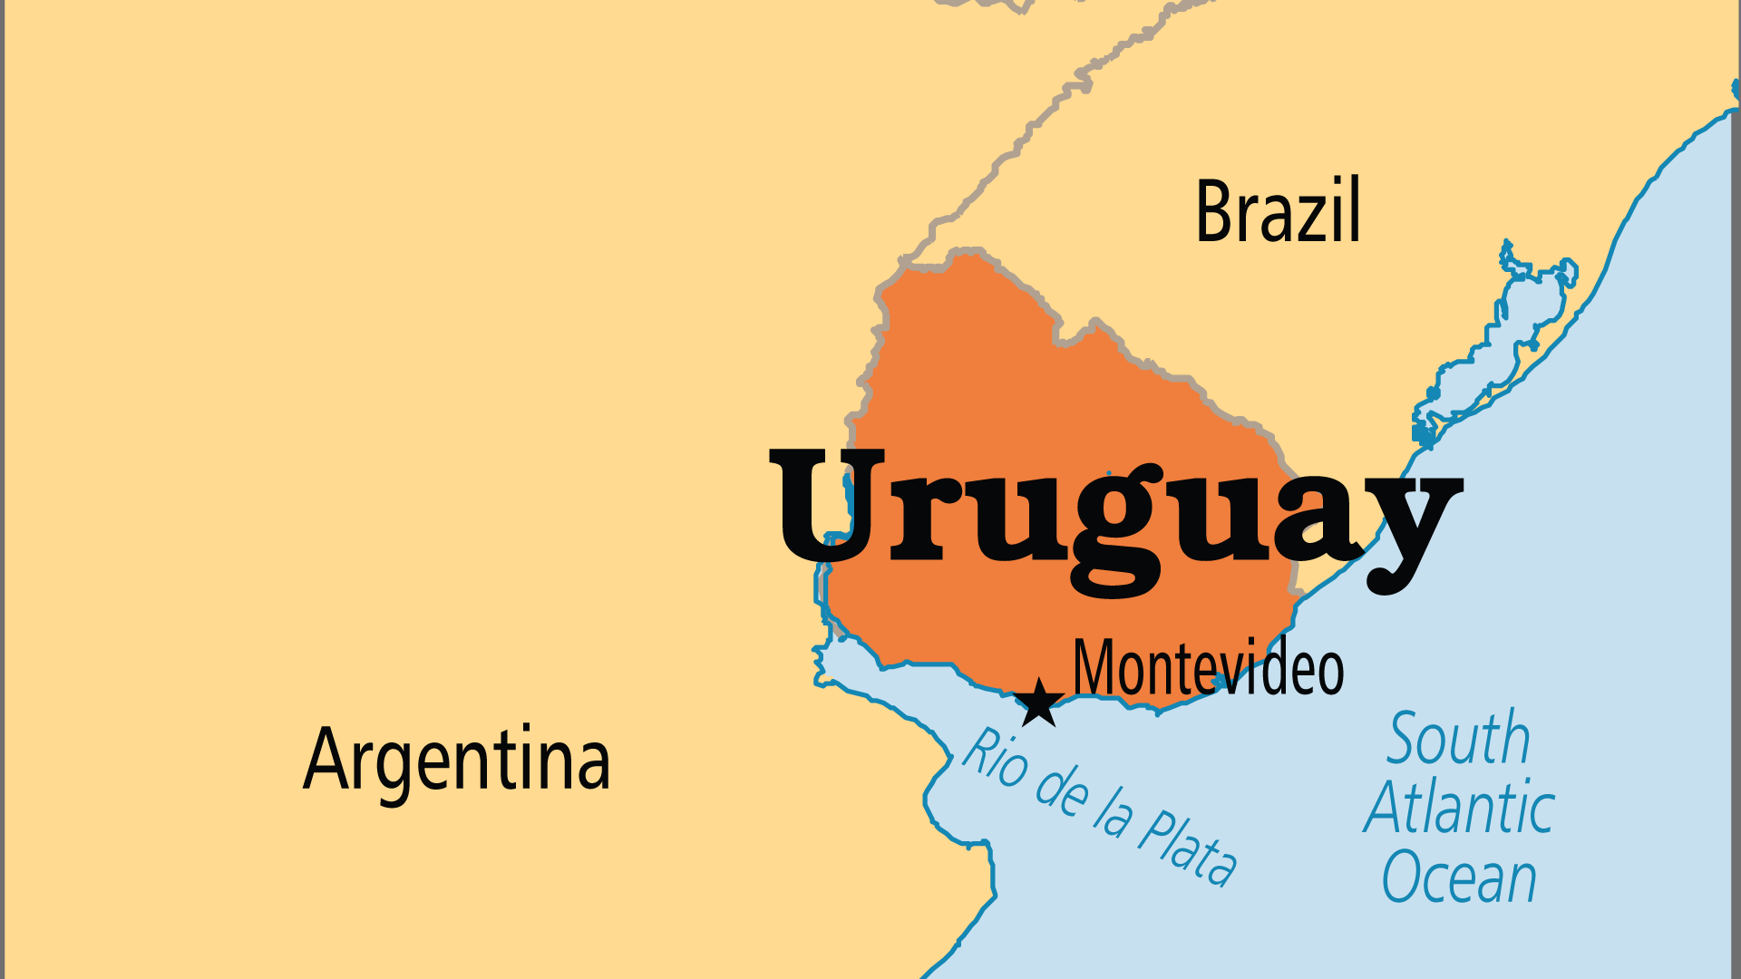
KEY STATS
Capital: | Montevideo
Population: | 3,384,688
Official Language: | Spanish
Languages: | 12
Life Expectancy: | 75.4 yrs (84th/236)
HDI Ranking: | 58/193
% Christian: | 64.7 %
% Evangelical: | 6.2 %
% Unevangelized: | 1 %

Slide 4

FOR PRAYER
Uruguay has the most secular society in South America. While much positive progress came in areas like political transparency, equality, and economic development, modern developments like the legalization of abortion, same-sex marriage, and cannabis use came as well. Uruguay's rates of depression, suicide, and abortion are some of the highest on the continent. Most Uruguayans follow a "do-it-yourself" spirituality influenced by New Age ideas. Catholics are now less than 50% (lowest in Spanish-speaking Latin America). Only 2% attend mass. Afro-Brazilian Spiritism attracts many. Pray for the Holy Spirit to expose religious deceptions and the demonic influences behind them.

