Slide 1




Slide 2


PRAYING FOR
UNITED STATES OF AMERICA

Slide 3
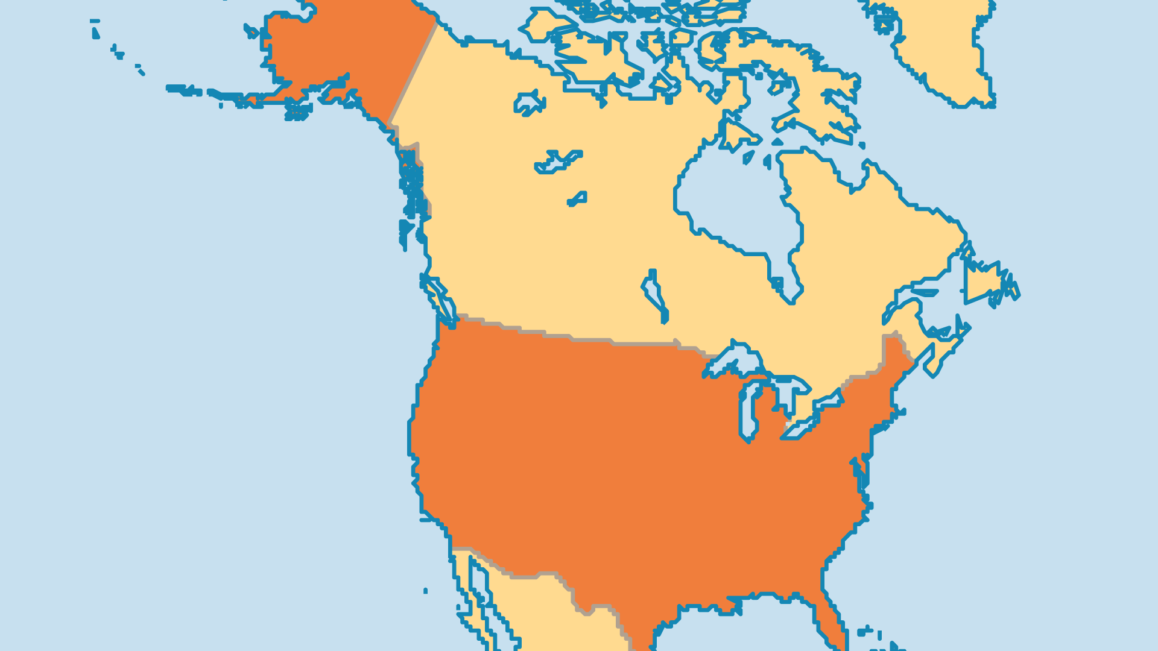
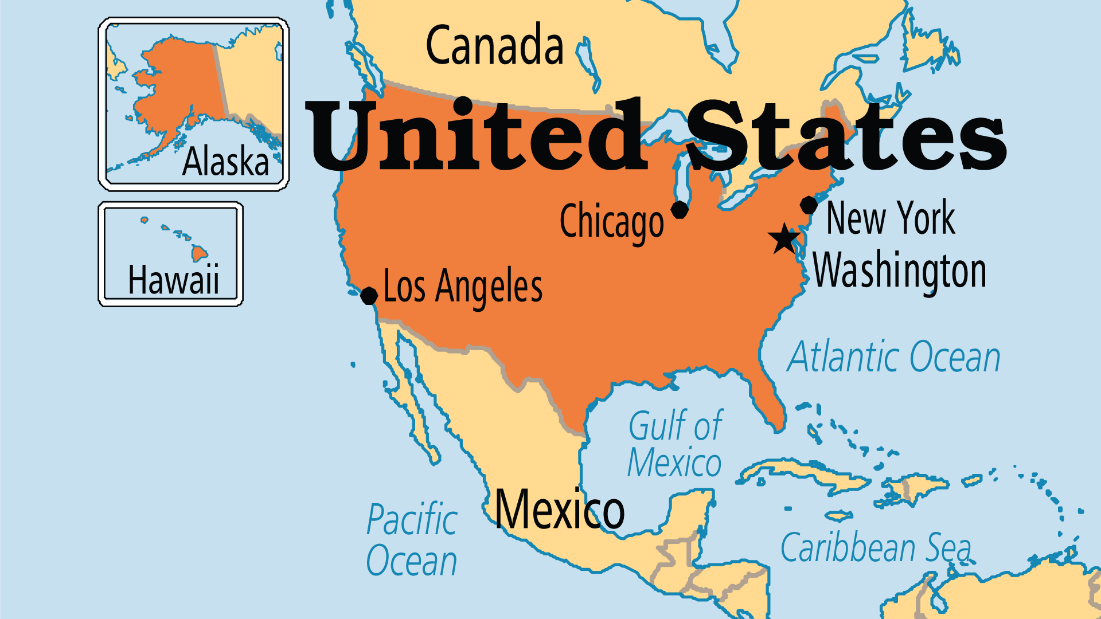
KEY STATS
Capital: | Washington DC
Population: | 347,275,808
Official Language: | English
Languages: | 176
HDI Ranking: | 21/193
% Christian: | 77.6 %
% Evangelical: | 28.9 %
People Groups: | 523
Least Reached People Groups: | 98
% Unevangelized: | 2 %

Slide 4

FOR PRAYER
Christianity has been a huge influence in the USA since before its founding as a nation. Evangelicals (28.9% of population) exist in all major ethnic groups and levels of society. The Pilgrim Fathers of America wanted a land with freedom to practise their Christian faith. This foundation supported the growth of one of the largest Christian movements in history. The USA has around 15% of the world’s evangelicals, and still, a significant proportion of the world’s missionaries. America’s Christian values helped shape the modern world in many positive ways. Pray that the USA might once more serve as a launch pad for the good news and the attendant transformation that it is meant to bring.

Slide 5
FOR PRAYER
The Church in the USA is as deeply divided as the nation itself. In this past generation, cracks papered over by previously shared values have become chasms. The USA's spiritual heritage has long been under attack by those opposed to the gospel, but no external enemies have done more damage than the politicization of Christianity and accompanying polarization in the body. The idol of nationalism - "Christian" or otherwise - is a blight on the message of the gospel, as is any ideology that divides or distracts believers from their core identity as the body of Christ. Pray for the Lord to raise up believers who will fearlessly and publicly place their oneness in Christ above all race, ethnicity, gender, and ideology!

Slide 6
FOR PRAYER
America has a massive cultural and social influence. No other country has as much potential to be a redemptive force in the world, and no other country does more to spread sin. America has made the world a better place through aid and development, innovation in technology and media, universal education, information, defence of human rights, and opposition to tyranny. America has also hurt the world through countless channels of vice and sin. Pray that God might shape this nation to be a greater force for good, and destroy these sinful practices that pollute much of the world.

Slide 7
FOR PRAYER
America bears many of the signs of an empire in decline - economic stratification, spiralling debt, deteriorating public health, ideological division, corruption, addiction to entertainment, demographic challenges, strained international relations and more. The shaking of the USA's foundations is intensifying even as change is accelerating. What kind of nation will emerge from this season of upheaval? Jesus stated: "Whoever would be great among you must be your servant, and whoever would be first among you must be slave of all." Pray that the Lord might hear the prayers of His people and pour out measures of divine mercy and justice that display His perfect wisdom.

Slide 8
FOR PRAYER
The American Church needs revival - not the slick mass evangelism and theatrics often associated with the word, but true revival with conviction of sin, repentance and an outpouring of the Holy Spirit. Revival is not smarmy spectacle. It is our brokenness before God and the new life and restoration that can come only from Him. More often than not, the public face of Christianity turns people away from Jesus rather than drawing them to Him. In many circles, the gospel is often little more than a self-help philosophy. Thank God for the pockets where revival is happening - and it is! Pray that it may spread.

