Slide 1




Slide 2


PRAYING FOR
UNITED KINGDOM

Slide 3
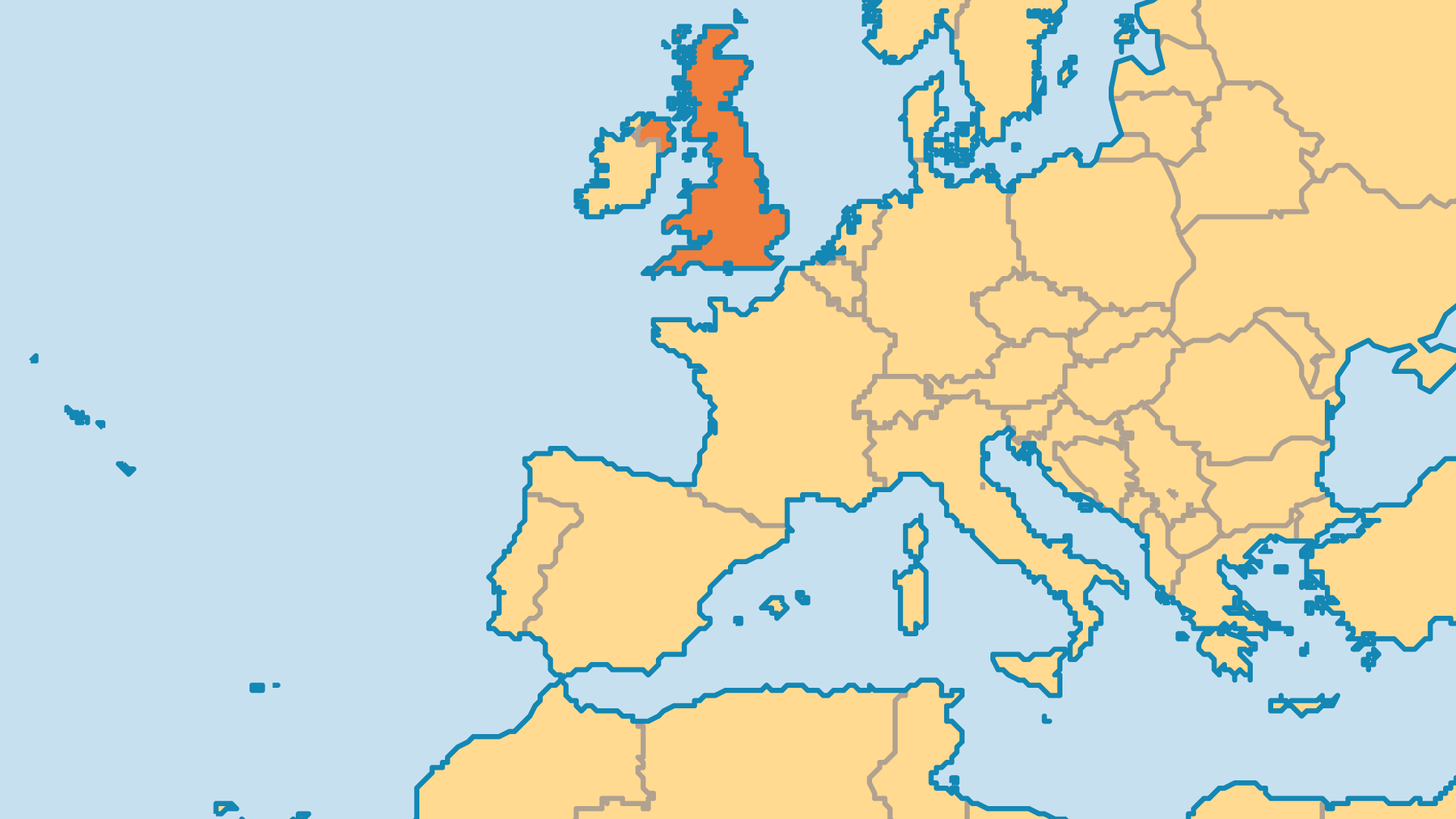
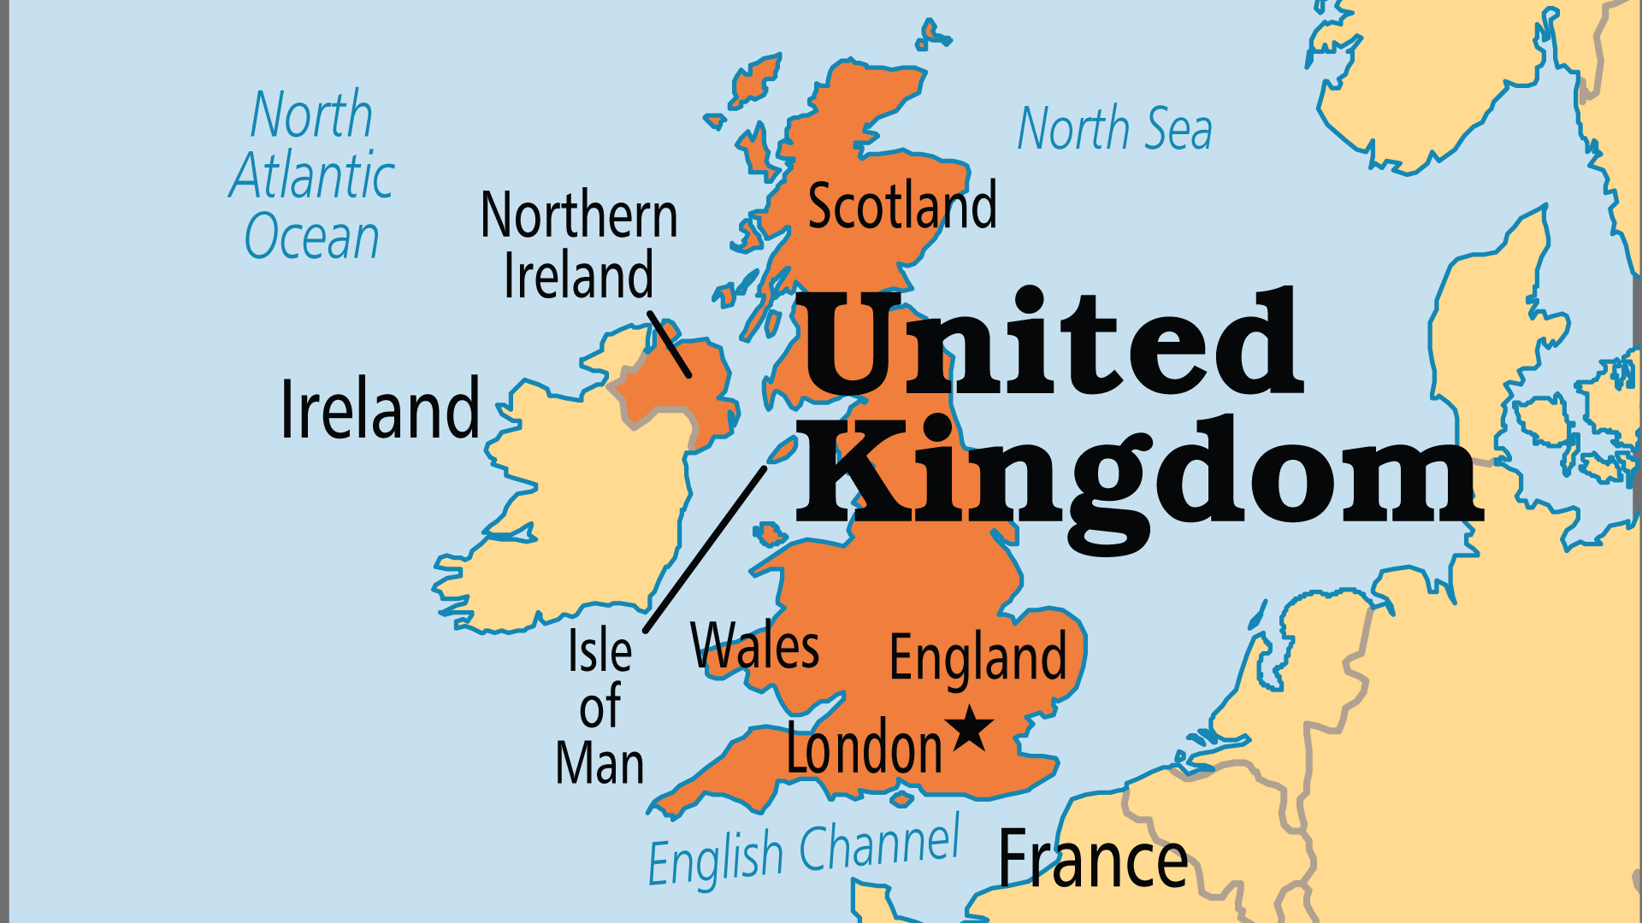
KEY STATS
Capital: | London
Population: | 69,551,332
% Urban: | 85.1 %
Official Language: | English; in Wales both English & Welsh.
Languages: | 15
HDI Ranking: | 18/193
% Christian: | 59.7 %
% Evangelical: | 8.8 %
% Unevangelized: | 5 %

Slide 4

FOR PRAYER
The Christian tradition once formed the foundation of society, but today minority religions, especially Islam, also receive significant attention and government support. Astrology, New Age, the occult, and old-world paganism (Druid/Wicca) are all slowly becoming more popular, but none as fast as spirituality and religion are declining. Less than half of England and Welsh identify as Christian; a precipitous decline even in the last 20 years. In almost every century of the last 800 years, revival came to Britain at least once. The last was in 1859-1869. Pray for another great spiritual awakening.

Slide 5
FOR PRAYER
Britain’s cultural, diplomatic, economic, and military influence shaped the world for the past two or three centuries. It is head of the Commonwealth and a permanent member of the UN Security Council. Despite the UK's shrinking profile since Brexit, London remains one of the world’s hub cities for finance, travel, politics, and culture. The UK has also contributed significantly to global Christianity for centuries, from Wycliffe and Tyndale until today with the Alpha Course, 24-7 Prayer, and many evangelical writers, theologians, and worship leaders. Pray for this influence to be used for the sake of what is just and right.

Slide 6
FOR PRAYER
Immigration is a reality of national life. In London, over 50 nationalities have communities of over 10,000 people, and every nationality in the world is represented here! Many Brits struggle to welcome immigrants, and immigrants struggle to adjust to life in the UK. Some react negatively to these changes, but society must face the challenges of many cultures living together in peace. Immigration blesses the UK Church in two ways – by bringing in vibrant believers from other nations, and by attracting people from unevangelized regions who can then hear the good news. Pray for a new wave of church growth & evangelism!
Want to know more? Go to www.operationworld.org

