Slide 1




Slide 2

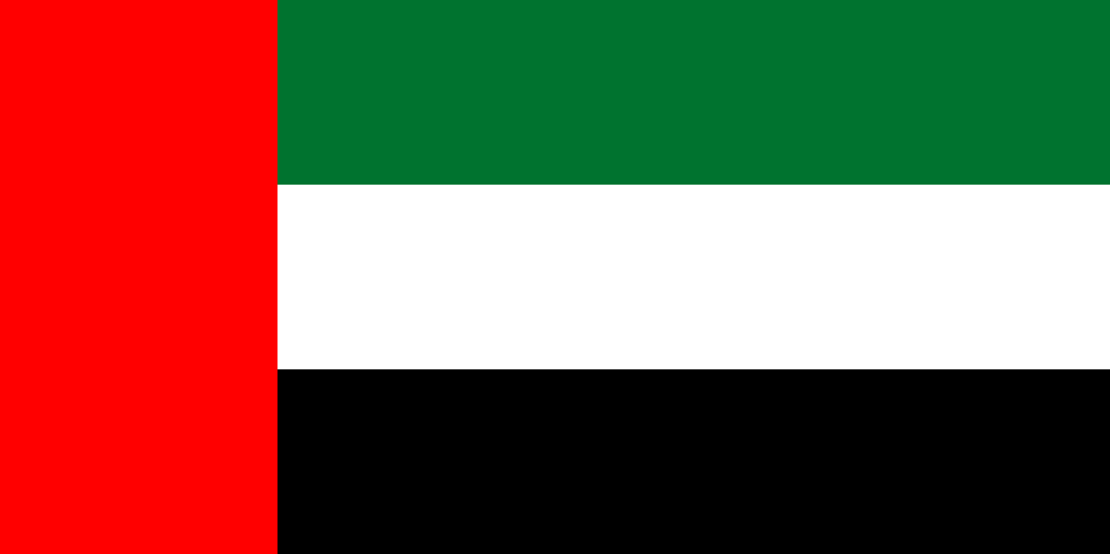
PRAYING FOR
UNITED ARAB EMIRATES

Slide 3
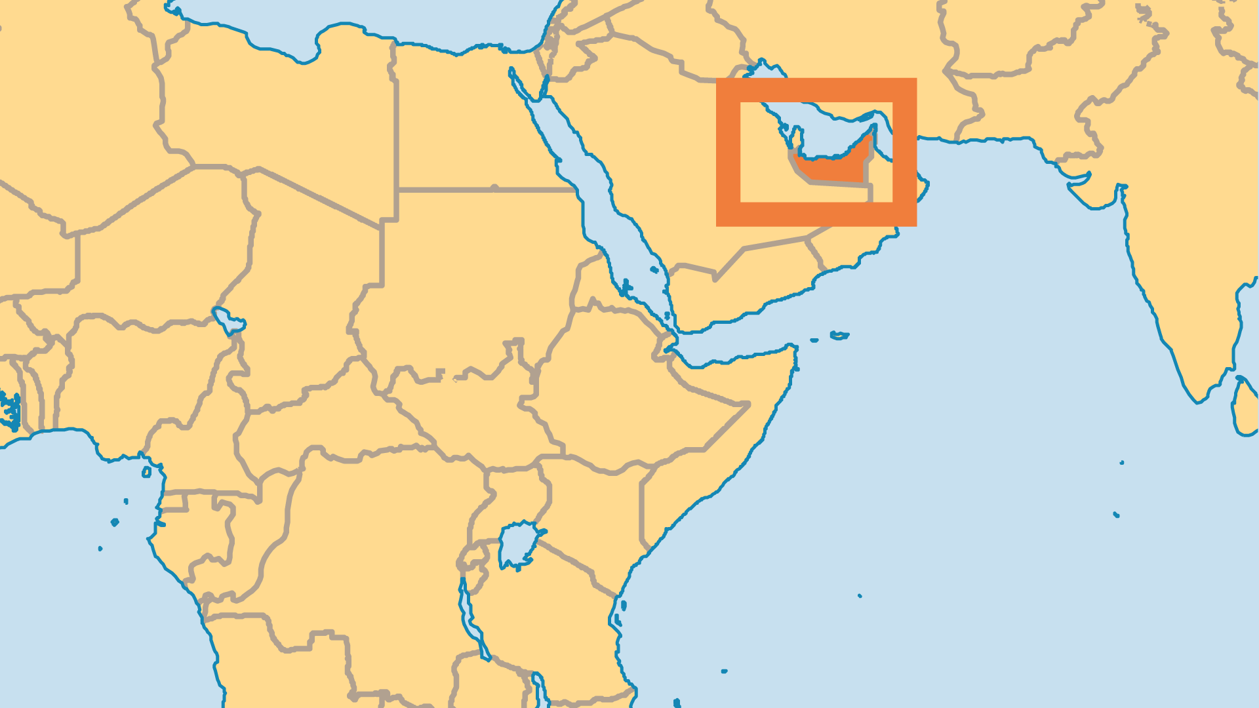
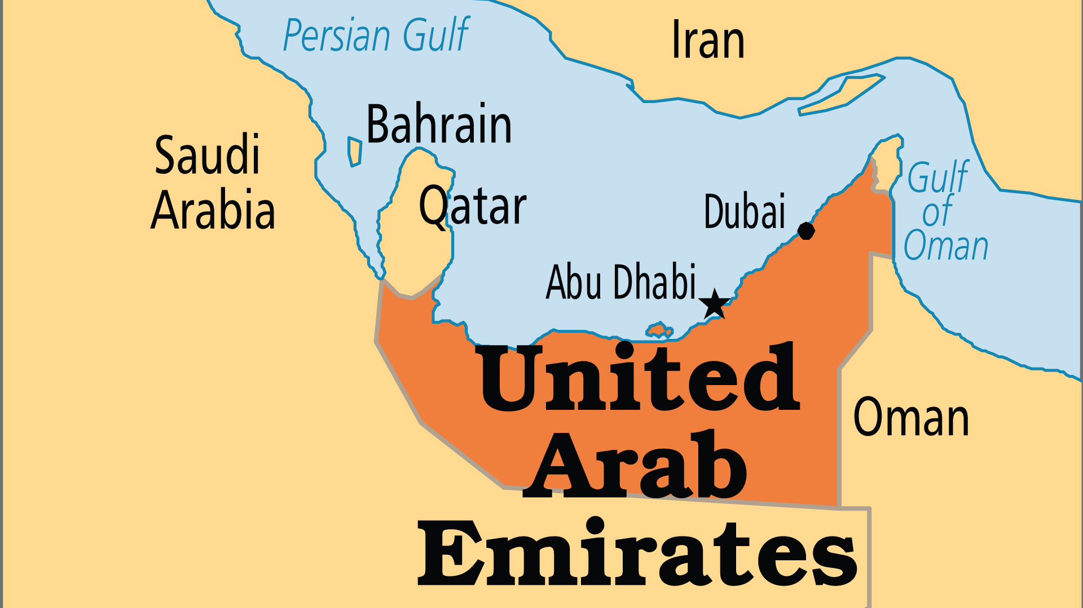
KEY STATS
Capital: | Abu Dhabi
Population: | 11,346,000
Official Language: | Arabic
Languages: | 36
% Christian: | 8.6 %
% Evangelical: | 1.3 %
Largest Religion: | Muslim
People Groups: | 36
Least Reached People Groups: | 31
% Unevangelized: | 45 %

Slide 4

FOR PRAYER
Oil wealth transformed much of the United Arab Emirates (UAE) from a poor, rural region to a haven and playground for the world's ultra-rich. Now it branches out to business and finance, as well as tourism. While those at the top live with incredible wealth, millions of migrant labourers often work in terrible conditions for low pay. Injustice, human rights violations, and human trafficking are significant challenges. Pray for God's compassion for the poor and downtrodden to be powerfully conveyed to all migrant labourers who endure oppressive conditions in the UAE.

