Slide 1




Slide 2

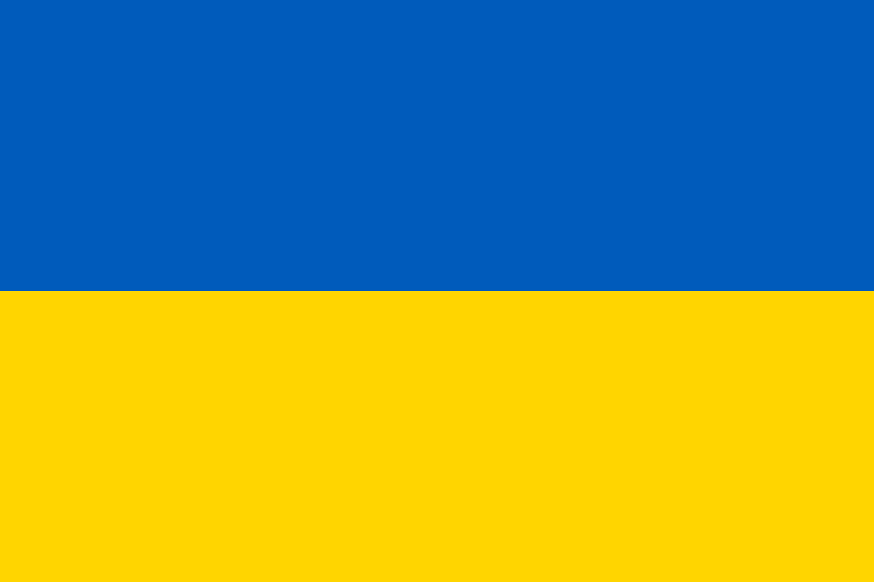
PRAYING FOR
UKRAINE

Slide 3
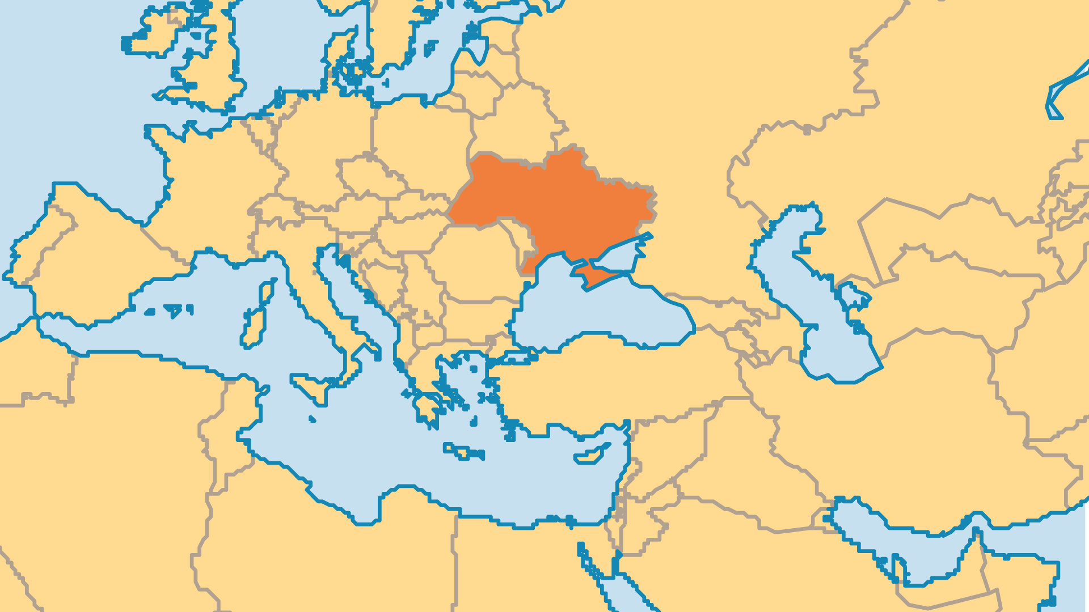
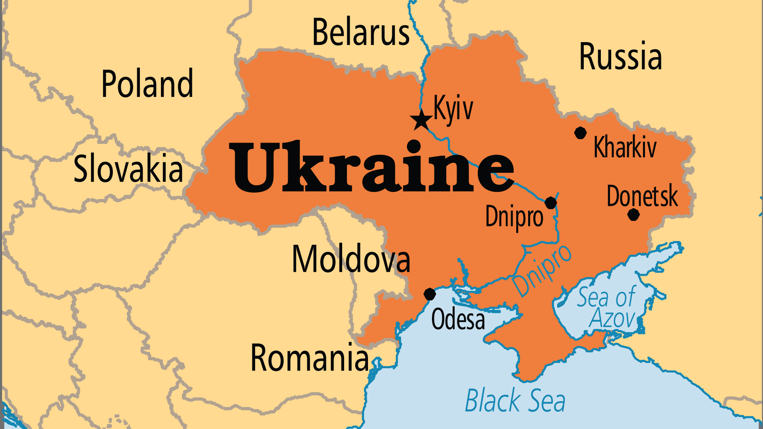
KEY STATS
Capital: | Kyiv
Population: | 38,980,377
% Urban: | 70.5 %
Official Language: | Ukrainian, but Russian widely spoken
Languages: | 42
HDI Ranking: | 77/193
% Christian: | 79 %
% Evangelical: | 3.8 %
% Unevangelized: | 1 %

Slide 4

FOR PRAYER
Ukraine’s location as the borderland between East and West has always left it in a vulnerable position. Russia’s invasion and annexation of Crimea in 2014, Moscow’s proxy war in the east, and the full-scale invasion of the country in 2022 demonstrate Russia’s determination to dominate Ukraine. Millions of Ukrainians have been displaced, and hundreds of thousands have been killed. Pray for the intervention of the God who makes wars cease to the ends of the earth and who breaks the bow and shatters the spear (Psa 46:9). Pray for wisdom from above, and divine fortitude for Ukraine’s leaders and its people.
Want to know more? Go to www.operationworld.org

Slide 5
FOR PRAYER
Thank God for the rich Christian heritage of Ukraine. Russian interference and invasion brought incalculable destruction. This includes religious persecution in the occupied areas, as well as hostility from the Russian Orthodox Church toward most other expressions of Christianity. There has been so much trauma and suffering, but these trials have been a crucible for the refining of God's people. The faithful perseverance of the Church continues to bear fruit. Today it impacts most of society. Pray that the endurance, spiritual drive and vision of the body of Christ in Ukraine might not be destroyed or dulled by what the enemy seeks to accomplish there.

