Slide 1




Slide 2

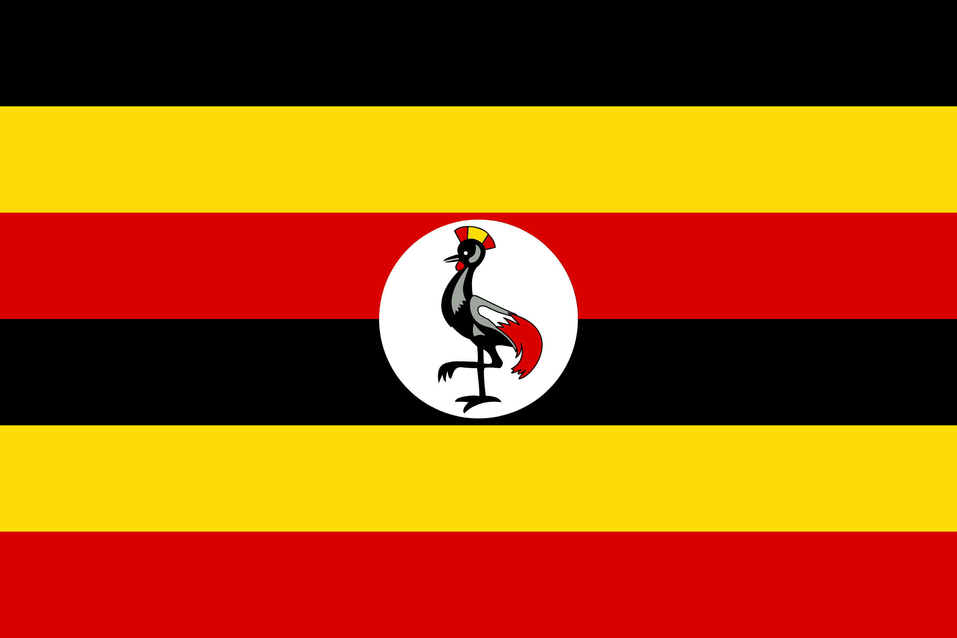
PRAYING FOR
UGANDA

Slide 3
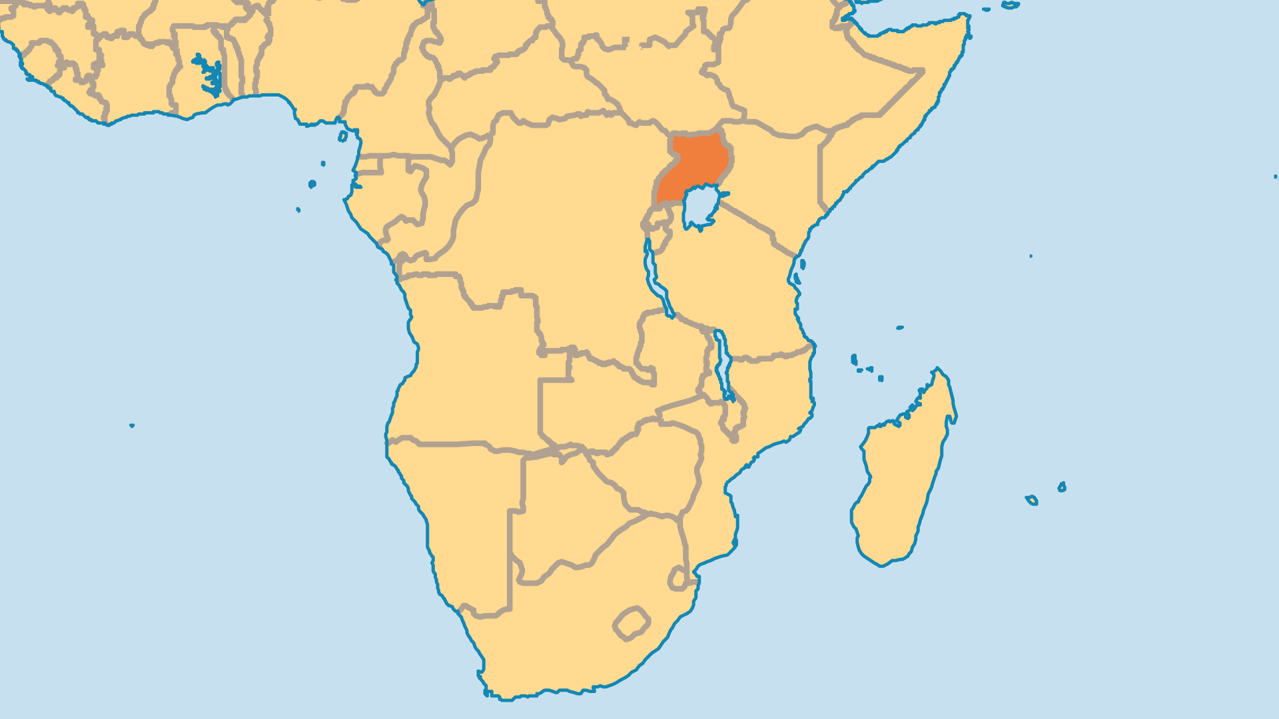
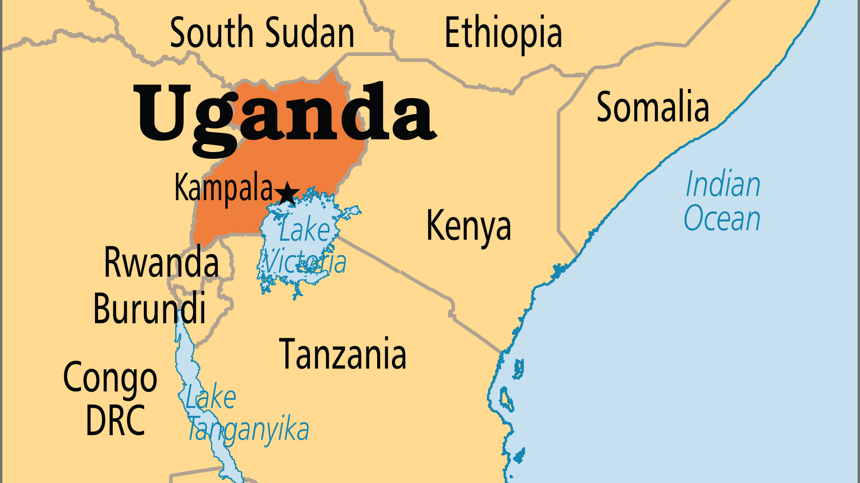
KEY STATS
Capital: | Kampala
Population: | 51,384,894
Official Language: | English, Swahili
Languages: | 45
Literacy Rate: | 73 %
HDI Ranking: | 166/193
% Christian: | 84.7 %
% Evangelical: | 37 %
People Groups: | 68
Least Reached People Groups: | 2
% Unevangelized: | 1 %

Slide 4

FOR PRAYER
Nearly half of all Ugandans are under age 16 making young people’s ministry fundamental to developing the country. The scourges of poverty, HIV/AIDS (and other diseases), Islamist militias, and state-sponsored violence all make childhood in Uganda more dangerous than it should be. Pray for campus ministries which emphasize evangelism, discipleship and training. Pray also for effective Sunday school and youth programmes in churches. Pray that a nation with such a high proportion of Christians proportion might produce a generation that truly knows and loves the Lord!

Slide 5
FOR PRAYER
Uganda works hard to recover from many years of war, violence, and heavy-handed government. Pray for peace within the troubled region and the nation. The current president has been in power since 1986. Uganda has attracted attention through widespread child labour and allegations of widespread use of torture by those in power. Amidst these many points of concern, Christian NGOs and ministries provide aid, shelter, counselling, spiritual ministry, and education. Uganda has one of the world's highest proportions of evangelical Christians. Pray for God's people to be at the heart of the nation's restoration.
Want to know more? Go to www.operationworld.org

