Slide 1




Slide 2


PRAYING FOR
TUVALU

Slide 3
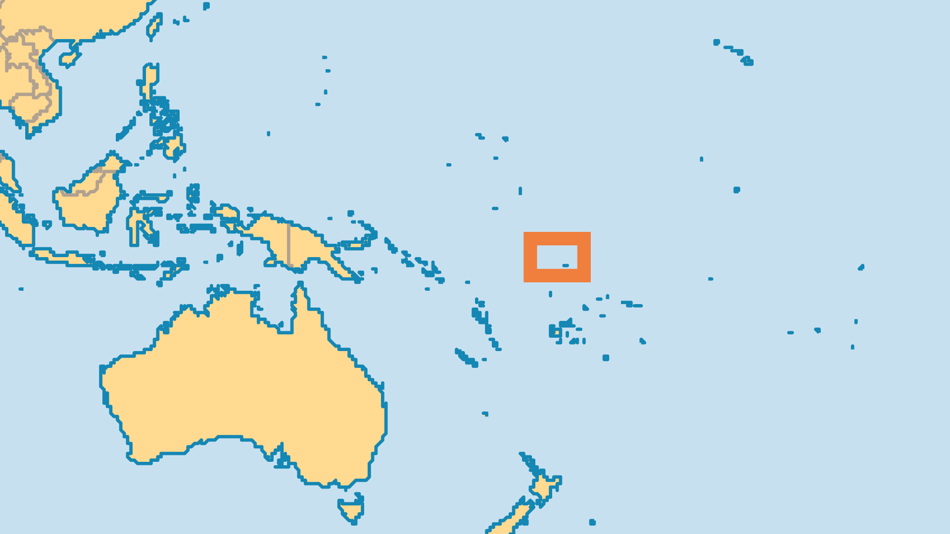
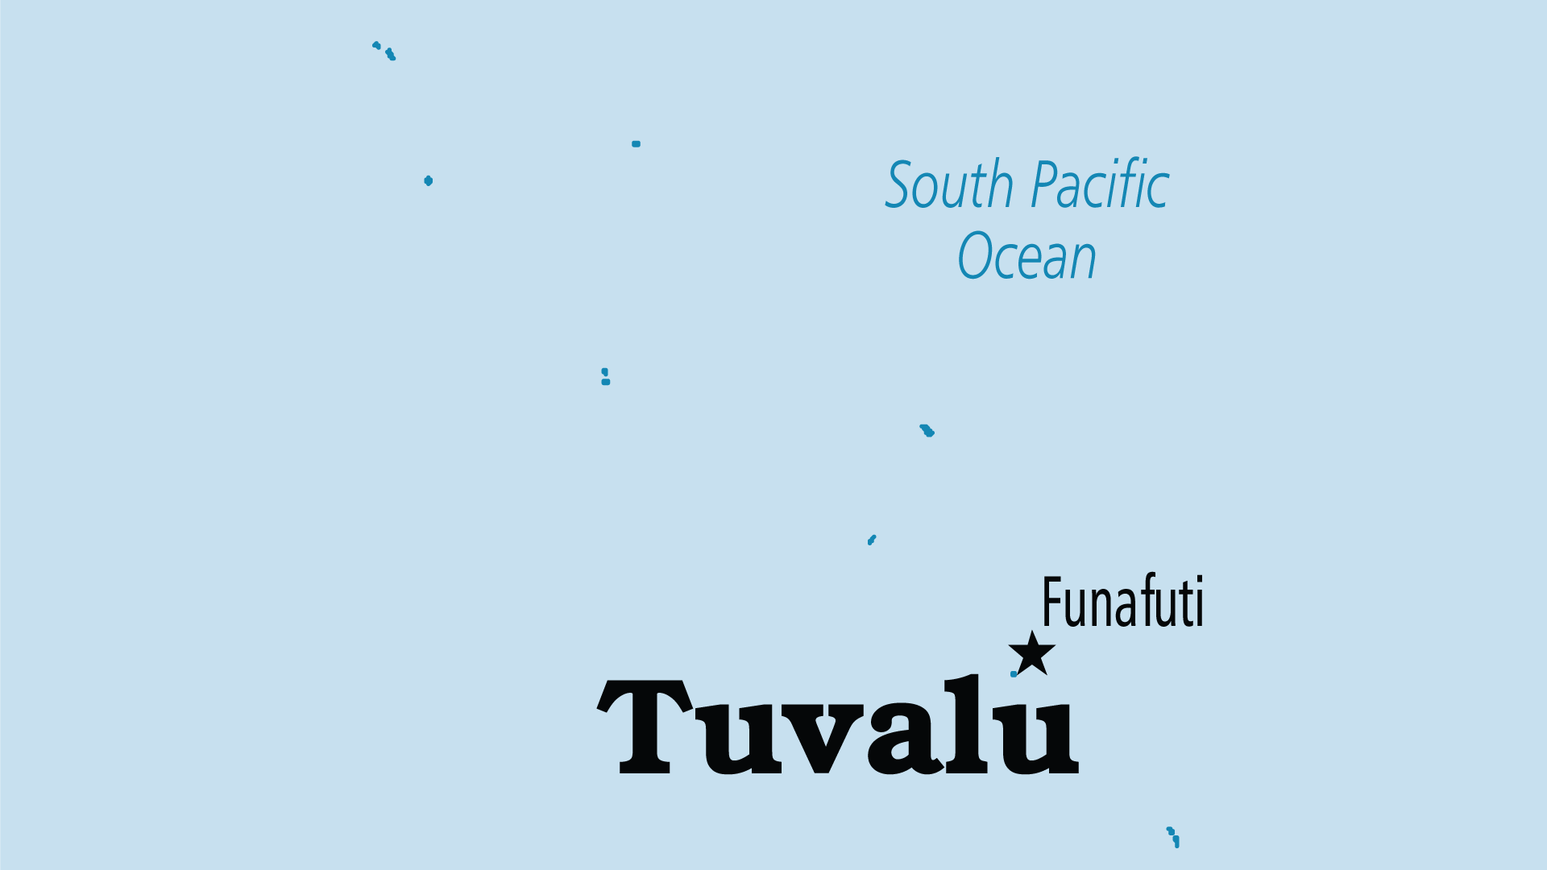
KEY STATS
Capital: | Funafuti
Population: | 9,492
Official Language: | Tuvaluan, English
Languages: | 2
Life Expectancy: | 64.5 yrs (194th/236)
HDI Ranking: | 130/193
% Christian: | 97.7 %
% Evangelical: | 17.8 %
% Unevangelized: | 1 %

Slide 4

FOR PRAYER
Tuvalu faces an uncertain future. Very limited resources, possible rising sea levels and modern/global external influences make this traditional culture fragile, both environmentally and socially. Pray that wisdom would prevail in preserving Tuvalu as a nation and culture, and that the long-standing presence of the Church would play a major role in this.
Want to know more? Go to www.operationworld.org

