Slide 1




Slide 2

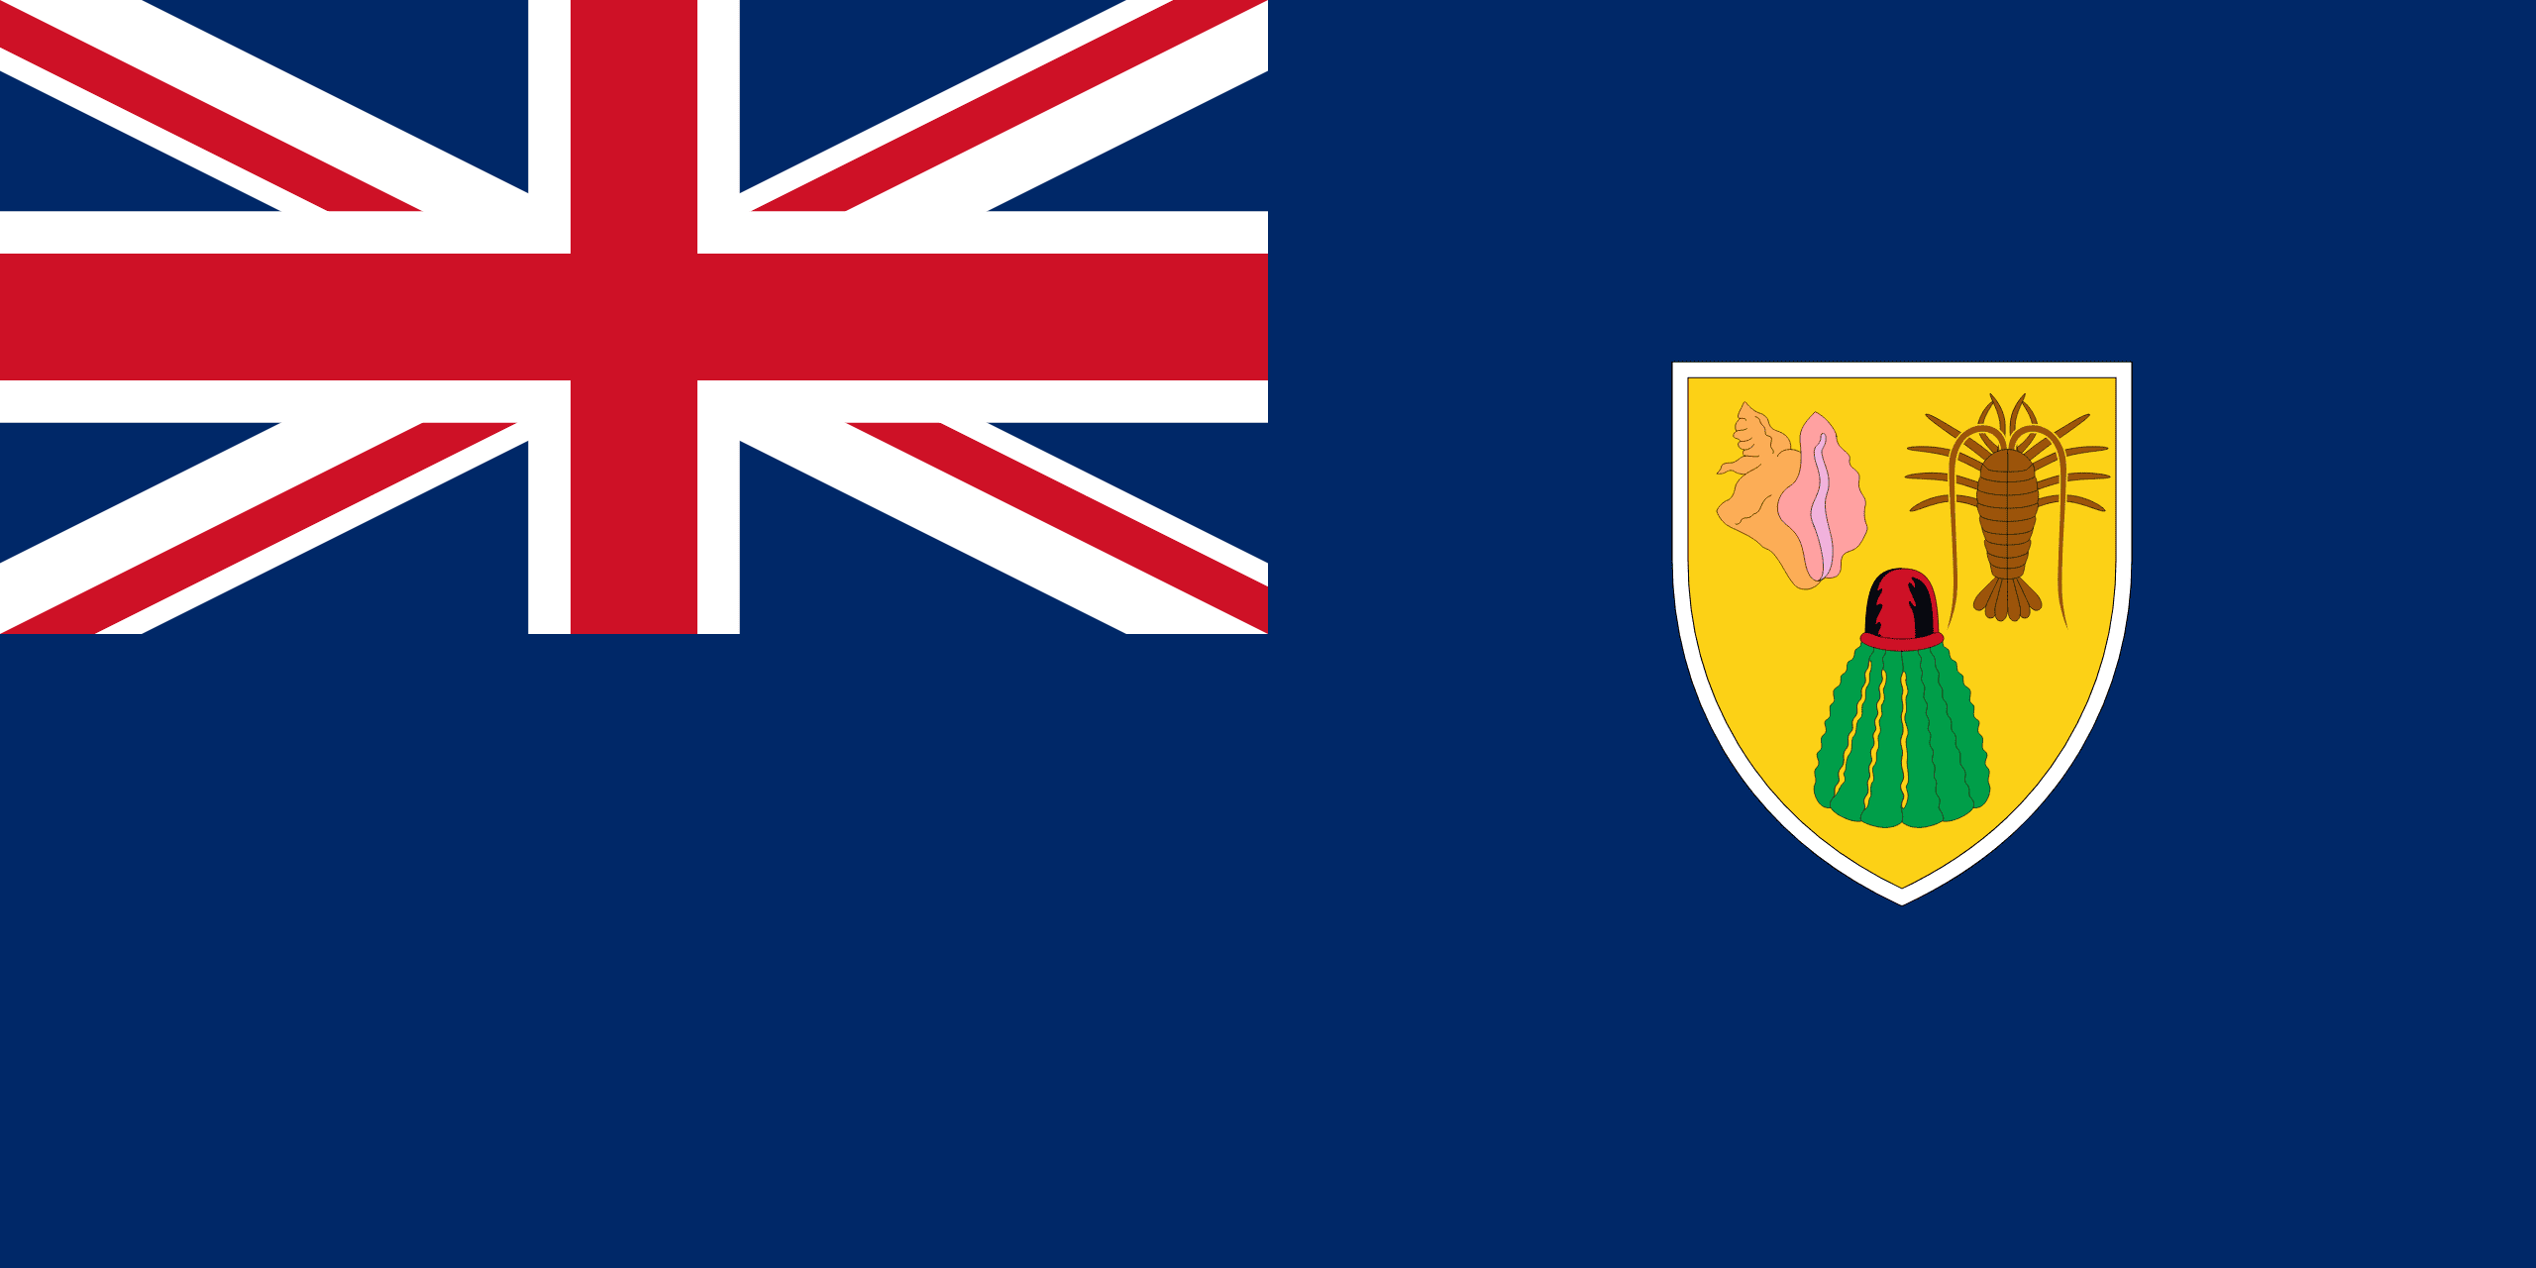
PRAYING FOR
TURKS & CAICOS ISLANDS

Slide 3
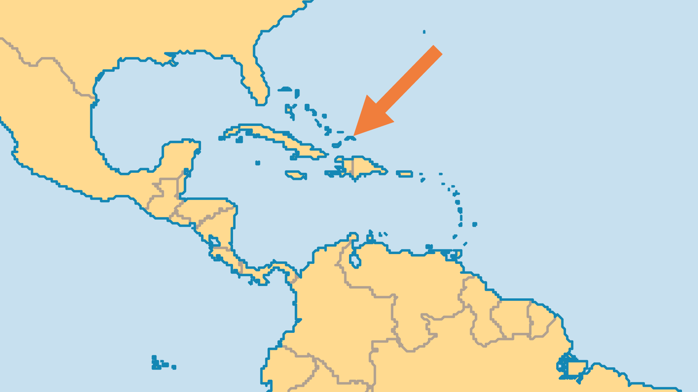
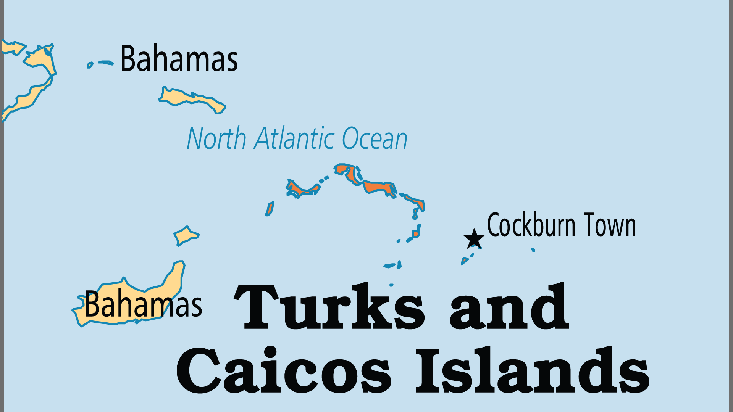
KEY STATS
Continent: | Caribbean
Capital: | Grand Turk (Cockburn Town)
Population: | 46,431
% Urban: | 93.8 %
Official Language: | English
% Christian: | 90.4 %
% Evangelical: | 32.4 %
People Groups: | 4
% Unevangelized: | 1 %

Slide 4

FOR PRAYER
Christian values in society are challenged by offshore finance with its frequent money laundering, by tourism with its increasing licentiousness and by illegal drug trafficking. Pray that churches might address these through holy living and genuine faith.
Want to know more? Go to www.operationworld.org

