Slide 1




Slide 2


PRAYING FOR
TURKMENISTAN

Slide 3
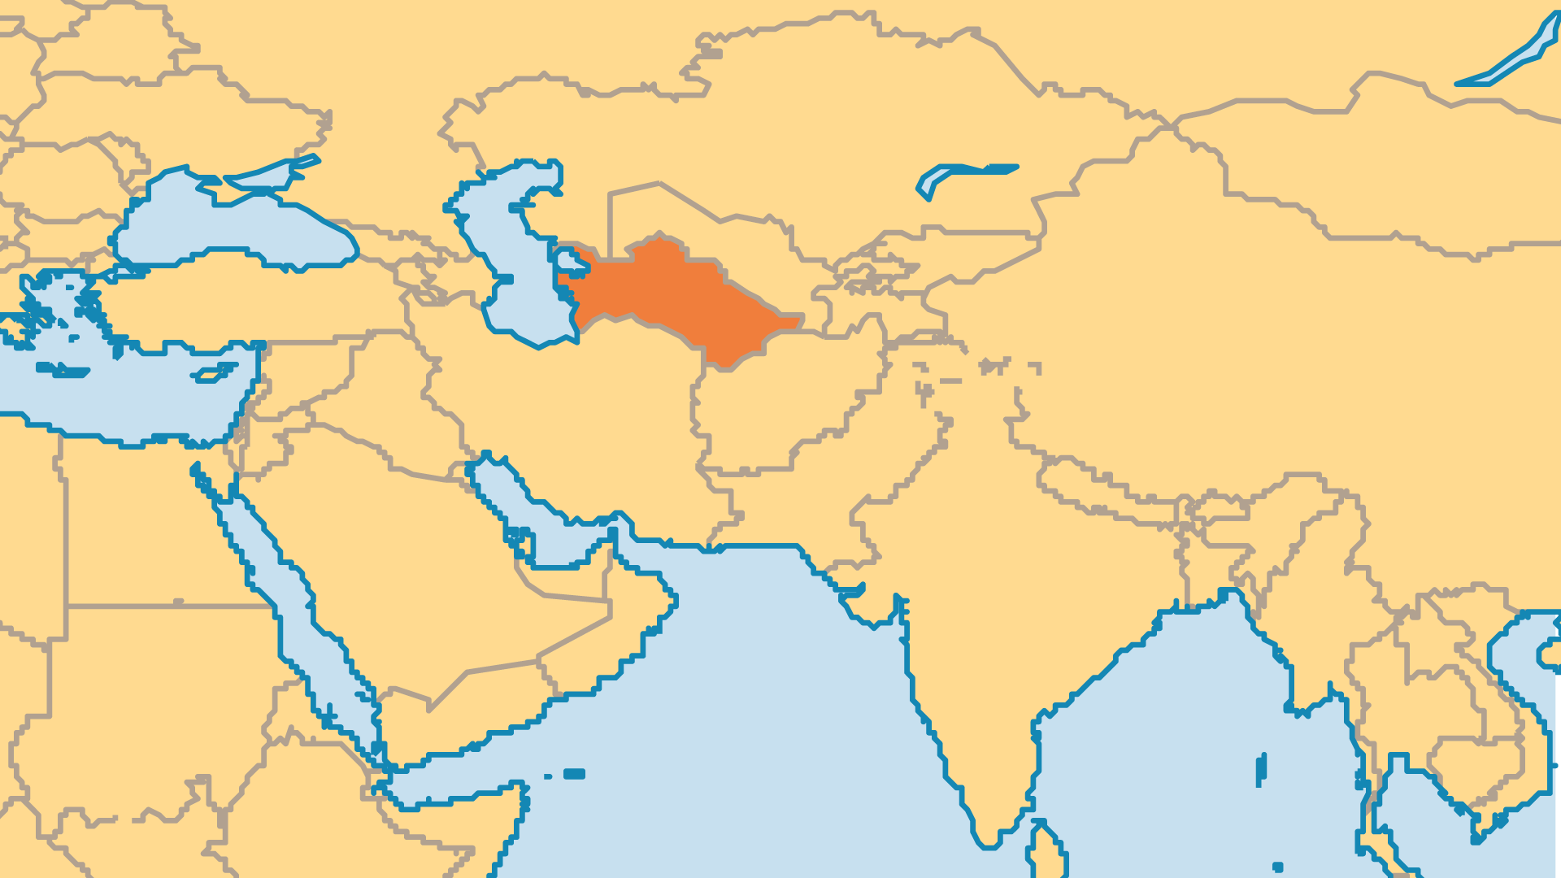
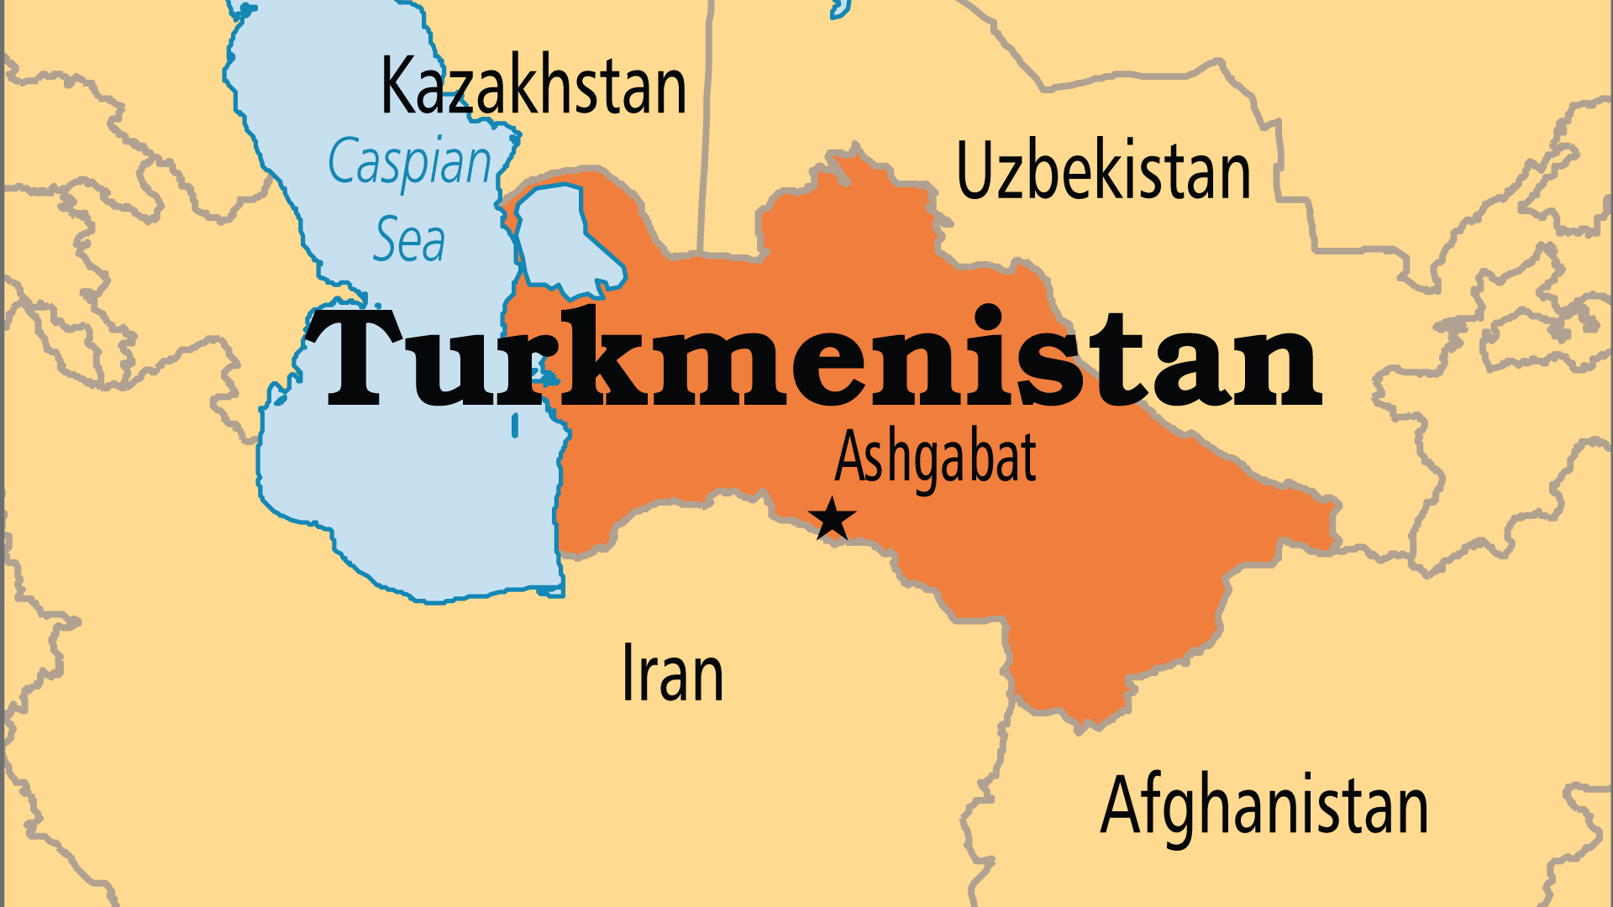
KEY STATS
Capital: | Ashgabat
Population: | 7,618,848
Official Language: | Turkmen
Languages: | 9
% Christian: | 1.8 %
% Evangelical: | 0 %
Largest Religion: | Muslim
% Largest Religion: | 96.2 %
% Unevangelized: | 63 %
Persecution Ranking: | 29/50

Slide 4

FOR PRAYER
Hostility against almost any foreign Christian activity or even presence has persisted for decades. Almost every foreign Christian has been expelled. Several national pastors have been exiled, beaten, heavily fined or imprisoned. The twenty or so registered congregations continue to be intimidated and forbidden to meet. Pray for a softening of the attitude of the authorities, for courage for Christians in Turkmenistan to stand firm and for Christians outside of the country to pray and speak up against these hostile actions.
Want to know more? Go to www.operationworld.org

