Slide 1




Slide 2

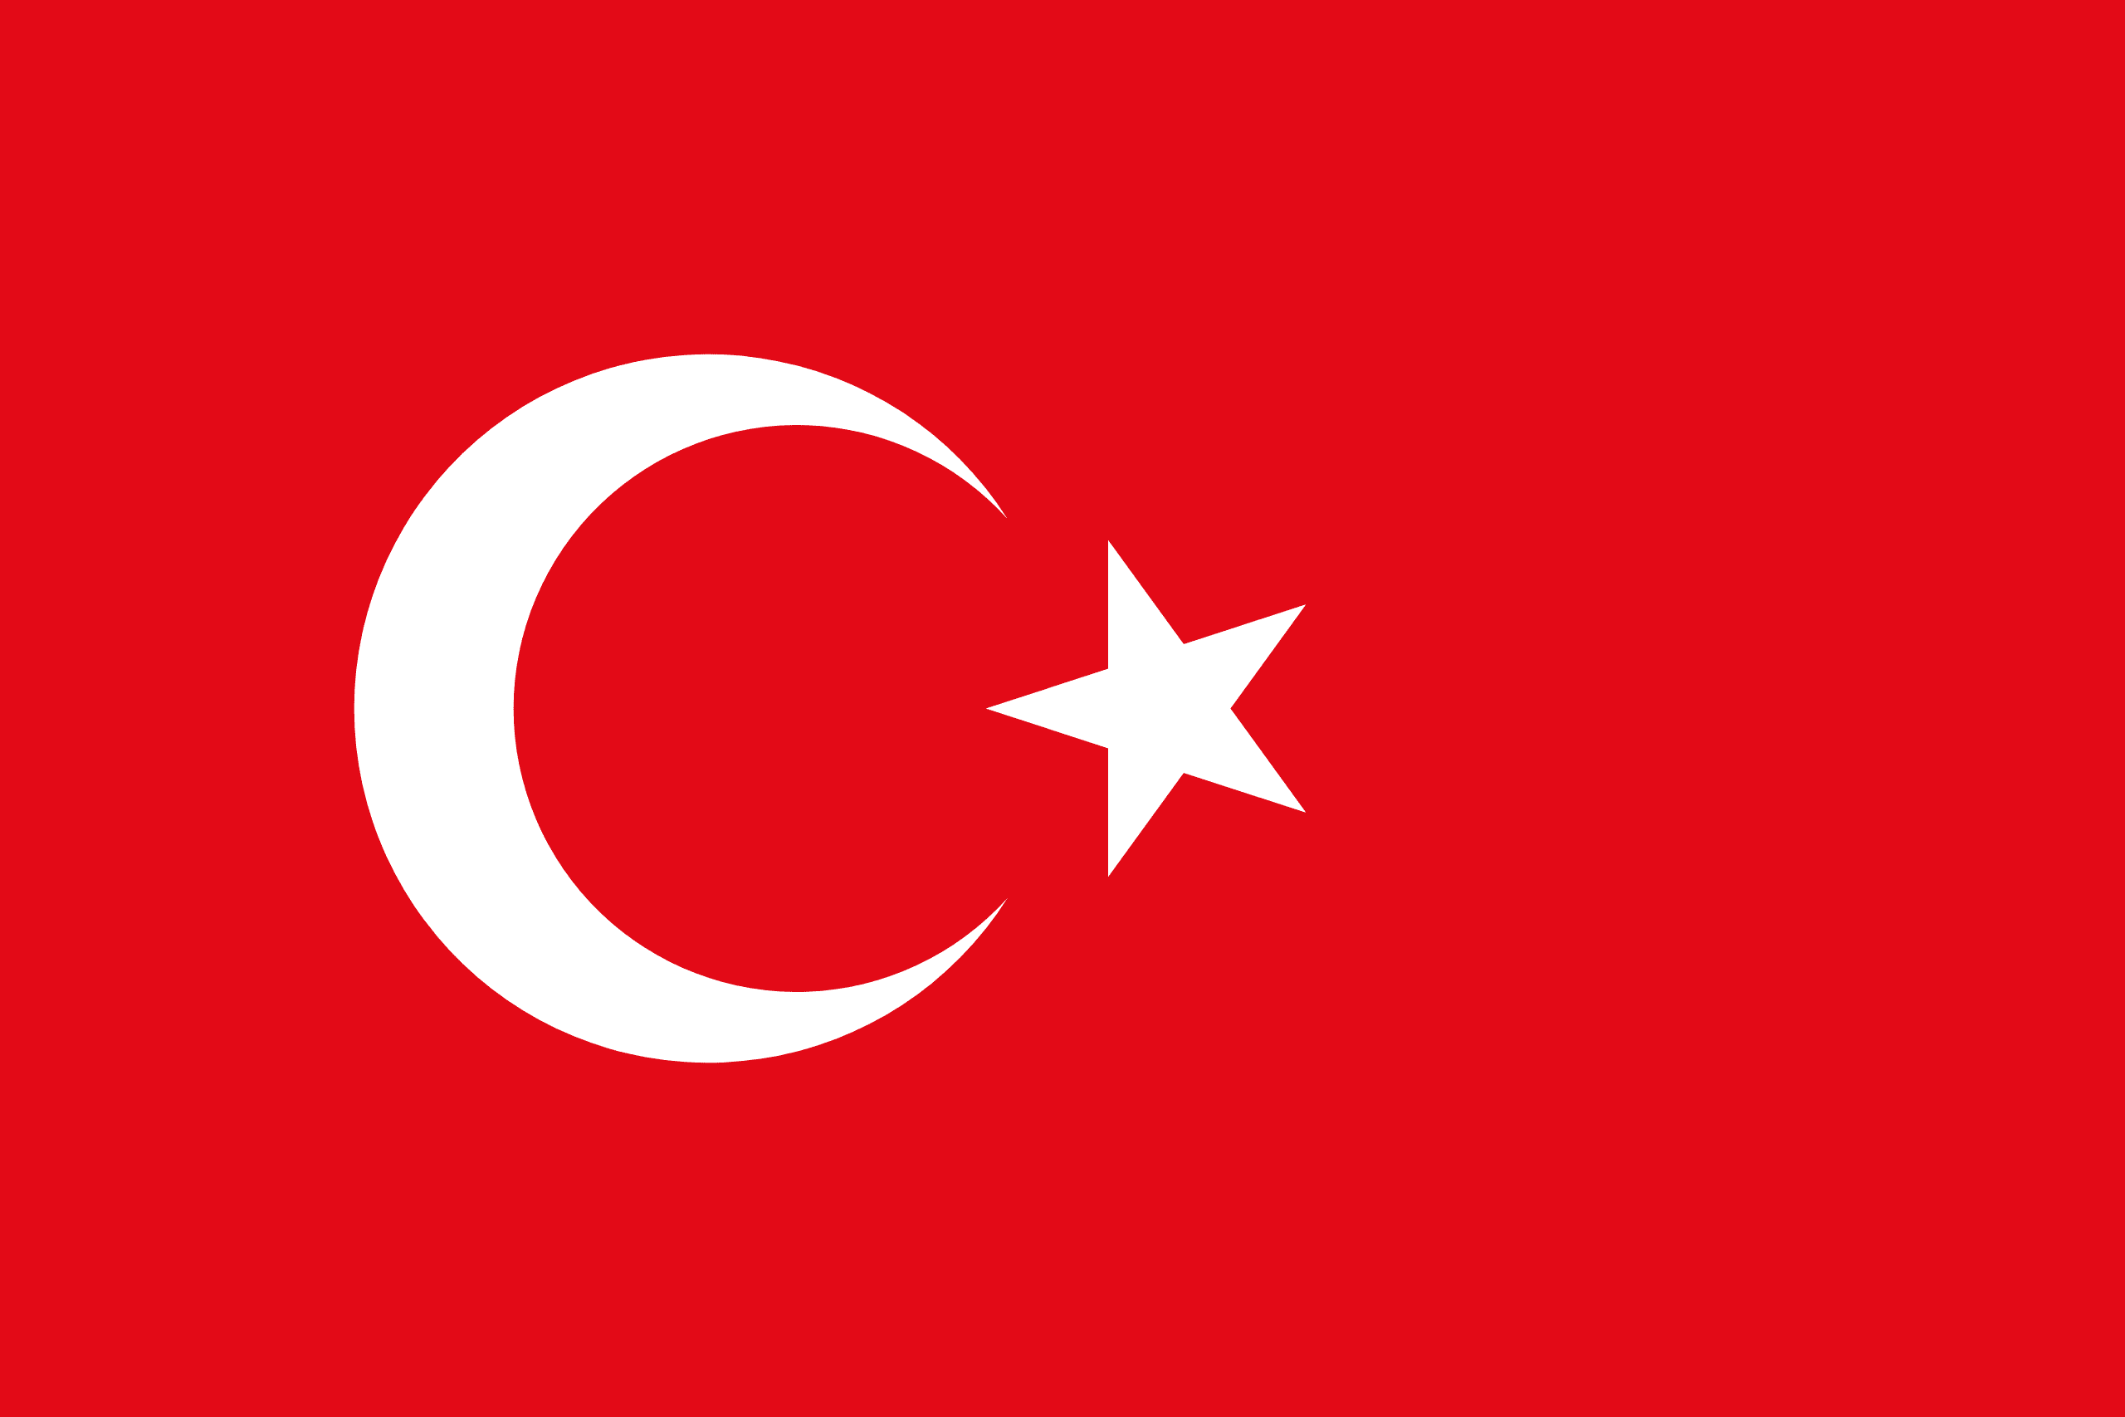
PRAYING FOR
TURKEY

Slide 3
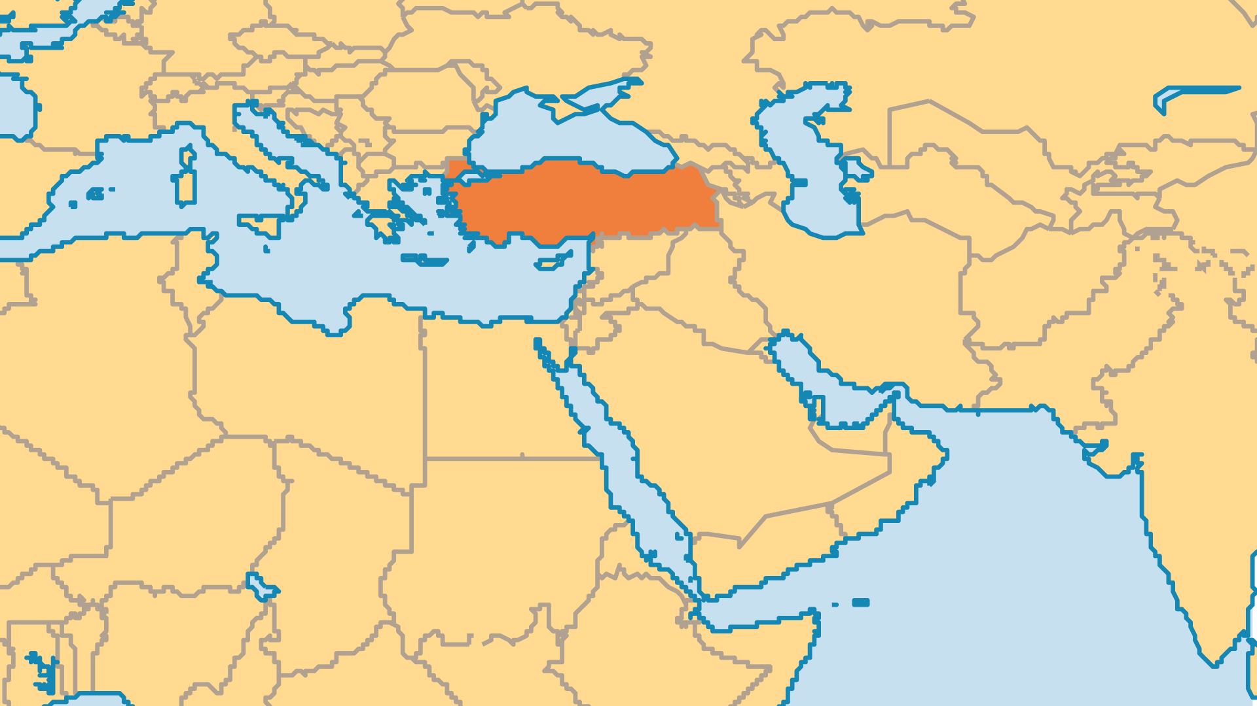
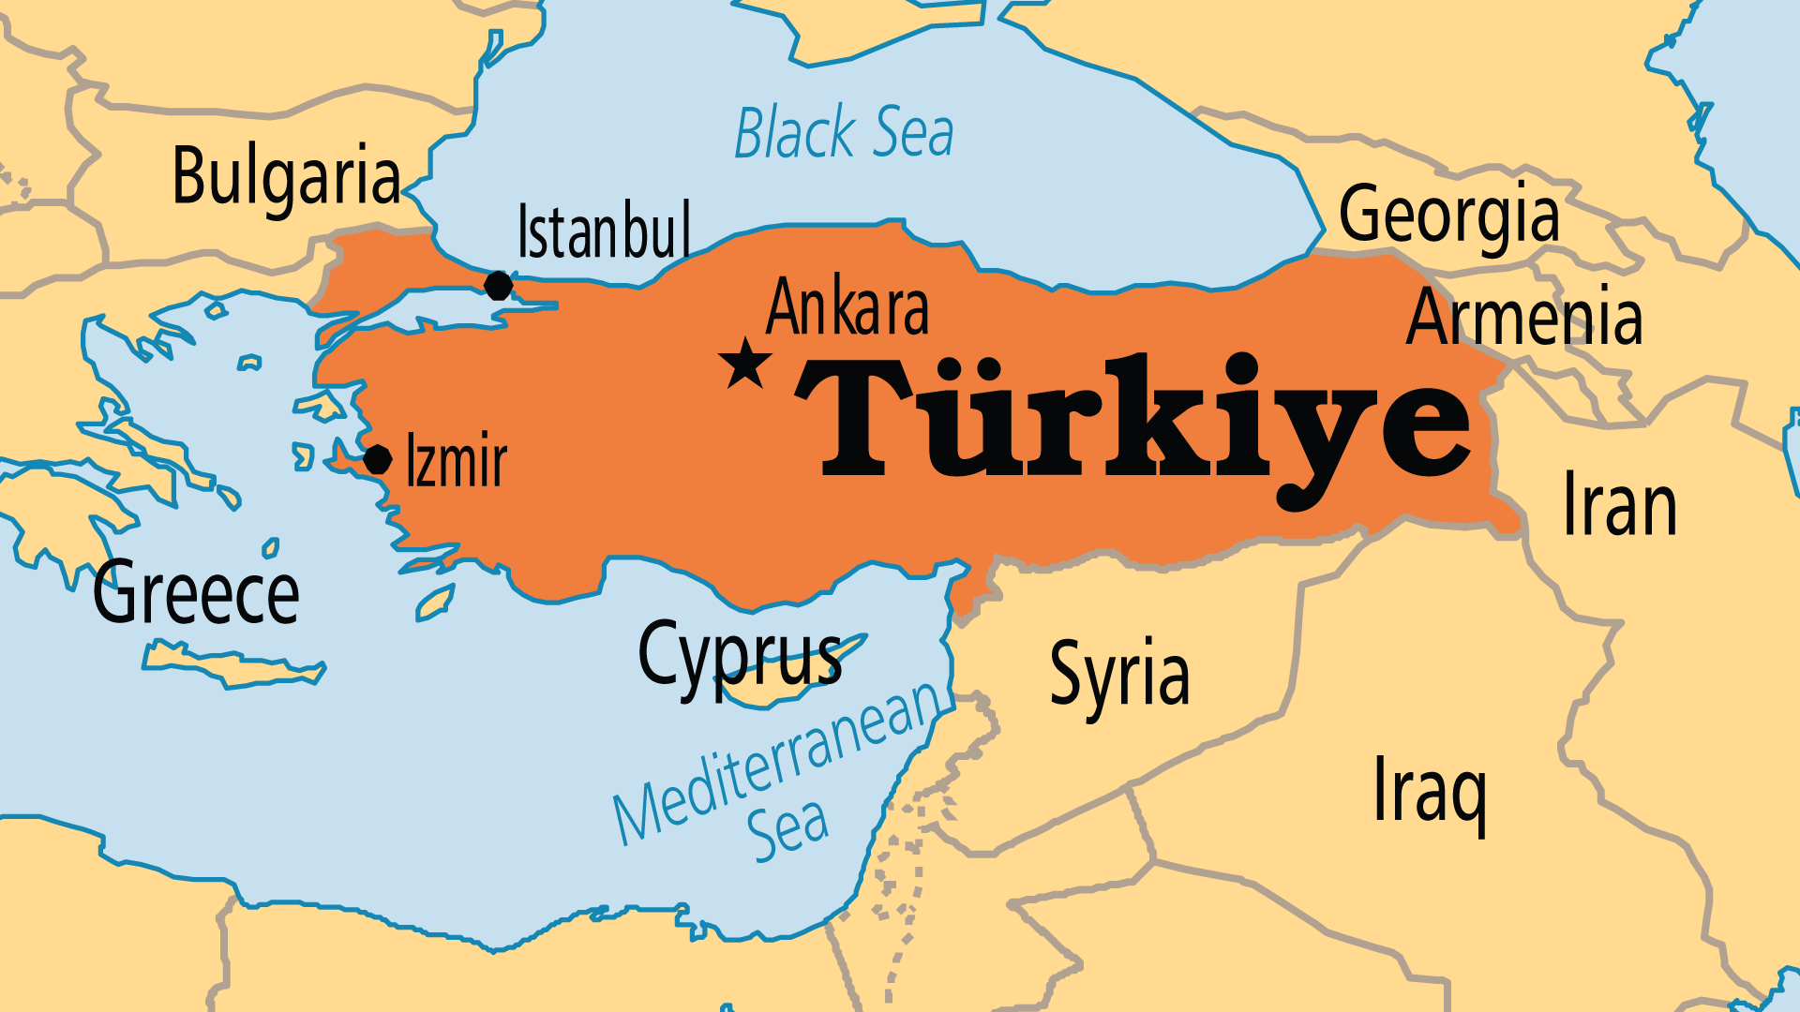
KEY STATS
Capital: | Ankara
Population: | 87,685,426
Official Language: | Turkish
Languages: | 45
% Christian: | 0.2 %
Largest Religion: | Muslim
% Largest Religion: | 96.6 %
% Unevangelized: | 52 %
Persecution Ranking: | 45/50

Slide 4

FOR PRAYER
The devastating earthquakes of February 2023 were Turkey's worst in 1500 years. Around 50,000 people died. Literally millions of buildings were destroyed or damaged and hundreds of thousands of people left homeless. Rebuilding both the physical infrastructure and faith in corrupted political leadership will take years or even decades - the trauma of loss will stay with many for their whole lives. Pray that God might use this tragedy to bring breakthrough to areas long resistant to the good news. Pray that Christians might pour into Turkey with love and compassion.
Want to know more? Go to www.operationworld.org

Slide 5
FOR PRAYER
Pray for refugees and migrants in Turkey. Many Iranians fled the violence and Islamic extremism of the 1979 Revolution. This was followed by over a million Kurds during the Gulf War in 1991. Millions more fled into Turkey from Syria and elsewhere during the war and the migrant crises. Turkey has in recent years hosted more refugees than any other country in the world. Many are proving quite open to the gospel. It is very possible that there are more refugees than ethnic Turks who are following Jesus inside of Turkey. Pray that through refugees and migrants, God might lead many Turks to know him.

Slide 6
FOR PRAYER
Give praise for the slow but steady growth of Turkish evangelical Christianity. Turkish and Kurdish believers probably numbered around 10 in 1960 but rose to around 4,000 by 2010. Many hoped for or expected greater growth of the Church. But while small in number, it grew stronger and more mature. The growth of the 1990s and early 2000s slowed down when faced with spiritual, legal, and cultural opposition. Pray for the evangelism and church planting of the past generation to carry on! Turkey is denying many foreign Christian workers visas, so the burden of reaching Turkey will fall more and more on national believers.

