Slide 1




Slide 2

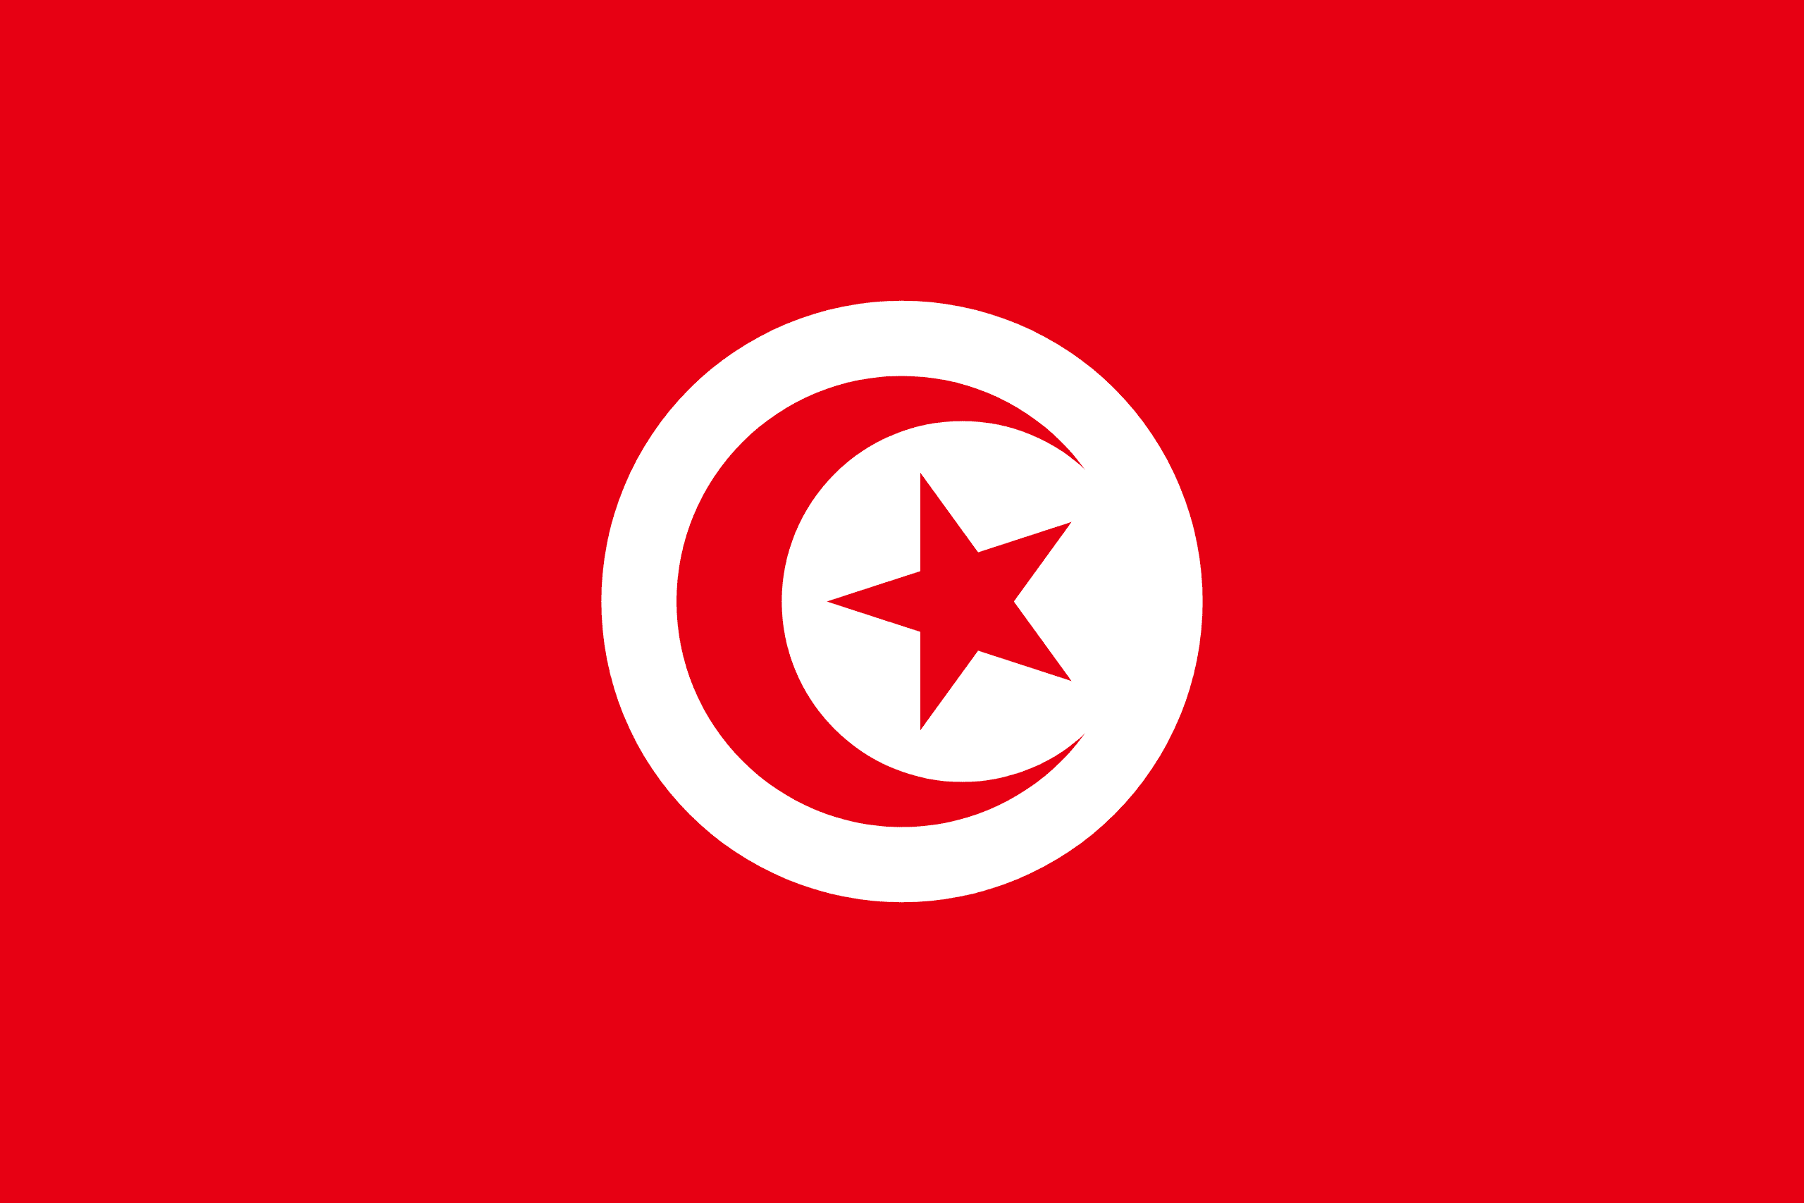
PRAYING FOR
TUNISIA

Slide 3
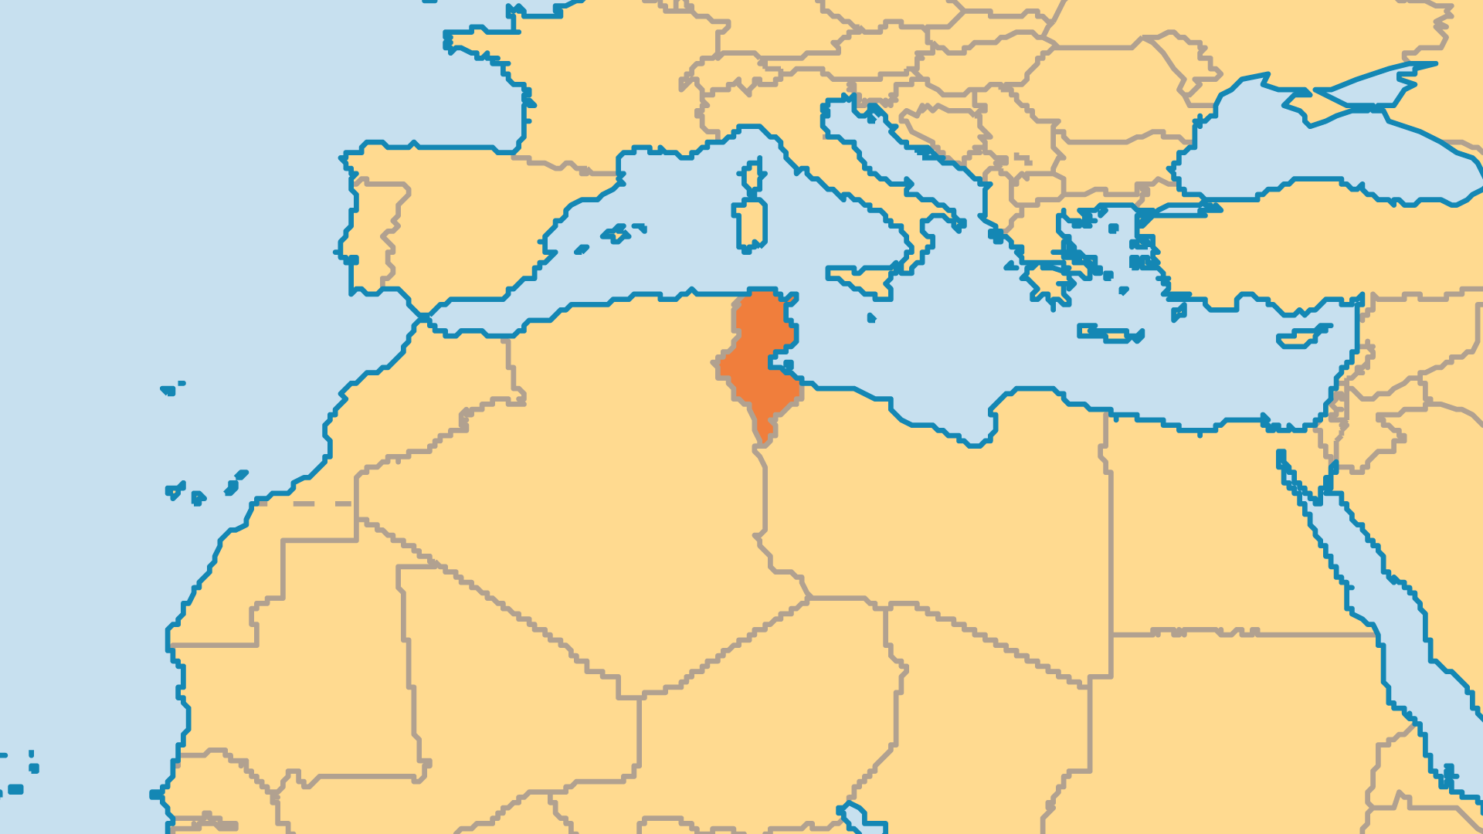
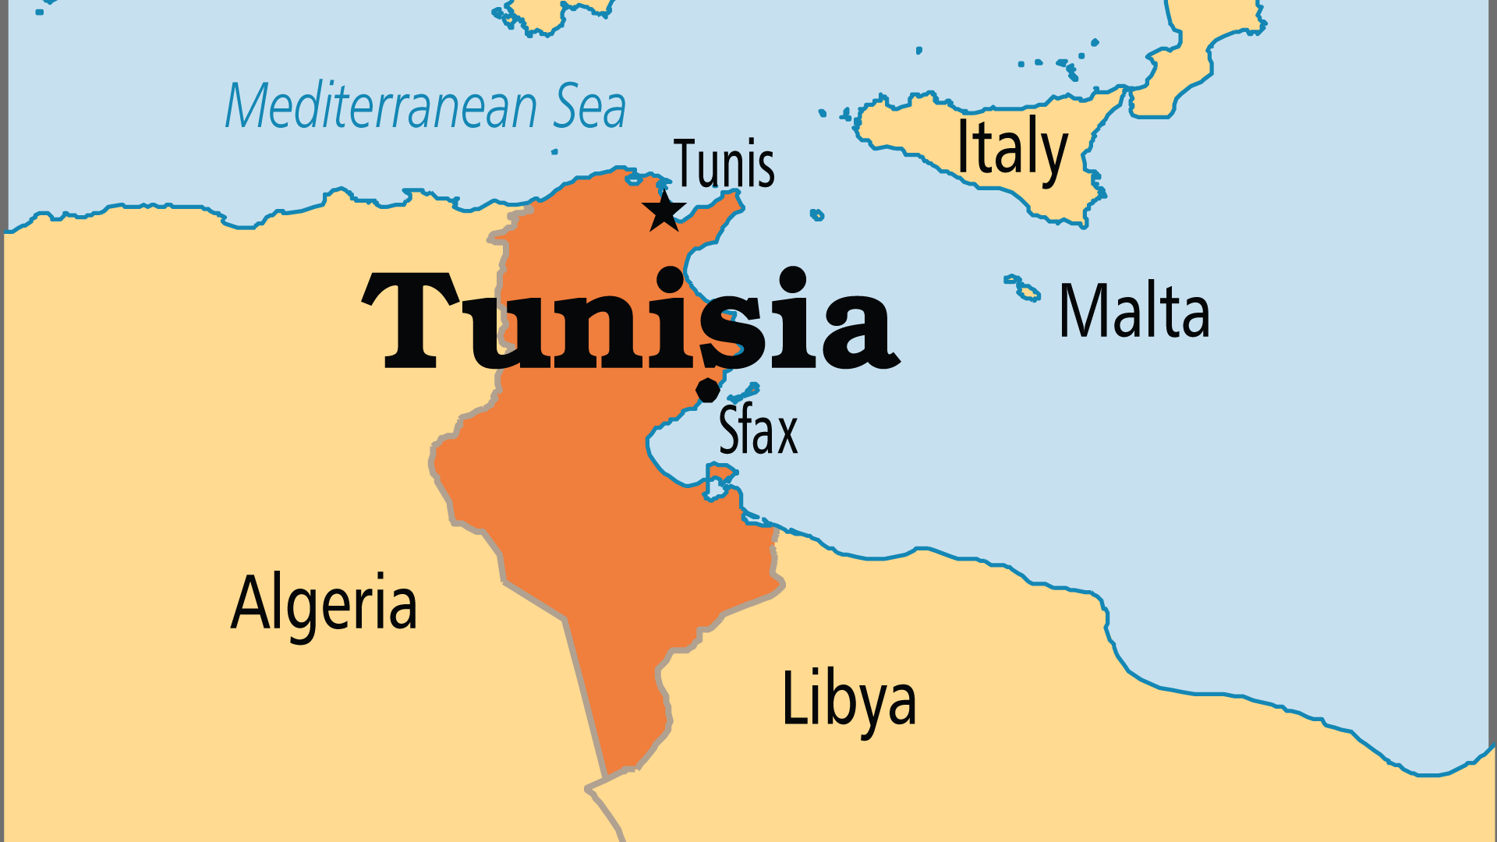
KEY STATS
Capital: | Tunis
Population: | 12,348,573
Official Language: | Arabic
Languages: | 10
Literacy Rate: | 79 %
HDI Ranking: | 97/193
% Christian: | 0.2 %
% Evangelical: | 0 %
Largest Religion: | Muslim
% Unevangelized: | 60 %
Persecution Ranking: | 34/50

Slide 4

FOR PRAYER
The Arab Spring began in Tunisia (December 2010). The country had one of the most progressive and open societies in the Arab world, but Tunisians felt frustrated by high unemployment, corruption, political oppression, and poor living conditions. Protests led to government changes and inspired similar protests across the whole Arab world. However, continued economic decline and unemployment, the increasing presence of Islamic fundamentalism, and a heavy-handed Prime Minister all serve to rob Tunisians of confidence in their country's future. Pray that the travails of Tunisia might somehow draw people towards Christ.
Want to know more? Go to www.operationworld.org

