Slide 1




Slide 2


PRAYING FOR
TRINIDAD & TOBAGO

Slide 3
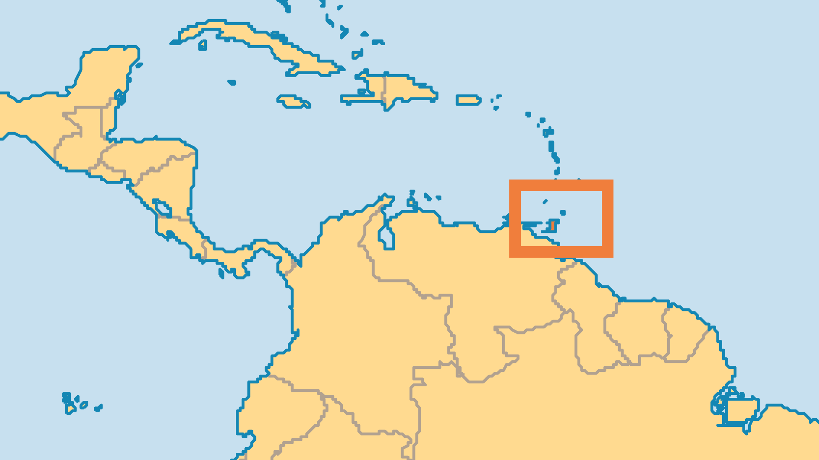
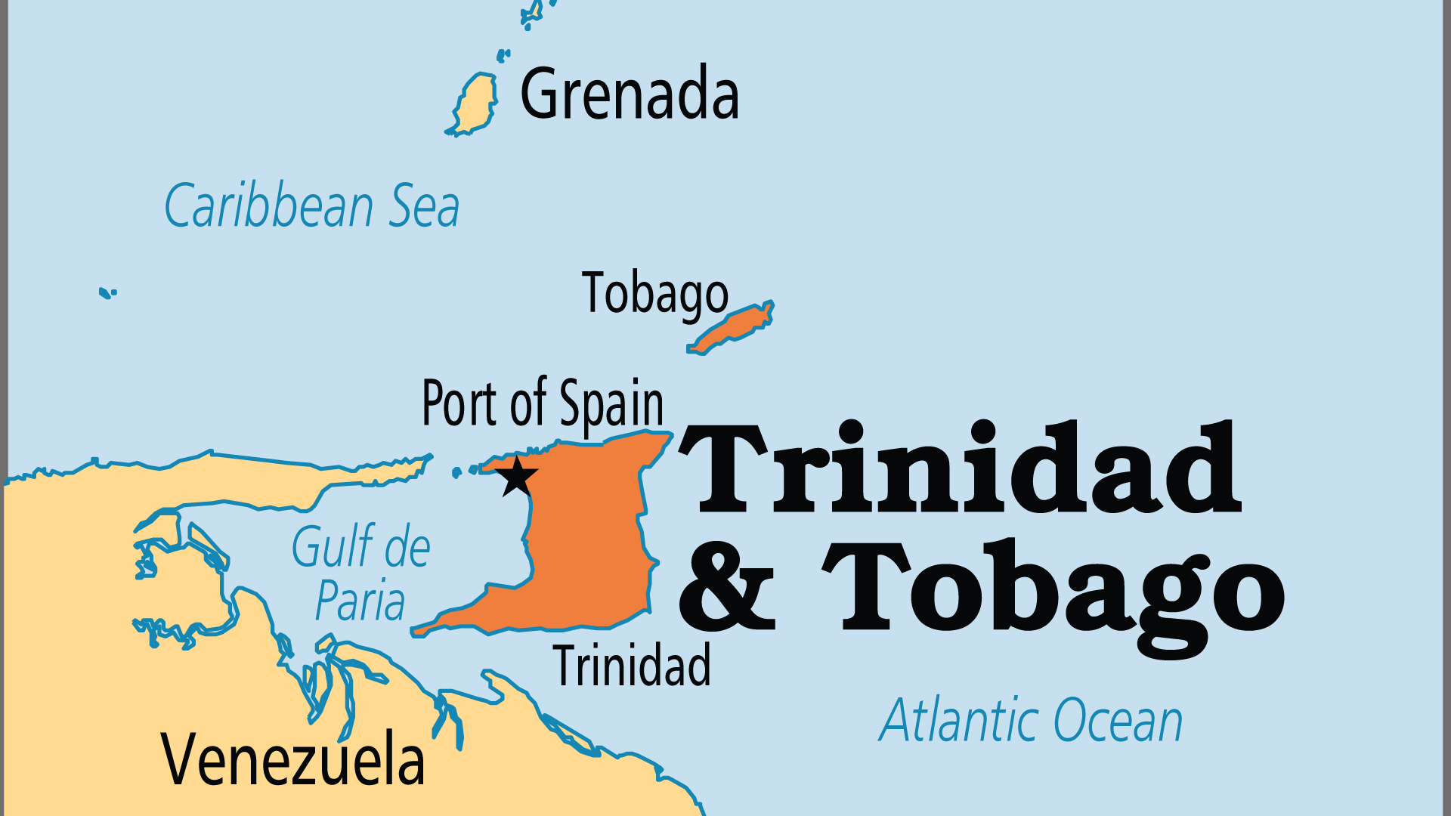
KEY STATS
Capital: | Port of Spain
Population: | 1,511,155
Official Language: | English
Languages: | 7
HDI Ranking: | 57/193
% Christian: | 65.6 %
% Evangelical: | 20.2 %
People Groups: | 14
% Unevangelized: | 8 %

Slide 4

FOR PRAYER
Christianity is professed by nearly two-thirds of the population, but true disciples faithful to God's Word are not so common. Many Christians are nominal; many others are polluted by witchcraft, Afro-Spiritist beliefs and Hinduism-influenced worldviews. Family life and morals within the Christian sphere often do not demonstrate the lordship of Christ. Greater theological training - for leaders as well as laity - is needed and a discipleship mentality must be fostered. Thank God for the minority who do live to please God and pray that purity and passion might be restored across all denominations.
Want to know more? Go to www.operationworld.org

