Slide 1




Slide 2


PRAYING FOR
TONGA

Slide 3
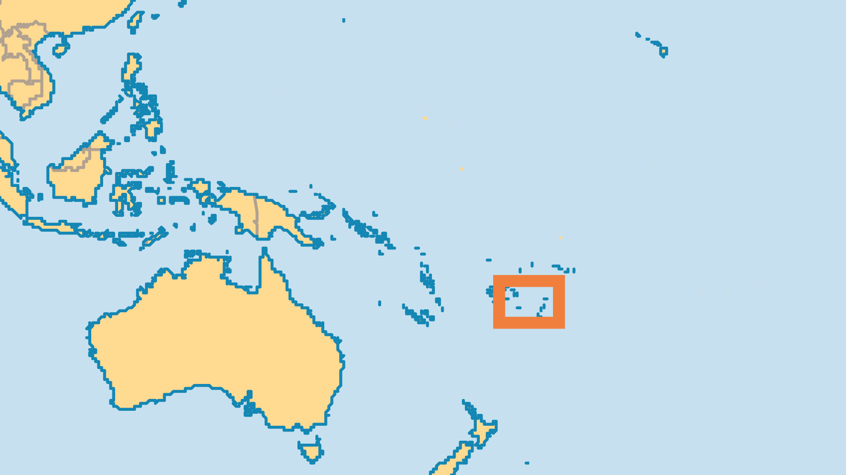
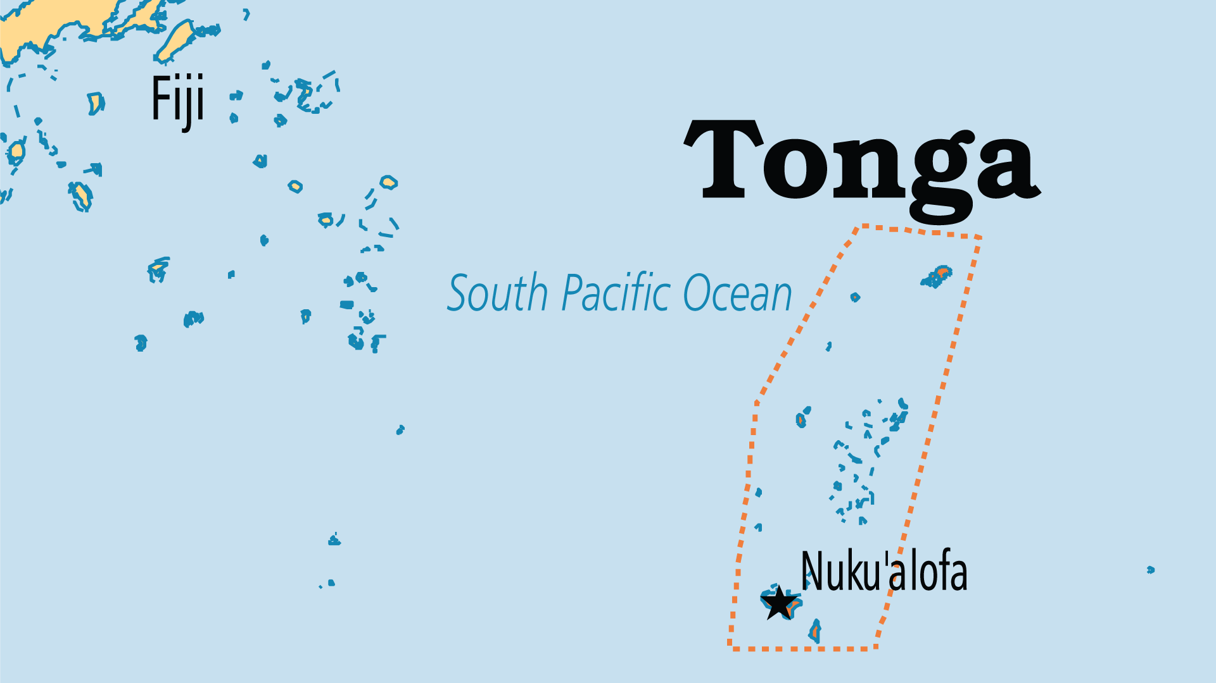
KEY STATS
Capital: | Nuku'alofa
Population: | 103,742
Official Language: | Tongan and English
Life Expectancy: | 71 yrs (145th/236)
HDI Ranking: | 91/193
% Christian: | 95.8 %
% Evangelical: | 15.5 %
People Groups: | 5
% Unevangelized: | 1 %

Slide 4

FOR PRAYER
A strongly Christian nation, Tonga sends significant numbers of missionaries from both Catholic and Protestant traditions, despite its relative poverty and isolation. Much more can be done; pray for the ministries of YWAM and other evangelical groups working toward this.
Want to know more? Go to www.operationworld.org

