Slide 1




Slide 2

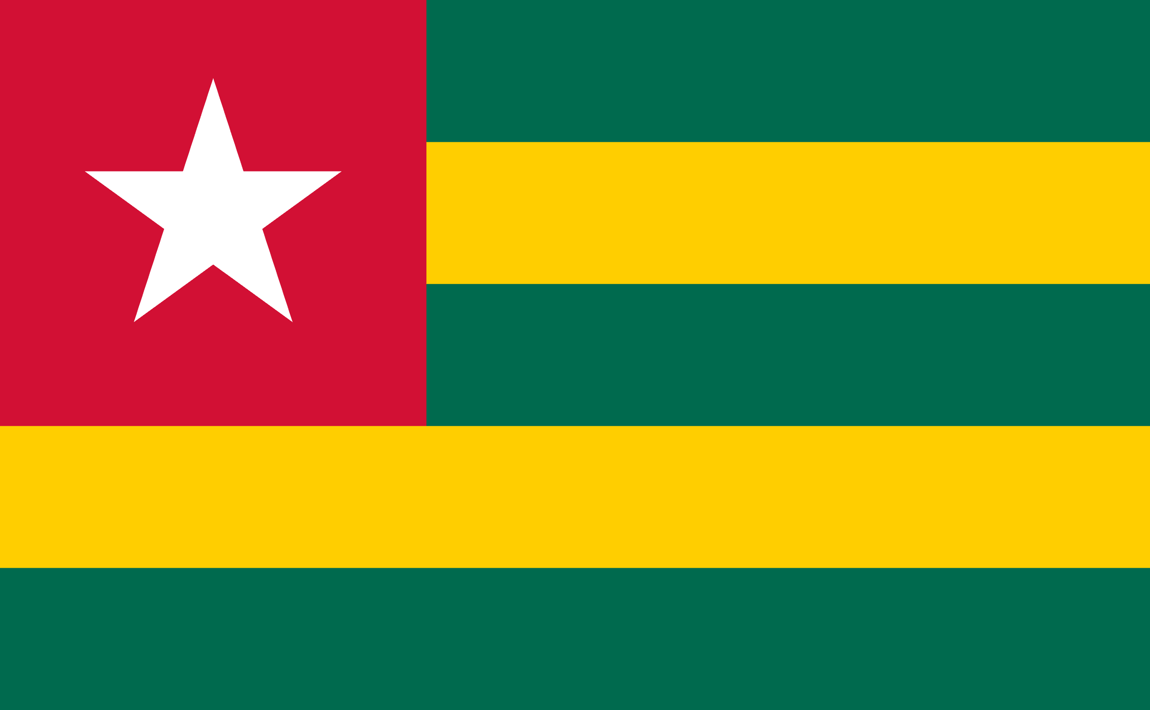
PRAYING FOR
TOGO

Slide 3
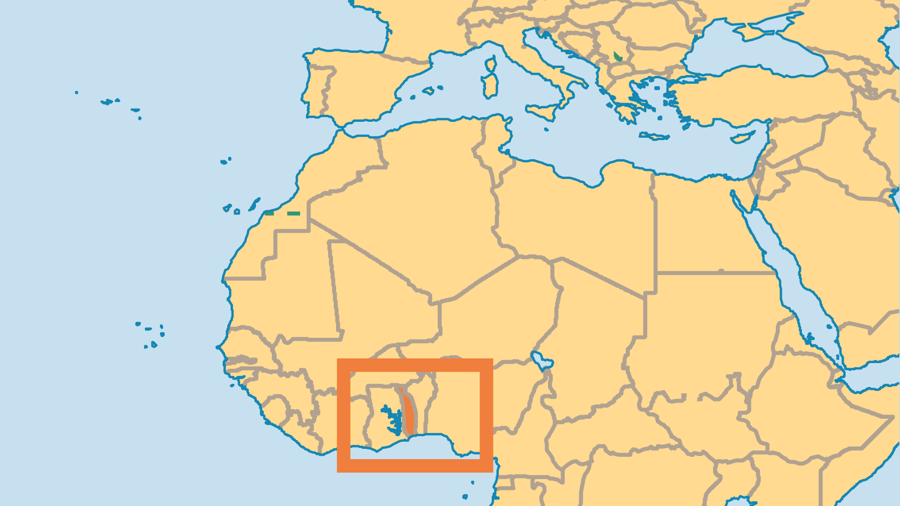
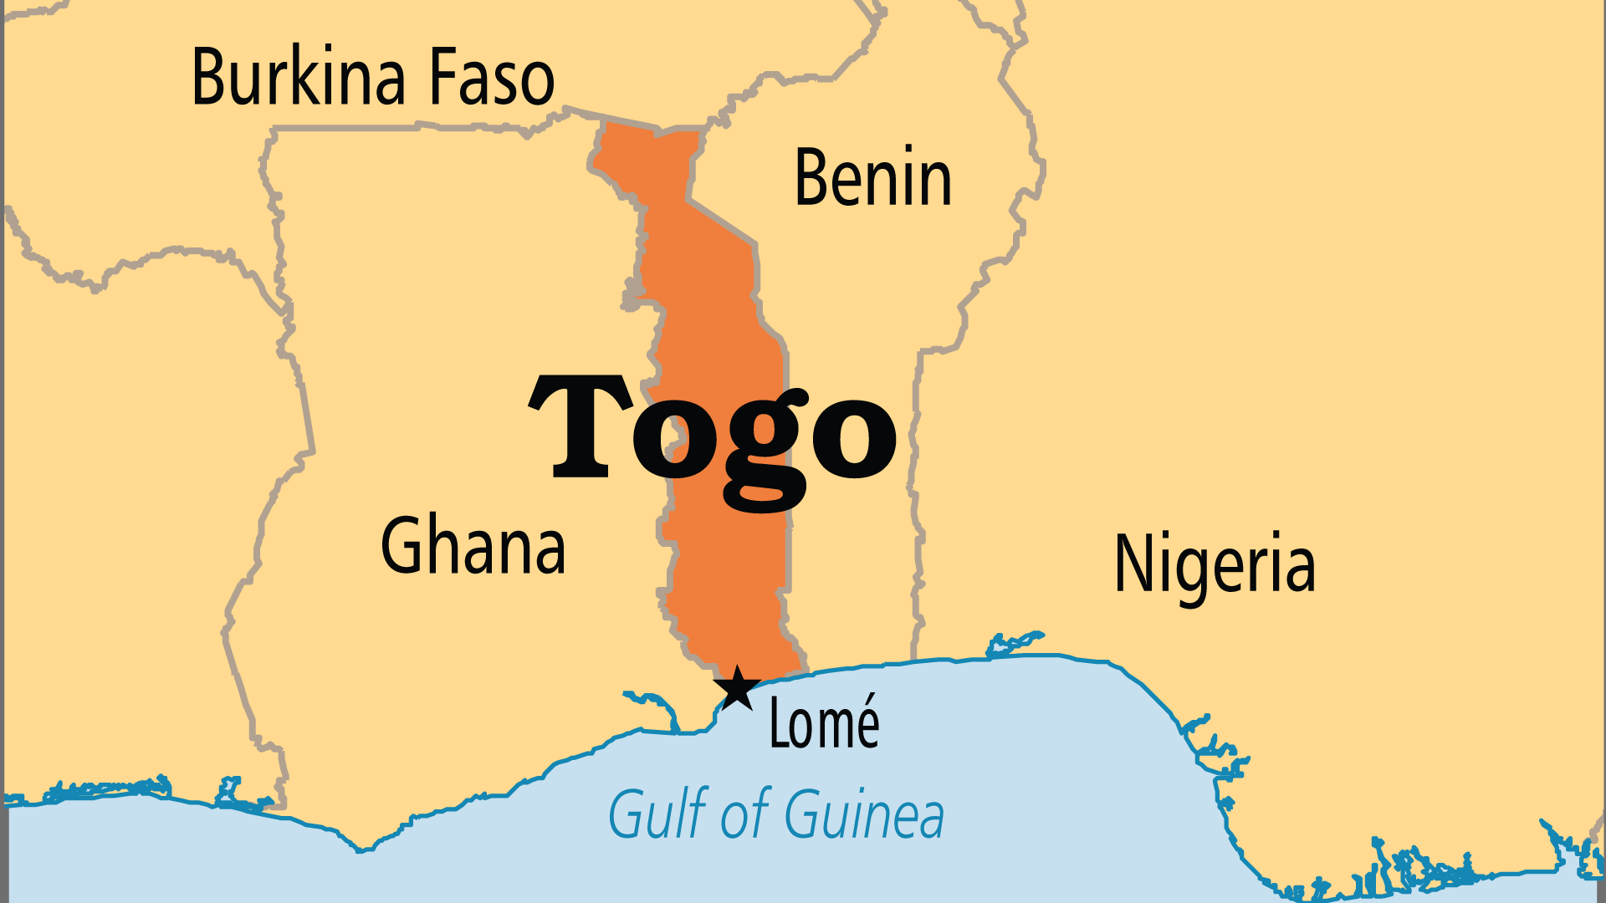
KEY STATS
Capital: | Lomé
Population: | 9,721,608
Official Language: | French
Languages: | 43
% Christian: | 45.4 %
% Evangelical: | 10.7 %
Largest Religion: | Christian
People Groups: | 56
Least Reached People Groups: | 8
% Unevangelized: | 17 %

Slide 4

FOR PRAYER
The political and economic situation remains precarious. A family dynasty ruling for over 50 years and an unequal electoral system both favour the central-northern Gur peoples over the southern Guinean peoples. Pray that God breaks down the resentment and bitterness between them. Poverty leaves orphans and unwanted children (over 300,000) vulnerable to human traffickers, and makes prostitution common. Pray for an end to these evils, and for effective ways to fight poverty.
Want to know more? Go to www.operationworld.org

