Slide 1




Slide 2


PRAYING FOR
TIMOR
LESTE

Slide 3
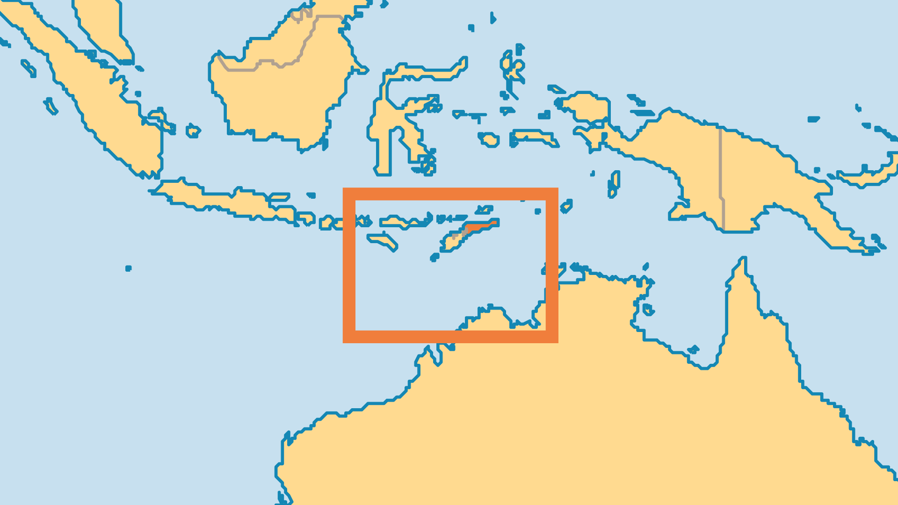
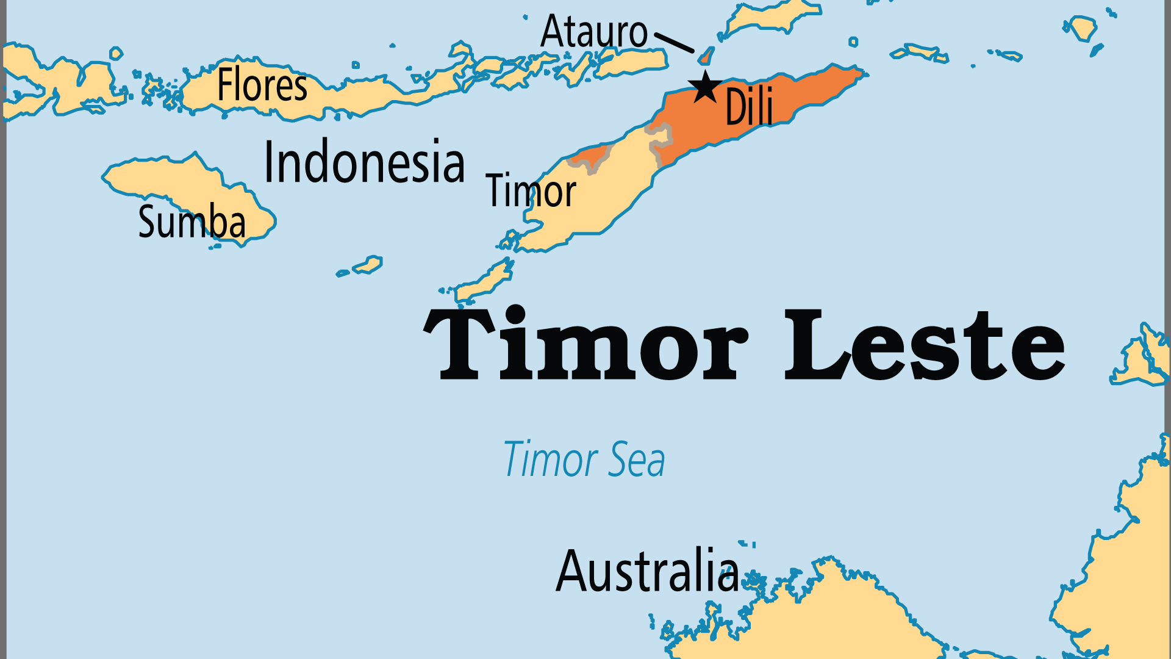
KEY STATS
Continent: | Asia
Capital: | Dili
Population: | 1,418,518
Pop Under 15 Yrs: | 37.3 %
Official Language: | Portuguese, Tetum Bahasa Indonesia
Languages: | 19
HDI Ranking: | 140/193
% Christian: | 87.4 %
% Evangelical: | 2.3 %
People Groups: | 24
% Unevangelized: | 4 %

Slide 4

FOR PRAYER
This small, young nation continues its struggles to break free of the poverty, division, and trauma of its tumultuous past. Close to half of the population is at or below the poverty line. Timor's population is the most youthful in Asia (along with Afghanistan), and one of the youngest in the world. National unity and development are uphill struggles, especially with high dependence on oil as a natural resource. Pray for wise, long-term policies that will raise the education, health, and living standards for Timorese, and for the formation of a harmonious national identity, all under Christ's lordship.
Want to know more? Go to www.operationworld.org

