Slide 1




Slide 2

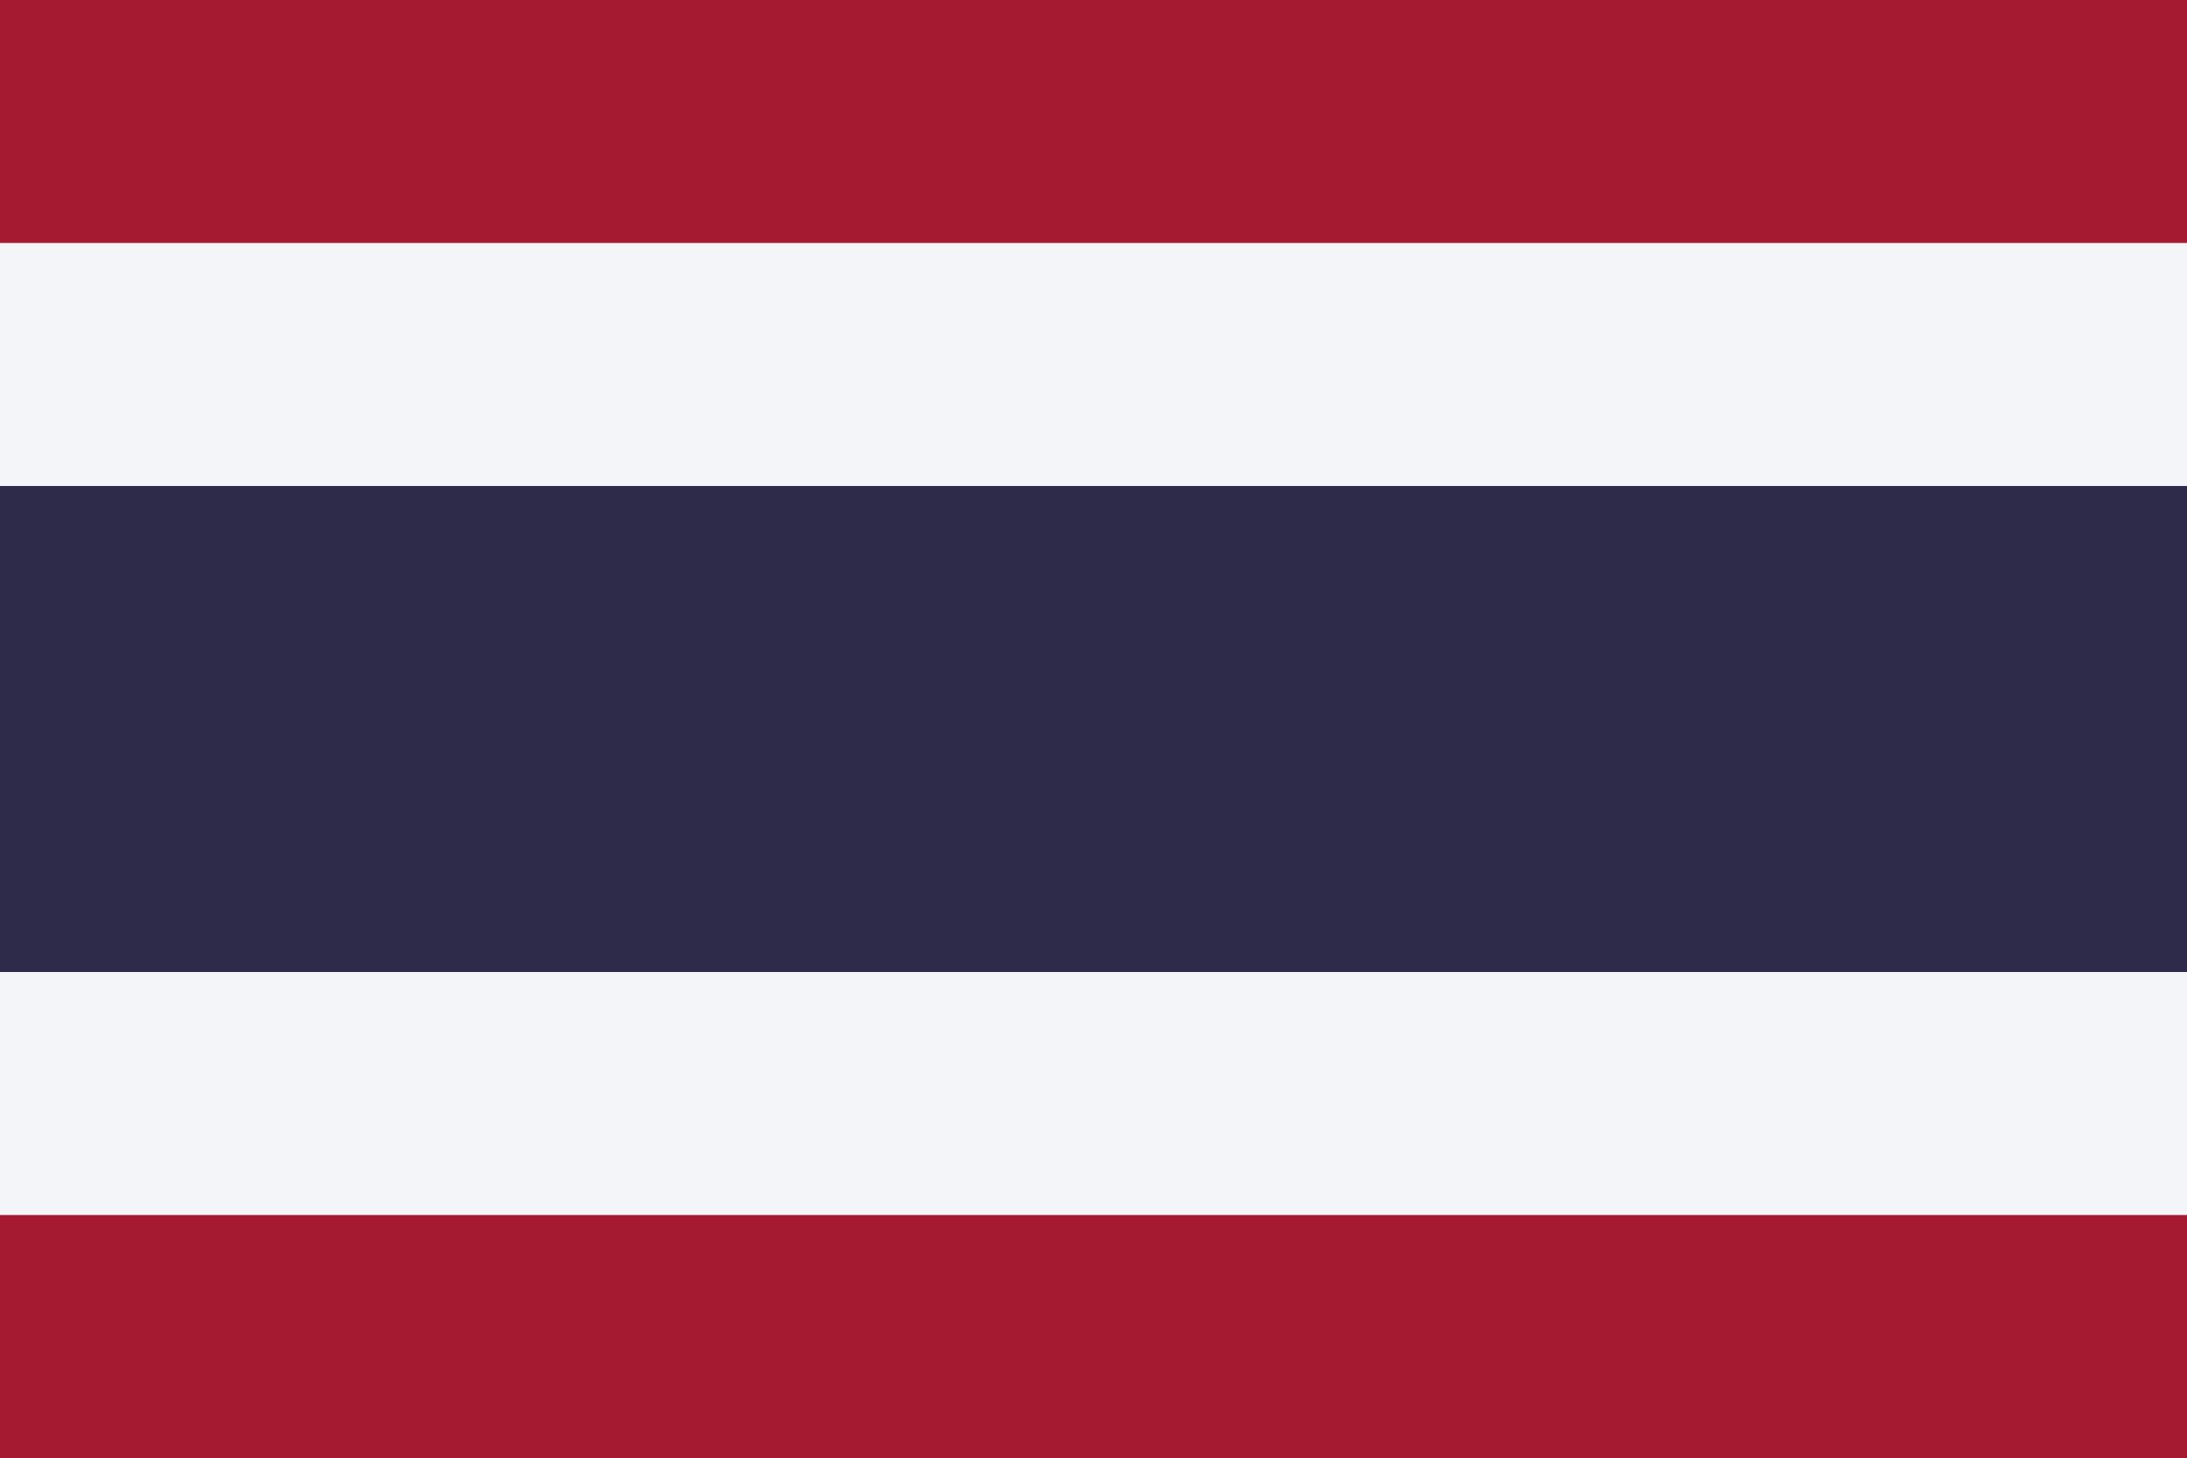
PRAYING FOR
THAILAND

Slide 3
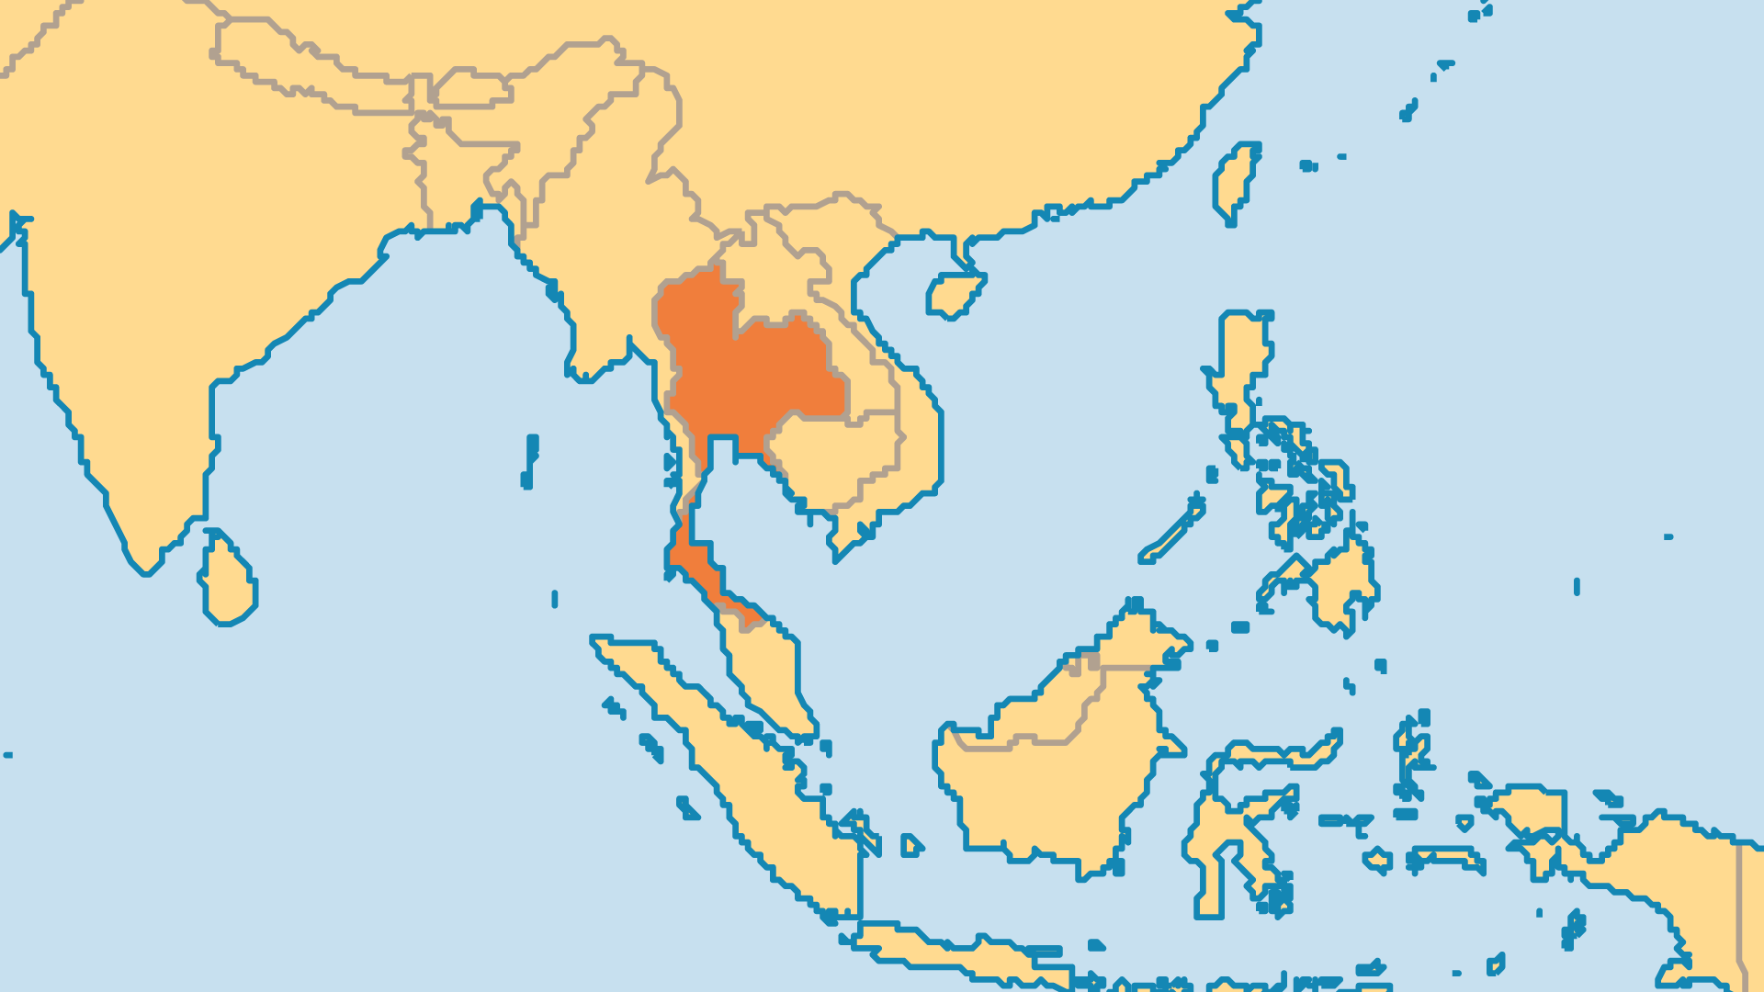
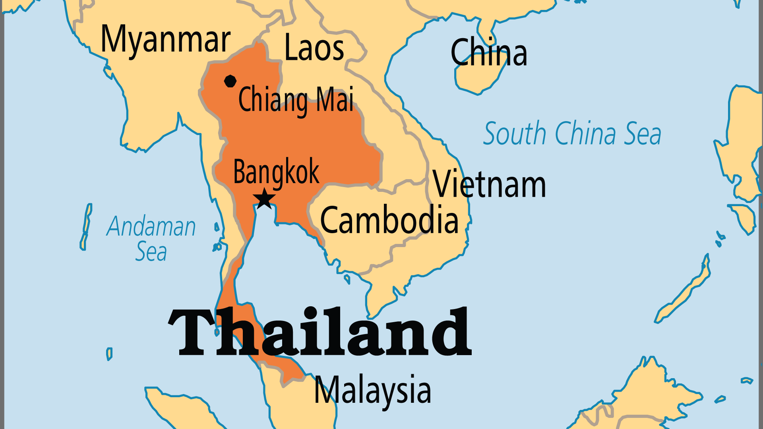
KEY STATS
Capital: | Bangkok
Population: | 71,619,863
Official Language: | Thai
Languages: | 85
HDI Ranking: | 66/193
% Christian: | 1.1 %
% Evangelical: | 0.5 %
Largest Religion: | Buddhist
% Largest Religion: | 85.3 %
% Unevangelized: | 43 %

Slide 4

FOR PRAYER
Thailand was traditionally a stable country in a troubled region. From time to time, power struggles emerge between political parties. Violent activity among Muslims in the south at times brings upheaval. Widespread corruption in business, politics, the military, and the police allows dishonest people to make themselves rich by oppressing others. Thailand means "Land of the Free", because it remained free when Western powers colonized the countries around it. Yet the land remains captive to Buddhism, traditional culture, spirit worship, and even occult practices. Pray for spiritual breakthrough, so that the Thai might truly be free in the Lord Jesus.

Slide 5
FOR PRAYER
Thai Christians remain around 1% of the population, even after 400 years of missionary work. Most of Thailand's churches are small (30-50 members). Nearly half of Protestants come from tribal groups (less than 5% of Thailand's population), and not ethnic Thais. Praise God that national leaders now have a bold goal to reach every one of Thailand's 80,000 villages and neighbourhoods with the gospel! Pray for their plans: a national prayer network, leadership development, extensive research, community development ministry, all in addition to evangelism.
Want to know more? Go to www.operationworld.org

