Slide 1




Slide 2


PRAYING FOR
TANZANIA

Slide 3
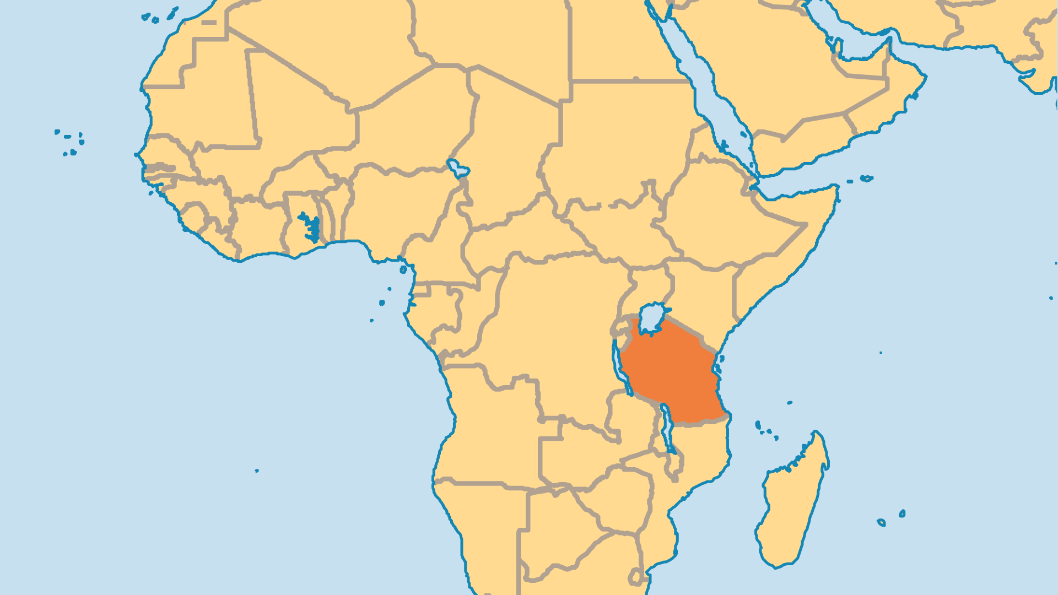
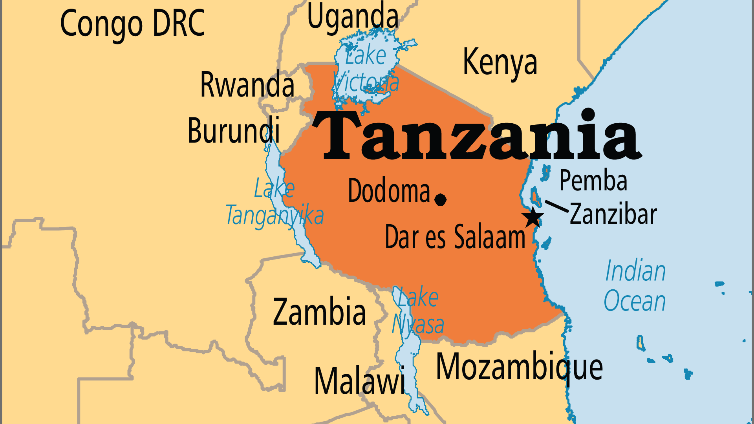
KEY STATS
Capital: | Dodoma (official); Dar es Salaam (de facto)
Population: | 70,545,865
Official Language: | Swahili, English
Languages: | 127
% Christian: | 54.1 %
% Evangelical: | 17.9 %
People Groups: | 157
Least Reached People Groups: | 24
% Unevangelized: | 14 %

Slide 4

FOR PRAYER
Tanzania remains an "island of peace" amidst troubled nations. It shelters over a million refugees who flee violence in their own lands, and serves as a base for Christian ministry in the region. Still, witchcraft mixes in with both Christianity and Islam in Tanzania. Spiritual superstition and occultism have great costs, and often lead to sexual abuse or even death for victims of these practices. Pray the government will be bold to confront evil, and wise to bring community harmony and religious freedom.
Want to know more? Go to www.operationworld.org

Slide 5
FOR PRAYER
The evangelical population grew from 2.4 million in 1990 to over 9 million in 2020, in mainline Churches (Lutheran, Anglican), in Pentecostal denominations and in African Initiated Churches. New church-planting agencies came about since the 1980s, as did partnerships between nationals and expatriate missionaries. Praise God that the commitment to plant new churches and to reach the unevangelized peoples of Tanzania bore good fruit in recent years among both animists and Muslims!
Want to know more? Go to www.operationworld.org

