Slide 1




Slide 2


PRAYING FOR
TAJIKISTAN

Slide 3
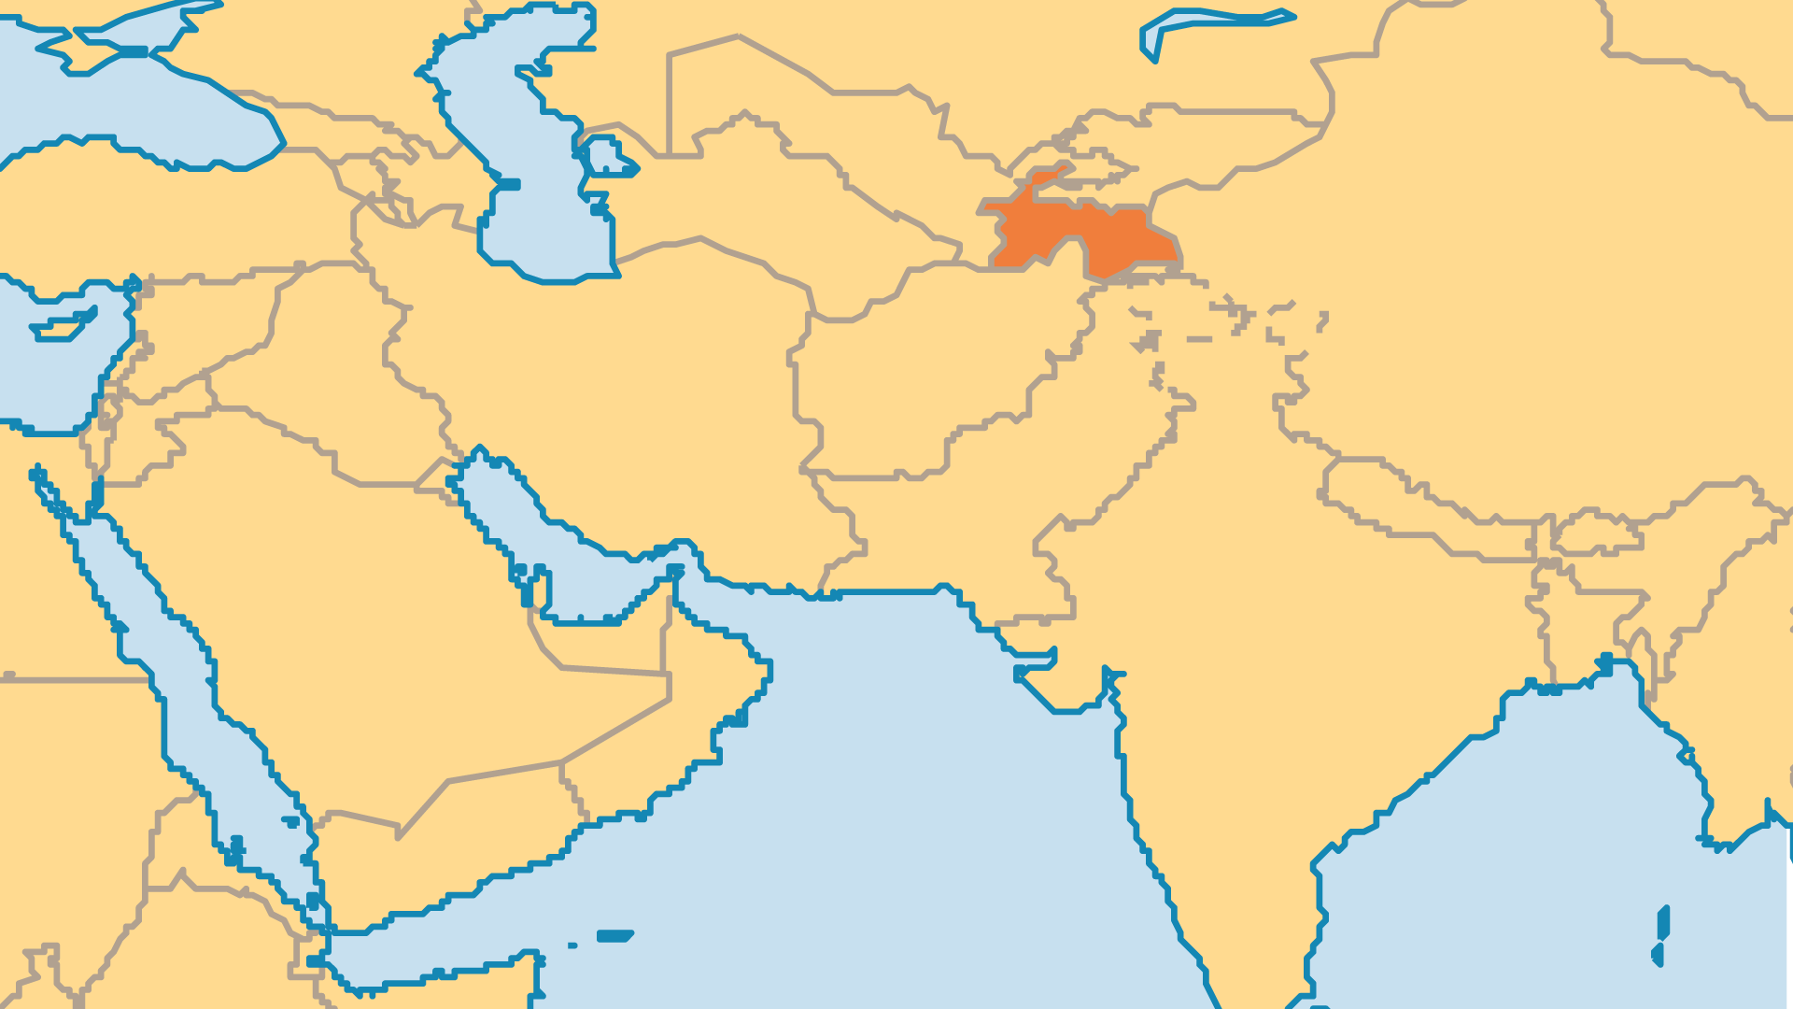
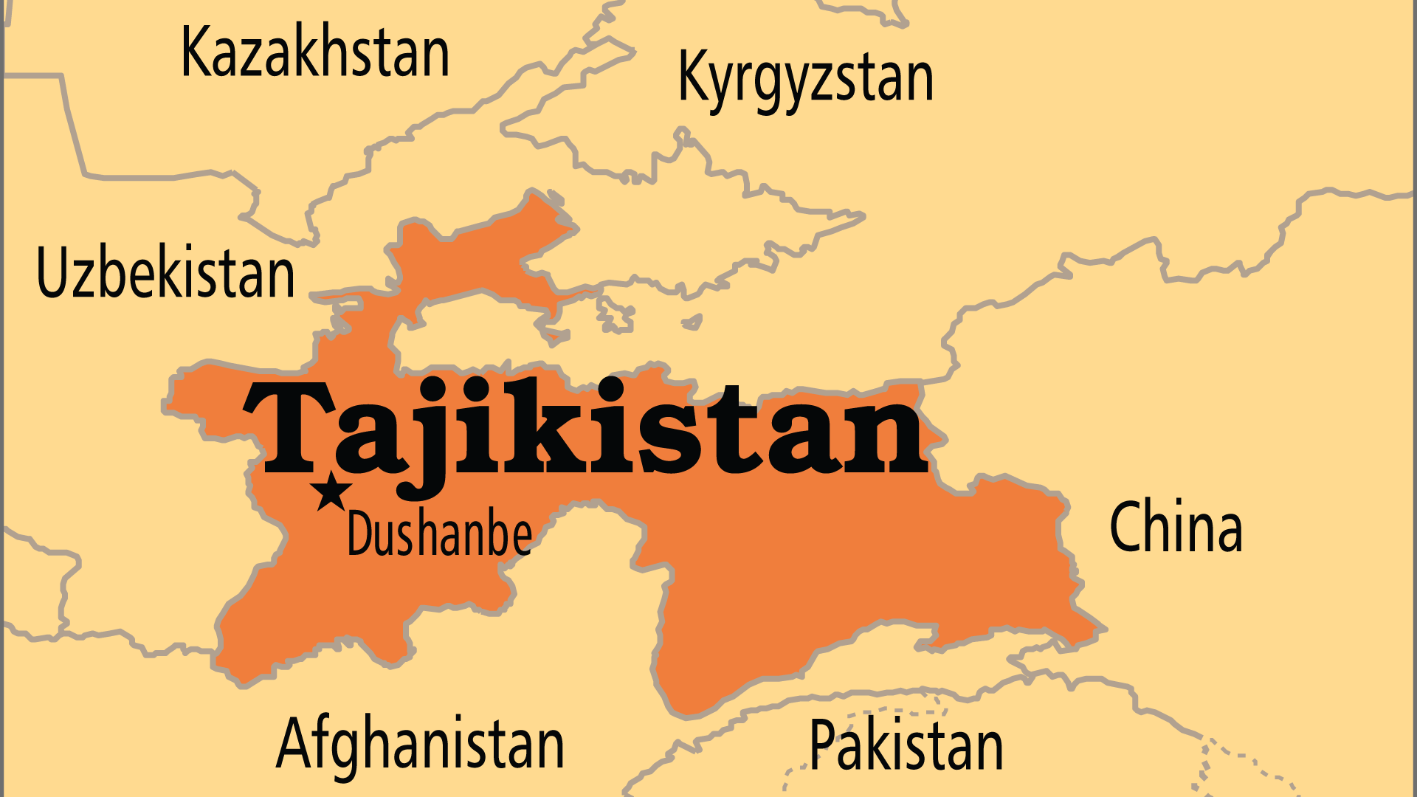
KEY STATS
Capital: | Dushanbe
Population: | 10,786,734
Official Language: | Tajik
Languages: | 33
Literacy Rate: | 99 %
% Christian: | 1 %
% Evangelical: | 0.1 %
Largest Religion: | Muslim
% Largest Religion: | 93.9 %
% Unevangelized: | 56 %
Persecution Ranking: | 39/50

Slide 4

FOR PRAYER
Although Islam is the religion of 94% of the population, only a small fraction practice "pure" Islam. Most are more influenced by folk superstitions and Zoroastrian beliefs. Mosques sprouted up everywhere in the years following independence, but now the government places severe restrictions on mosque building. Tajikistan's proximity to Iran and Afghanistan makes it vulnerable to Islamism. Pray for extremism to be restrained, and that Muslims might have unprecedented opportunities to discover Christ.
Want to know more? Go to www.operationworld.org

