Slide 1




Slide 2

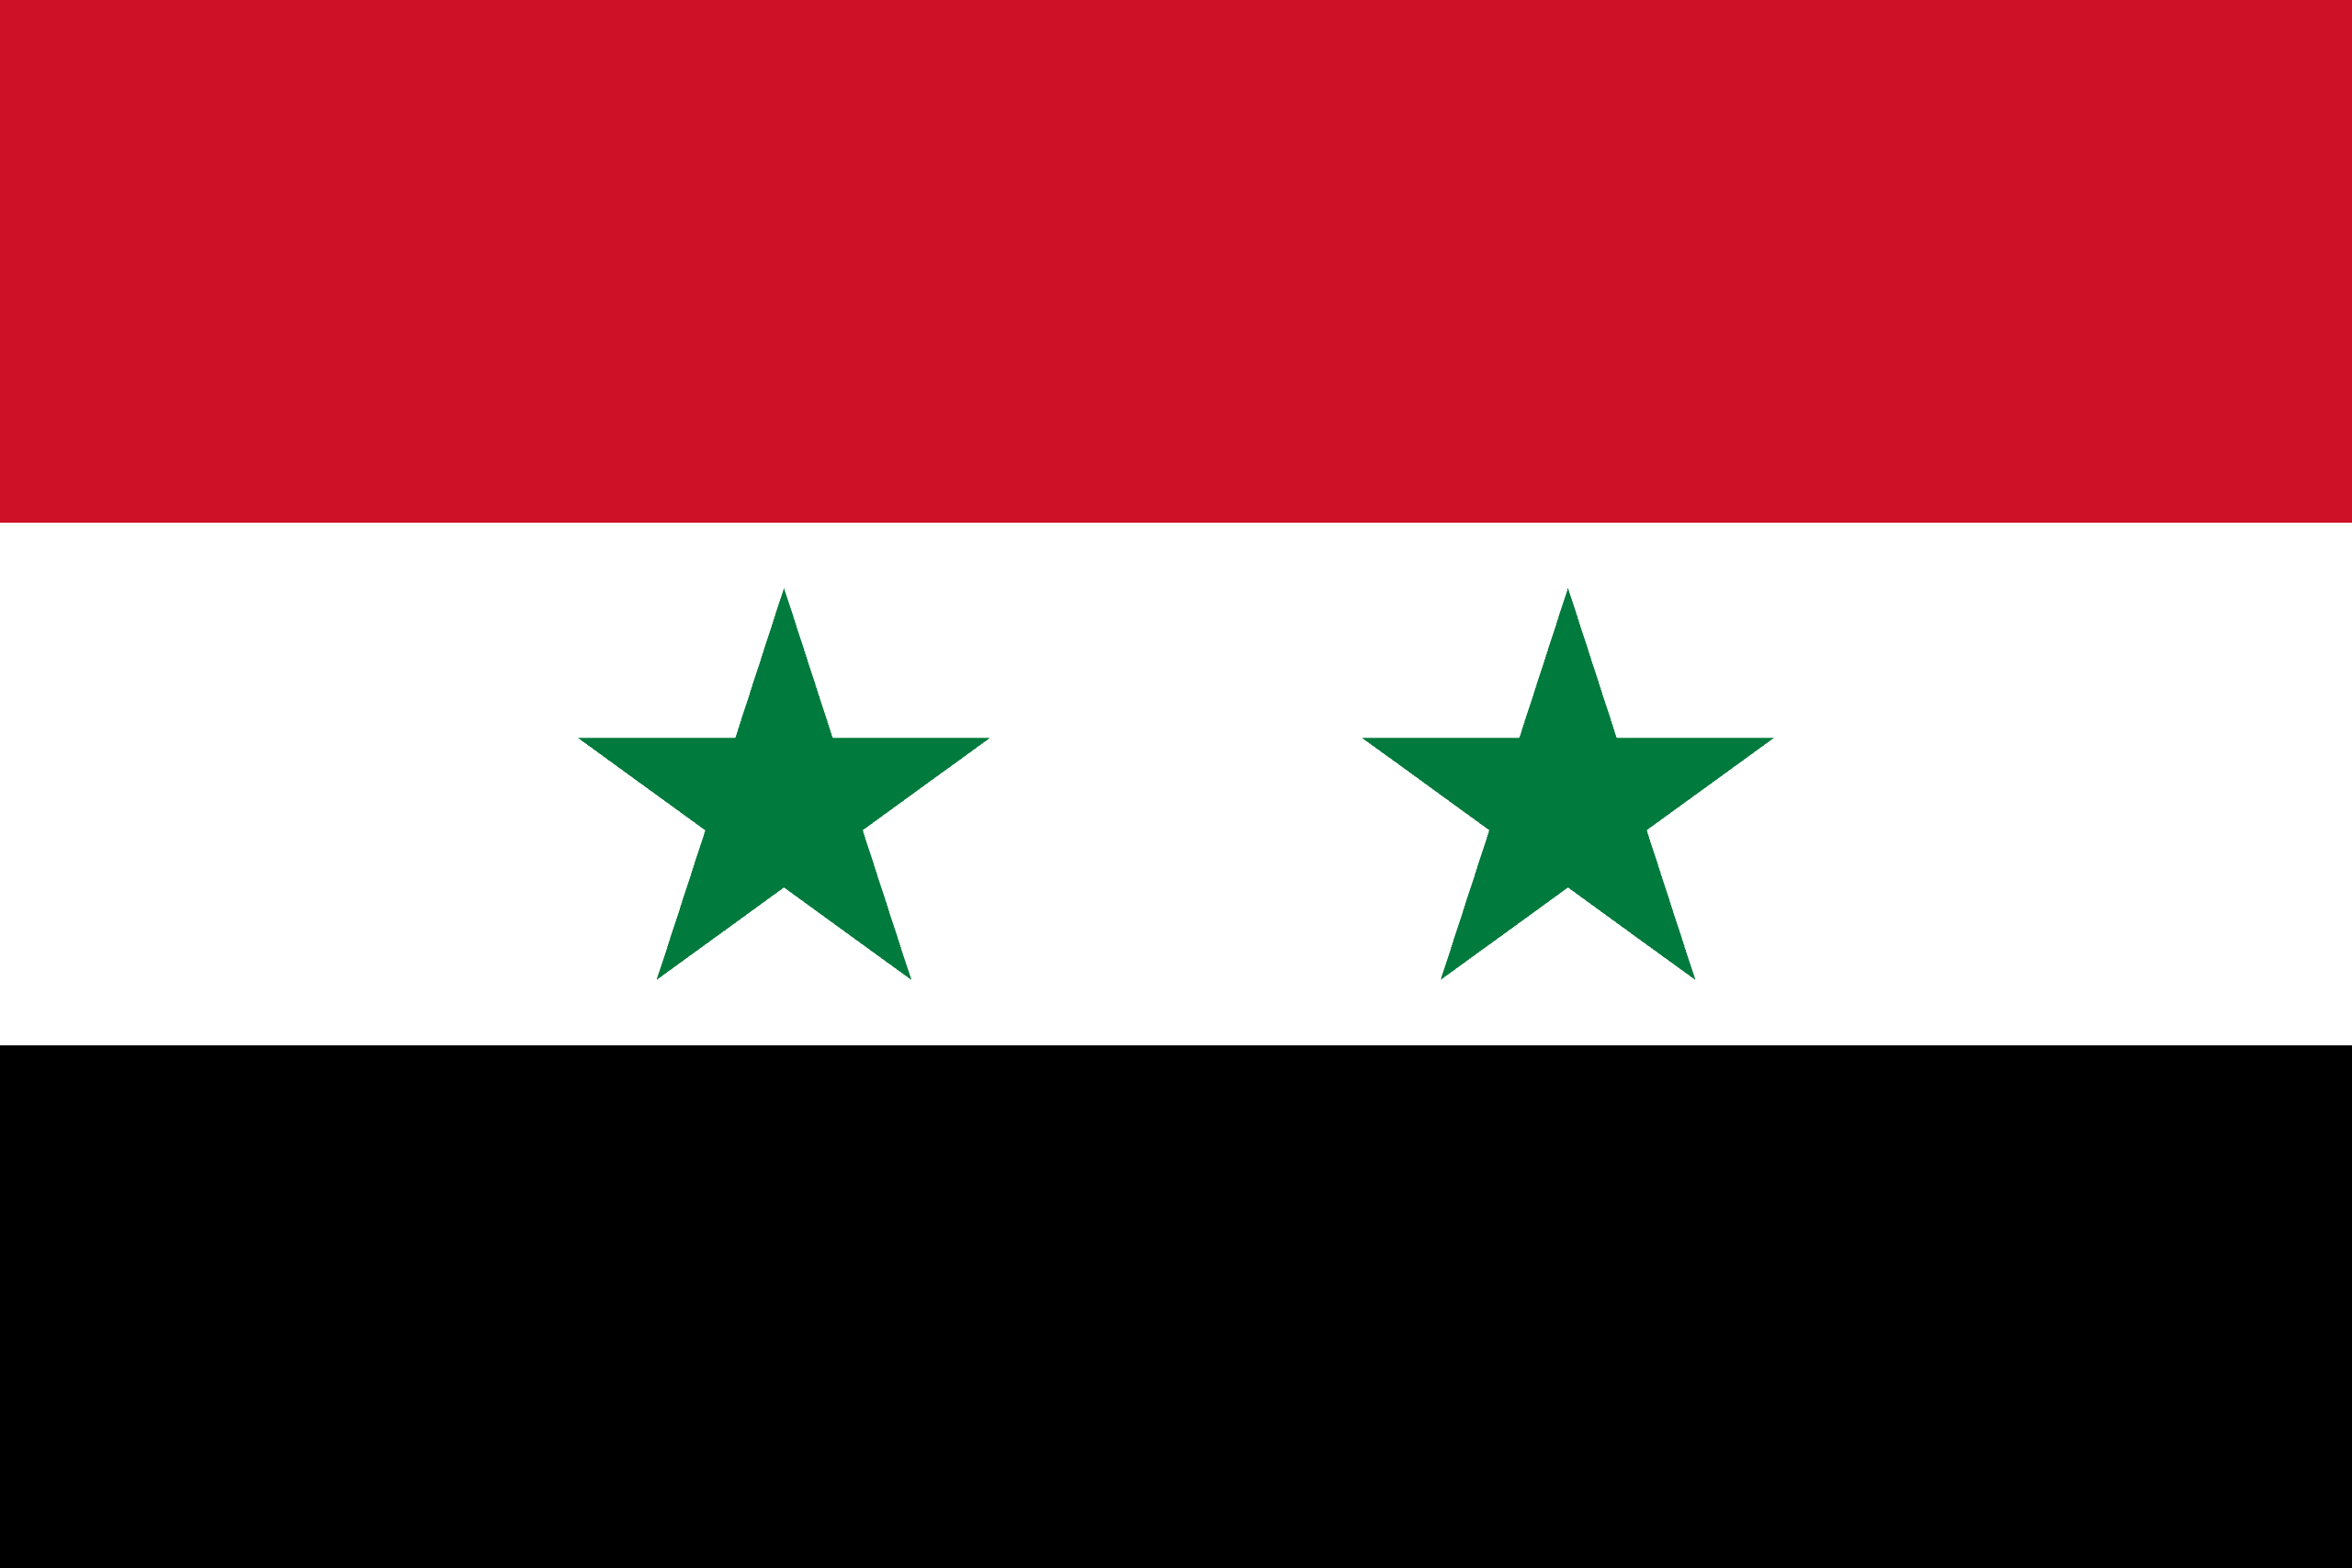
PRAYING FOR
SYRIA

Slide 3
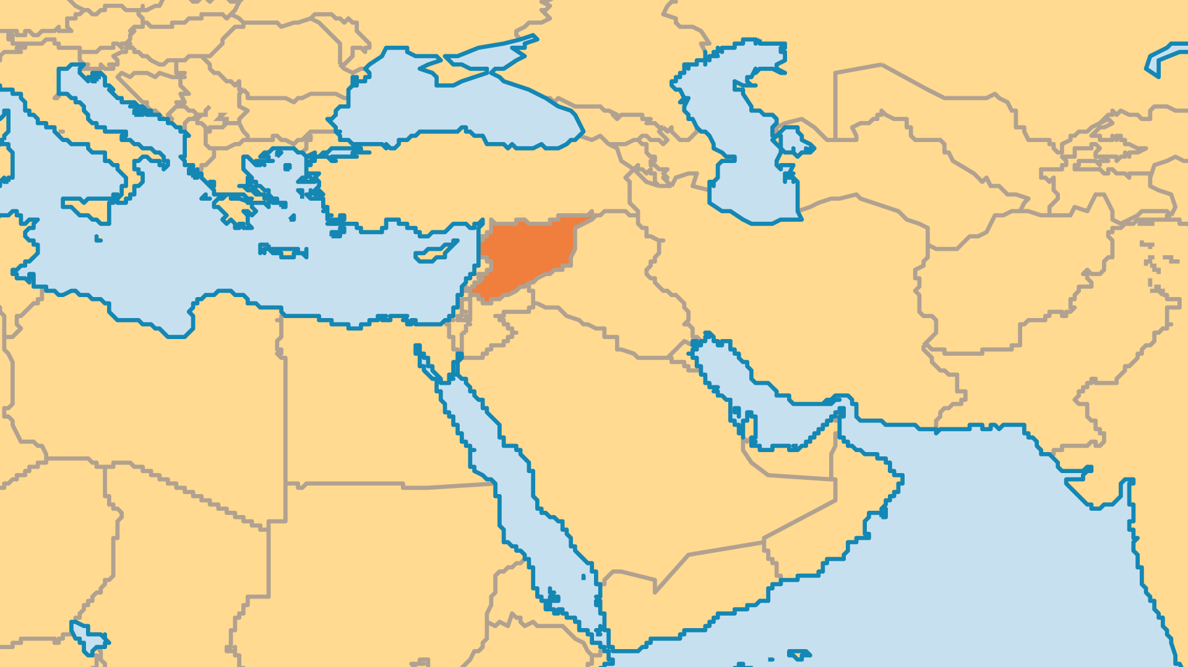
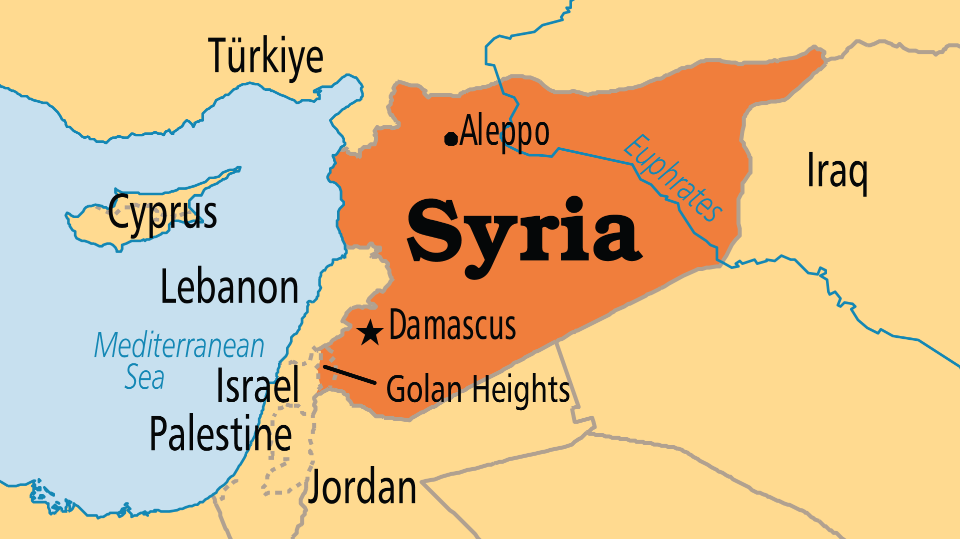
KEY STATS
Capital: | Damascus
Population: | 24,348,053
Official Language: | Arabic
Languages: | 22
HDI Ranking: | 150/193
% Christian: | 6.3 %
% Evangelical: | 0.1 %
Largest Religion: | Muslim
% Unevangelized: | 51 %
Persecution Ranking: | 18/50

Slide 4

FOR PRAYER
The anti-regime protests of 2011 led to a bloody war that took around 600,000 lives and left nearly half the population of Syria displaced. While the oppressive Assad dynasty was toppled in 2024, hostilities continue in a few areas due to the scores of factions involved in the conflict. A transitional government that oversees most of Syrian territory has been formed. But a Kurdish-led coalition retains some territory. Pray the peace of God for a land exhausted by war, and the mercy of God for the long-suffering people. A spirit of hopelessness afflicts many - pray for hope that might find its ultimate fulfilment in Christ!
Want to know more? Go to www.operationworld.org

