Slide 1




Slide 2

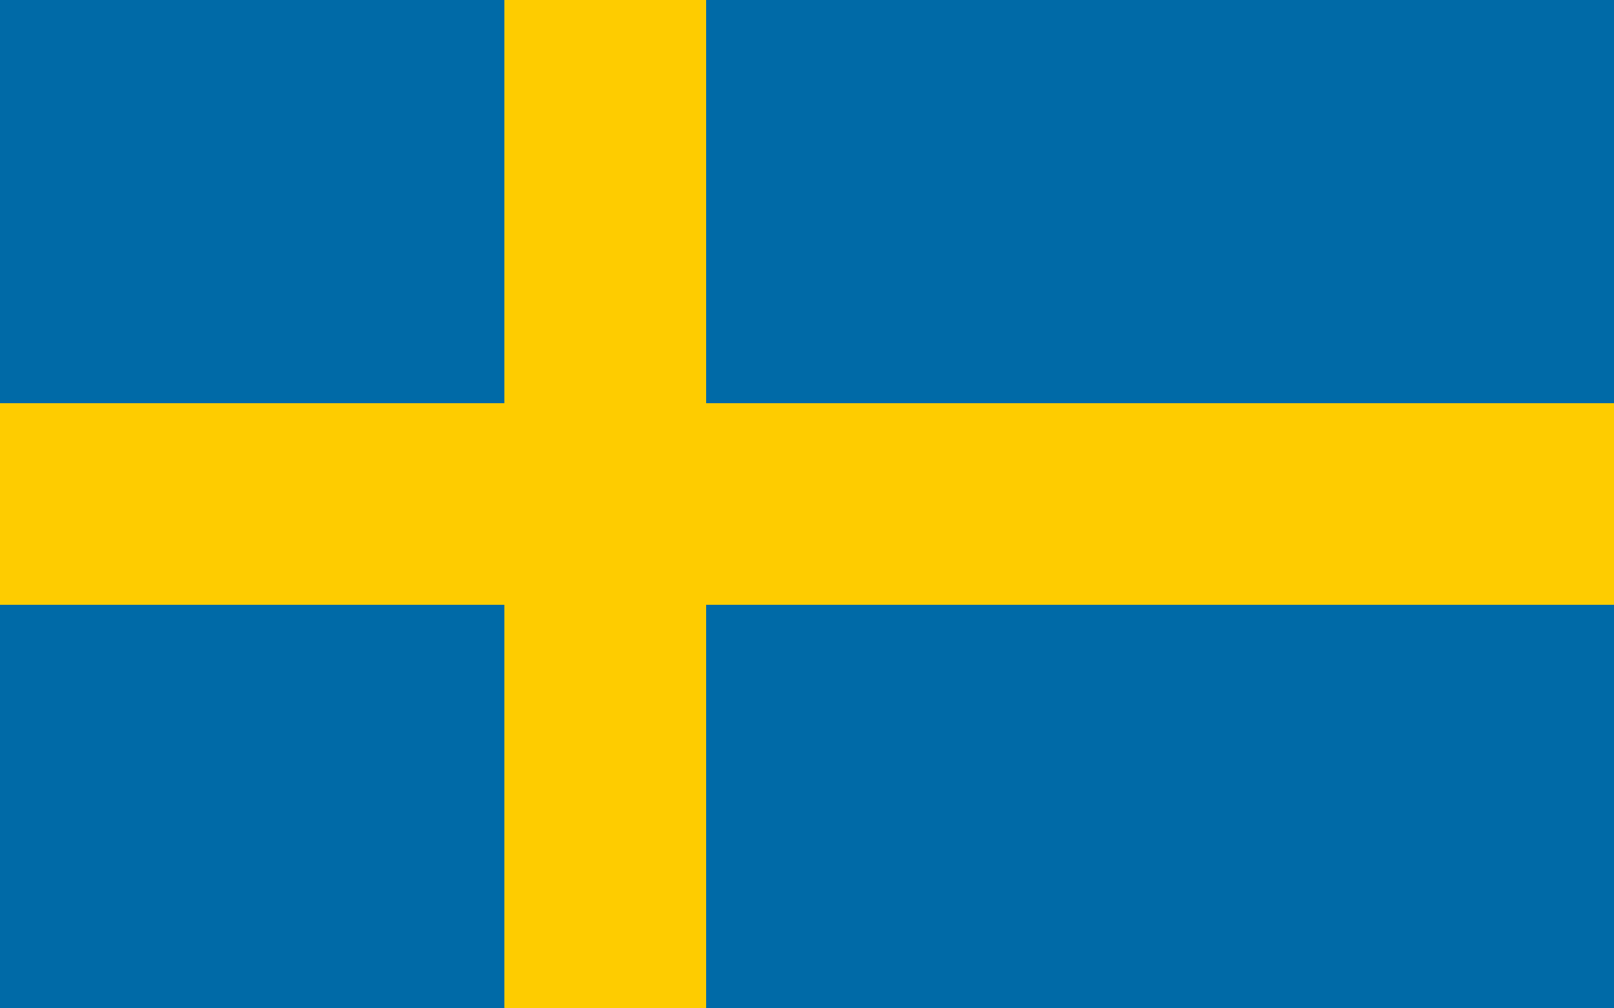
PRAYING FOR
SWEDEN

Slide 3
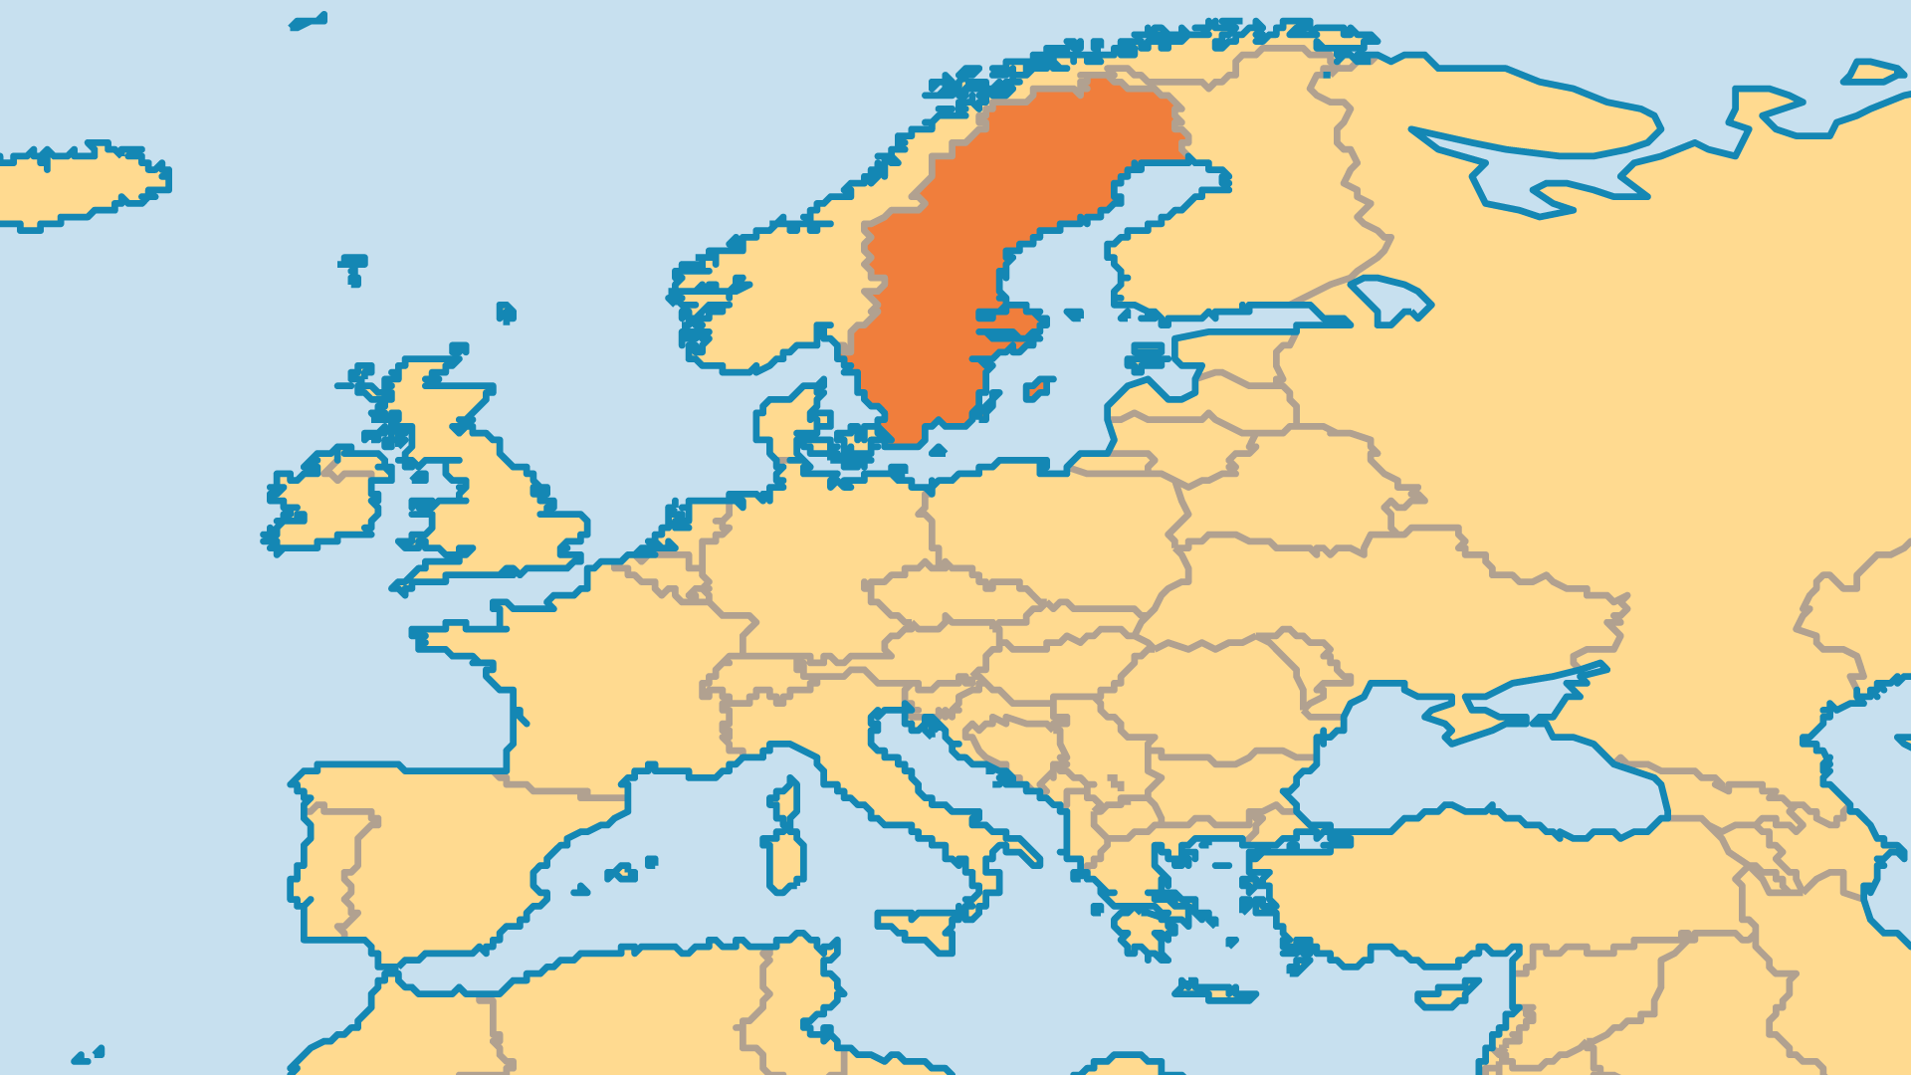
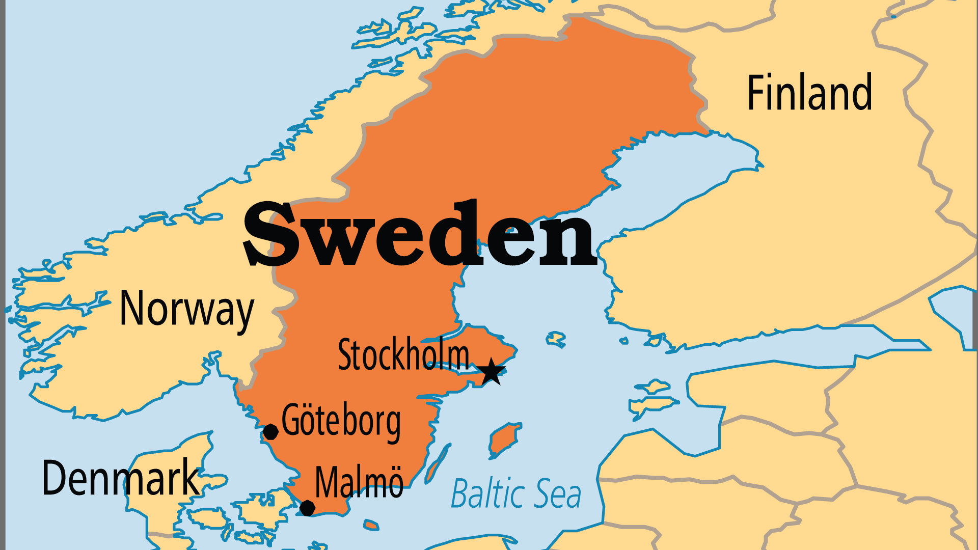
KEY STATS
Capital: | Stockholm
Population: | 10,656,633
Official Language: | Swedish
Languages: | 30
Life Expectancy: | 83 yrs (12nd/236)
HDI Ranking: | 7/193
% Christian: | 57.2 %
% Evangelical: | 6.9 %
People Groups: | 88
Least Reached People Groups: | 22
% Unevangelized: | 5 %

Slide 4

FOR PRAYER
Sweden faces widespread spiritual decline. Nearly every religious group loses members, and only 23% of people still believe in a personal God. Sweden has a rich Christian history, with many 19th-century revivals, a strong Free Church movement, and a great commitment to missions. The Church of Sweden (Lutheran) is no longer the state church. Society places a high value on material comfort, personal pleasure, and individualism. Pray for God to raise up teachers and leaders who know the Bible, who know the culture, and who do not compromise with the majority mindset in society.
Want to know more? Go to www.operationworld.org

