Slide 1




Slide 2

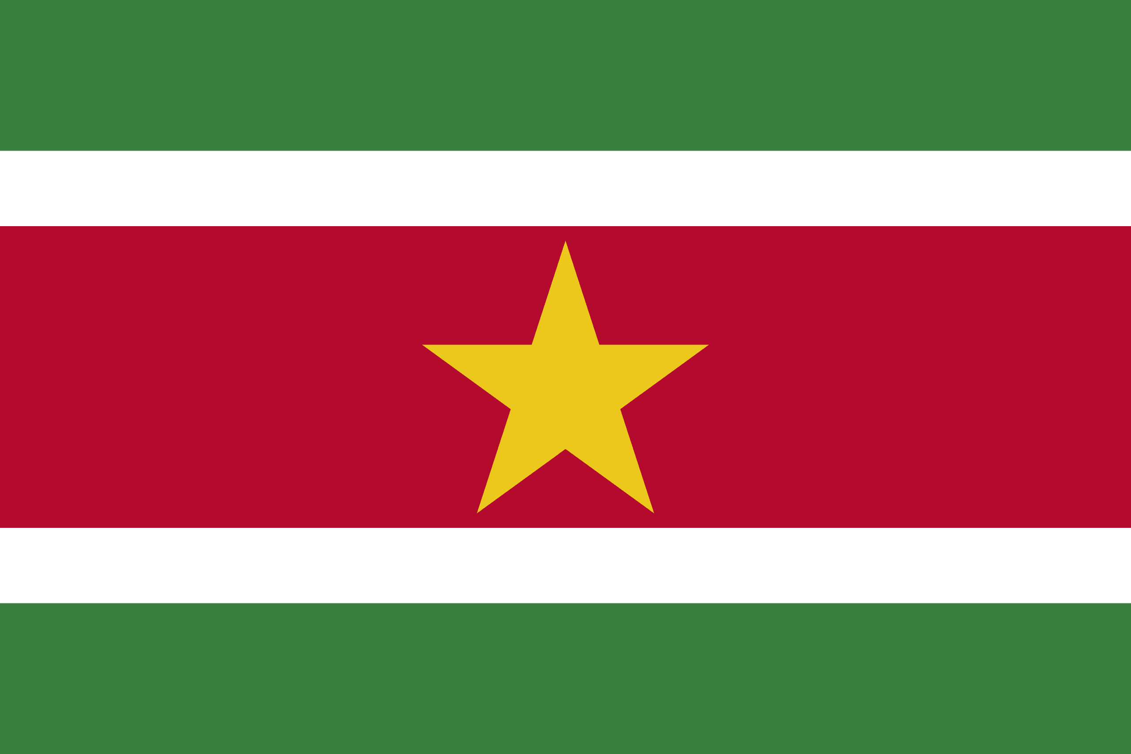
PRAYING FOR
SURINAME

Slide 3
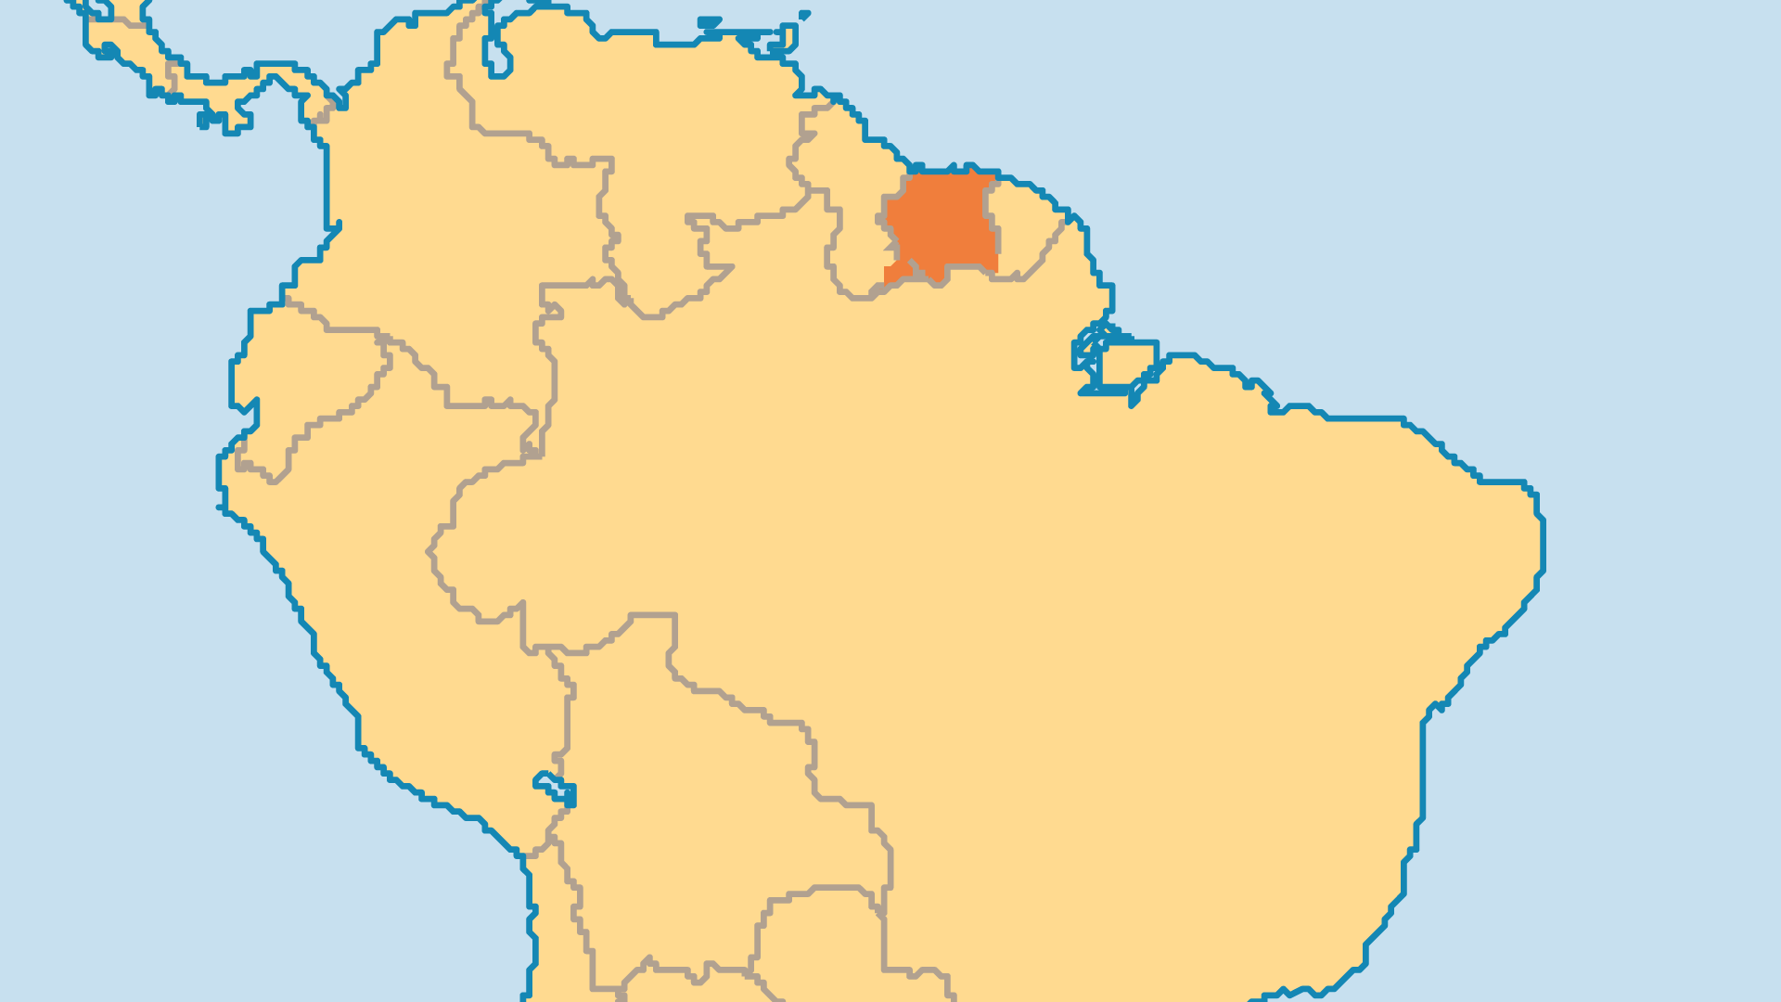
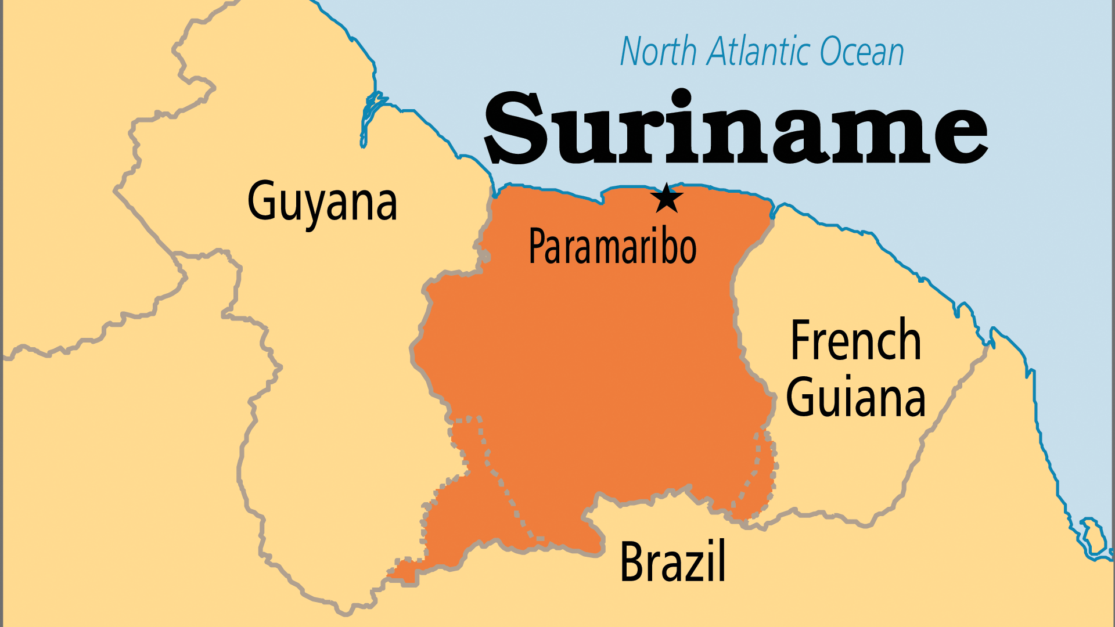
KEY STATS
Capital: | Paramaribo
Population: | 639,850
Official Language: | Dutch. Trade language Sranan Tongo
Languages: | 20
% Christian: | 49.6 %
% Evangelical: | 13.8 %
People Groups: | 24
Least Reached People Groups: | 2
% Unevangelized: | 16 %

Slide 4

FOR PRAYER
Suriname faced confusion in the years after independence. Many people lost their way with morals and ethics. Race and religion still divide people, and this blocks political and social progress for the nation. Powerful crime rings traffic drugs and smuggle gold, and they appear unstoppable. Pray for godly leadership for this young nation.
Want to know more? Go to www.operationworld.org

