Slide 1




Slide 2


PRAYING FOR
SUDAN

Slide 3
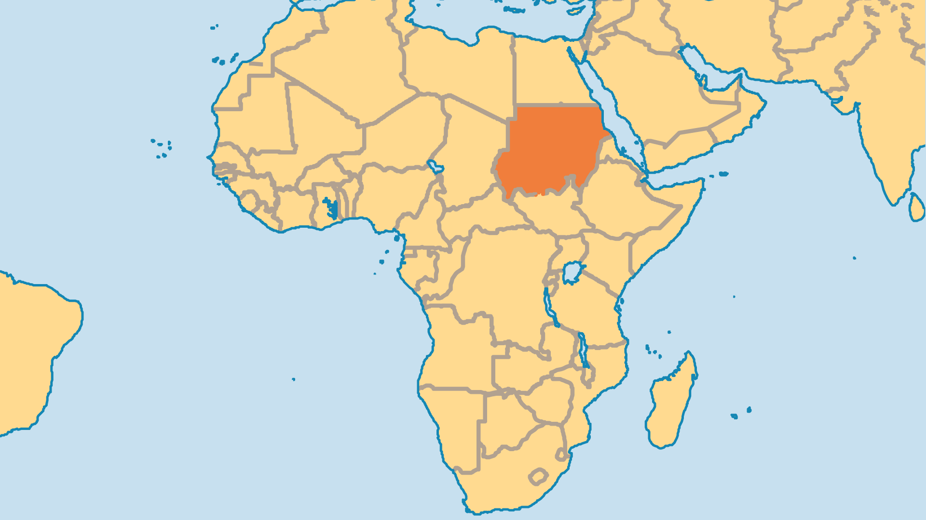
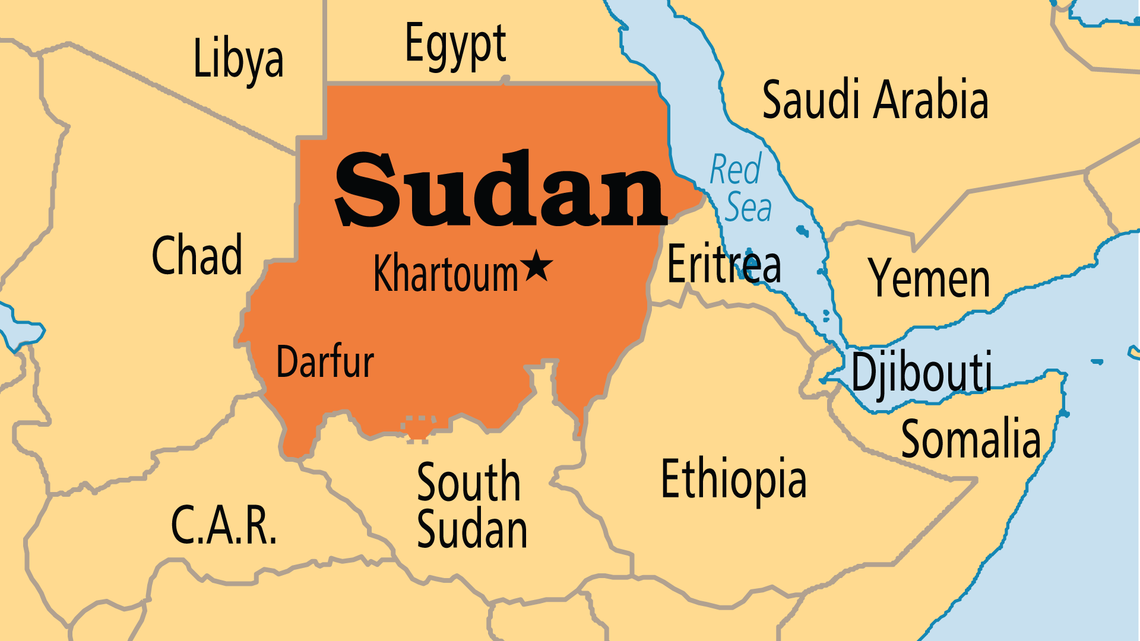
KEY STATS
Capital: | Khartoum
Population: | 51,662,148
Pop Under 15 Yrs: | 40.2 %
Official Language: | Arabic and English
Languages: | 134
% Christian: | 5 %
% Evangelical: | 2.5 %
Largest Religion: | Muslim
% Unevangelized: | 64 %
Persecution Ranking: | 5/50

Slide 4

FOR PRAYER
Massive protests in 2018 led to the arrest of the President which ended his rule. A transitional military-civilian government was formed in 2019, but this brief hope for progress was undone by subsequent military coups. Now, civil war rages between the Sudan Armed Forces and the Rapid Support Forces which was formed from government-supported paramilitaries. Over 10 million Sudanese are displaced, and famine - especially in Darfur - reaches out to claim more lives. Pray that the legacy of oppressive, militaristic rule in Sudan might be ended in Jesus’ name.
Want to know more? Go to www.operationworld.org

Slide 5
FOR PRAYER
The gospel spread through these many years of upheaval. Although the conflicts created terrible suffering, they made the Church more mature. The Islamic government bombed churches and other Christian buildings in the South, and specifically targeted Christian areas for attack. The wars scattered Christian refugees throughout the country, so even through suffering the good news spread. Churches formed in places and among peoples that previously had no Christians! Praise God that this growth occurs across many denominations. Pray for them to find unity through Christ.

