Slide 1




Slide 2

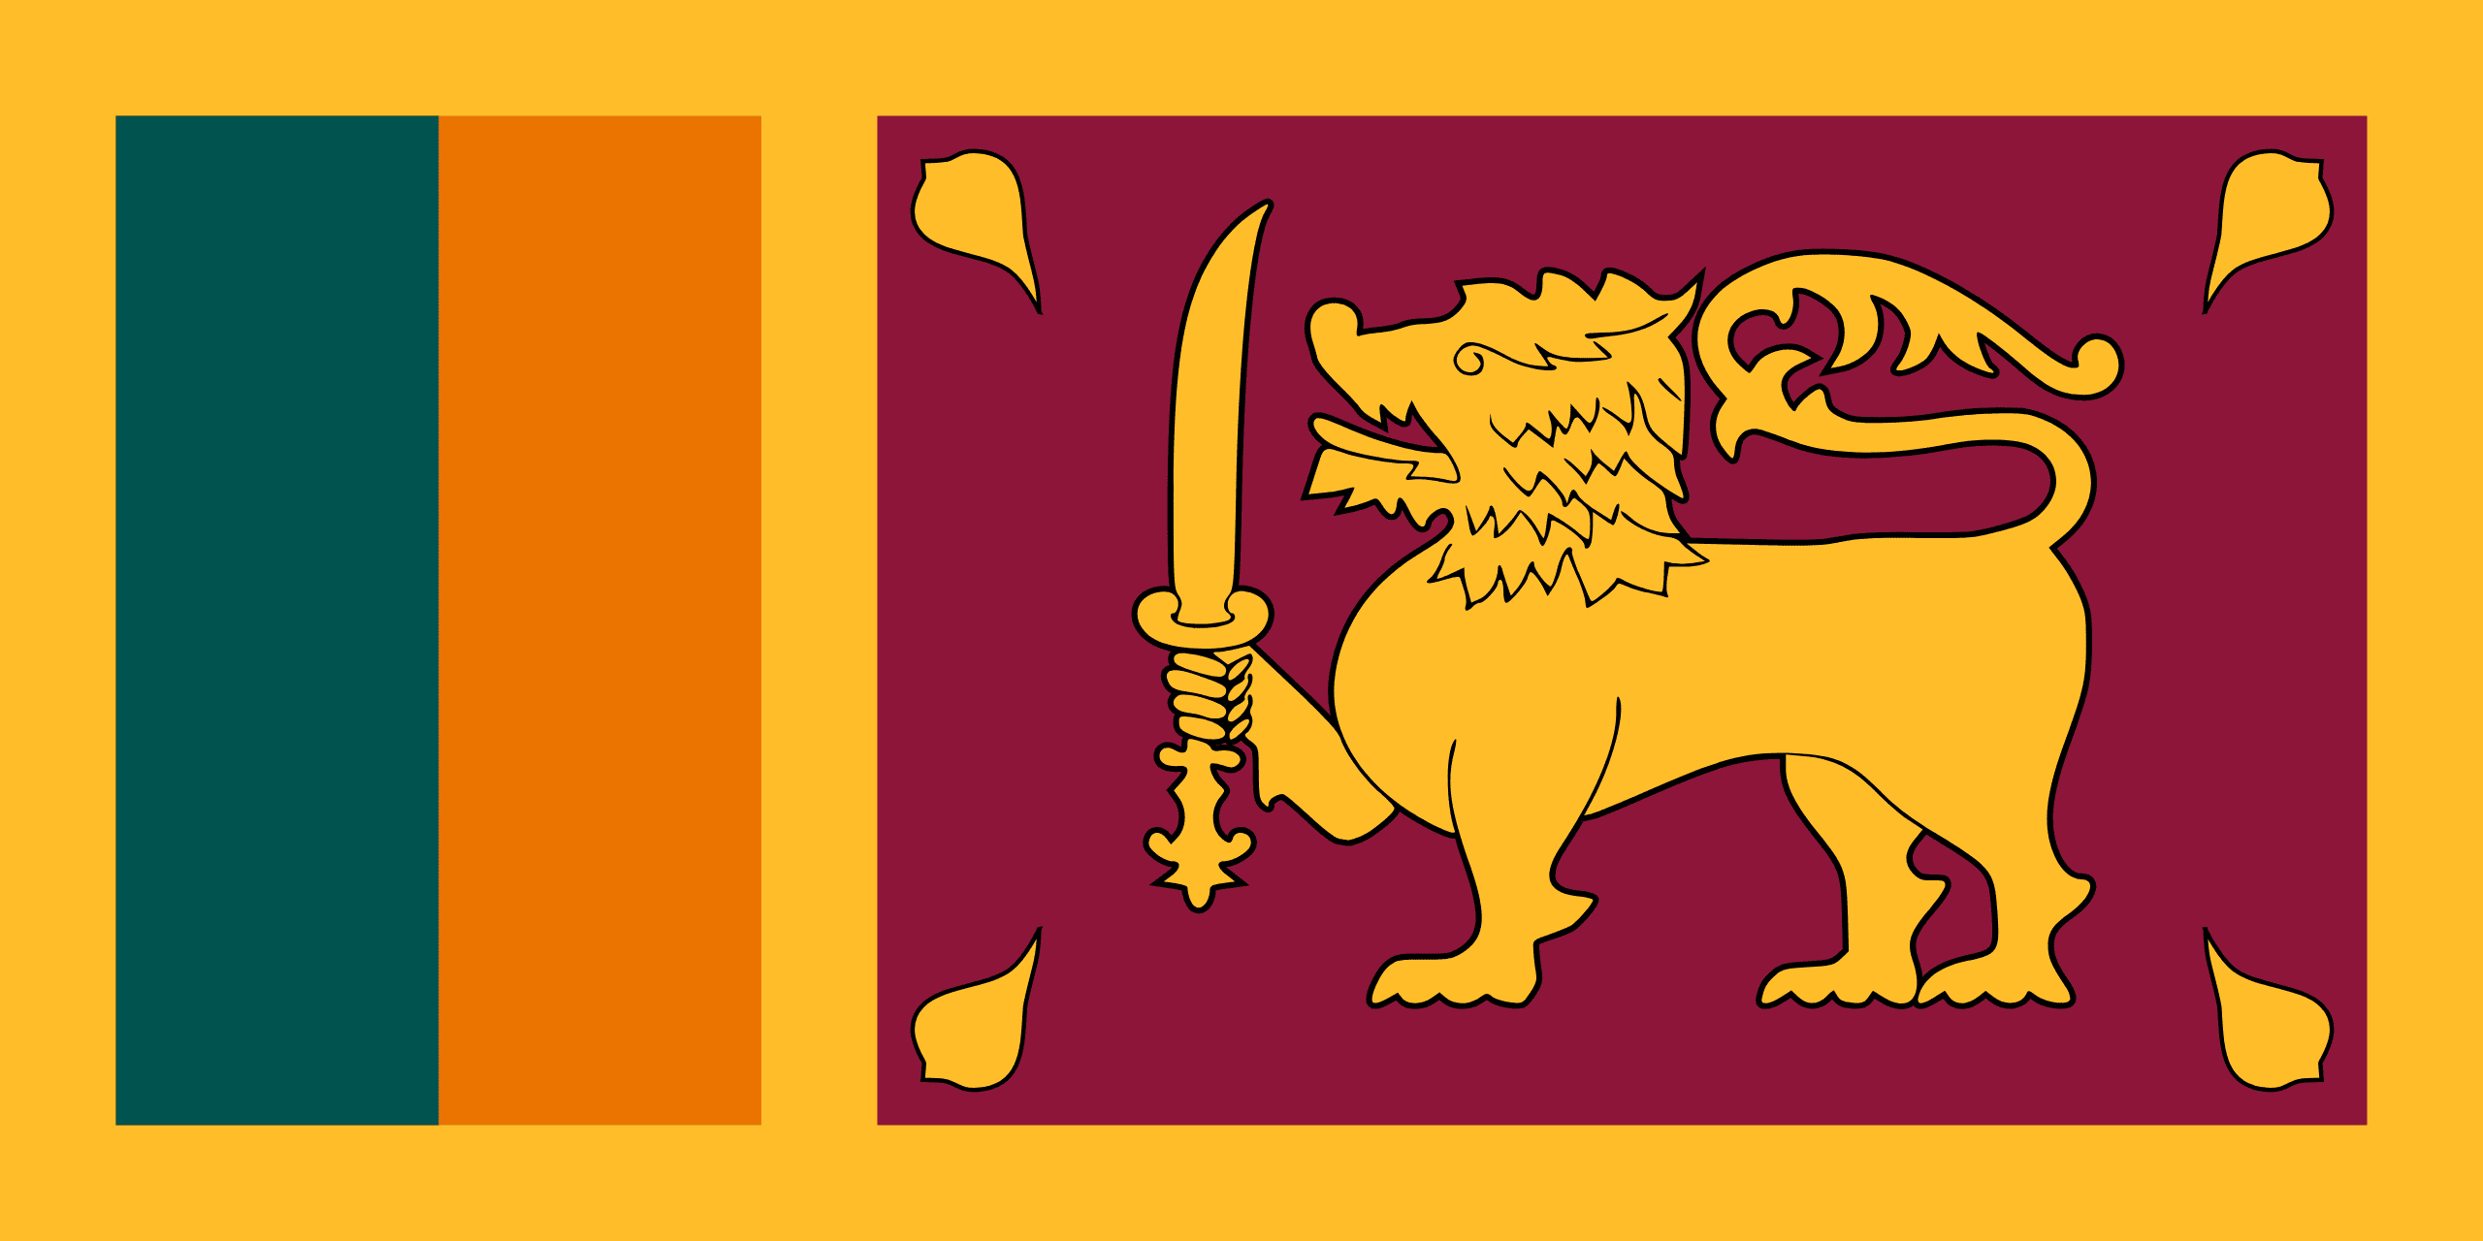
PRAYING FOR
SRI LANKA

Slide 3
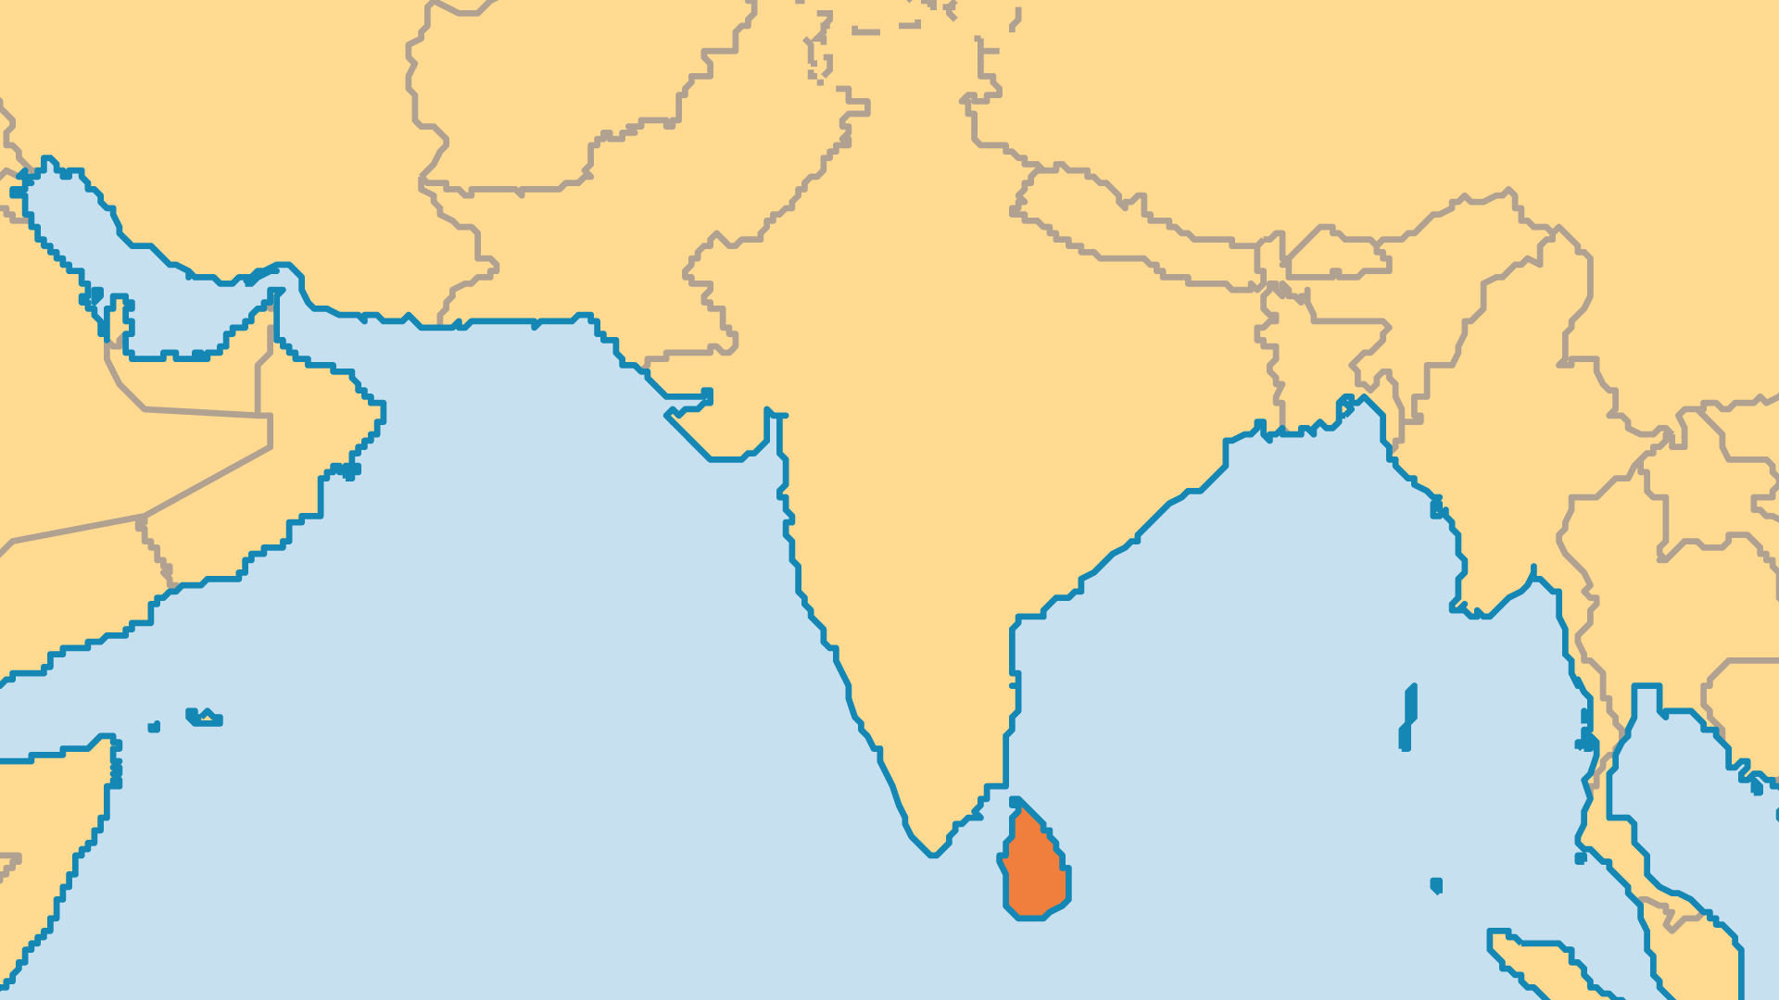
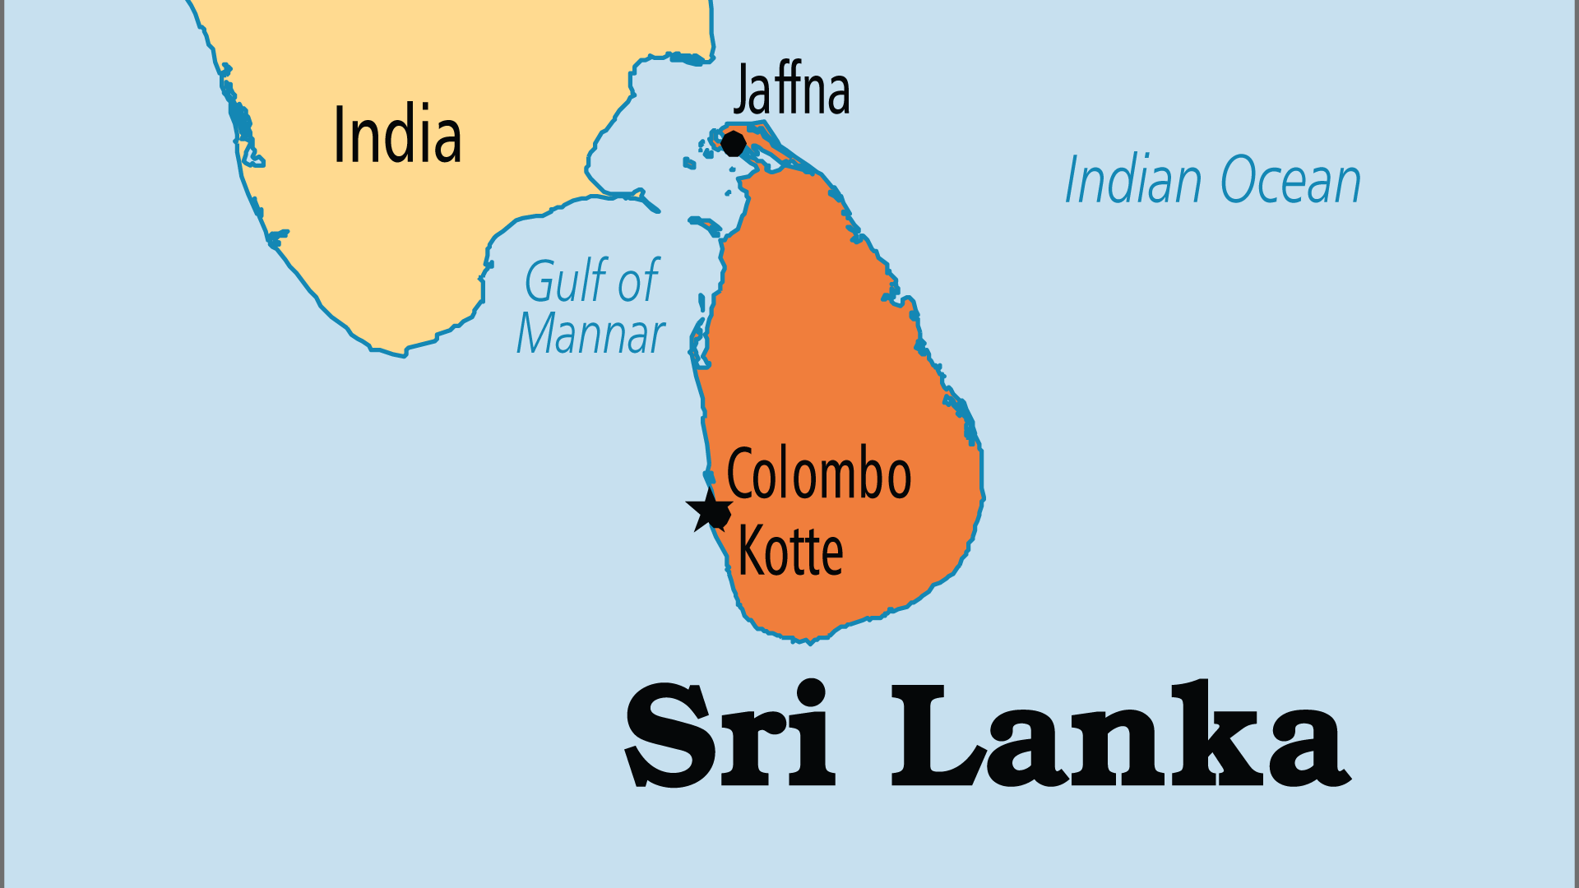
KEY STATS
Capital: | Colombo
Population: | 23,229,471
Official Language: | Sinhala and Tamil, with English as the link language
HDI Ranking: | 73/193
% Christian: | 8.4 %
% Evangelical: | 1.2 %
Largest Religion: | Buddhist
% Largest Religion: | 70 %
% Unevangelized: | 37 %

Slide 4

FOR PRAYER
Sri Lanka has endured much upheaval in the past generation. The 2004 tsunami, the bloody end to the civil war in 2009, the Islamist suicide bombings in 2019, and the economic crises in 2021 that led to the mass protests which finally toppled the government in 2022. Now, signs of hope spring forth. A closely contested but peaceful 2024 election gave a left-leaning new president a mandate to eliminate corruption and alleviate poverty. Pray that this new era might bring a time of good governance, economic restoration, justice for all ethnic and religious groups, and freedom for the gospel.

Slide 5
FOR PRAYER
Sri Lanka once was known for its tolerance and non-violence. For centuries it was a Buddhist kingdom that welcomed refugees from India (Hindu, Muslim, Christian). But Buddhist extremism has grown in this multi-religious, multi-ethnic country. Persecution against Christians comes in waves, and at least 250 churches were destroyed or damaged in recent years. Intensifying Hindu extremism and Arab-funded Islamization in eastern Sri Lanka both target Christians. Beneath the layers of Buddhism and Hinduism the ancient spirits, gods, and demons still hold power. Pray for the power of Christ to break these strongholds.
Want to know more? Go to www.operationworld.org

