Slide 1




Slide 2

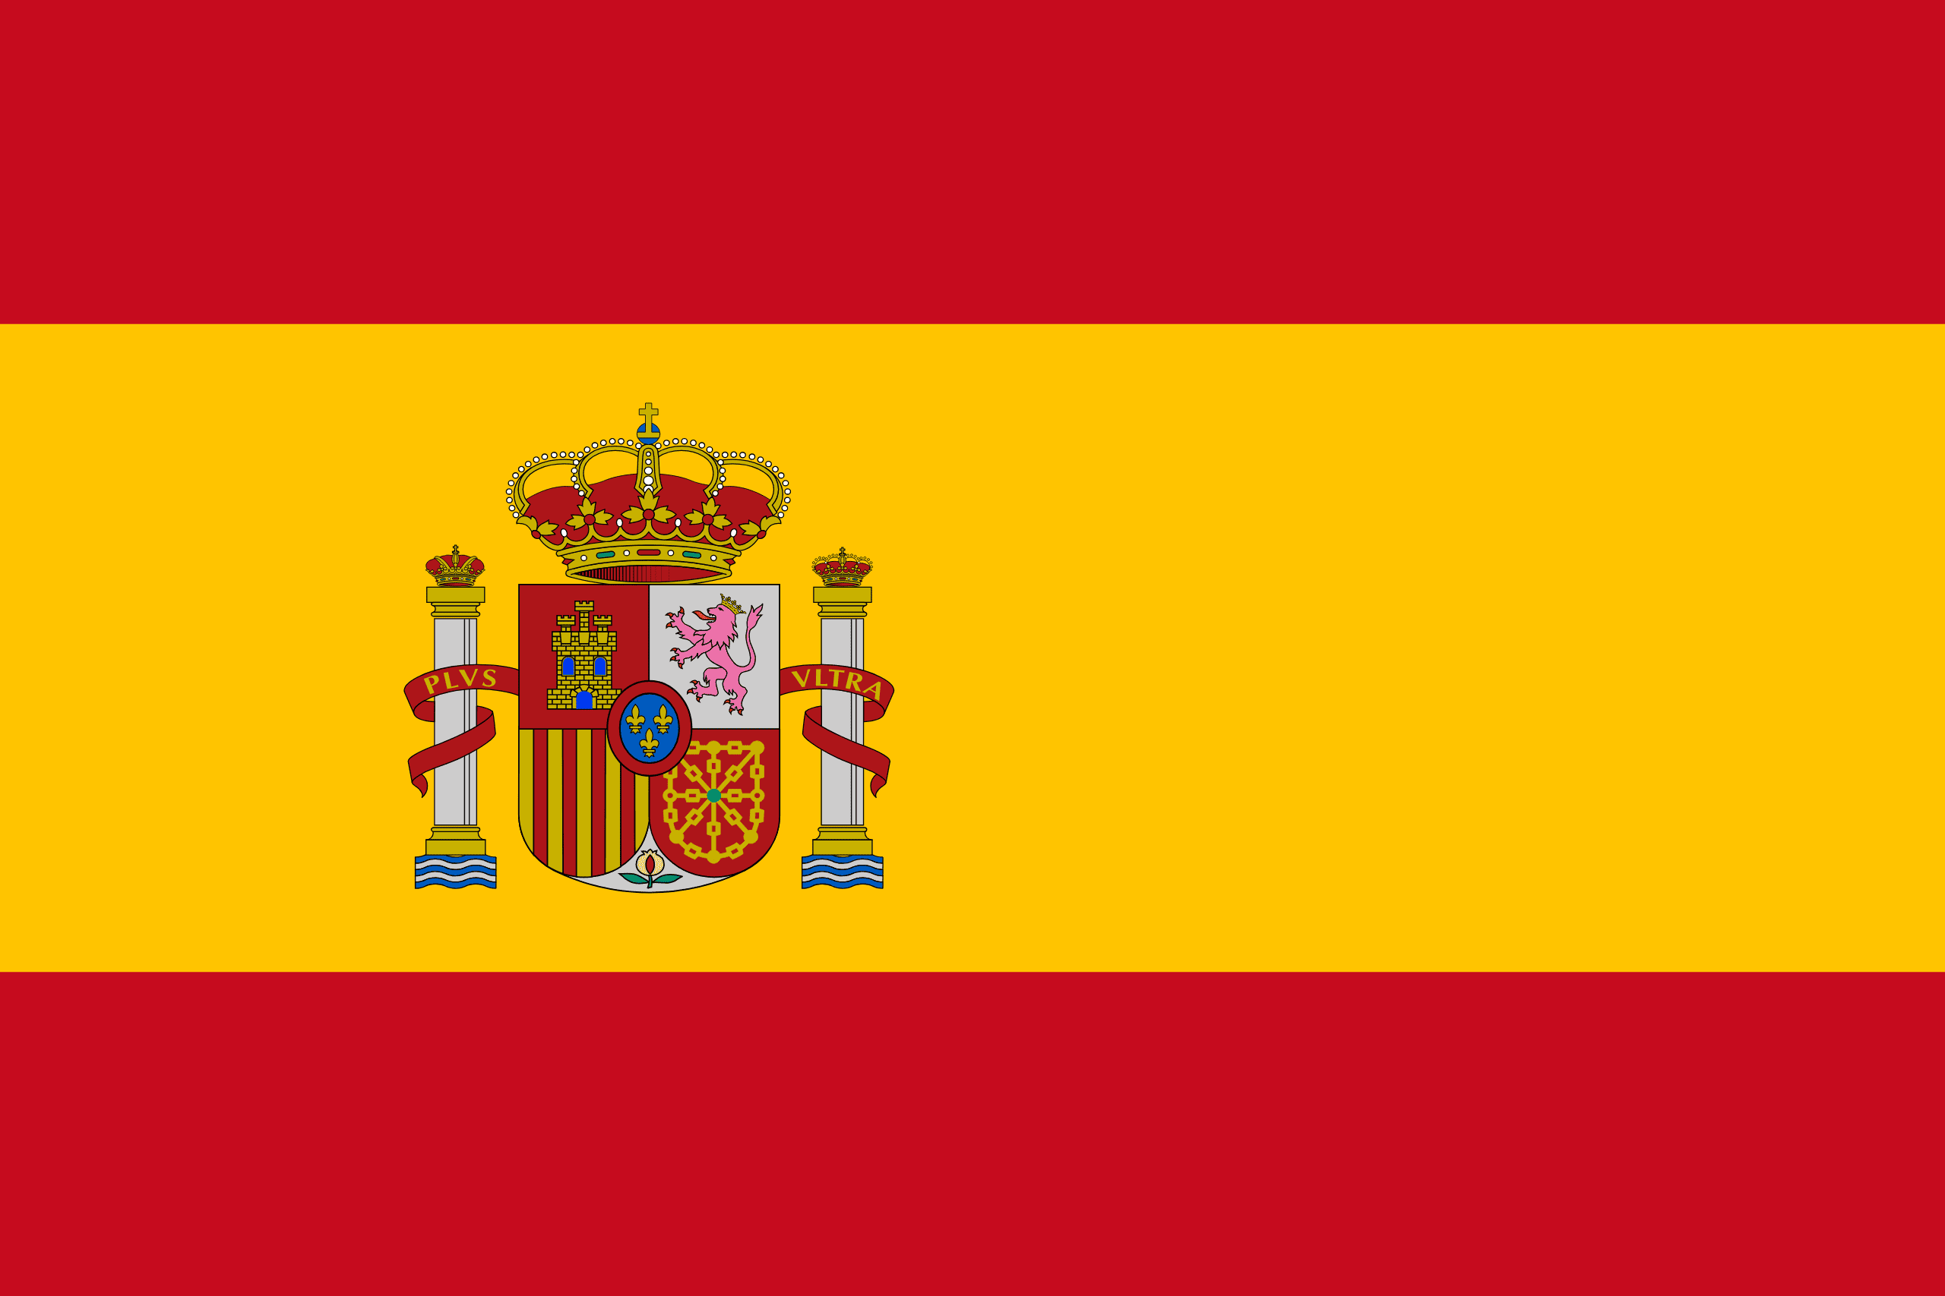
PRAYING FOR
SPAIN

Slide 3
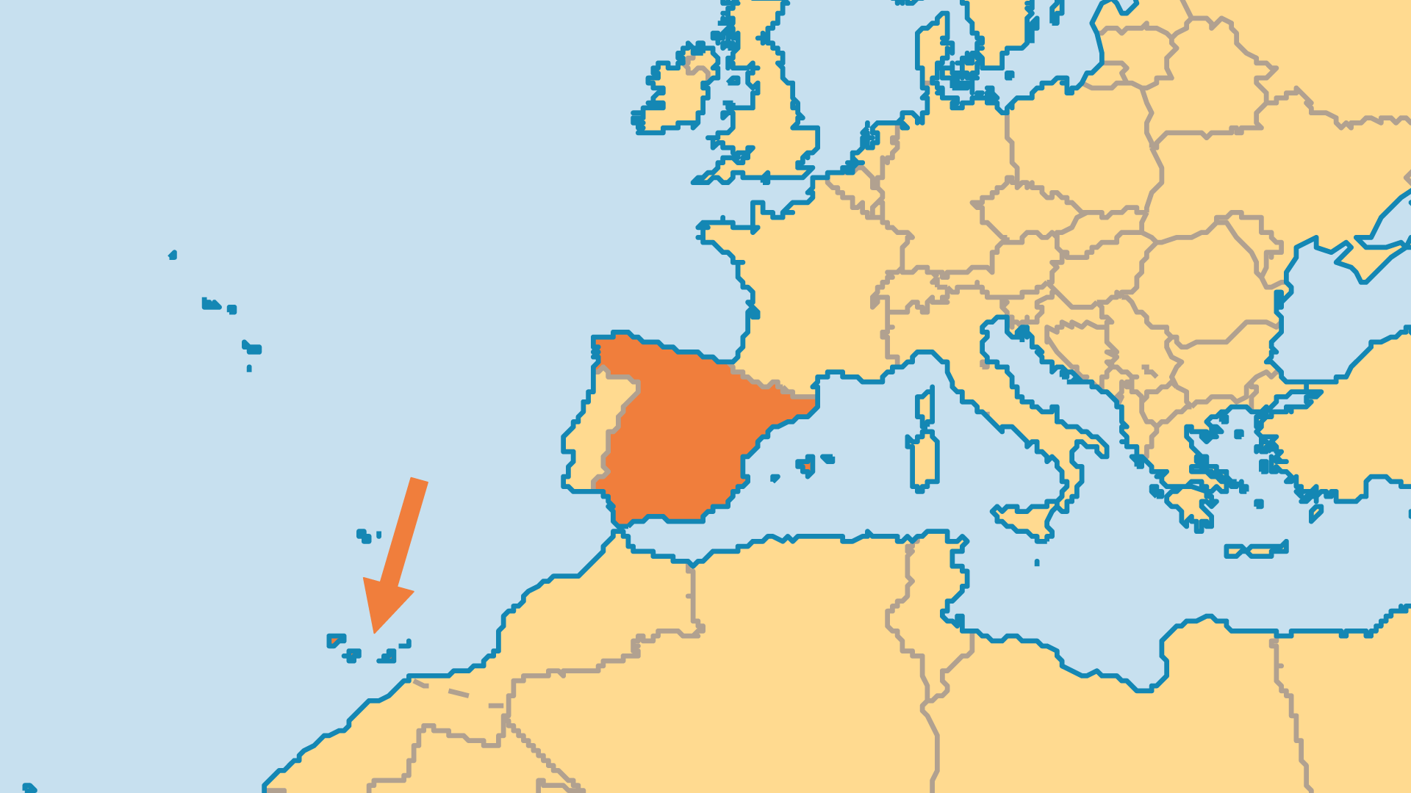
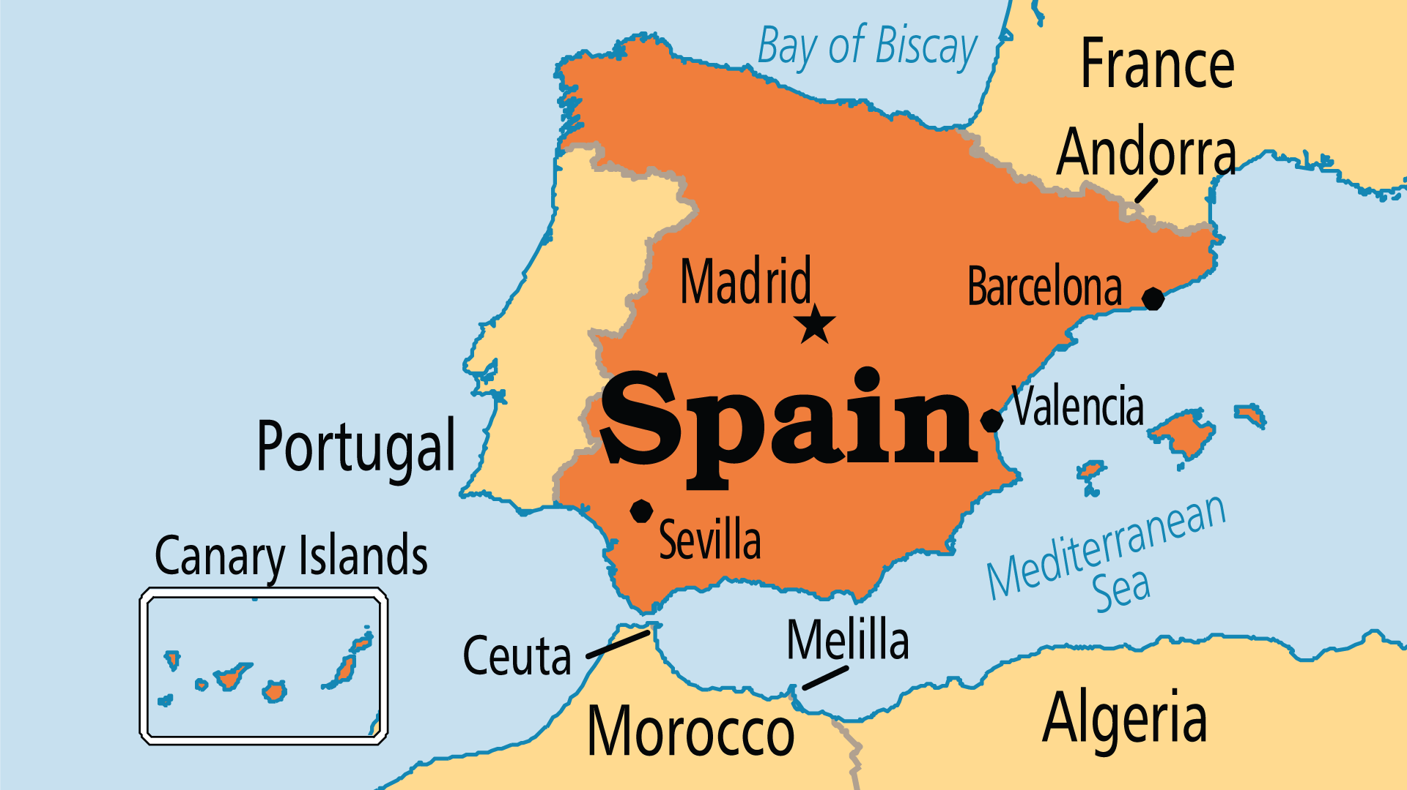
KEY STATS
Capital: | Madrid
Population: | 47,889,958
% Urban: | 82.1 %
Pop Under 15 Yrs: | 14.6 %
Official Language: | Catalán, Galician and Basque, Castilian (Spanish)
Life Expectancy: | 83 yrs (11st/236)
HDI Ranking: | 27/193
% Christian: | 77.1 %
% Evangelical: | 1 %
% Unevangelized: | 2 %

Slide 4

FOR PRAYER
Spain has experienced a profound transformation since 1978. Spain's younger generations are among the most spiritually disengaged in Europe. Materialism and hedonism have brought about widespread prostitution, alcohol overconsumption, and illicit drug use. Gambling addictions are a serious challenge to society, as are depression and other mental health issues. These factors and the easy access to abortion makes it no surprise that Spain's birth rate is one of the world's lowest. Pray for Spain to wake up to the lies that have blinded it to the truth of the gospel.

Slide 5
FOR PRAYER
Spain was considered one of the most Catholic countries, but today less than 17% of Spanish people say they are practicing their faith. 38% of Spaniards call themselves "non-practicing Catholics." In the 16th century (during the Inquisition), leaders tortured or killed thousands suspected of heresy, and forced hundreds of thousands of Jews, Muslims, and Protestants to either convert or leave. Pray for full repentance, and that the shame on Christianity may be lifted. Pray for renewal that breathes new life into the Catholic Church.
Want to know more? Go to www.operationworld.org

