Slide 1




Slide 2

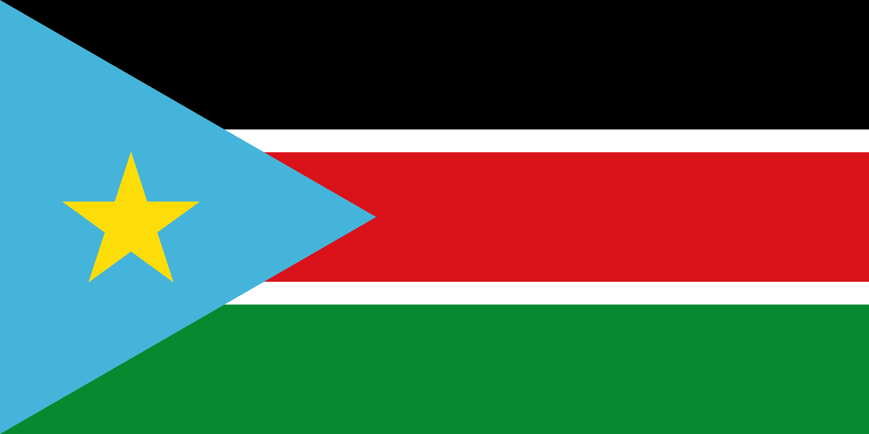
PRAYING FOR
SOUTH SUDAN

Slide 3
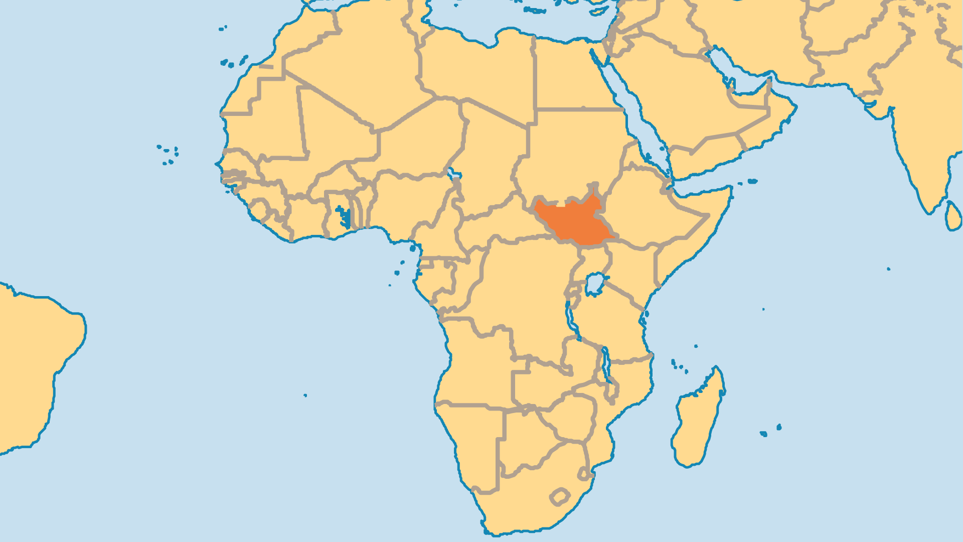
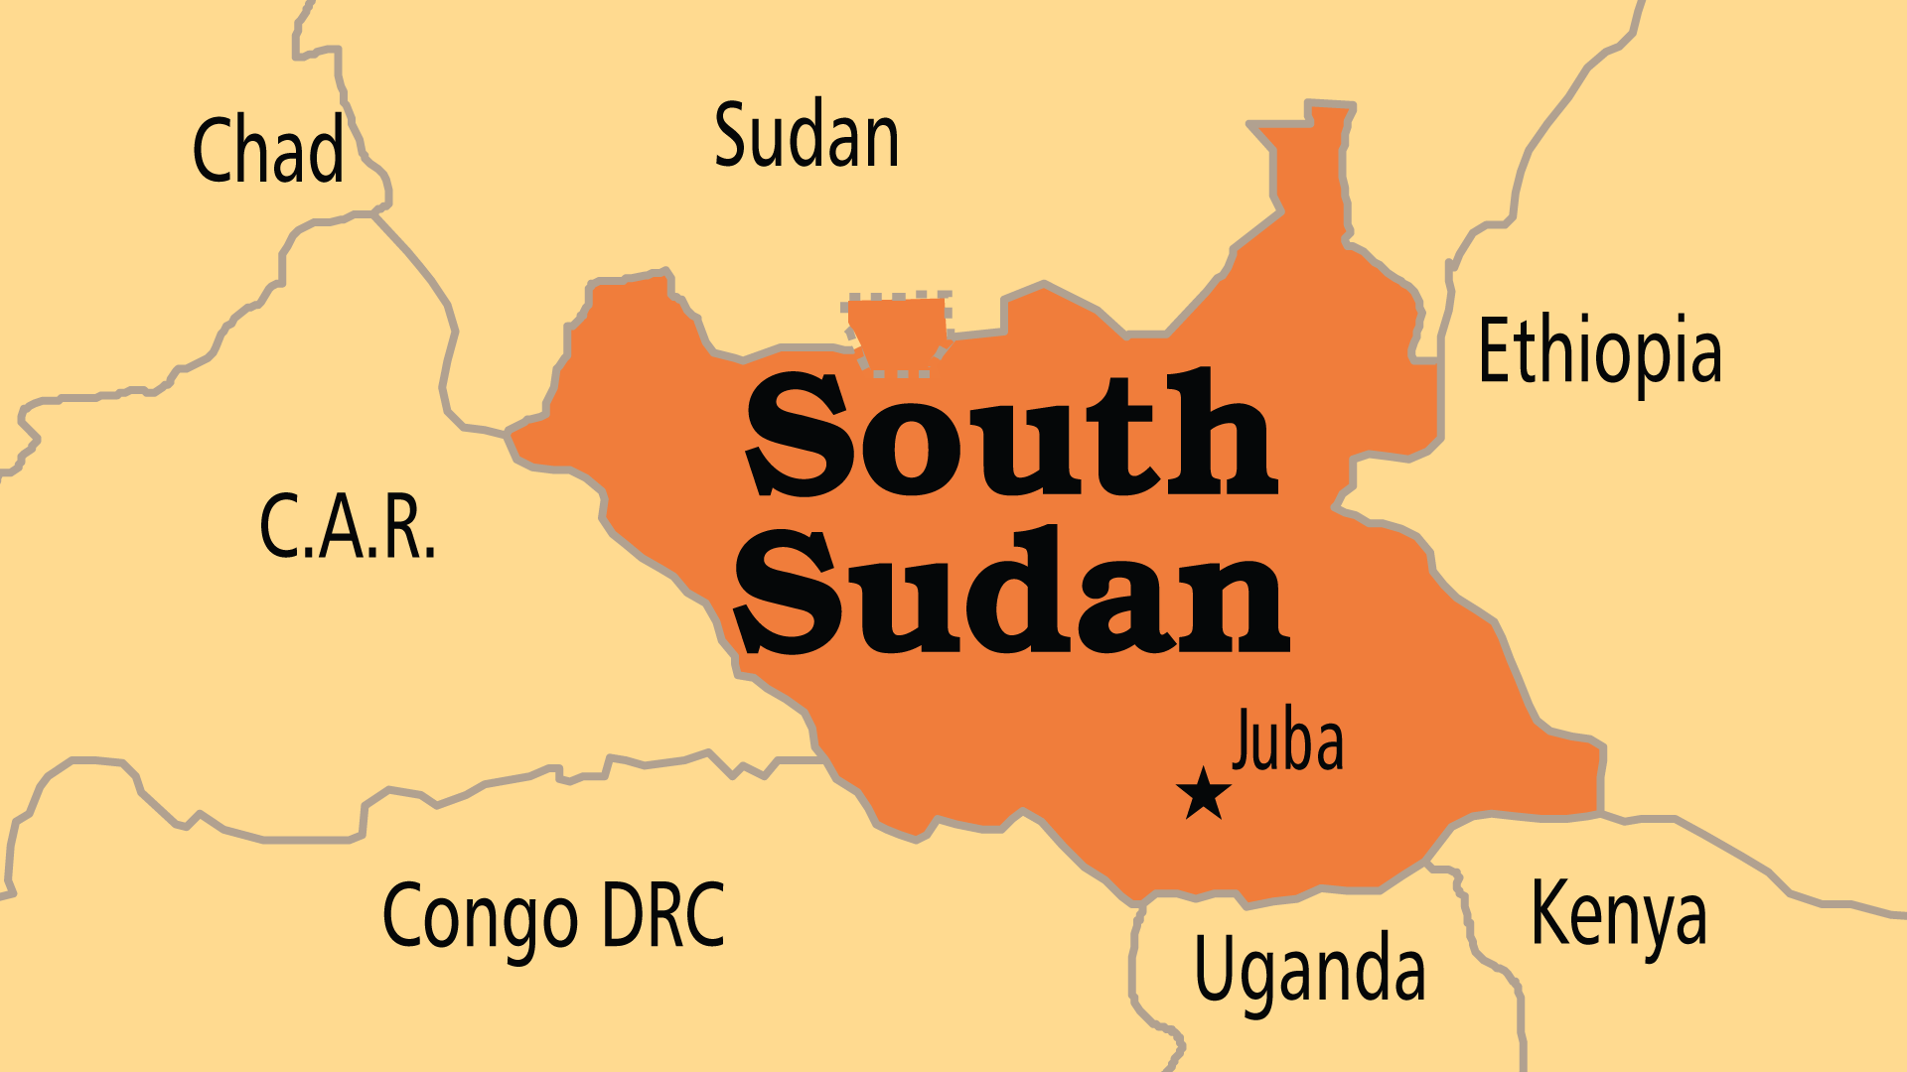
KEY STATS
Capital: | Juba
Population: | 12,188,788
Official Language: | English
Languages: | 68
Literacy Rate: | 27 %
Life Expectancy: | 55 yrs (232nd/236)
HDI Ranking: | 192/193
% Christian: | 62.3 %
% Evangelical: | 29.5 %
% Unevangelized: | 14 %

Slide 4

FOR PRAYER
South Sudan is the world's newest country. The nation was born in a great spirit of unity, happiness, and hope. Thank God for this freedom from the long, painful domination by the north. Yet, little more than 10 years on, over a quarter of the population rely on aid agencies for food, many females have suffered sexual violence, and progress is stalled by ethnic rivalries who refuse to share power, reconcile or build a better future together. Every family in South Sudan suffers lasting effects from the horrors of war and conflict. Pray for the Church to have a good influence in society and leadership, to make life better for all people.
Want to know more? Go to www.operationworld.org

