Slide 1




Slide 2

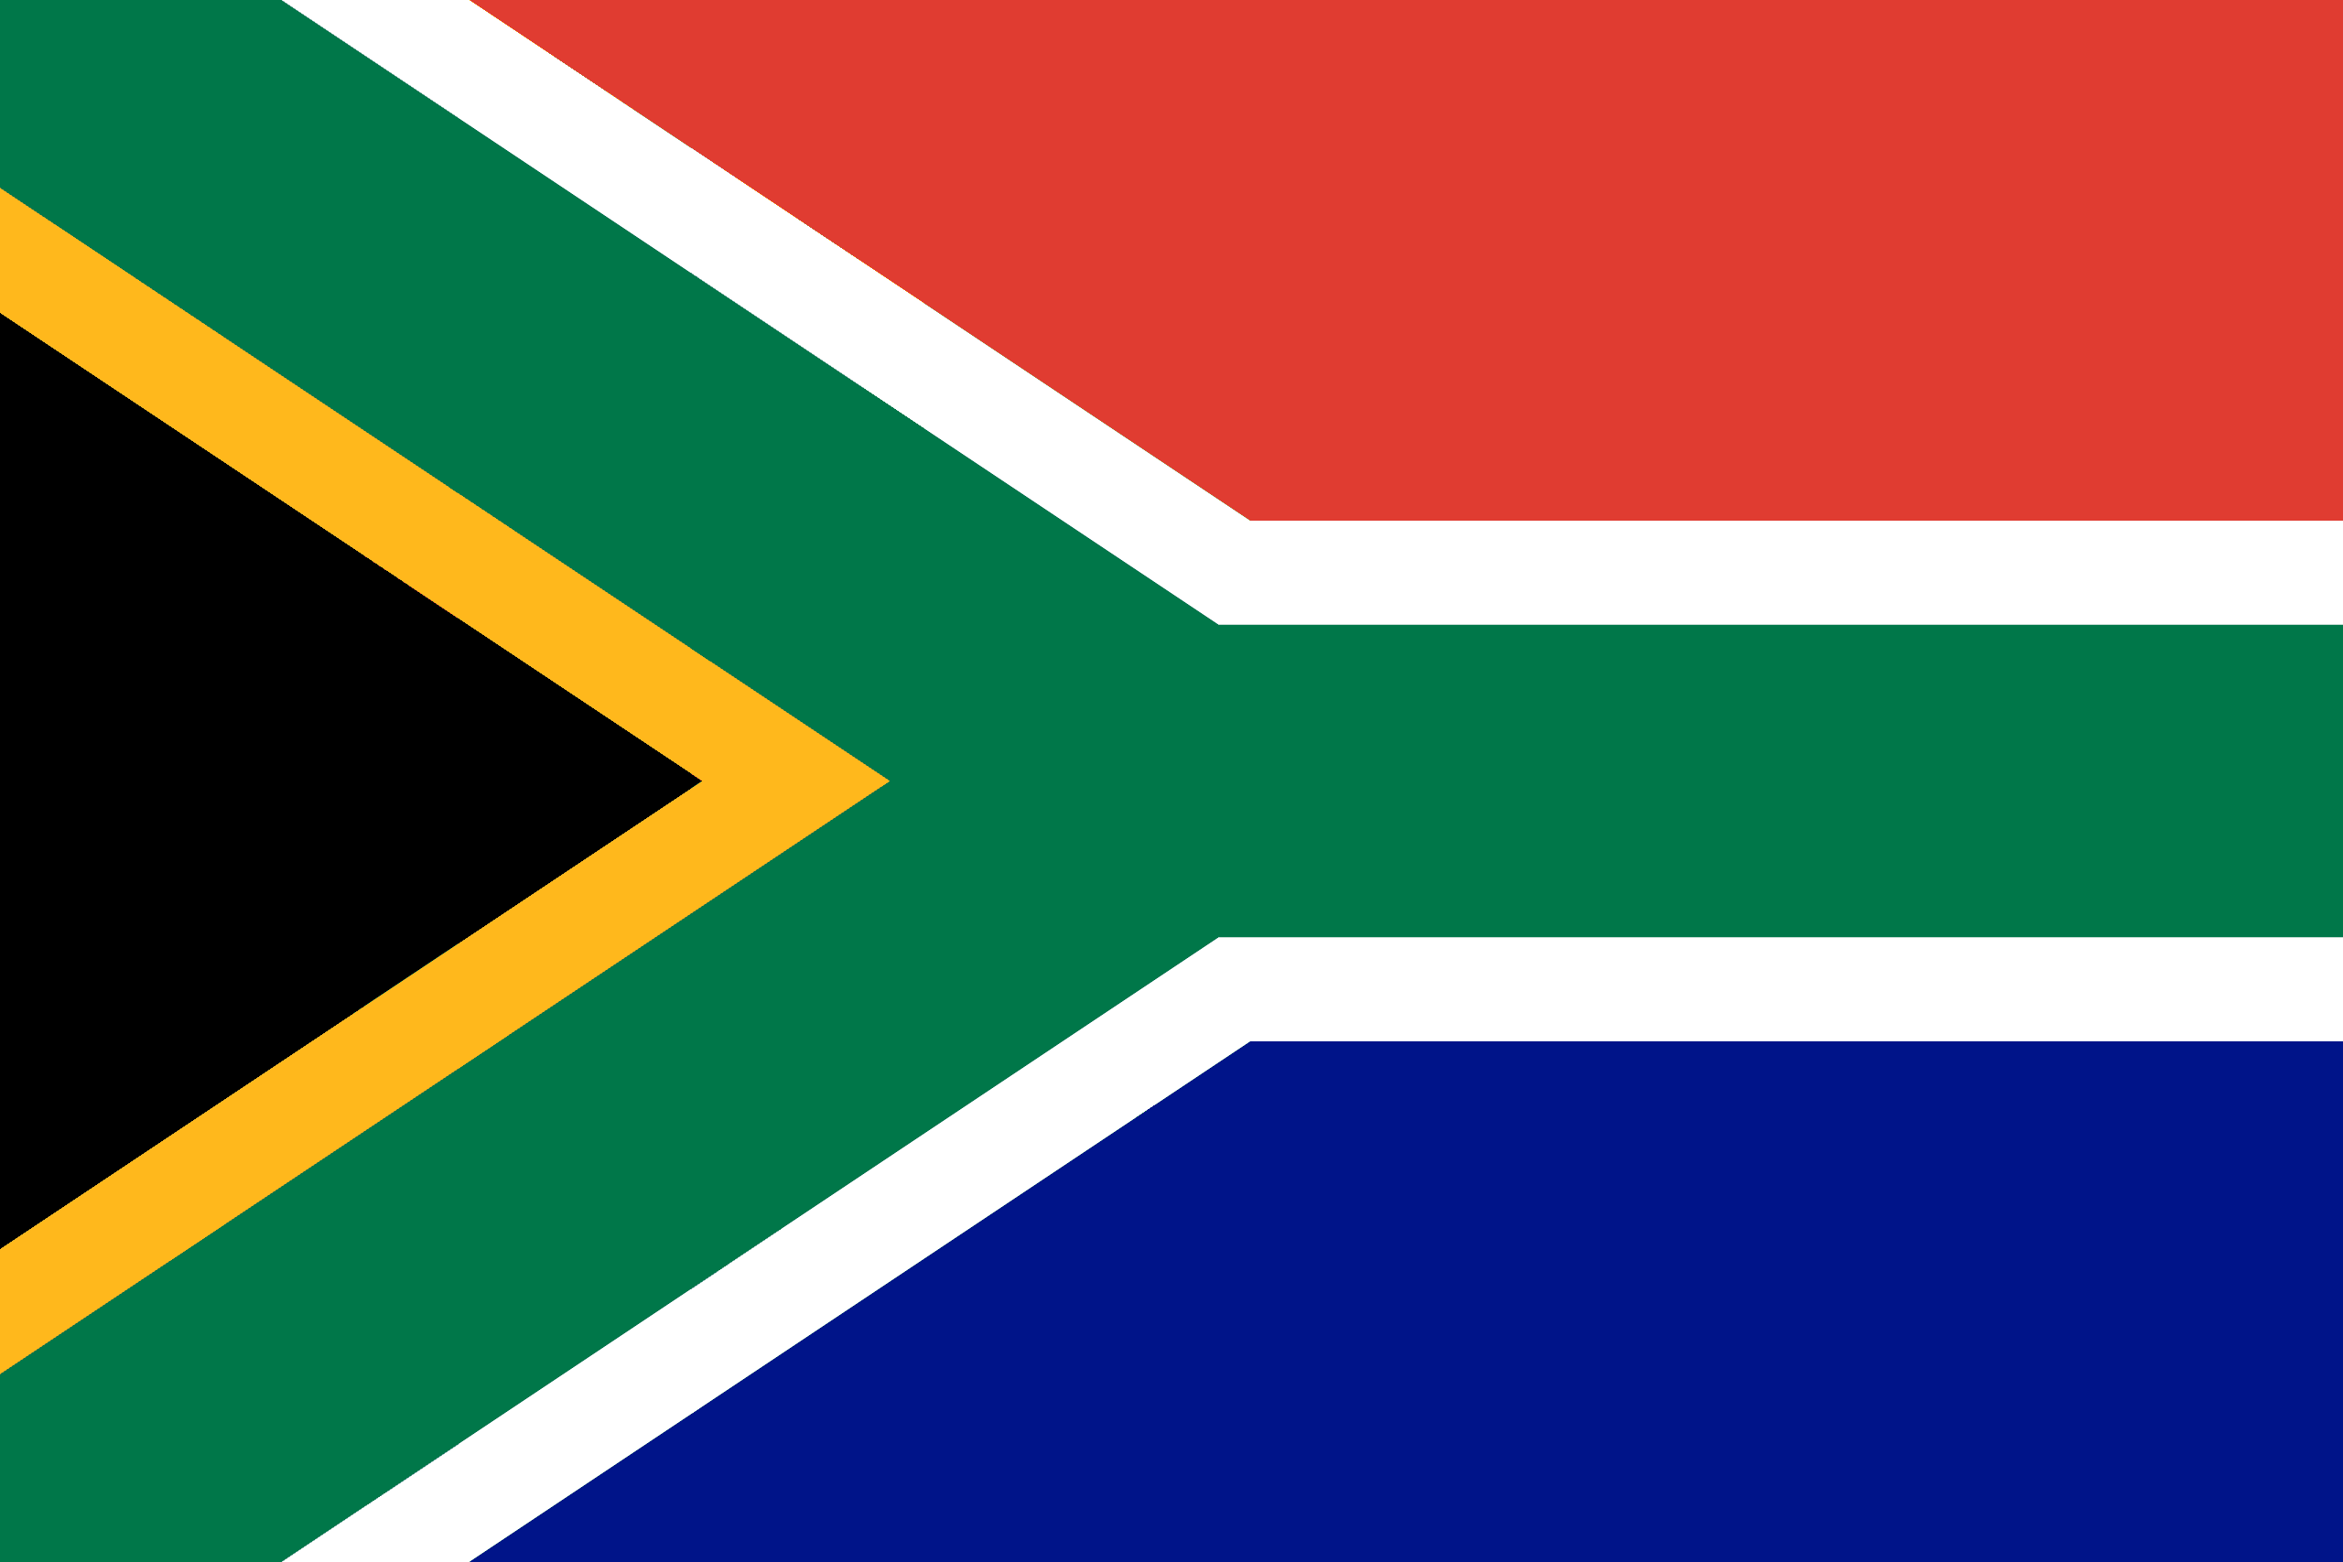
PRAYING FOR
SOUTH AFRICA

Slide 3
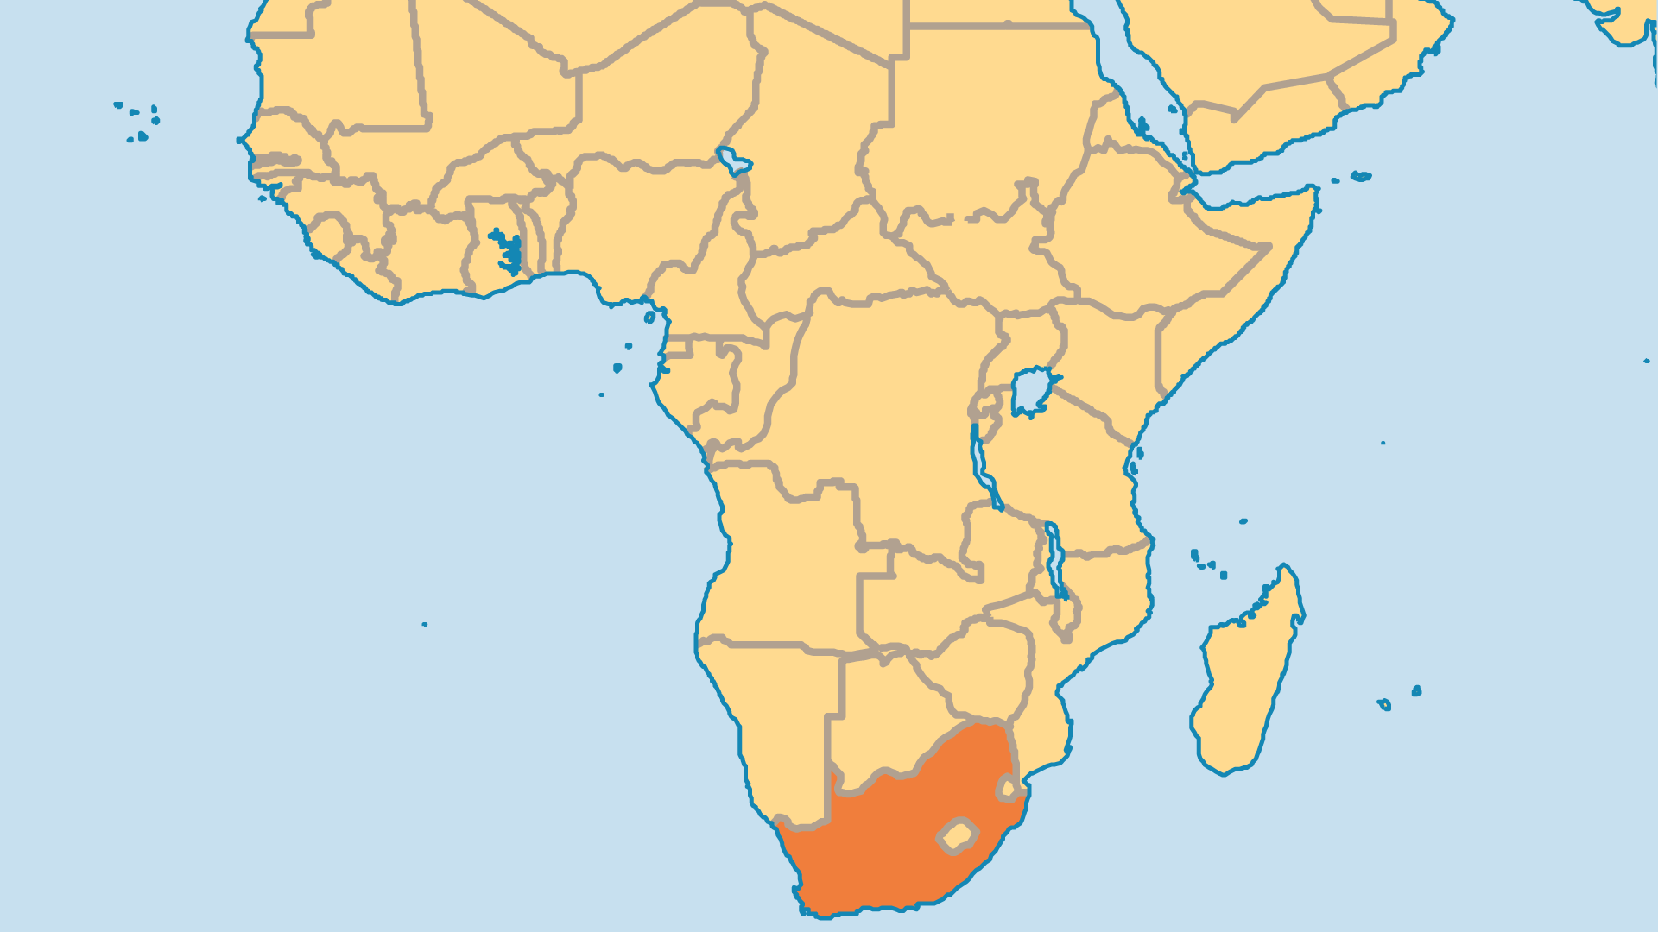
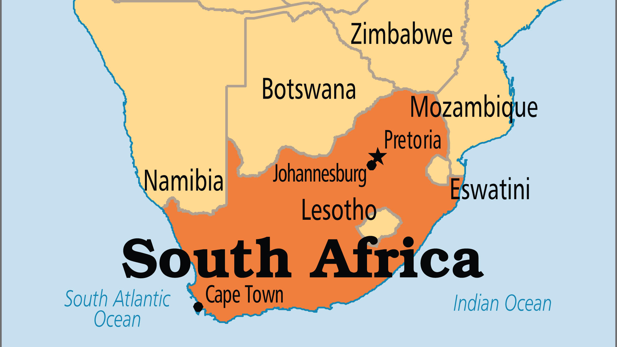
KEY STATS
Capital: | Cape Town, Pretoria, Bloemfontein
Population: | 64,747,320
Official Language: | All the major ethnic languages. English and Afrikaans
Languages: | 11
HDI Ranking: | 109/193
% Christian: | 75.2 %
% Evangelical: | 21.1 %
% Unevangelized: | 2 %

Slide 4

FOR PRAYER
Prayer initiatives begun in South Africa went on to impact the whole world! The Global Day of Prayer started in Cape Town (2001), and Christians from almost every country joined in this event on Pentecost Sunday. Large scale prayer events like "It's Time" in 2017 demonstrate South Africa's continued legacy in prayer. Biblical Christianity has a strong legacy in South Africa. But poverty, injustice, corruption, and terrible violence are alarmingly widespread for a nation with so many claiming to be Christian. Pray for the many Christian agencies that serve among the needy sections of society.
Want to know more? Go to www.operationworld.org

Slide 5
FOR PRAYER
Pray for all in government and leadership, that the priorities would be justice, righteousness, and economic improvement for all. In the 2024 election, the ANC lost its majority for the first time since apartheid ended - a sure sign that South Africans want change. Greater transparency, a more mature democracy, and free press, would all help combat corruption and deception. The nation faces high rates of rape and violent crime. The legacy of racism and injustice do not justify the lawlessness and wickedness evident. Pray that the spirit of violence, both physical and sexual, might be bound under the authority of Christ.

