Slide 1




Slide 2

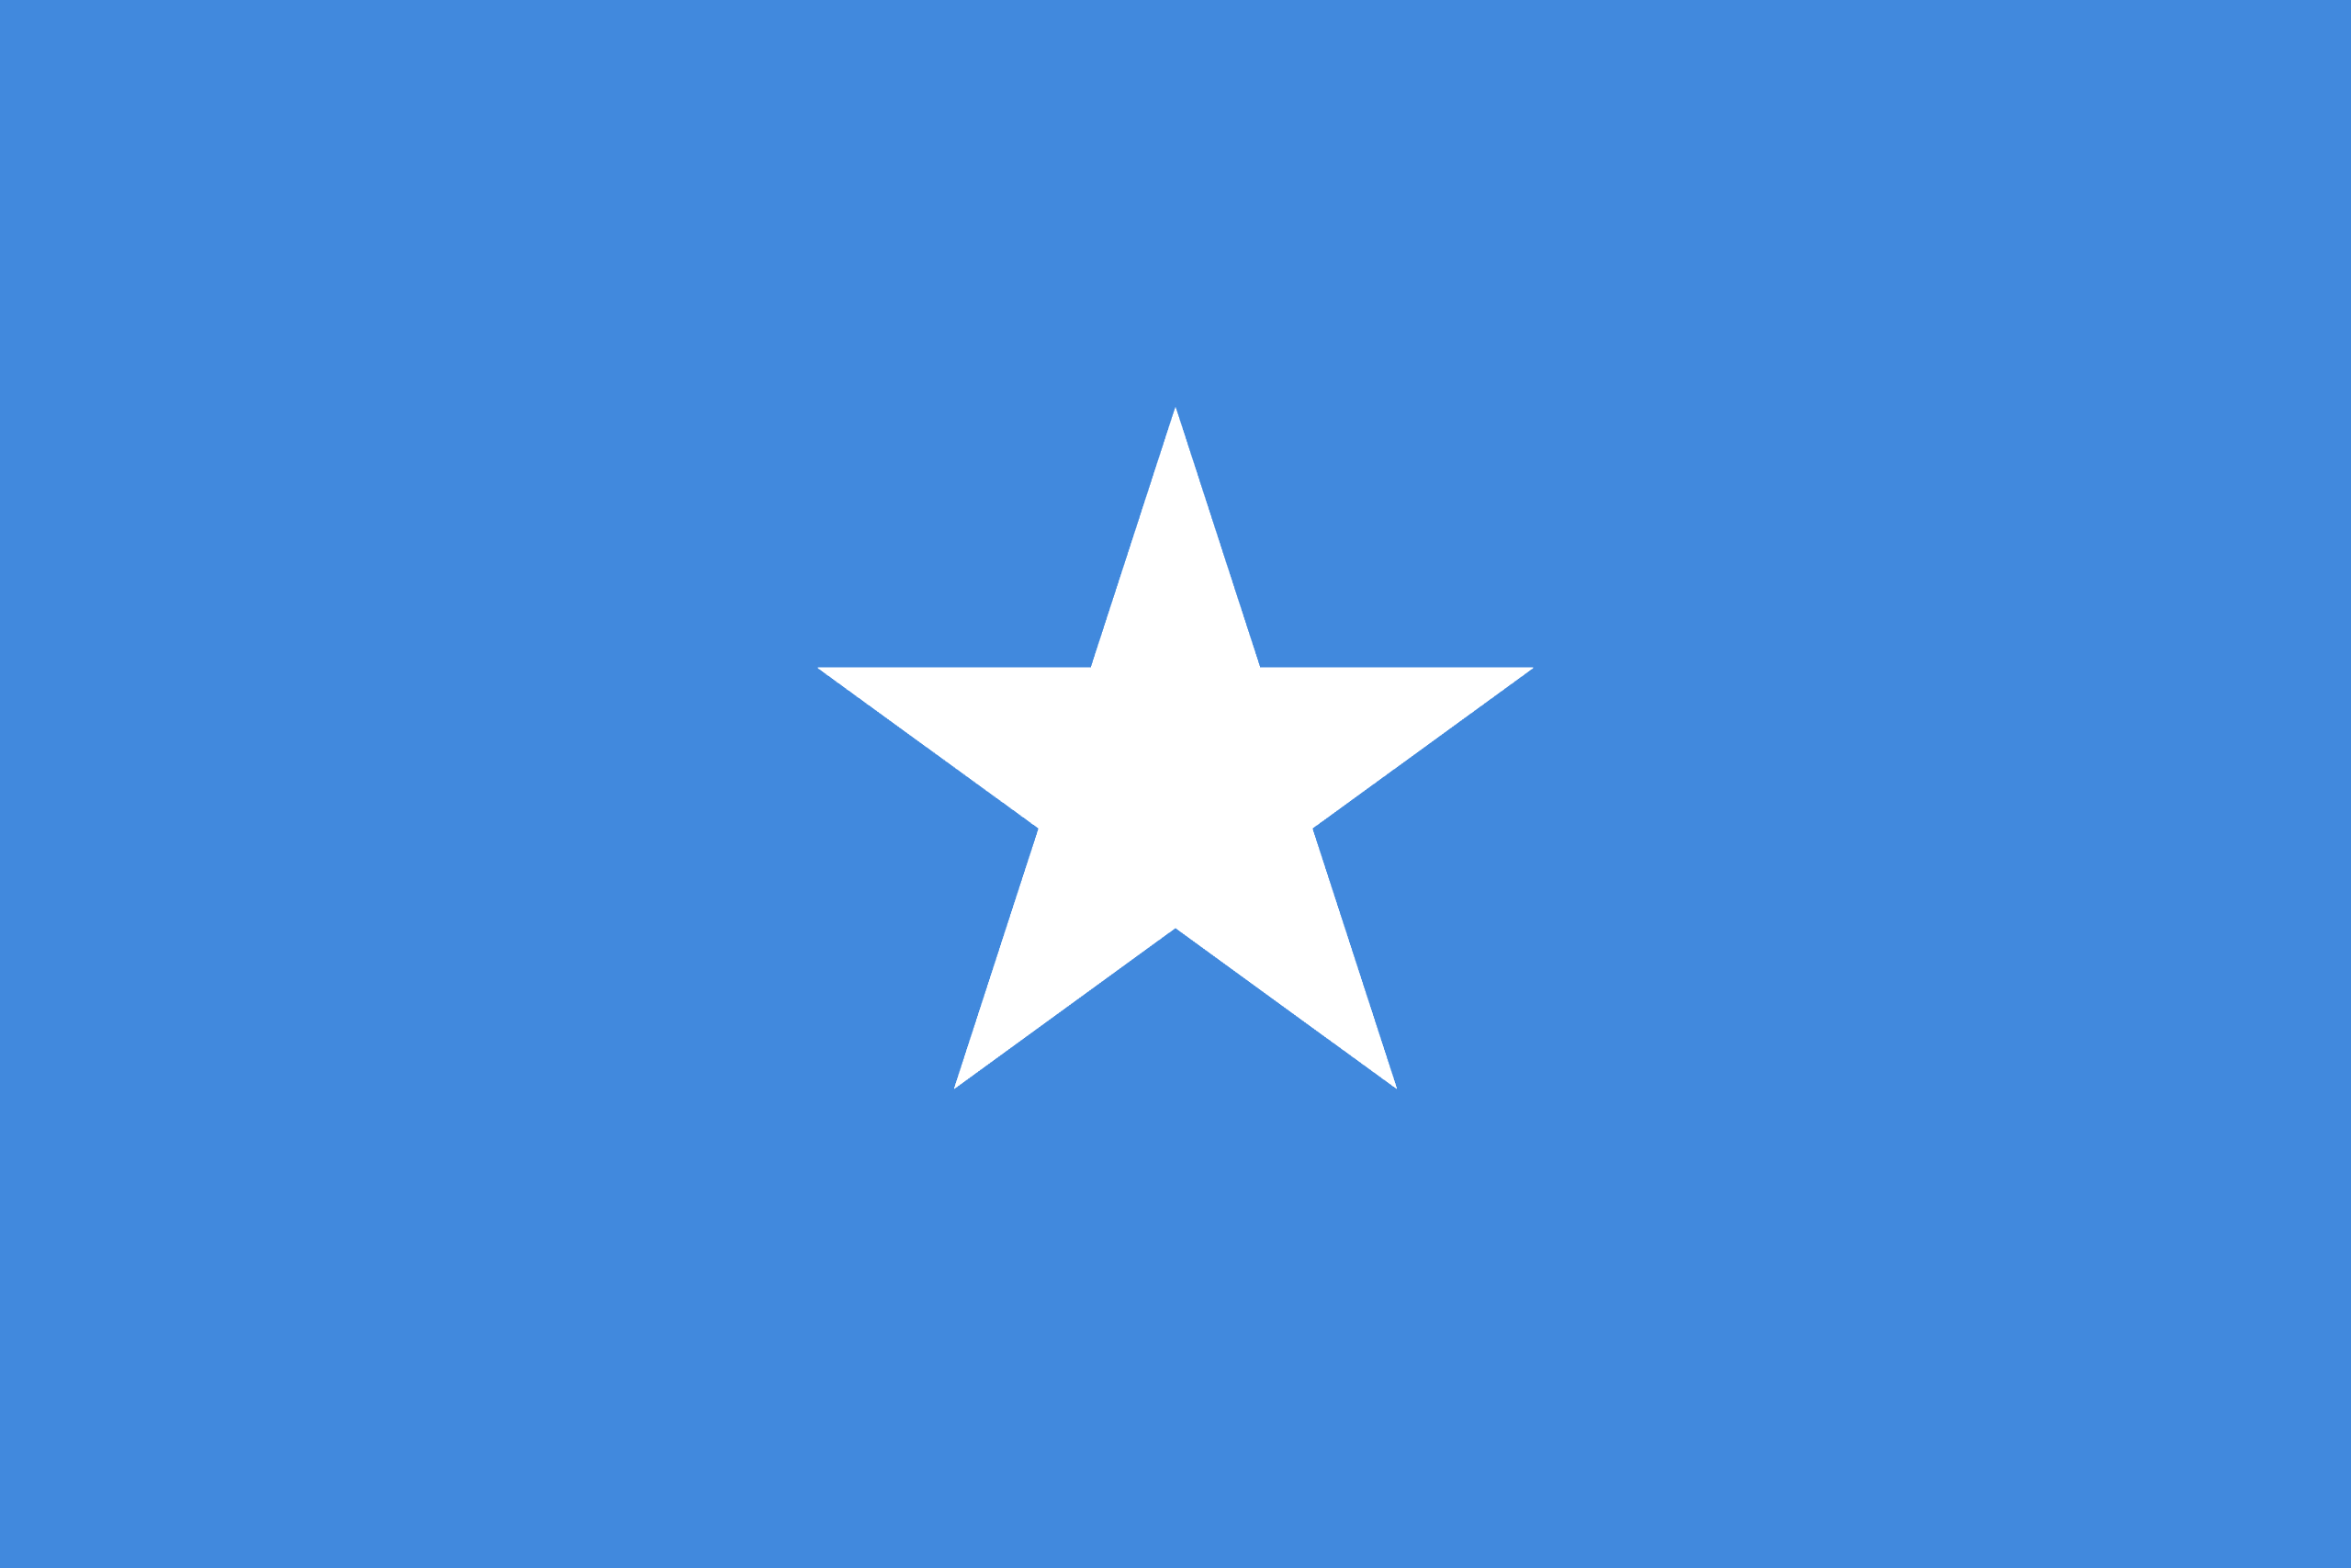
PRAYING FOR
SOMALIA

Slide 3
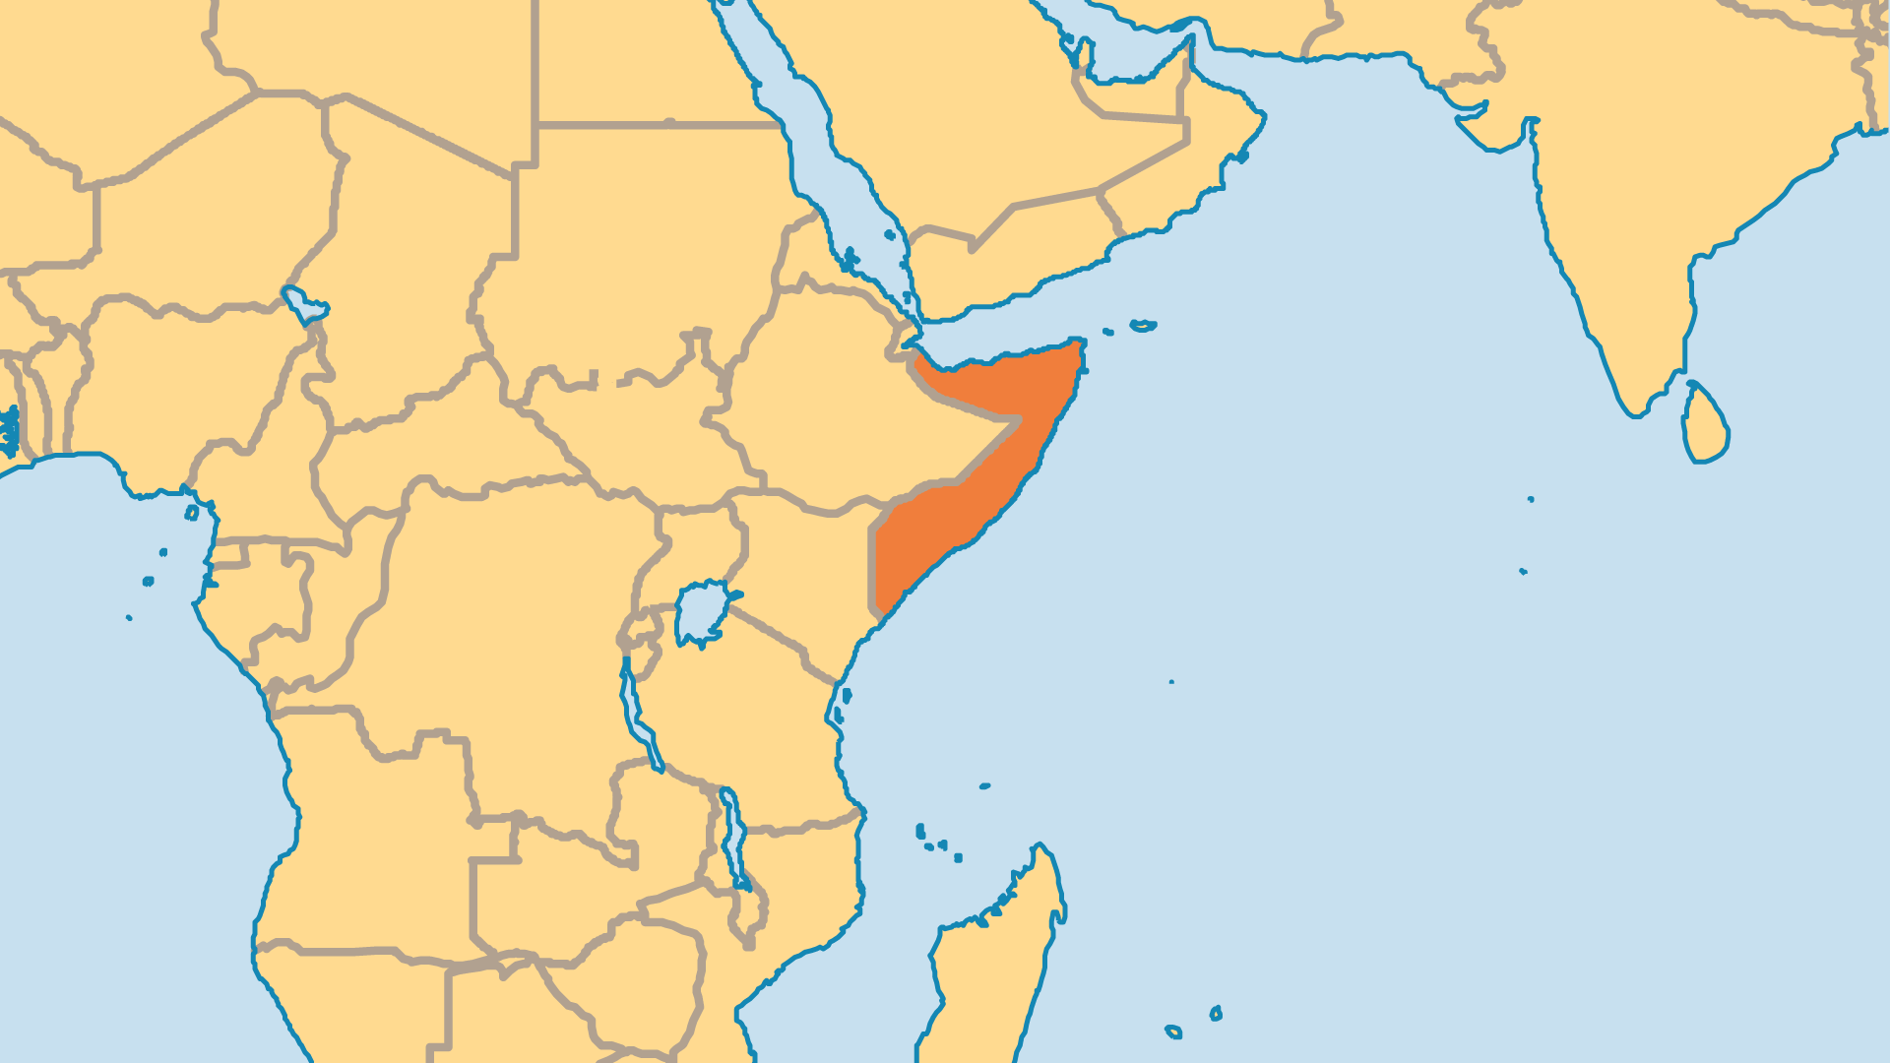
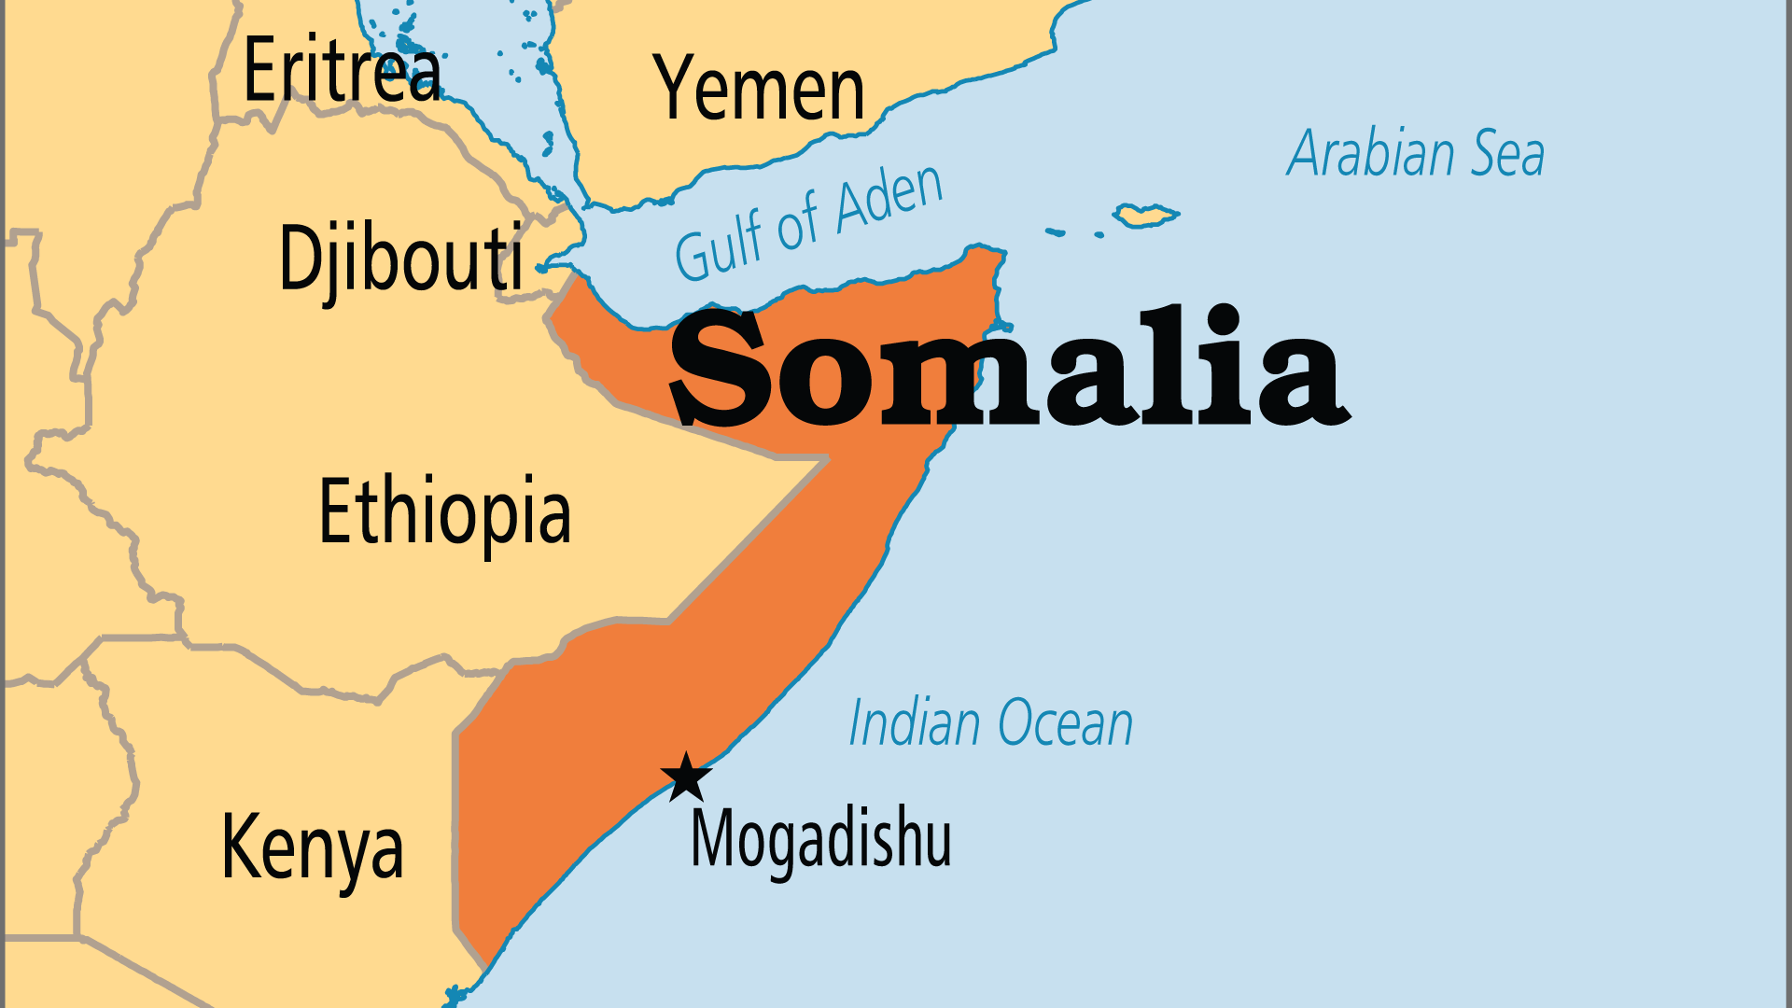
KEY STATS
Capital: | Mogadishu
Population: | 19,654,739
Official Language: | Somali, Arabic (few speak it)
Languages: | 15
Life Expectancy: | 55.3 yrs (231st/236)
% Christian: | 0.3 %
% Evangelical: | 0 %
Largest Religion: | Muslim
% Unevangelized: | 62 %
Persecution Ranking: | 2/50

Slide 4

FOR PRAYER
Stability in Africa's most failed state remains depressingly elusive. Somalia now has a parliament and recognized national leaders after 20 years without an effective central government. But the militant Islamist group Al-Shabaab (linked to Al-Qaeda) still controls much of southern and central Somalia and continues to hold influence in rural areas. Pray that Somalia's rulers might learn from the past, govern for the good of the people, and respect human rights and religious freedom. Pray that those deceived by the enemy into committing terrorism might encounter Jesus who loves them and died on their behalf.
Want to know more? Go to www.operationworld.org

Slide 5
FOR PRAYER
A negative prejudice against Christianity must be overcome if the community of faith is ever to make a greater breakthrough. These issues include:
False notions of Christianity. Pray that the association of Christianity with Western decadence, European colonialism and Ethiopian interference would be broken.
Practical demonstrations of Christ's love through aid and mercy ministry must be done in the right manner. Pray that refugees and recipients of help from Christians would be touched and would respond.

