Slide 1




Slide 2

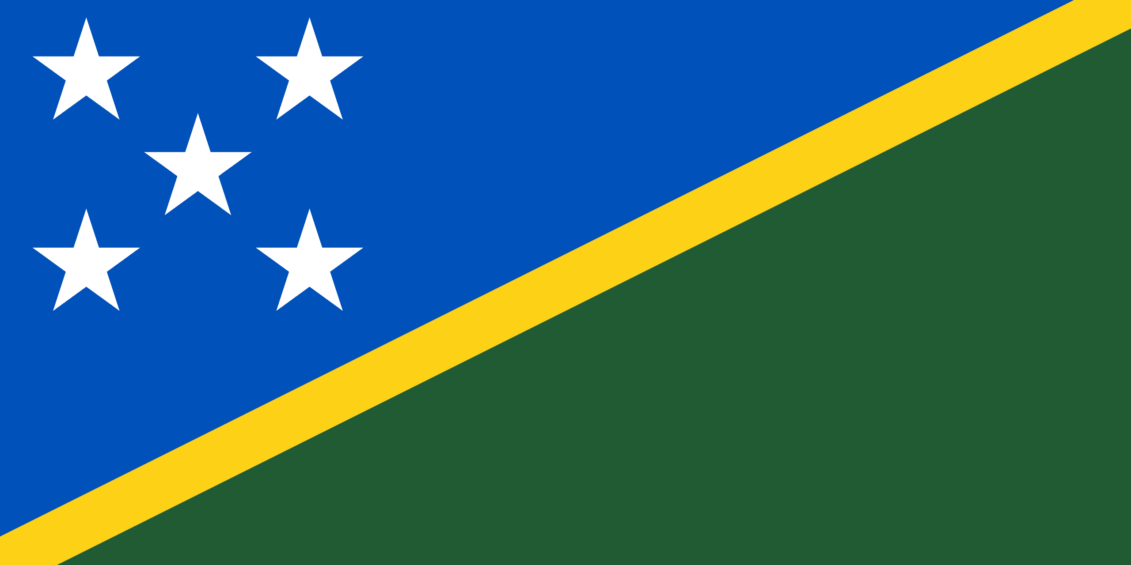
PRAYING FOR
SOLOMON ISLANDS

Slide 3
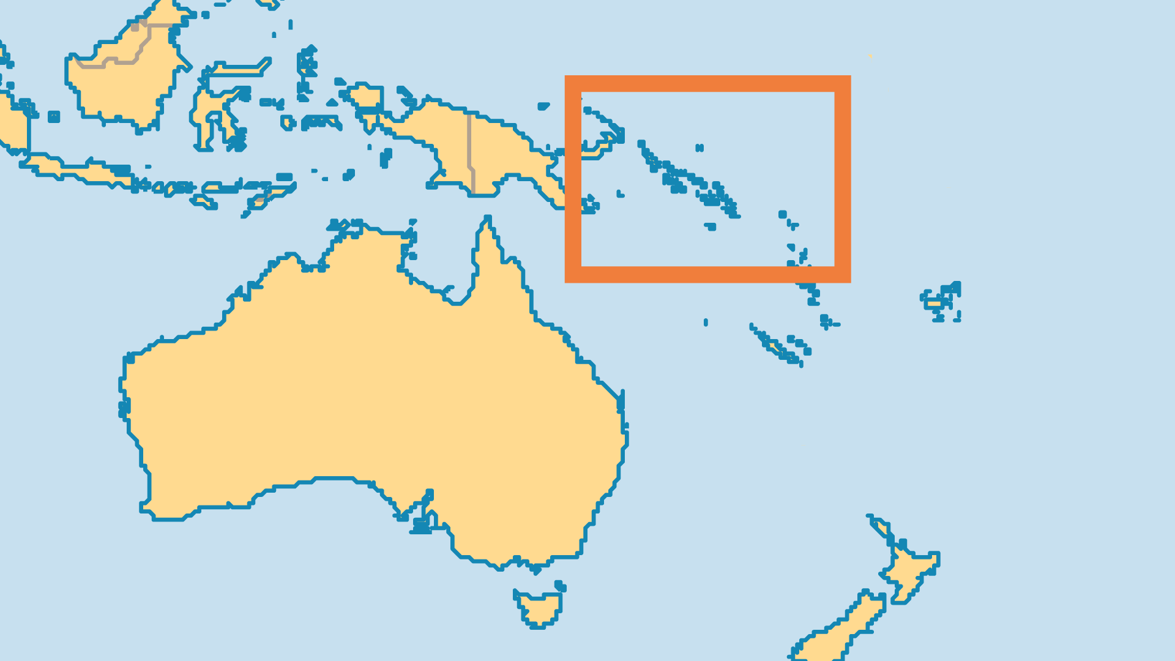
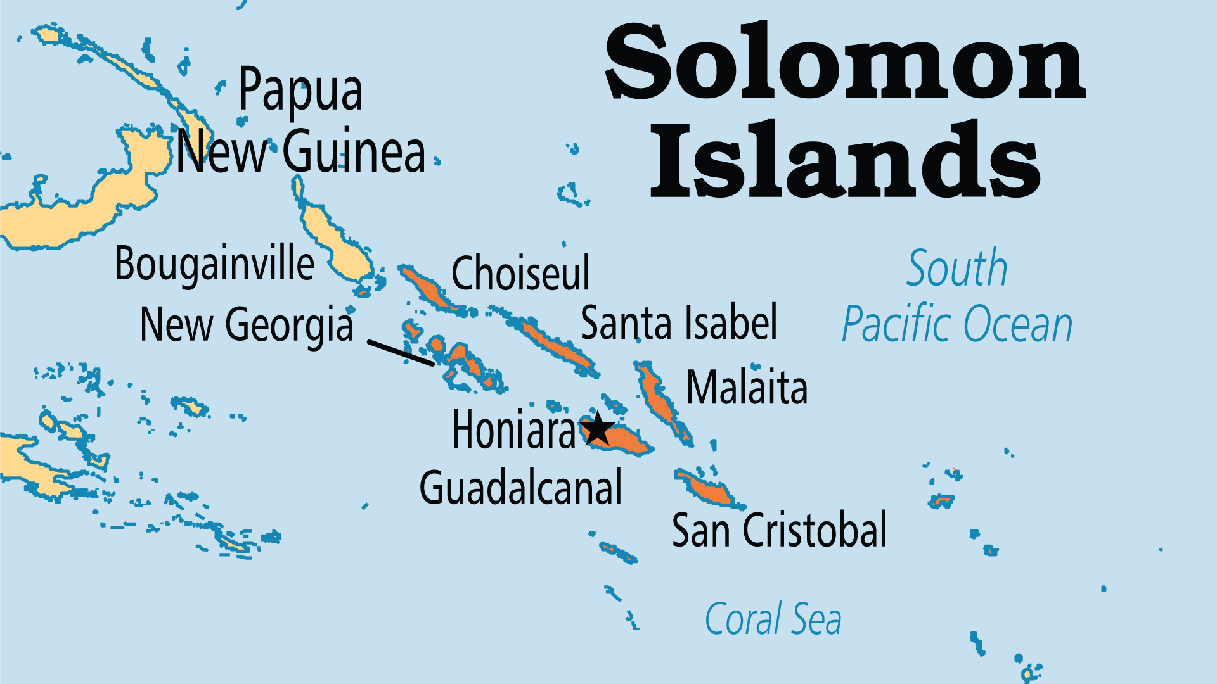
KEY STATS
Capital: | Honiara
Population: | 838,646
Pop Under 15 Yrs: | 40.1 %
Official Language: | English, Solomons Pijin
Languages: | 71
HDI Ranking: | 155/193
% Christian: | 95.8 %
% Evangelical: | 33.3 %
People Groups: | 74
% Unevangelized: | 0 %

Slide 4

FOR PRAYER
Ethnic diversity and a divided geography (6 major island groups) create a divided society. Tribes and political groups live together but struggle to form a unified nation. These language and culture barriers also inhibit Christian work. Each small ethnic group needs a different approach and language resources. Denominations divide along tribal lines. Pray that Christianity may take root in each group in a relevant way and can overcome division. Pray for true forgiveness and reconciliation that come only through repentance. Without these, the nation can never truly progress.
Want to know more? Go to www.operationworld.org

