Slide 1




Slide 2

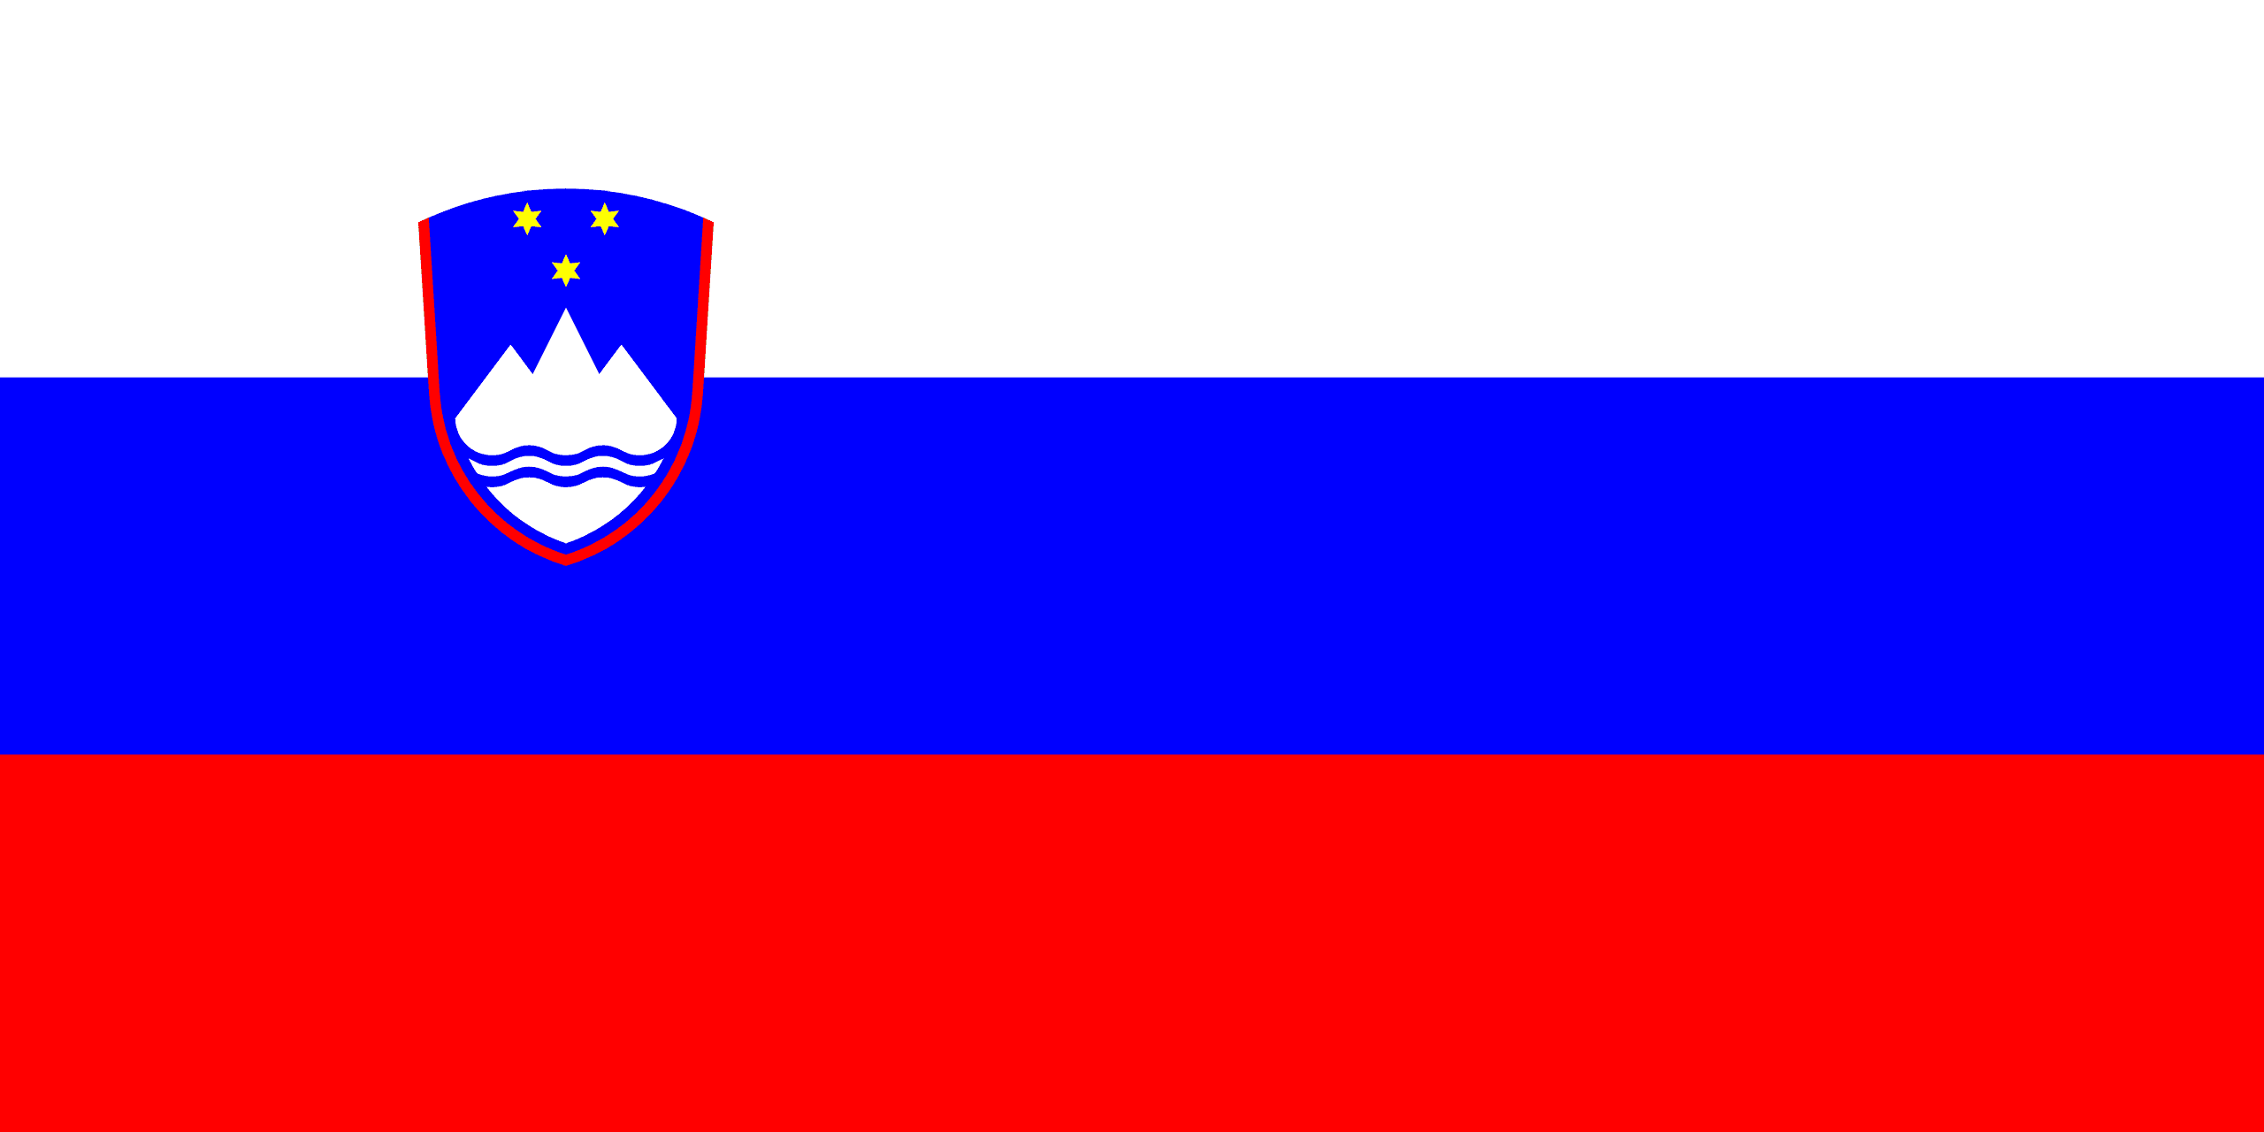
PRAYING FOR
SLOVENIA

Slide 3
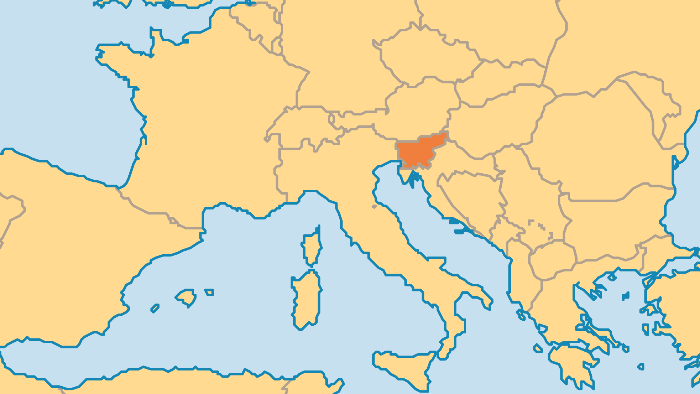
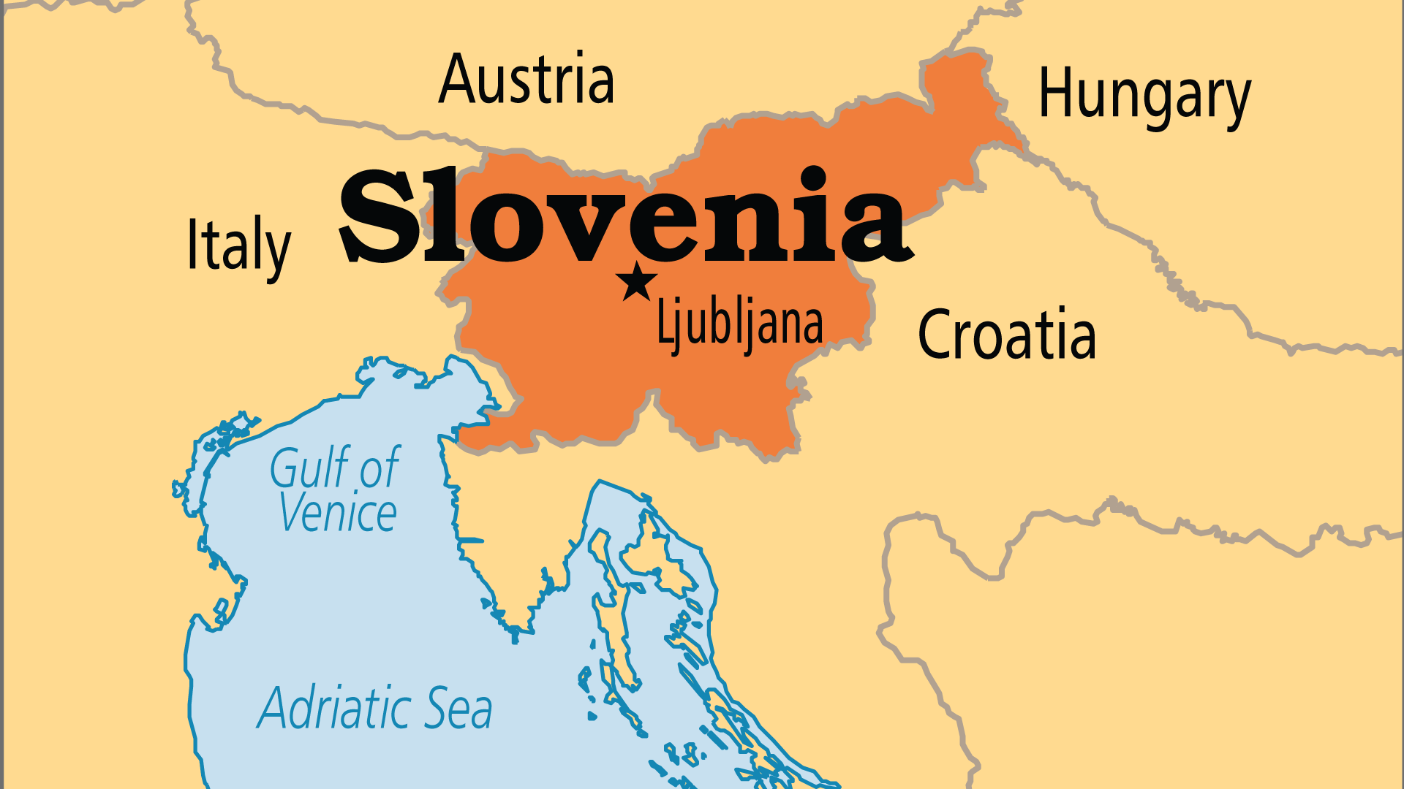
KEY STATS
Capital: | Ljubljana
Population: | 2,117,072
Official Language: | Slovene, Hungarian, Italian
Languages: | 10
Literacy Rate: | 99 %
HDI Ranking: | 23/193
% Christian: | 54.2 %
% Evangelical: | 0.1 %
% Unevangelized: | 3 %

Slide 4

FOR PRAYER
Slovenia has had a Protestant witness since the Reformation but still has very few evangelical churches and needs church-planting teams. The very small evangelical population is divided by ethnic group. Pray for unity, and for an Evangelical Alliance to unite the churches. Most congregations lack a full-time pastor, and need outside financial assistance. Pray for Slovene believers to evangelize their country, to support their pastors, and even to send missionaries!
Want to know more? Go to www.operationworld.org

