Slide 1




Slide 2

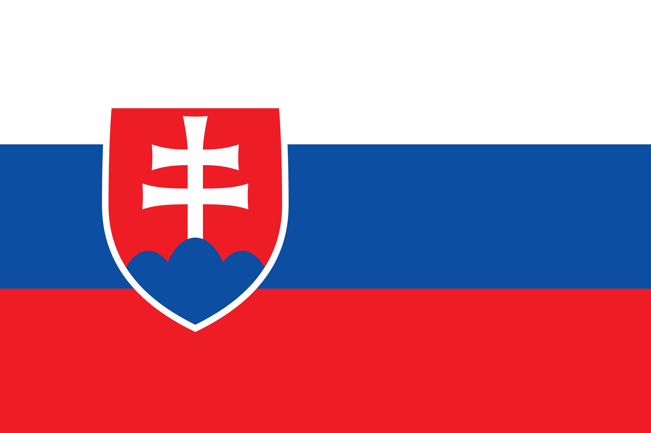
PRAYING FOR
SLOVAKIA

Slide 3
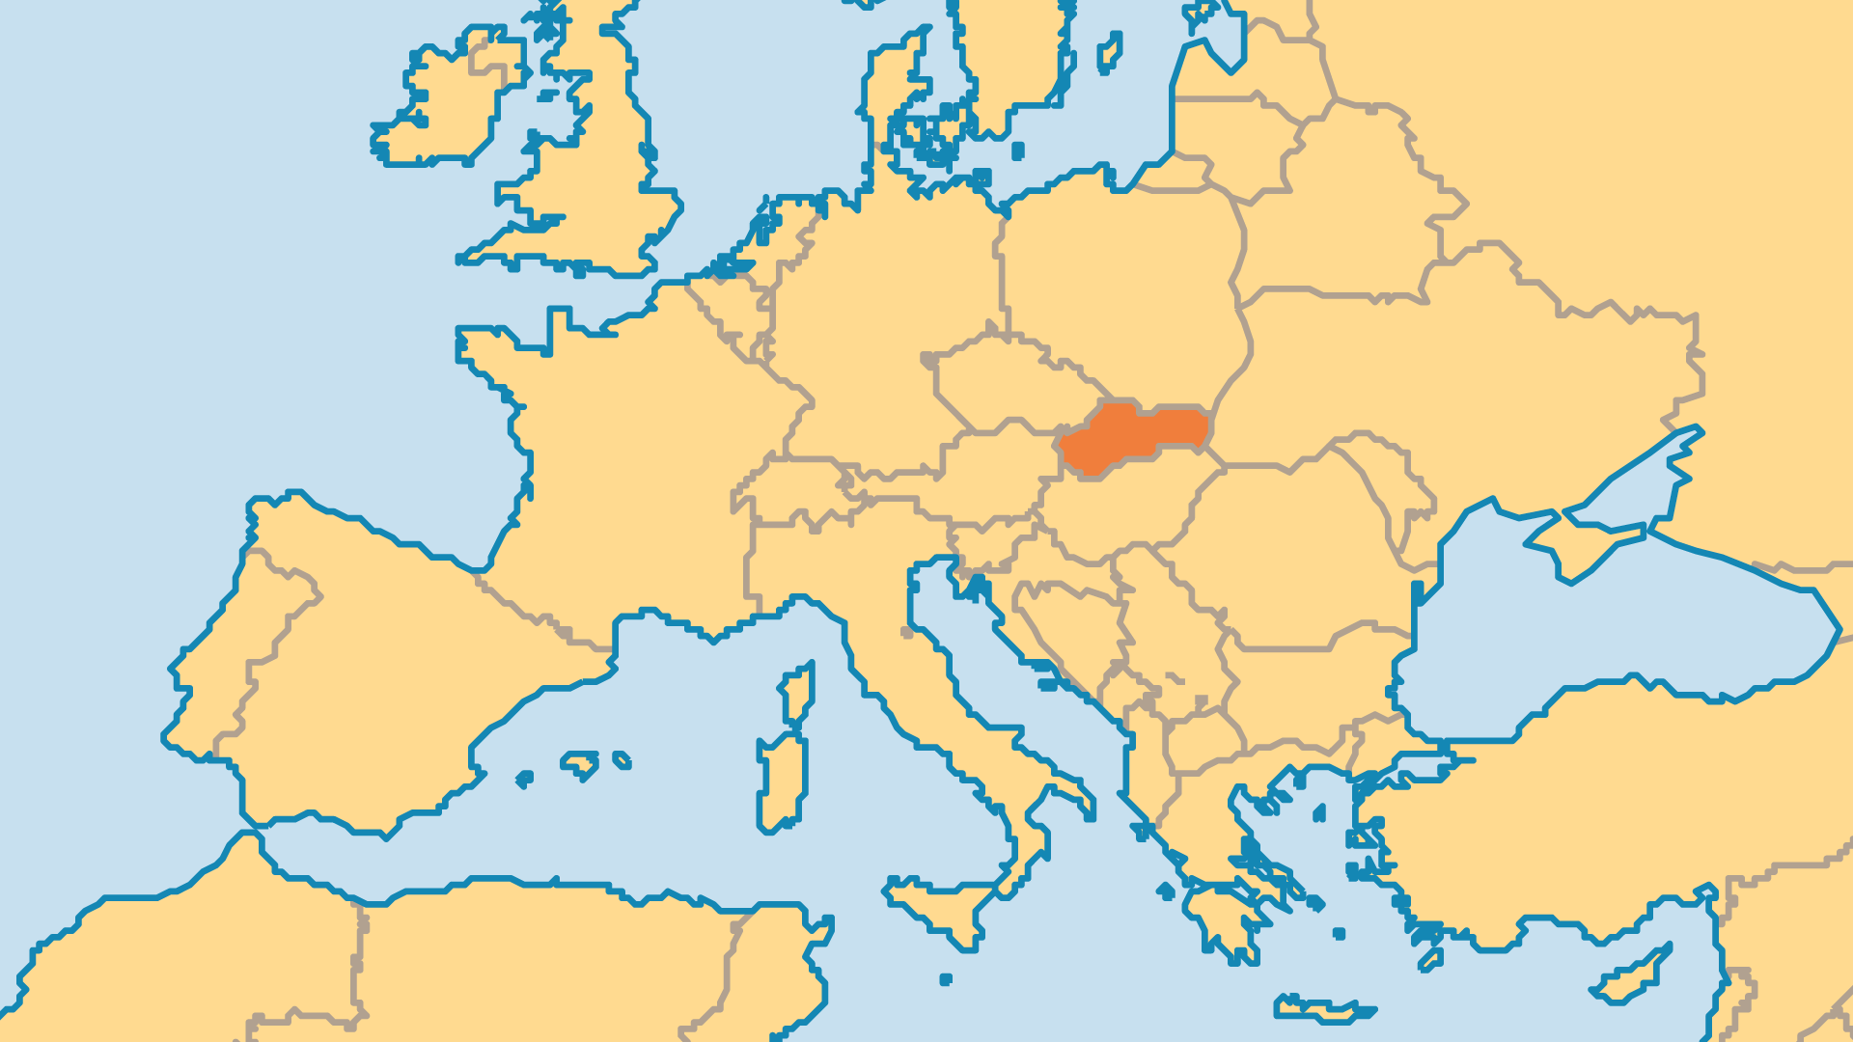
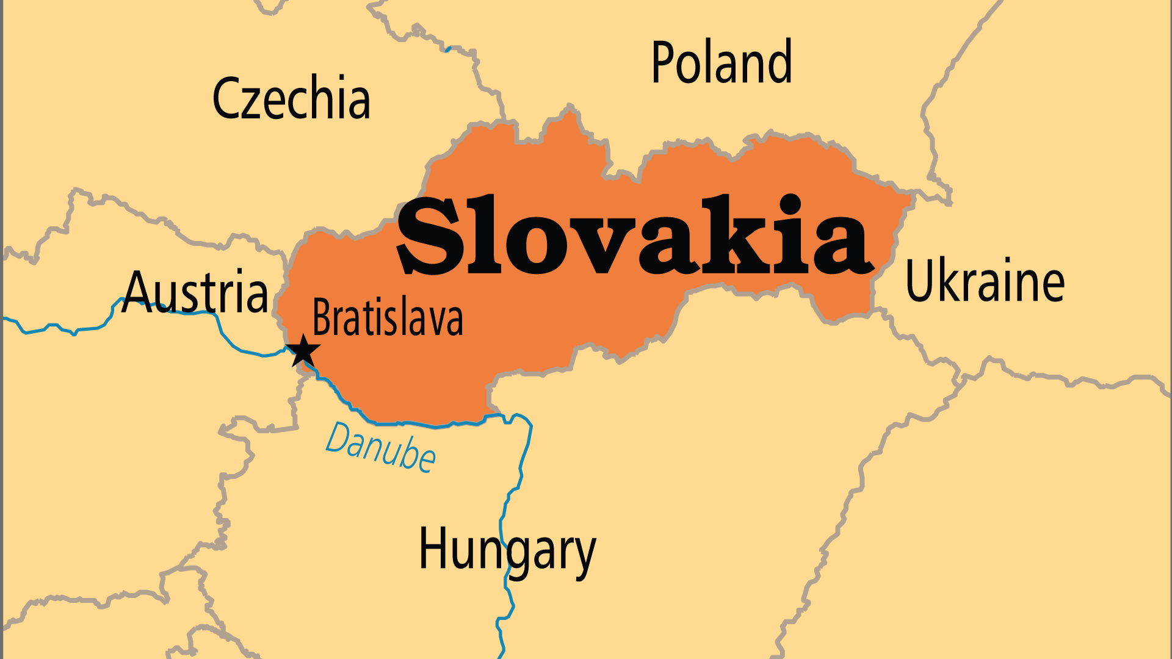
KEY STATS
Capital: | Bratislava
Population: | 5,474,881
% Urban: | 54.3 %
Pop Under 15 Yrs: | 15.5 %
Official Language: | Slovak
Languages: | 13
Literacy Rate: | 99 %
% Christian: | 93.3 %
% Evangelical: | 1.2 %
% Unevangelized: | 1 %

Slide 4

FOR PRAYER
From the Velvet Divorce in 1992 to entry into the EU in 2004, Slovakia has experienced much change in the past generation. While its close neighbour Czechia has shaken off most of its religious history, most Slovaks still believe in God (69%). Yet the challenges common to Central Europe remain: the emptiness of materialism and moral relativism, regional inequalities, and the hostile treatment of some minorities. Pray that Slovaks might encounter in powerful ways the God that the majority still say they believe in.
Want to know more? Go to www.operationworld.org

