Slide 1




Slide 2

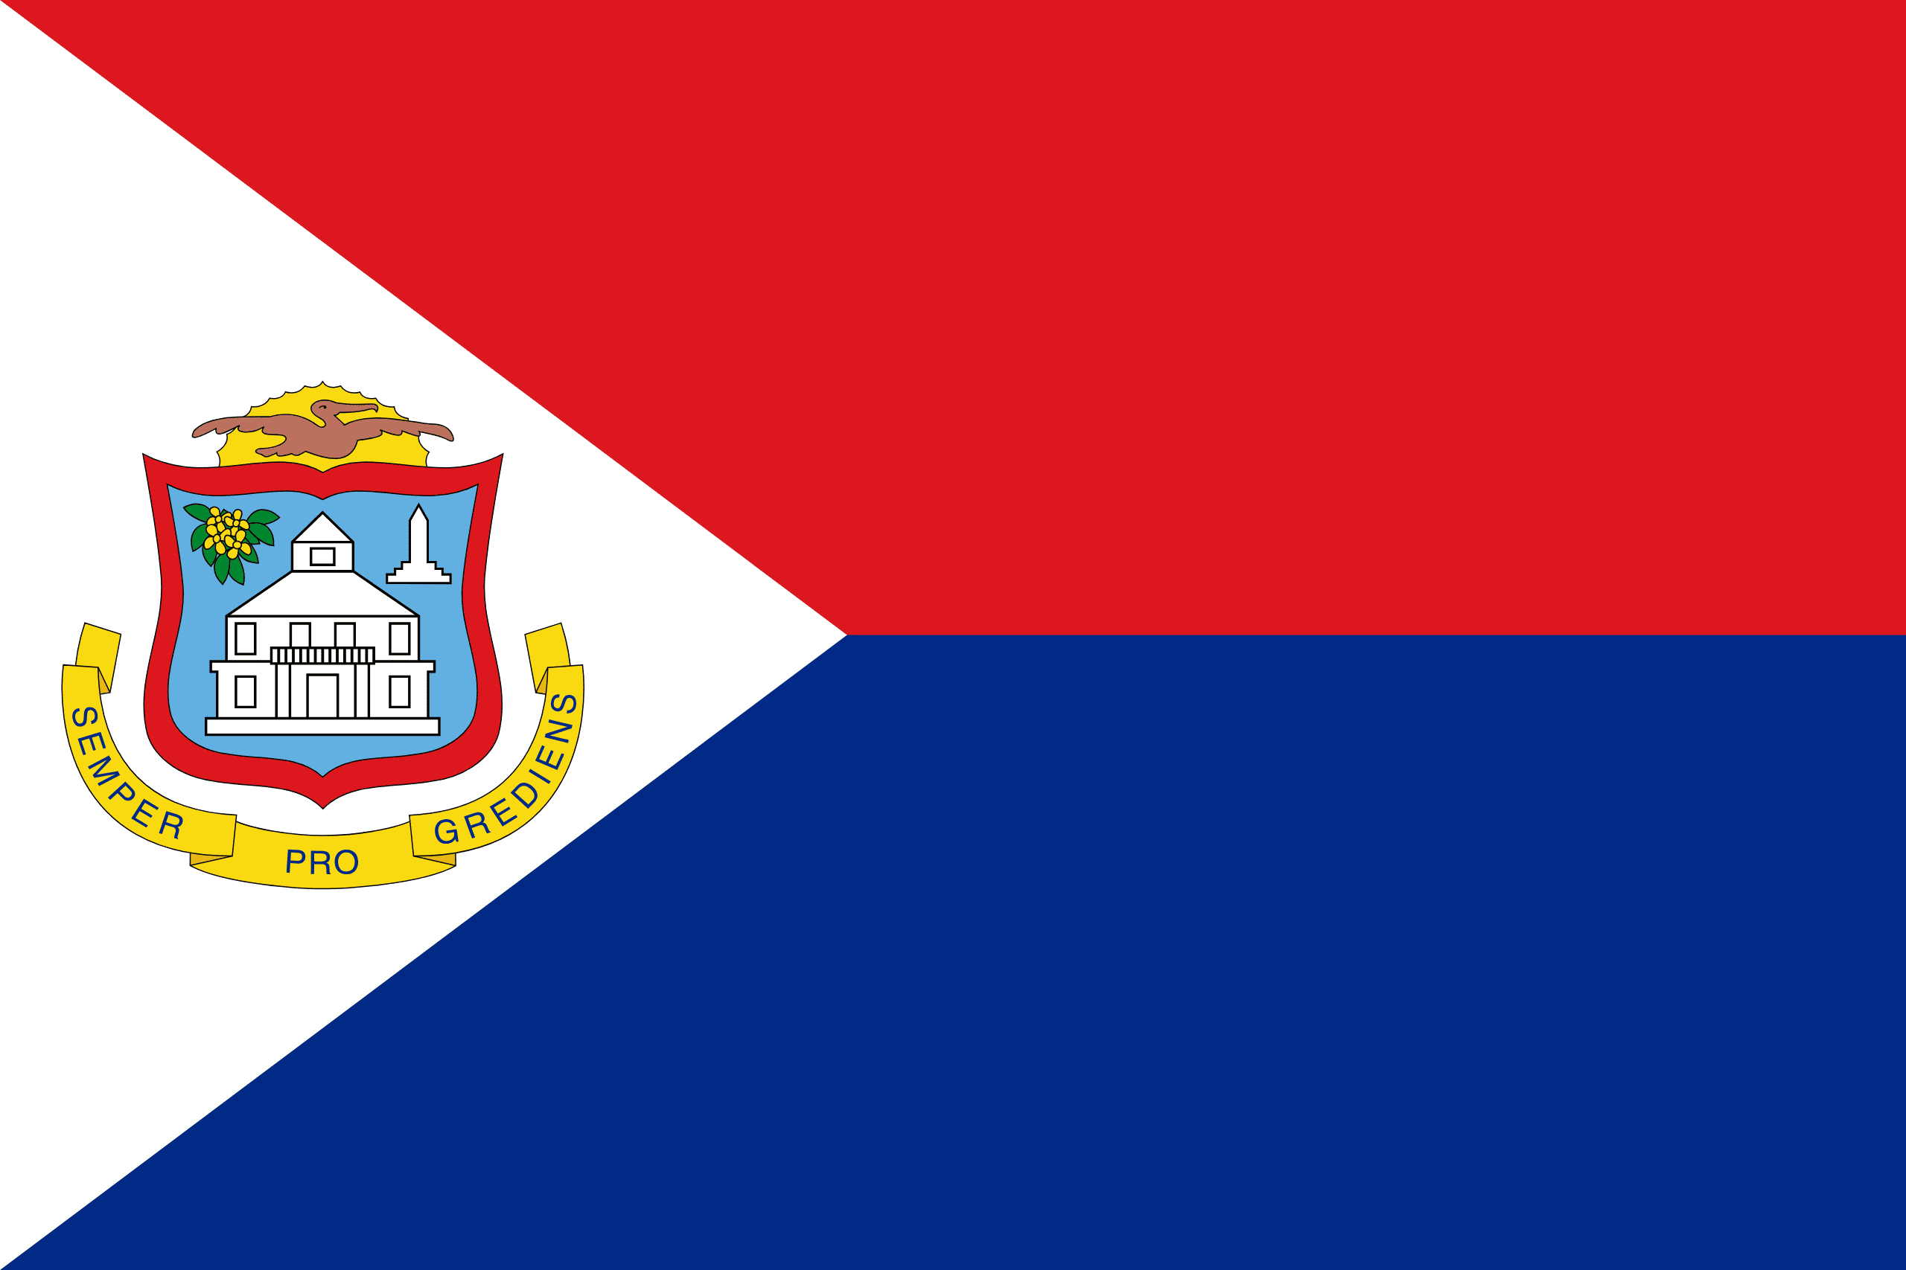
PRAYING FOR
SINT MAARTEN

Slide 3
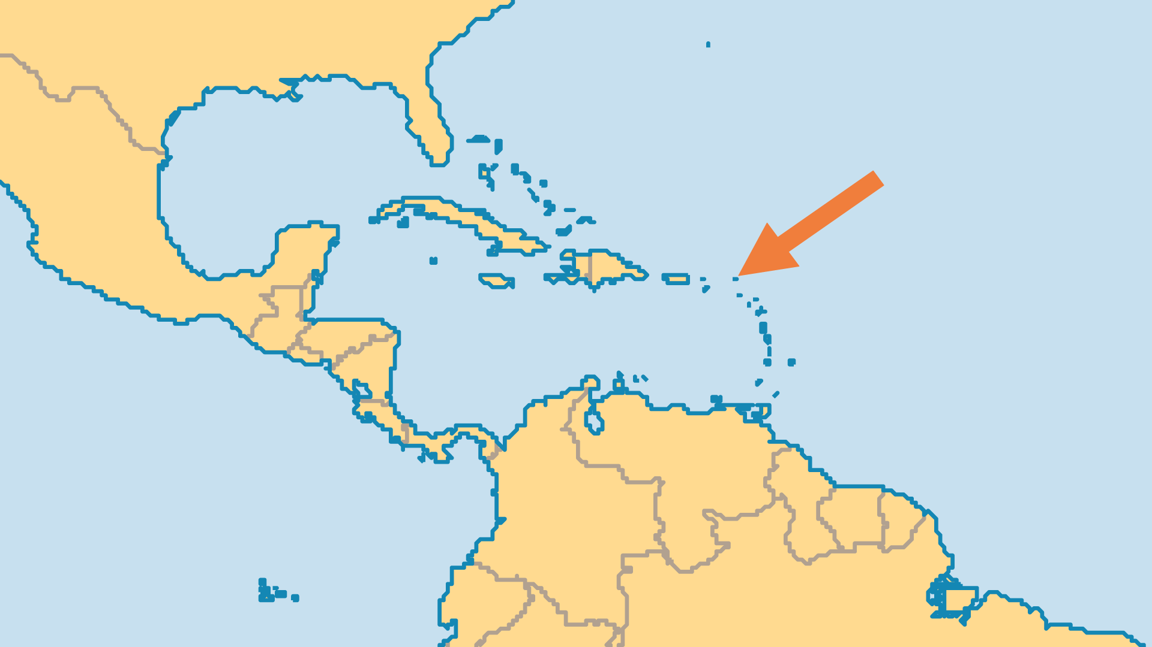
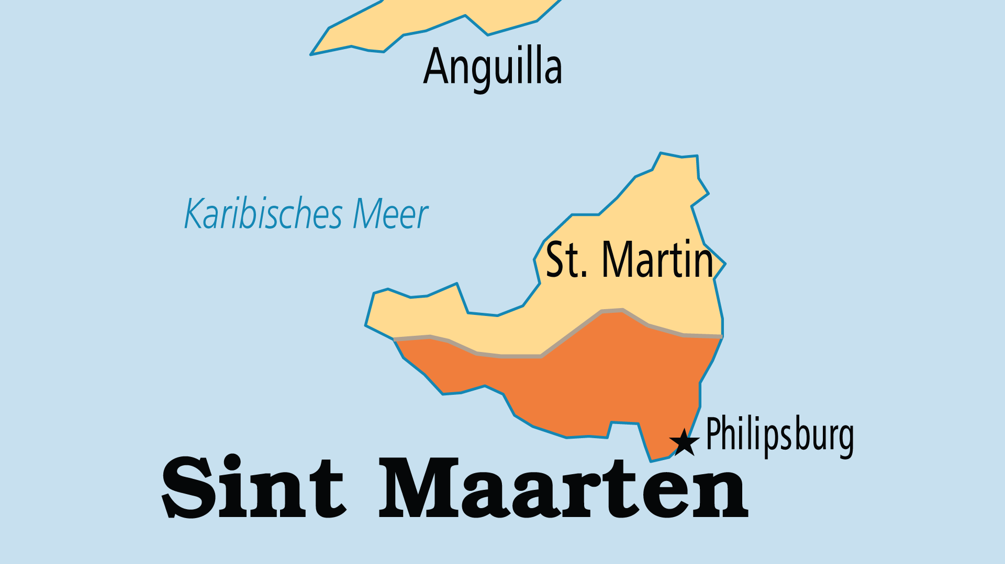
KEY STATS
Capital: | Philipsburg
Population: | 43,923
% Urban: | 100 %
Official Language: | Dutch, English
Languages: | 4
Literacy Rate: | 87 %
Life Expectancy: | 74 yrs (107th/236)
% Christian: | 82.2 %
% Evangelical: | 7.7 %
% Unevangelized: | 1 %

Slide 4

FOR PRAYER
Sint Maarten is the Dutch southern half of the island of Saint Martin, shared with France. It has a high standard of living, and an economy dependent on attracting tourists to its beaches, casinos, and nightclubs. Unsurprisingly, this creates serious challenges for the spiritual vibrancy of a population that is 82% Christian. Pray for a spiritual awakening!
Want to know more? Go to www.operationworld.org

