Slide 1




Slide 2

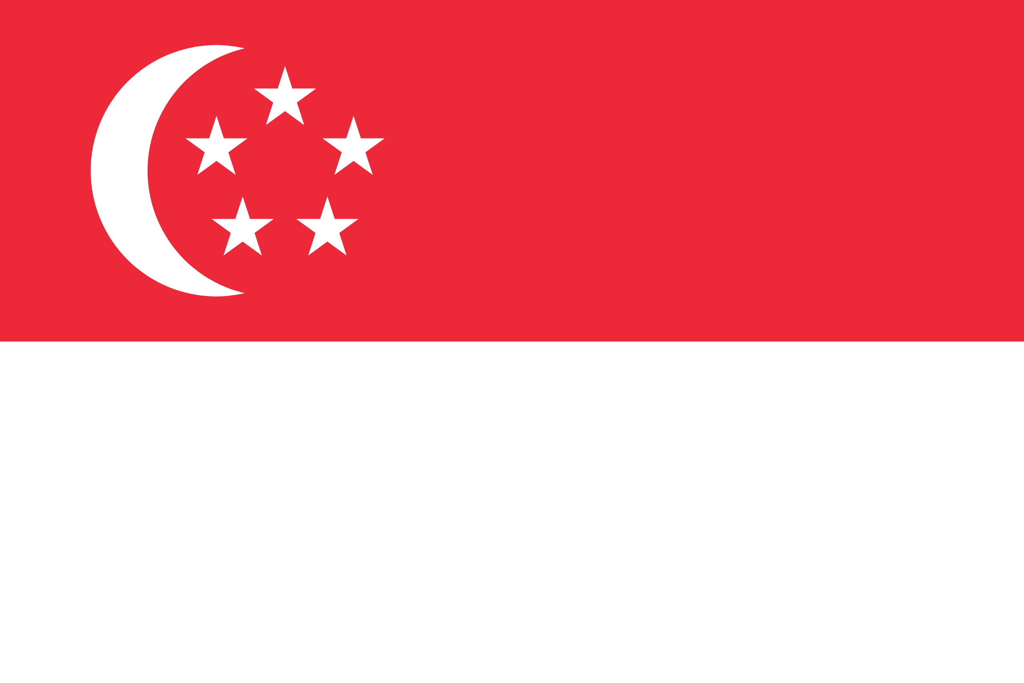
PRAYING FOR
SINGAPORE

Slide 3
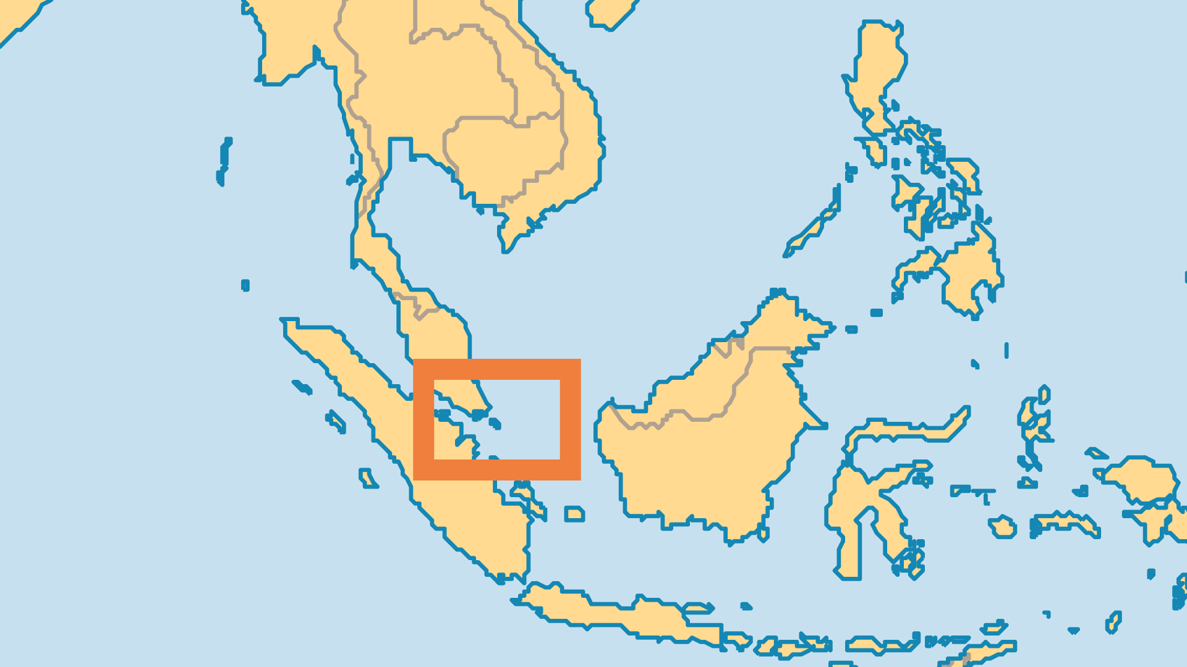
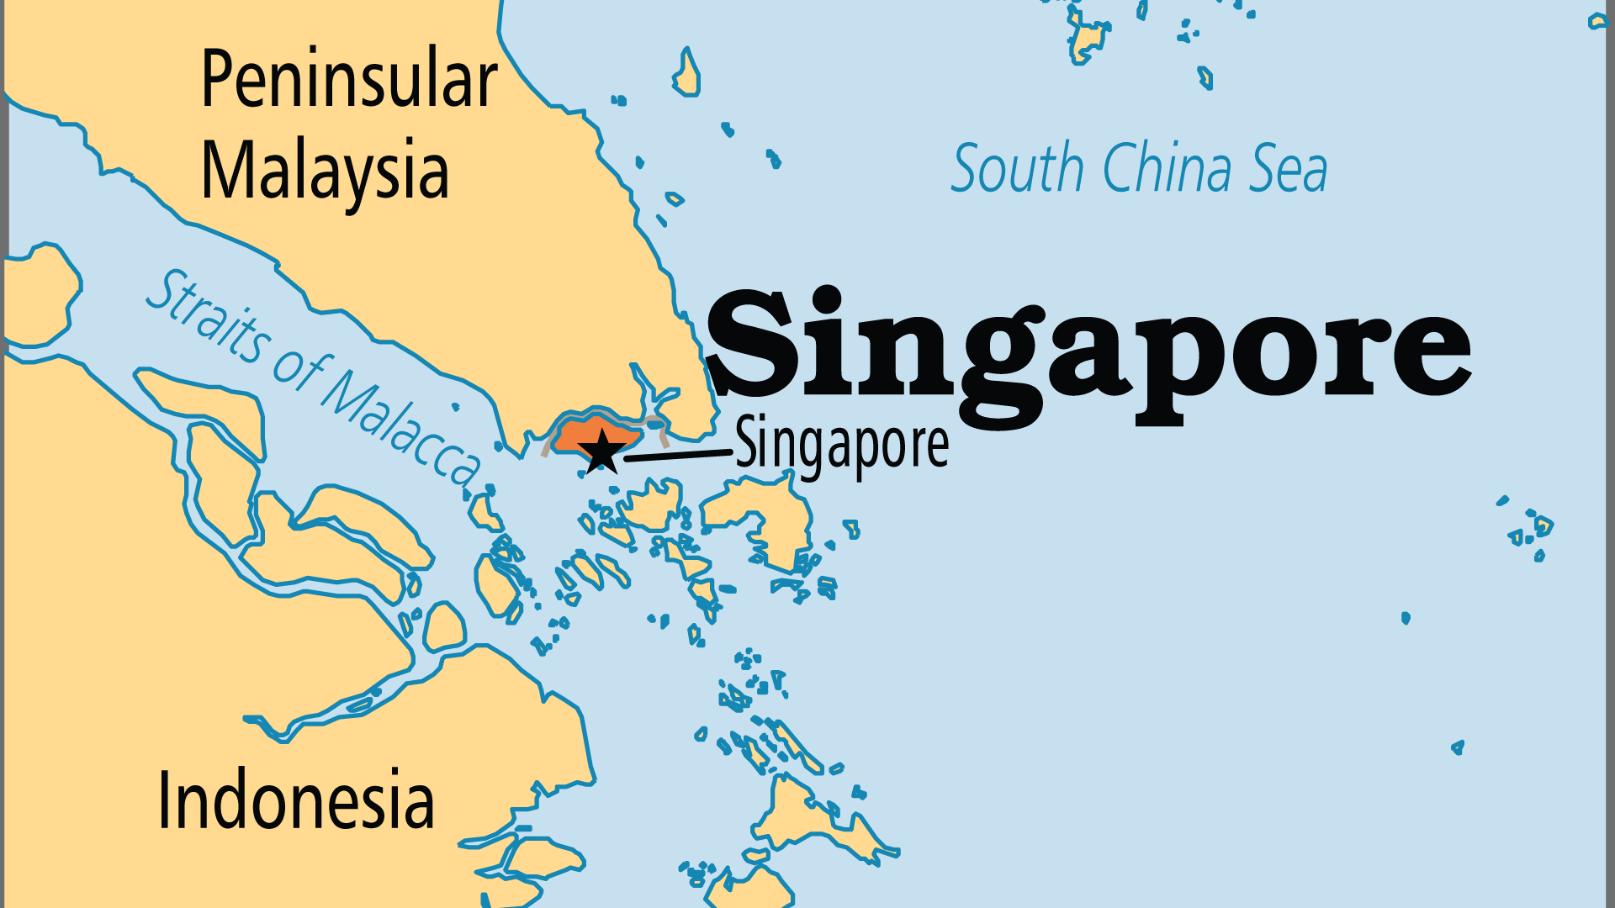
KEY STATS
Capital: | Singapore
Population: | 5,870,750
Official Language: | Mandarin (Chinese), English, Malay, Tamil
Languages: | 31
Literacy Rate: | 97 %
HDI Ranking: | 12/193
% Christian: | 16 %
% Evangelical: | 7.8 %
Largest Religion: | Buddhist
% Unevangelized: | 21 %

Slide 4

FOR PRAYER
Singaporean society is built on dedicated labour, discipline and self-reliance. Materialism has noticeably increased. Much of Singapore's affluence is now dependent on imported labour from poorer countries; entire sectors of the nation's economy would collapse without it. Singapore's very population would be in pronounced decline without immigration, as it has one of the world's lowest fertility rates. Pray for justice and fair treatment for all those from abroad; despite good legal safeguards, exploitation does exist. Pray that churches might become more active in assisting those at risk.
Want to know more? Go to www.operationworld.org

