Slide 1




Slide 2

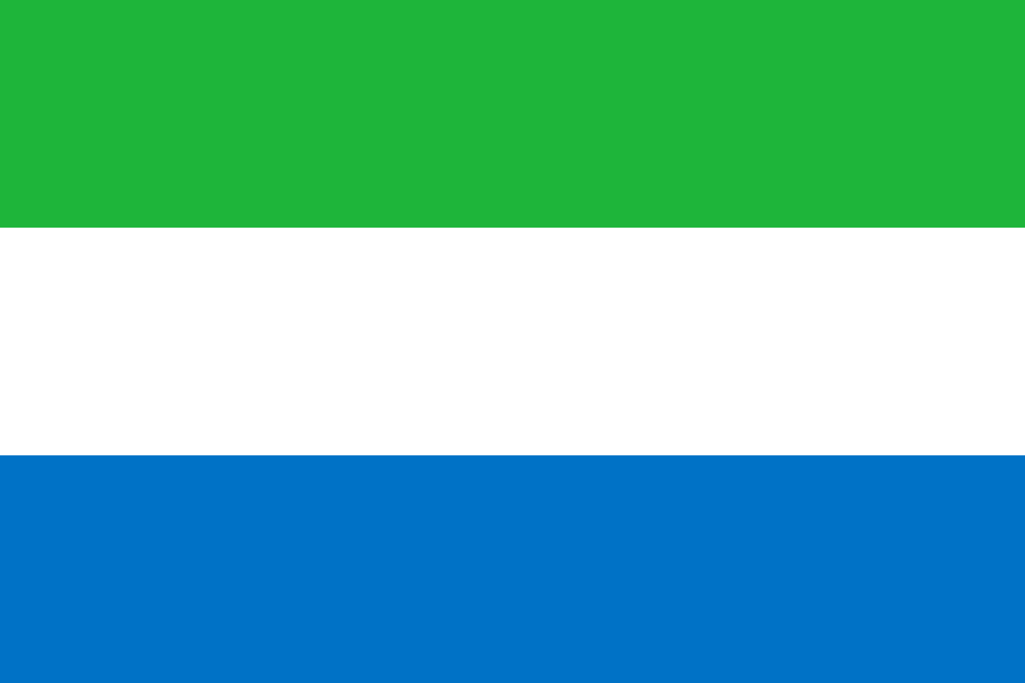
PRAYING FOR
SIERRA LEONE

Slide 3
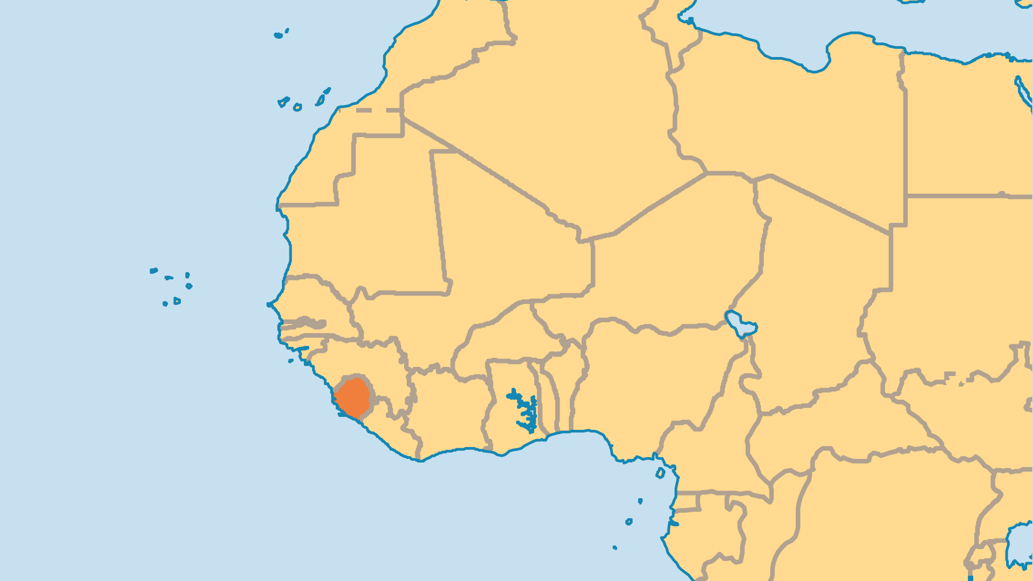
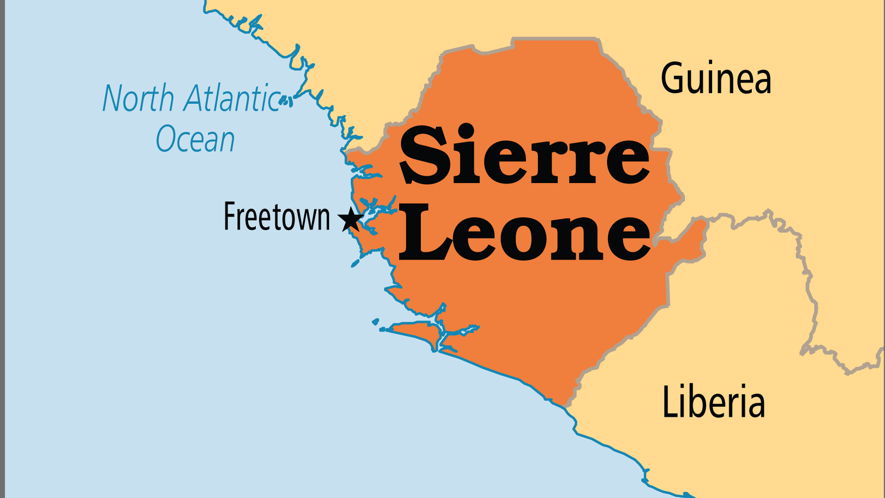
KEY STATS
Capital: | Freetown
Population: | 8,819,794
Official Language: | English. Trade language Krio (Creole)
Languages: | 26
HDI Ranking: | 181/193
% Christian: | 13.2 %
% Evangelical: | 3.9 %
Largest Religion: | Muslim
% Unevangelized: | 39 %

Slide 4

FOR PRAYER
Sierra Leone continues its effort to move forward and away from its tragic recent history. The horrifying civil war of the '90s and the crippling effect of Ebola in 2014-2015 both reversed efforts at nation-building. The increasing inclusion of women in politics and community leadership is a contrast to the culture of sexual violence that still plagues this country. Many Christian ministries and aid agencies continue to help the long-term process of meeting people's physical, psychological, and spiritual needs. Praise God for their freedom to minister and pray for their fruitfulness.
Want to know more? Go to www.operationworld.org

