Slide 1




Slide 2

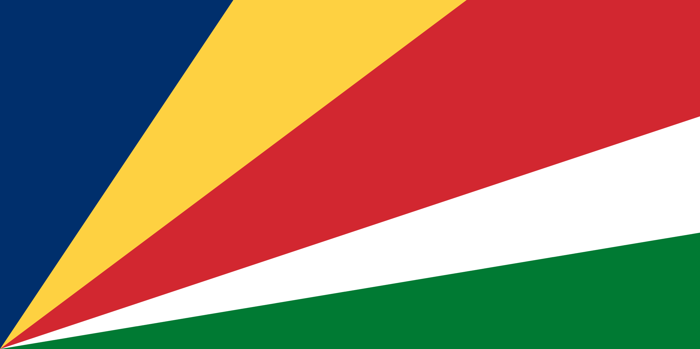
PRAYING FOR
SEYCHELLES

Slide 3
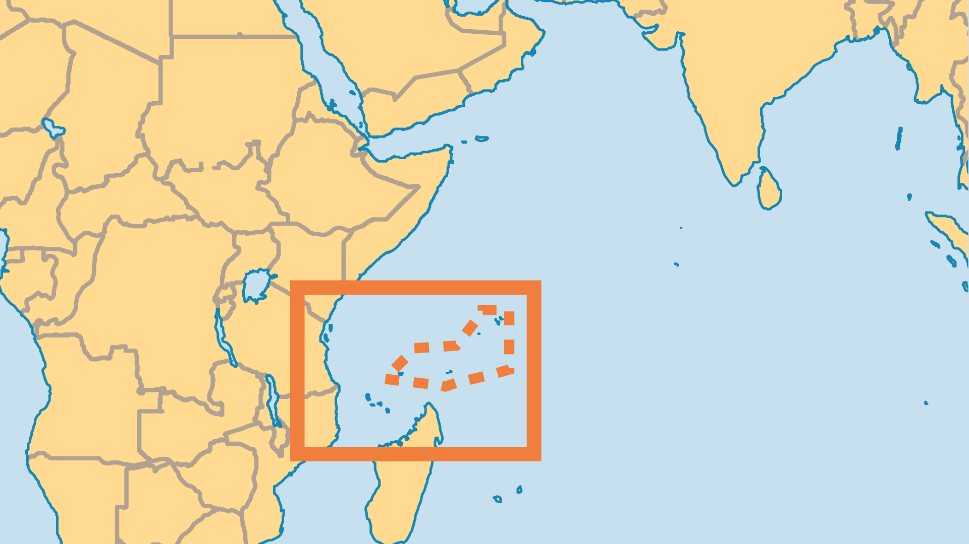
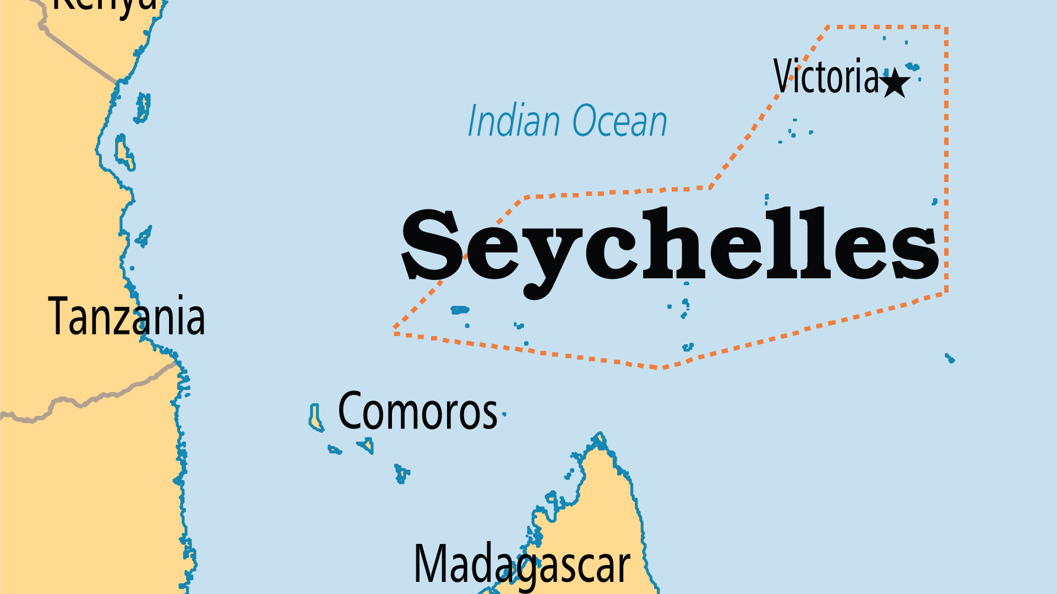
KEY STATS
Continent: | Africa
Capital: | Victoria
Population: | 132,779
Official Language: | French, English and Seychellois Creole
HDI Ranking: | 72/193
% Christian: | 96.1 %
% Evangelical: | 5.9 %
People Groups: | 5
% Unevangelized: | 2 %

Slide 4

FOR PRAYER
The vast majority of Seychellois claim to be Christian, but evidence of true spiritual transformation seems outweighed by superstition and nominalism. Gris-gris, a voodoo-like African spiritism based on black magic and herbalism, permeates the lives of Christians. Despite the disapproval of religious leaders, most Seychellois remain happy to mix religion into this dangerous cocktail. Pray that the Holy Spirit may bring new life evidenced by repentance and sustained fruit.
Want to know more? Go to www.operationworld.org

