Slide 1




Slide 2


PRAYING FOR
KOSOVO

Slide 3
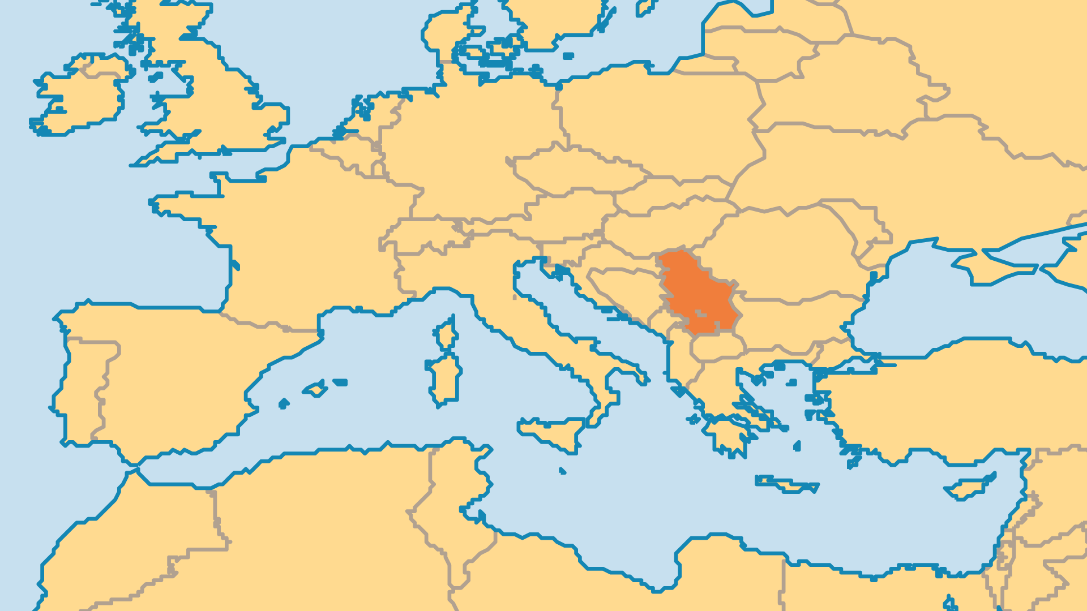
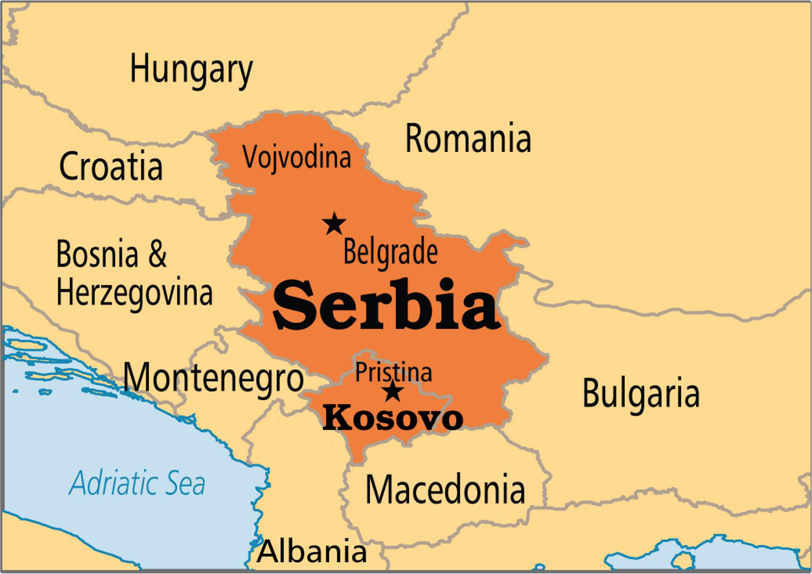
KEY STATS
Capital: | Pristina
Population: | 1,667,483
Official Language: | Albanian, Serbian
Literacy Rate: | 92 %
Life Expectancy: | 76.8 yrs (70th/236)
% Christian: | 10 %
Largest Religion: | Muslim
% Largest Religion: | 80 %
% Unevangelized: | 40 %

Slide 4

FOR PRAYER
The evangelical Church is very small but growing. From around 80 believers at the outbreak of war in 1998, there are now over 2,000, mostly young men and teens (often, girls are forced to keep their faith secret). There are now about 35 evangelical churches, and they are quite evangelistic in their outlook. The formation of an evangelical alliance (Evangelical Movement of Kosovo) and the recognition of evangelicals as one of Kosovo's five faith communities are both answers to prayer. Pray for unity among believers and continued growth in numbers and spiritual maturity.
Want to know more? Go to www.operationworld.org

