Slide 1




Slide 2

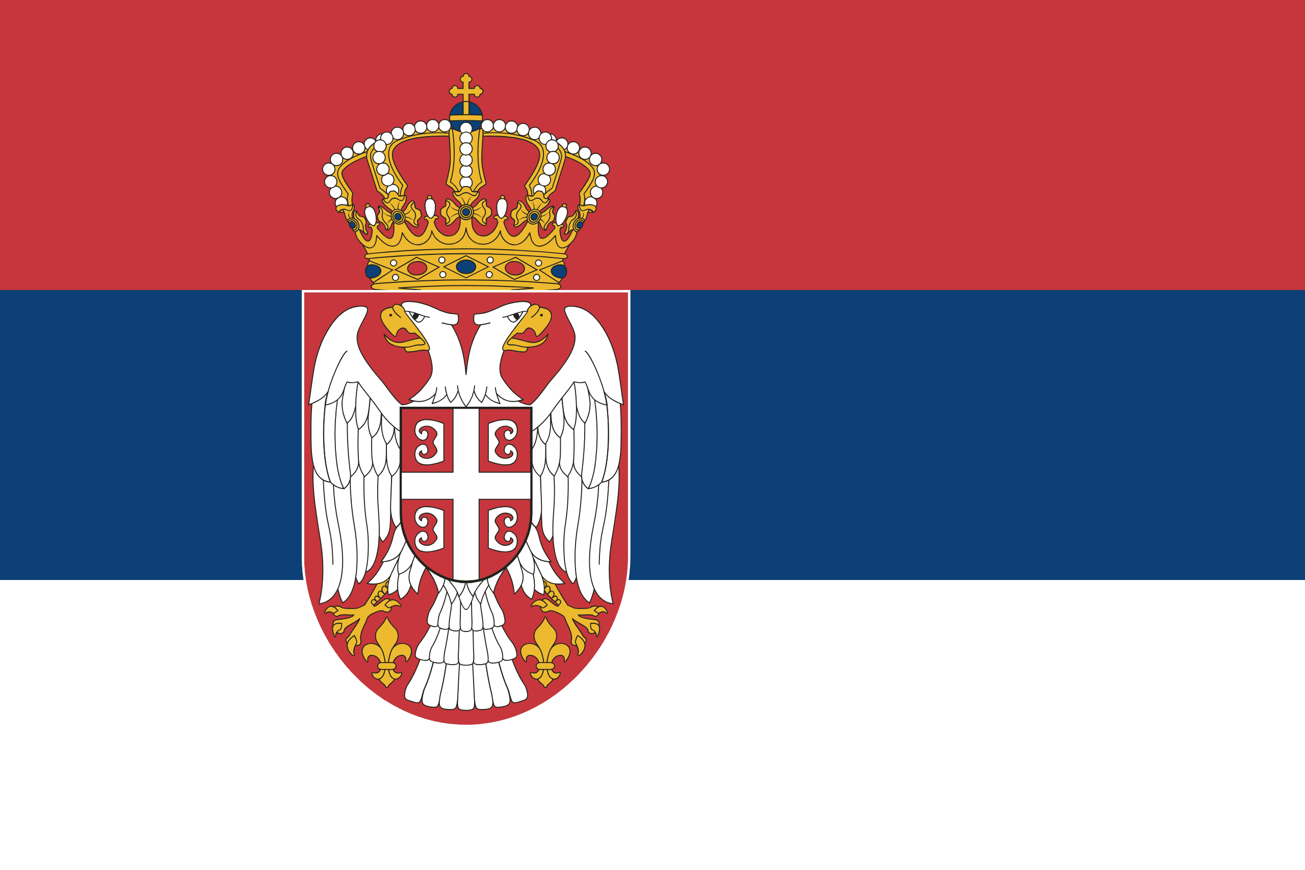
PRAYING FOR
SERBIA

Slide 3
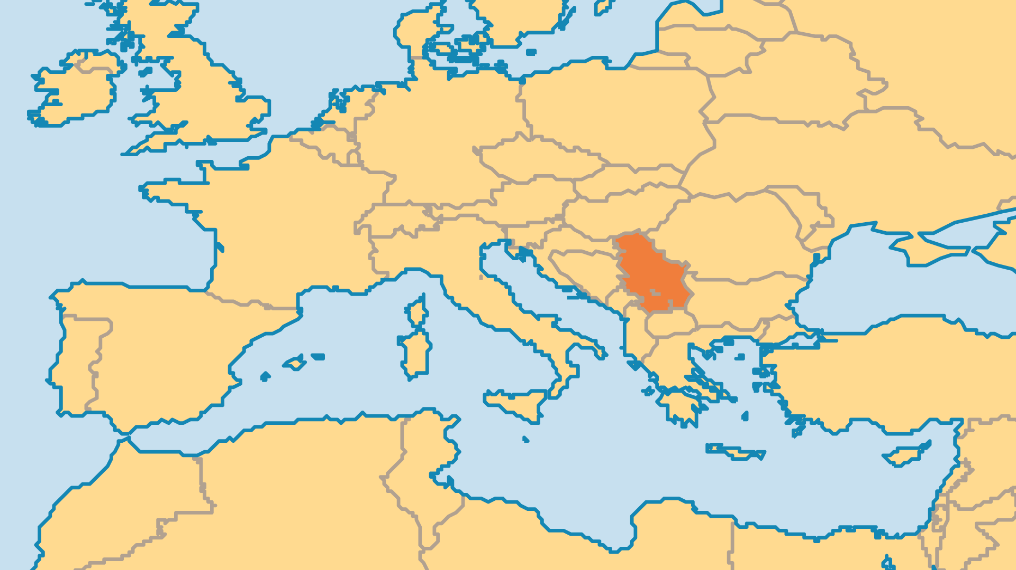
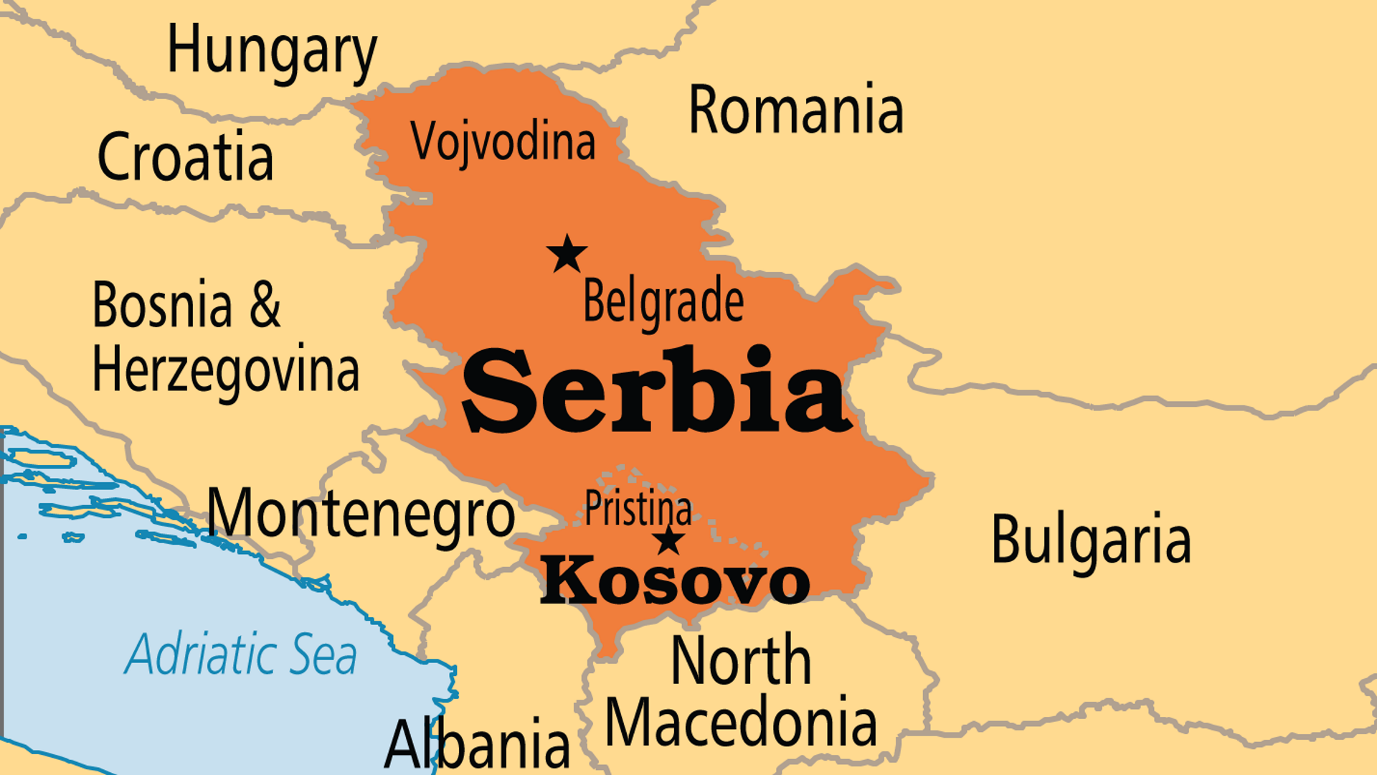
KEY STATS
Capital: | Belgrade
Population: | 6,689,039
Official Language: | Serbian
Languages: | 21
HDI Ranking: | 63/193
% Christian: | 80.4 %
% Evangelical: | 0.6 %
People Groups: | 35
Least Reached People Groups: | 6
% Unevangelized: | 3 %

Slide 4

FOR PRAYER
Evangelicals in Serbia face many difficulties. The recent religion law creates difficulty for all new religious groups, including many new evangelical groups. Protestants (110,000) have a long history among Hungarians and Slovak minorities, but little impact among Serbs and Albanians. Pray for revival. For groups where ethnic identity determines religious identity, evangelicals can appear to be traitors and part of a religious sect. But through all these challenges, newer churches do grow and minister Christ to others! Romani churches grow the fastest in Serbia and reflect the culture of the Romani people well.
Want to know more? Go to www.operationworld.org

