Slide 1




Slide 2

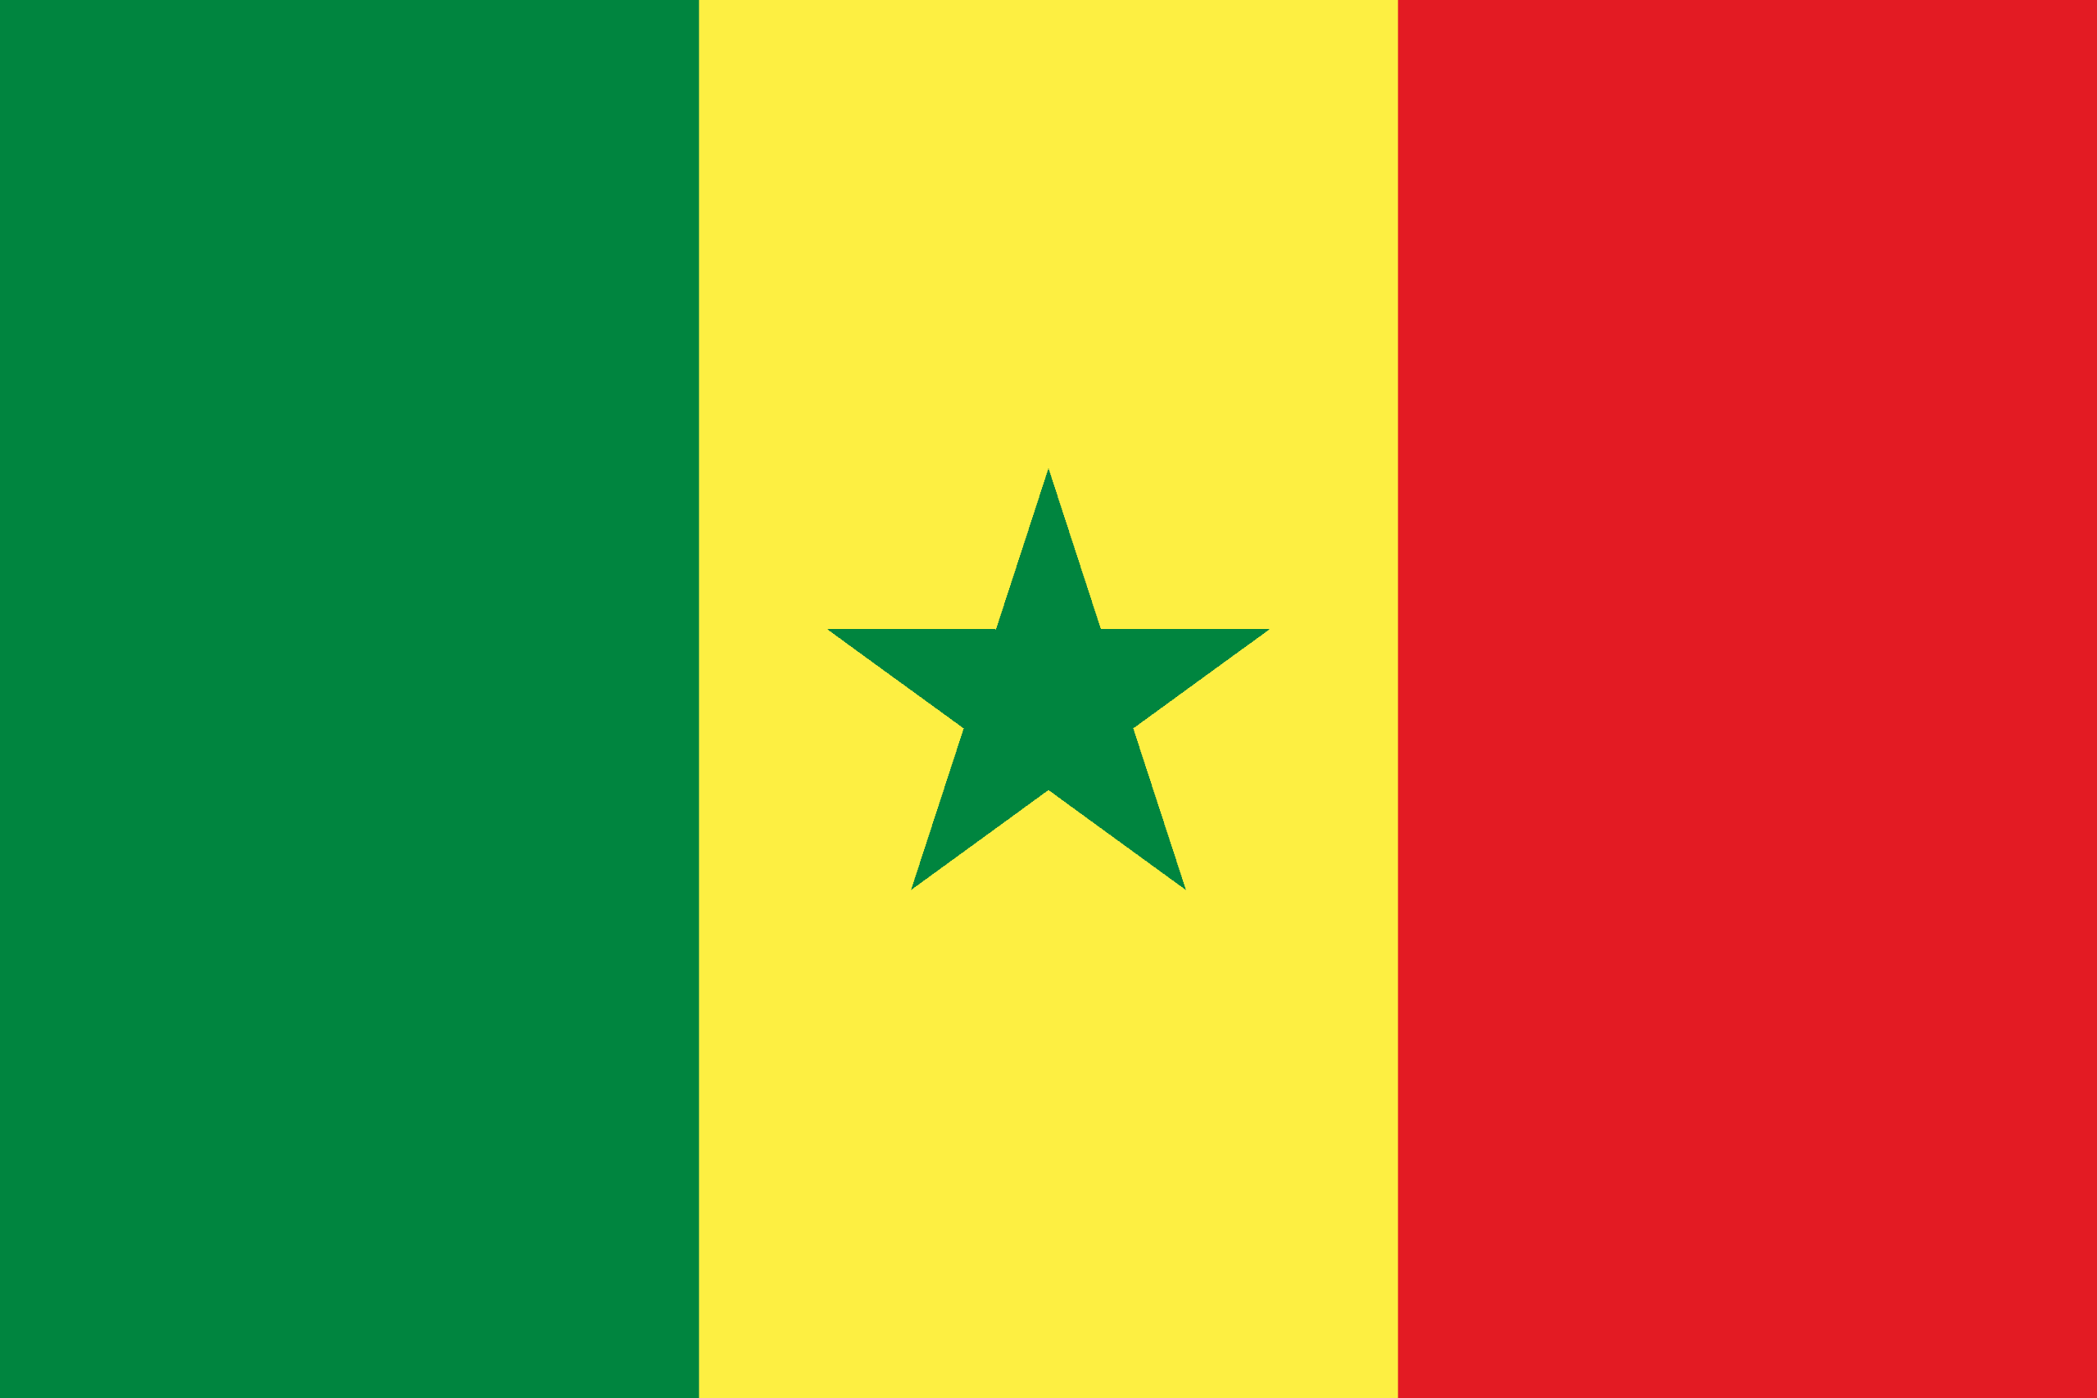
PRAYING FOR
SENEGAL

Slide 3
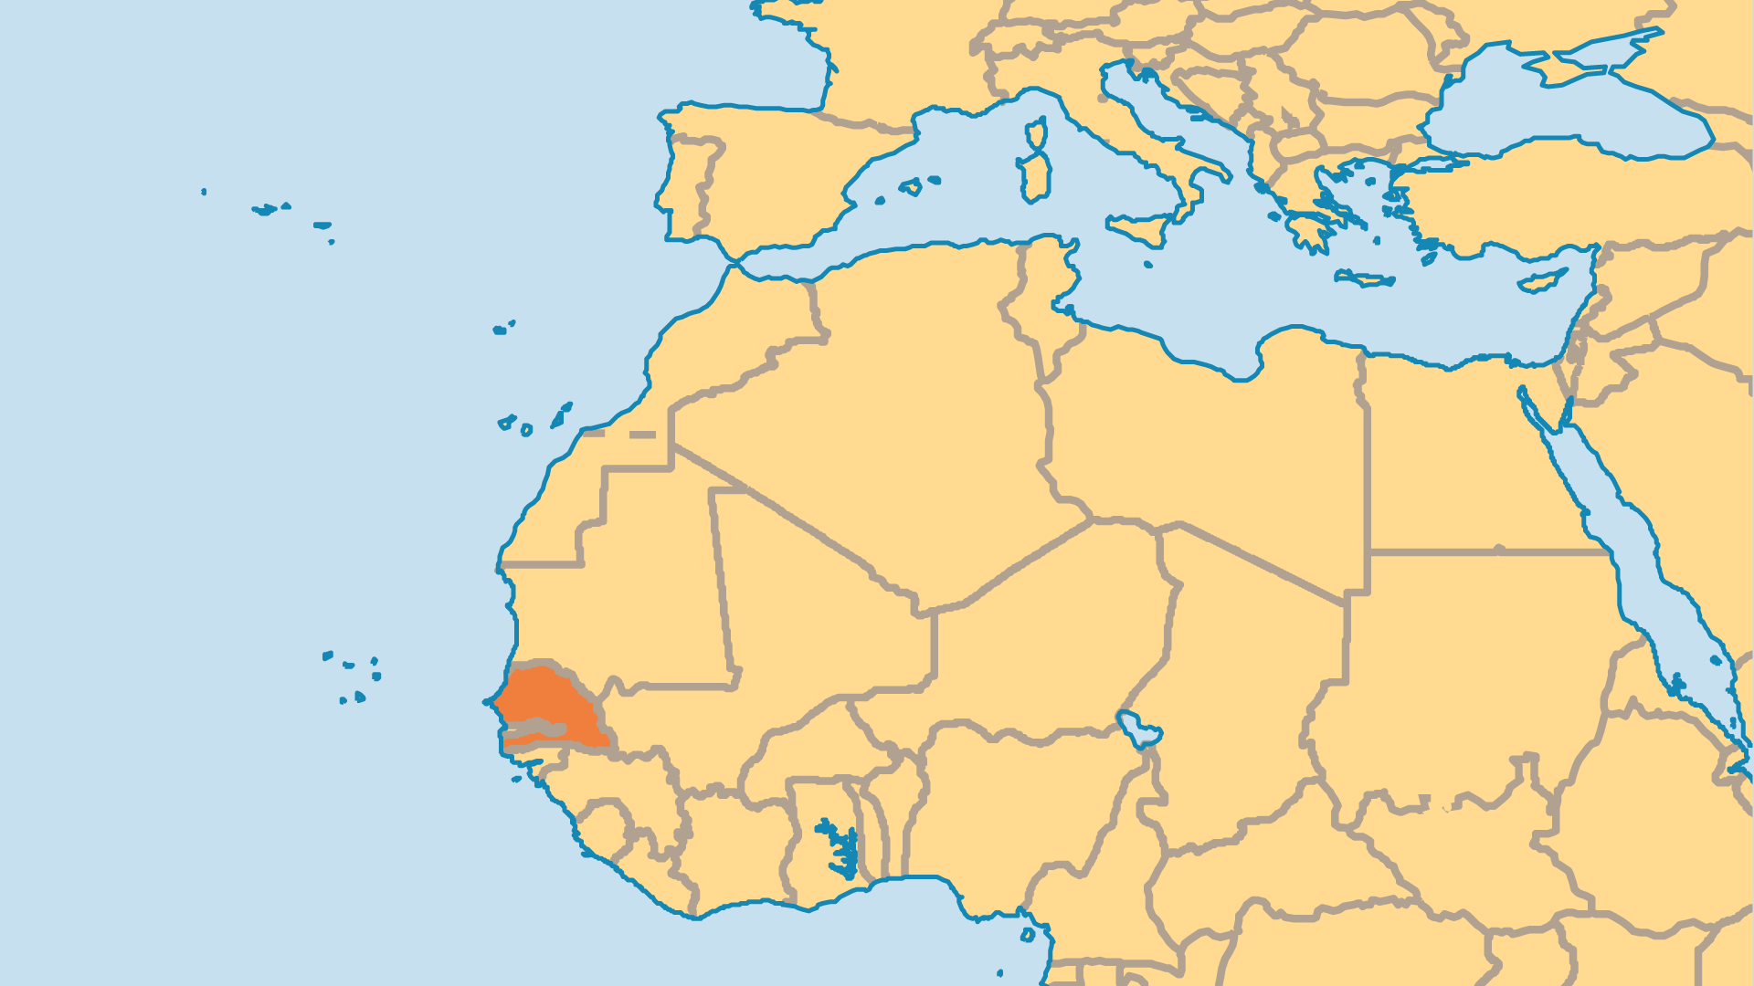
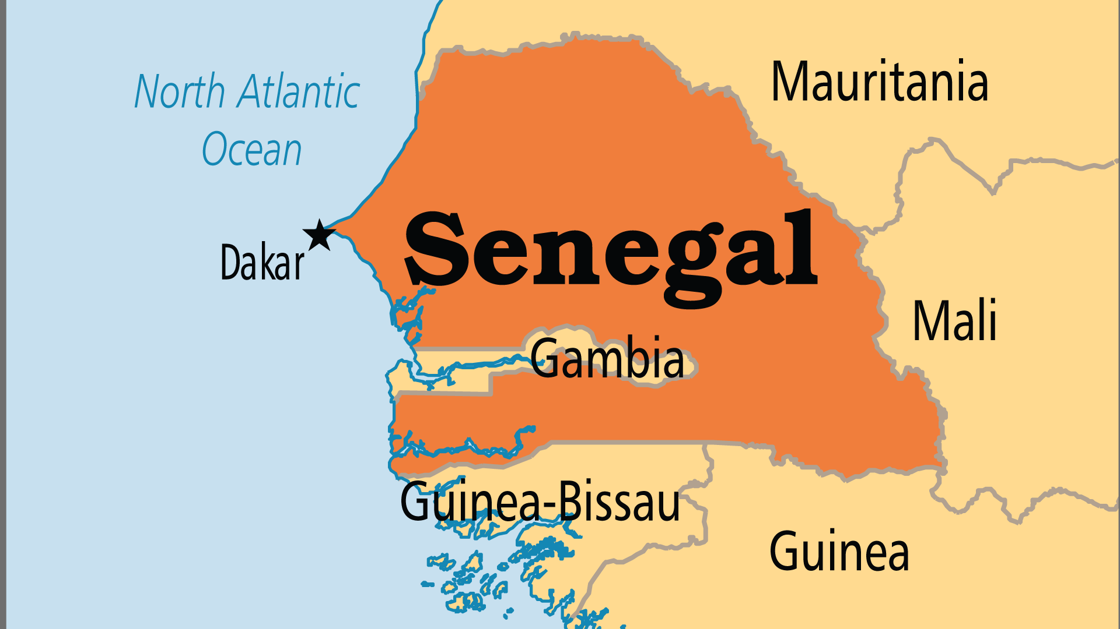
KEY STATS
Capital: | Dakar
Population: | 18,931,967
Official Language: | French, Wolof
Languages: | 46
HDI Ranking: | 170/193
% Christian: | 6.4 %
% Evangelical: | 0.2 %
Largest Religion: | Muslim
% Largest Religion: | 91.1 %
% Unevangelized: | 56 %

Slide 4

FOR PRAYER
Senegal appears both open and closed spiritually. The nation enjoys religious freedom and tolerates many faiths, and Senegalese feel proud about this. But few of the Muslim majority have ever come to Christ. The Muslim Sufi brotherhoods are organized, wealthy, and have political power. Over 85% of all Muslims belong to one of them. Even after long-standing Christian presence and outreach, a spiritual heaviness covers the land. Pray for the spiritual breakthrough that many wait for!
Want to know more? Go to www.operationworld.org

Slide 5
FOR PRAYER
Dakar, the capital, is the most strategic location for evangelizing the entire country. It hosts over 25% of the nation's population as well as representatives of every ethnic group. From 15 evangelical groups meeting in 1990, there are over 60 today. But while Dakar itself is blessed with many congregations, the outlying areas have only a few small churches - not nearly enough for the 3.5 million people in the Dakar area. Dakar is the mission base for most agencies, but only a few missionaries are actually committed to church planting there. Pray for this city to become a source of gospel light for the whole country.

