Slide 1




Slide 2

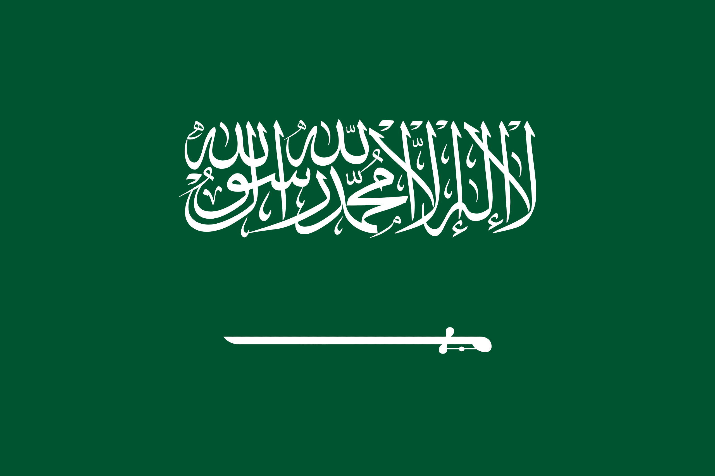
PRAYING FOR
SAUDI ARABIA

Slide 3
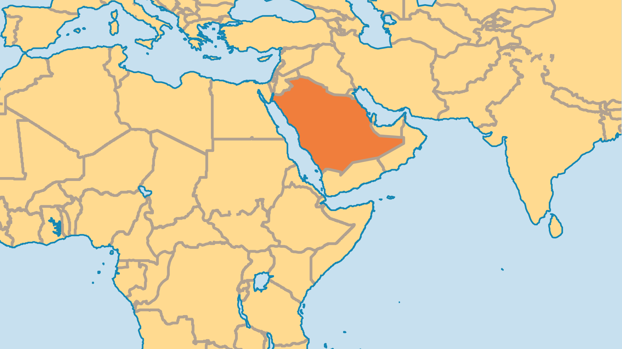
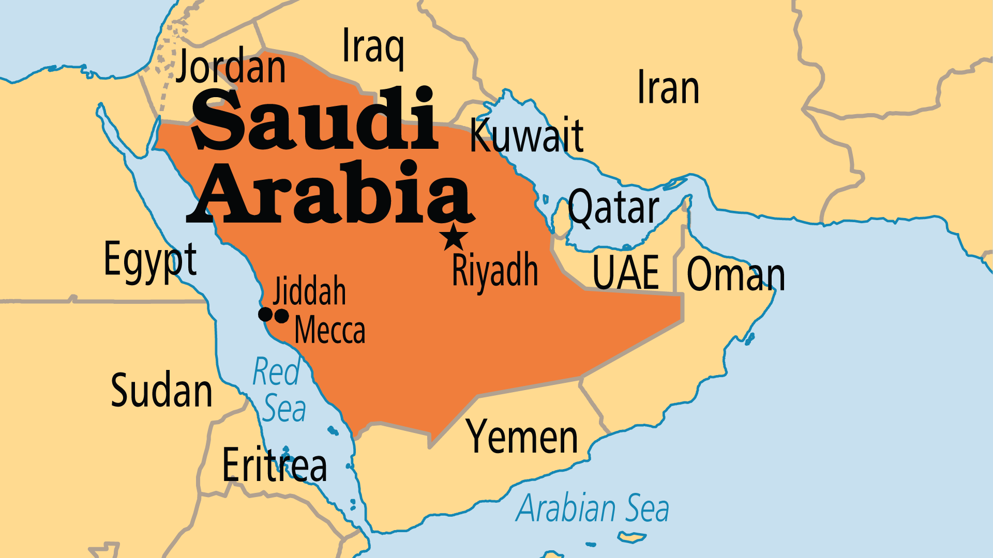
KEY STATS
Capital: | Riyadh
Population: | 34,566,328
Official Language: | Arabic
Languages: | 20
HDI Ranking: | 35/193
% Christian: | 5.4 %
% Evangelical: | 0.3 %
Largest Religion: | Muslim
% Unevangelized: | 58 %
Persecution Ranking: | 12/50

Slide 4

FOR PRAYER
Saudi Arabia is the birthplace and stronghold of Islam. From Mecca, Islam holds influence over billions, and touches many cultures worldwide. Billions of oil dollars go towards promotion of Islam around the world every year. A spiritual breakthrough for Jesus Christ here would transform Islam and all who follow it! All Muslims must pray toward Mecca 5 times daily, and over 2 million Muslims make the pilgrimage (Hajj) to Mecca every year. Pray that many who seek God might encounter the living Christ.
Want to know more? Go to www.operationworld.org

Slide 5
FOR PRAYER
Saudi Arabia's record on religious freedom and human rights is probably the world's worst. People of faiths other than Islam can live in Saudi Arabia, but they cannot practice their religion openly or even gather privately. Authorities watch Christian expatriates all the time, and those caught meeting even in homes can face beatings, prison, expulsion, or even execution. Pray for strength, wisdom, and courage for the community of foreign believers. Pray also for a witness to Christ among all foreign workers, that many might come to Jesus while in this land.

