Slide 1




Slide 2

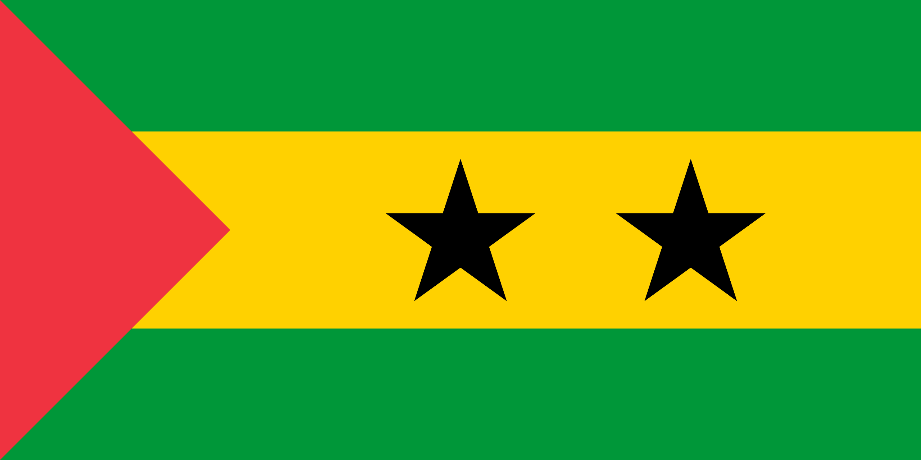
PRAYING FOR
SAO TOMÉ & PRINCIPE

Slide 3
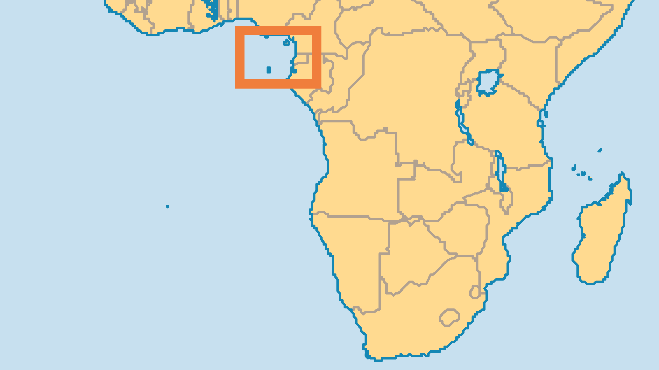
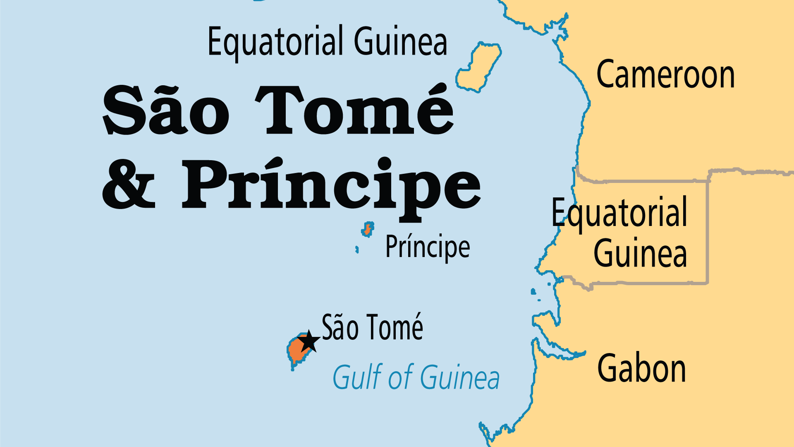
KEY STATS
Capital: | São Tomé
Population: | 236,381
Pop Under 15 Yrs: | 42.1 %
Official Language: | Portuguese and three Creole dialects
Languages: | 5
HDI Ranking: | 138/193
% Christian: | 87.6 %
% Evangelical: | 4.2 %
People Groups: | 6
% Unevangelized: | 1 %

Slide 4

FOR PRAYER
The majority of the population are Catholic, but practice is usually mixed with deep-seated African spiritist beliefs. Appeasing spirits and ancestors is often of greater importance than honouring God. Pray for the Holy Spirit to move through the Catholic Church, bringing renewal. Pray for the sovereignty of Jesus to be clearly demonstrated amid syncretized Catholicism and the growth of Islam and marginal sects.
Want to know more? Go to www.operationworld.org

