Slide 1




Slide 2

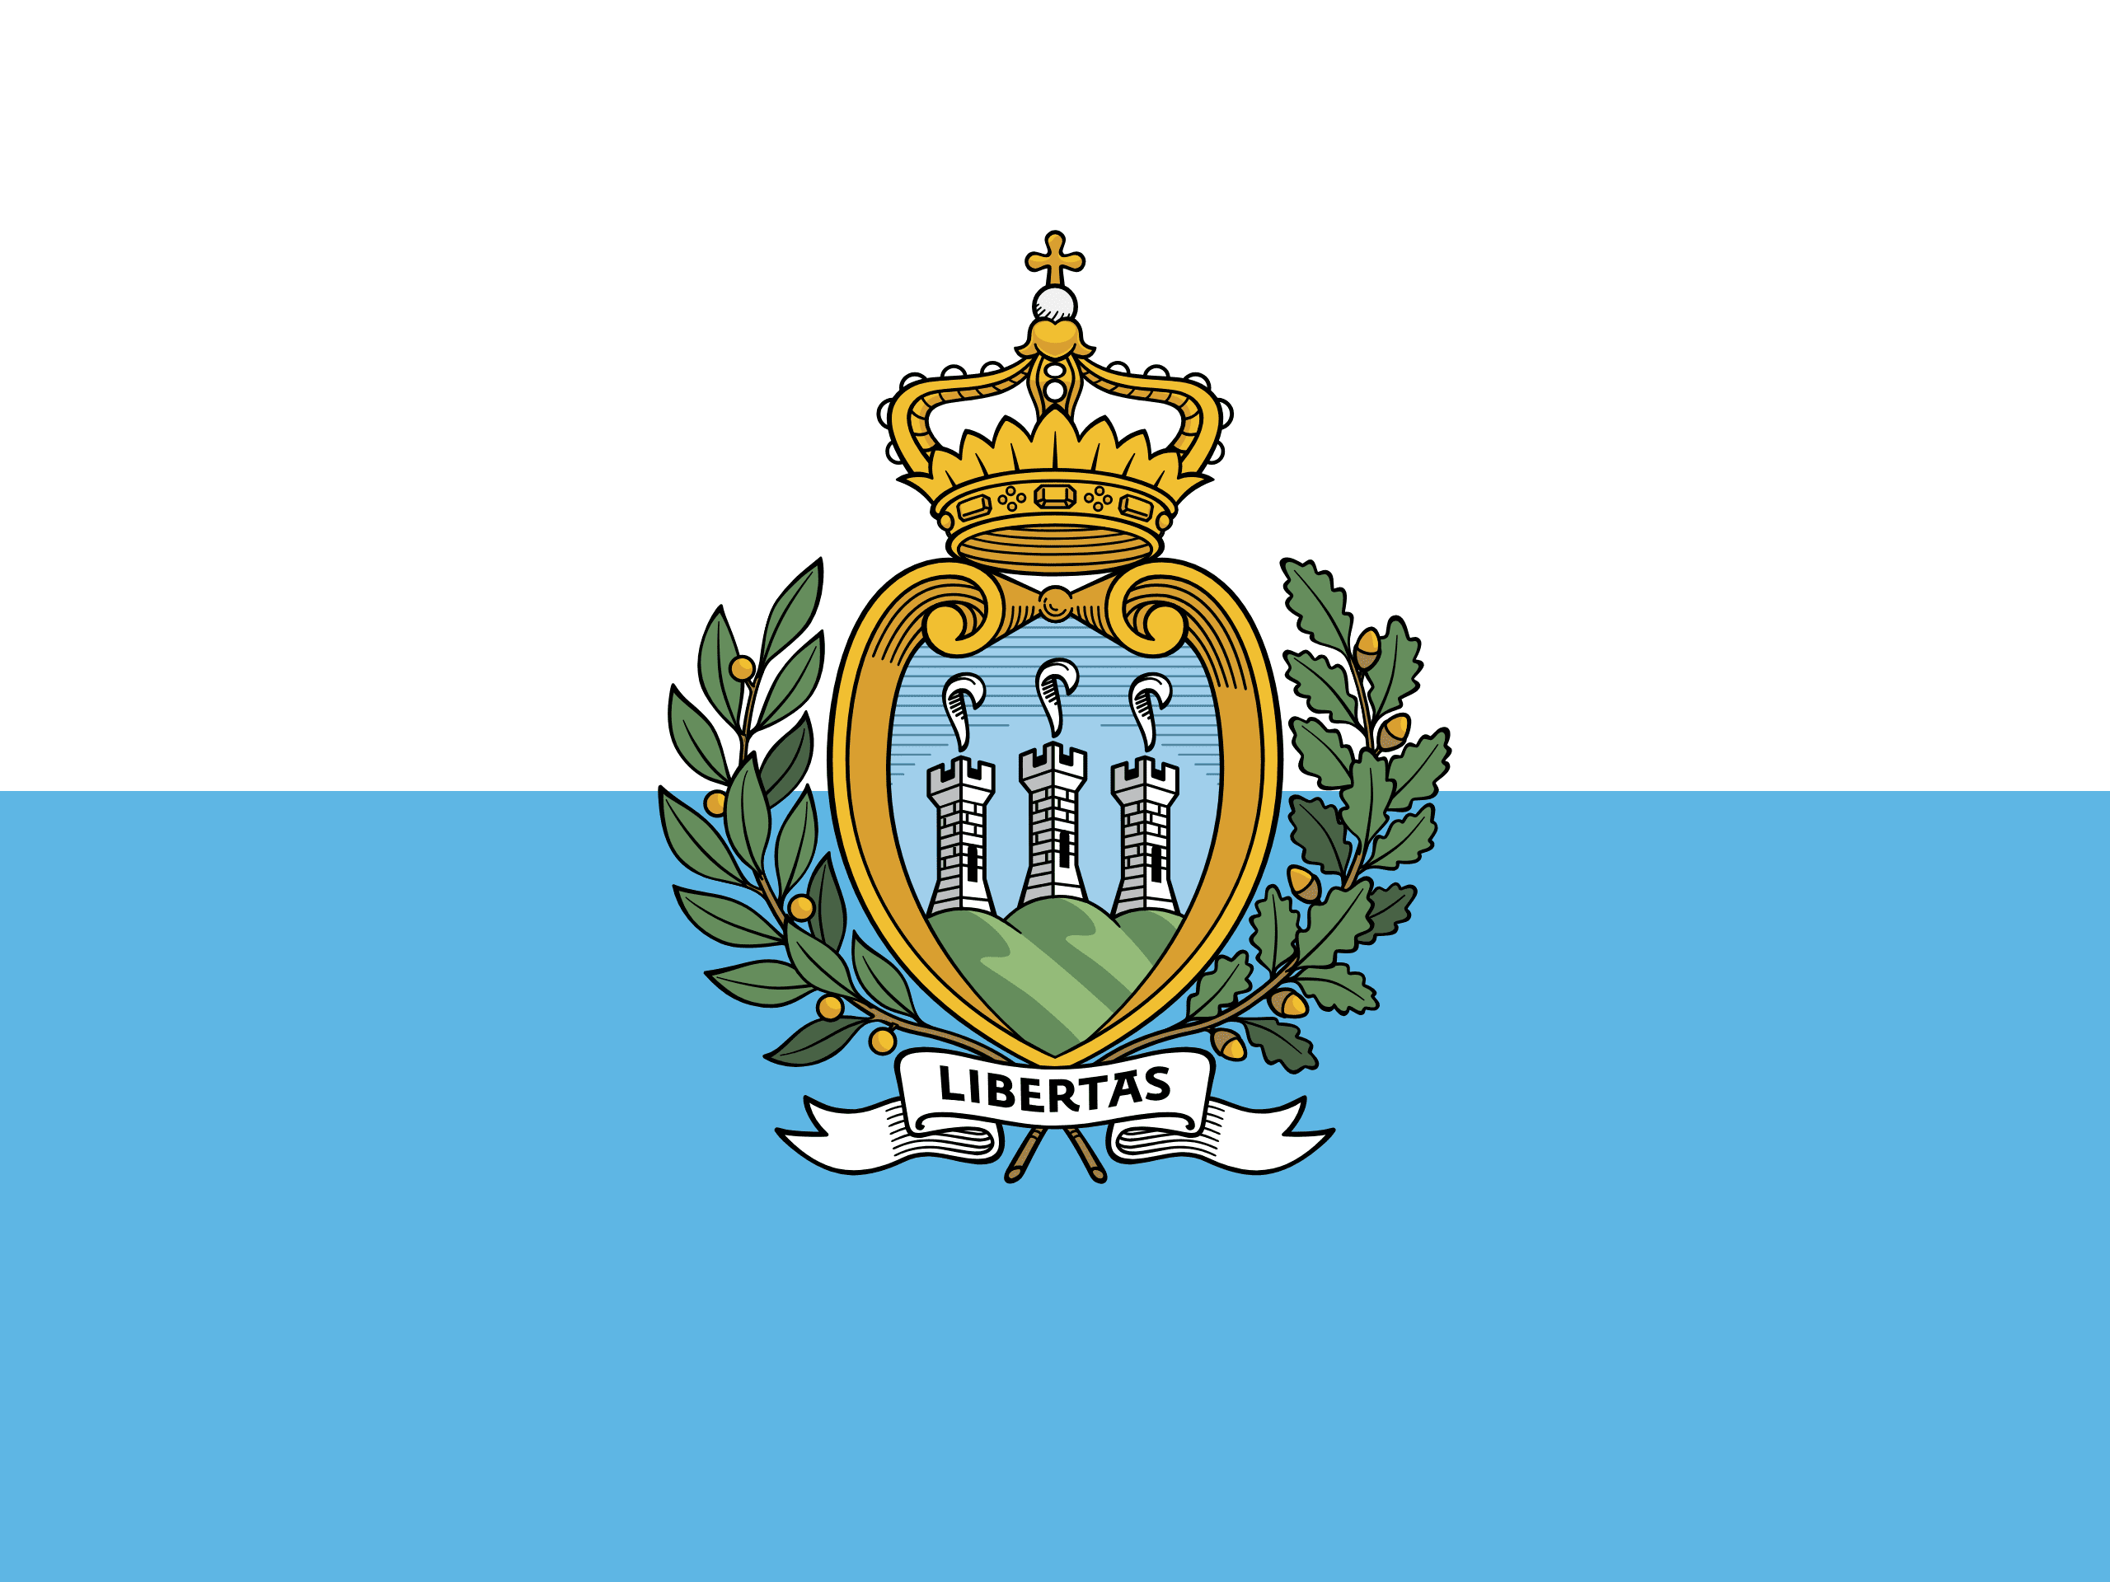
PRAYING FOR
SAN MARINO

Slide 3
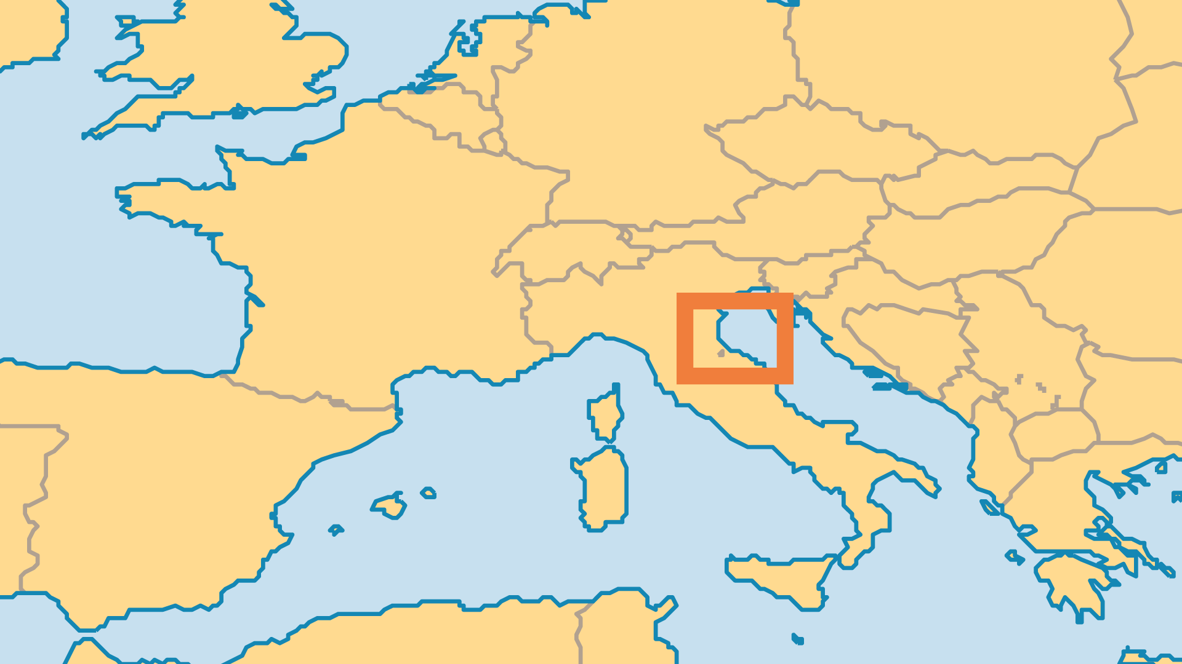
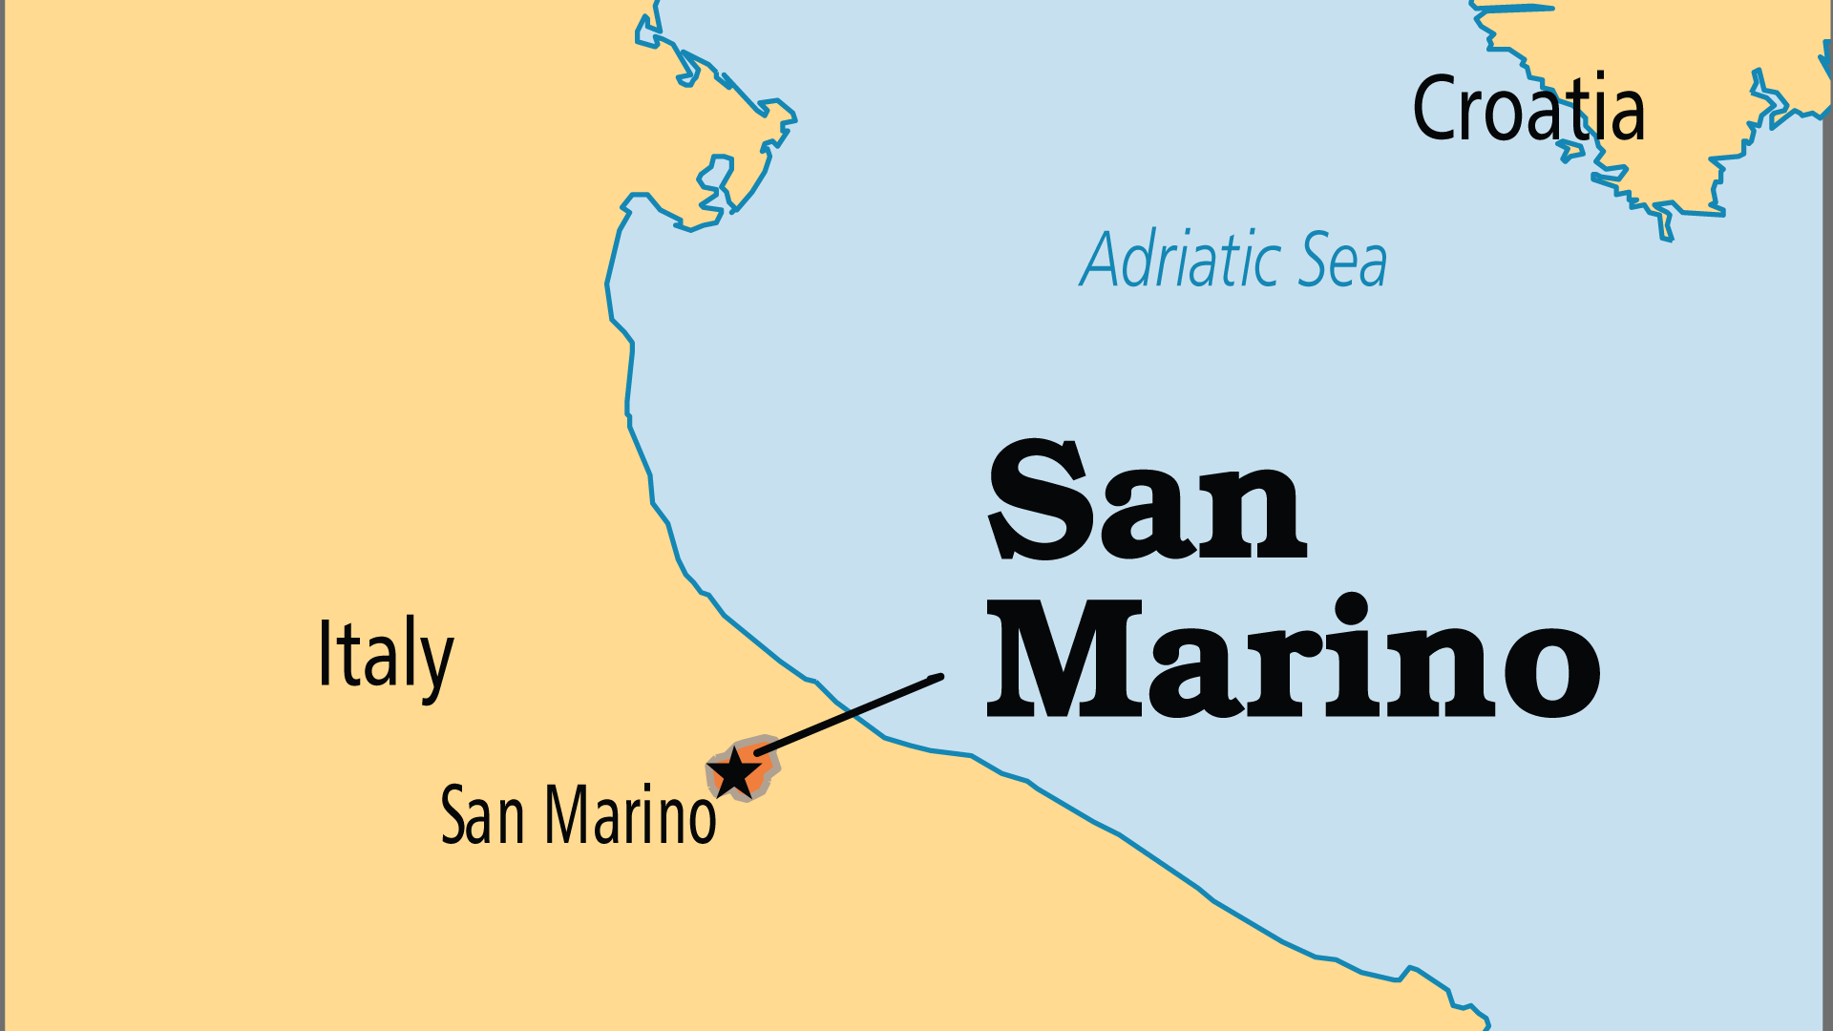
KEY STATS
Capital: | San Marino
Population: | 33,573
Official Language: | Italian
Languages: | 2
Literacy Rate: | 96 %
Life Expectancy: | 80.9 yrs (33rd/236)
HDI Ranking: | 44/193
% Christian: | 88.8 %
% Evangelical: | 0 %
% Unevangelized: | 1 %

Slide 4

FOR PRAYER
San Marino has been an independent republic since AD 301 with ties to Italy. The Sammarinese are Catholic by tradition and culture, but few practise their faith. Some reject their religious heritage, and there are small groups of other faiths here. San Marino calls itself the "Ancient Land of Liberty", and people have freedom to worship. But evangelism hardly exists. Past outreach by evangelicals resulted in jail or expulsion from the country, so no churches or ministries currently evangelize here. Pray for a new season of true spiritual liberty.
Want to know more? Go to www.operationworld.org

