Slide 1




Slide 2


PRAYING FOR
SAMOA

Slide 3
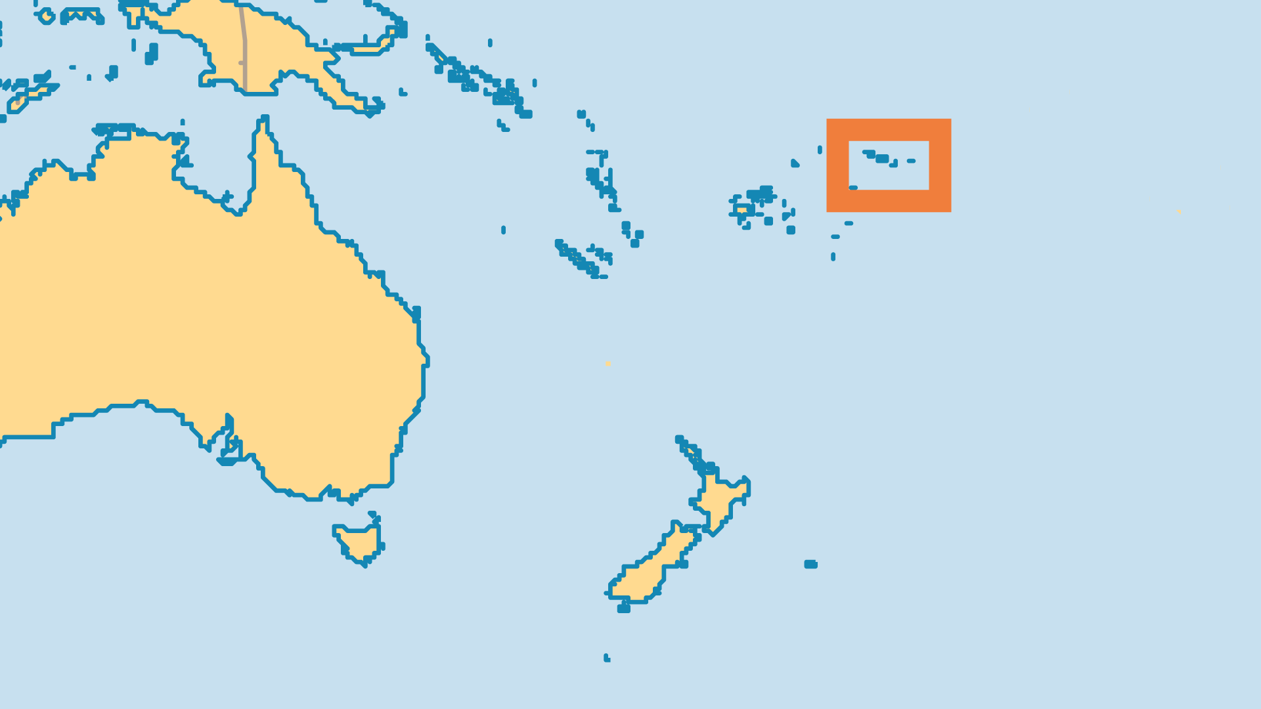
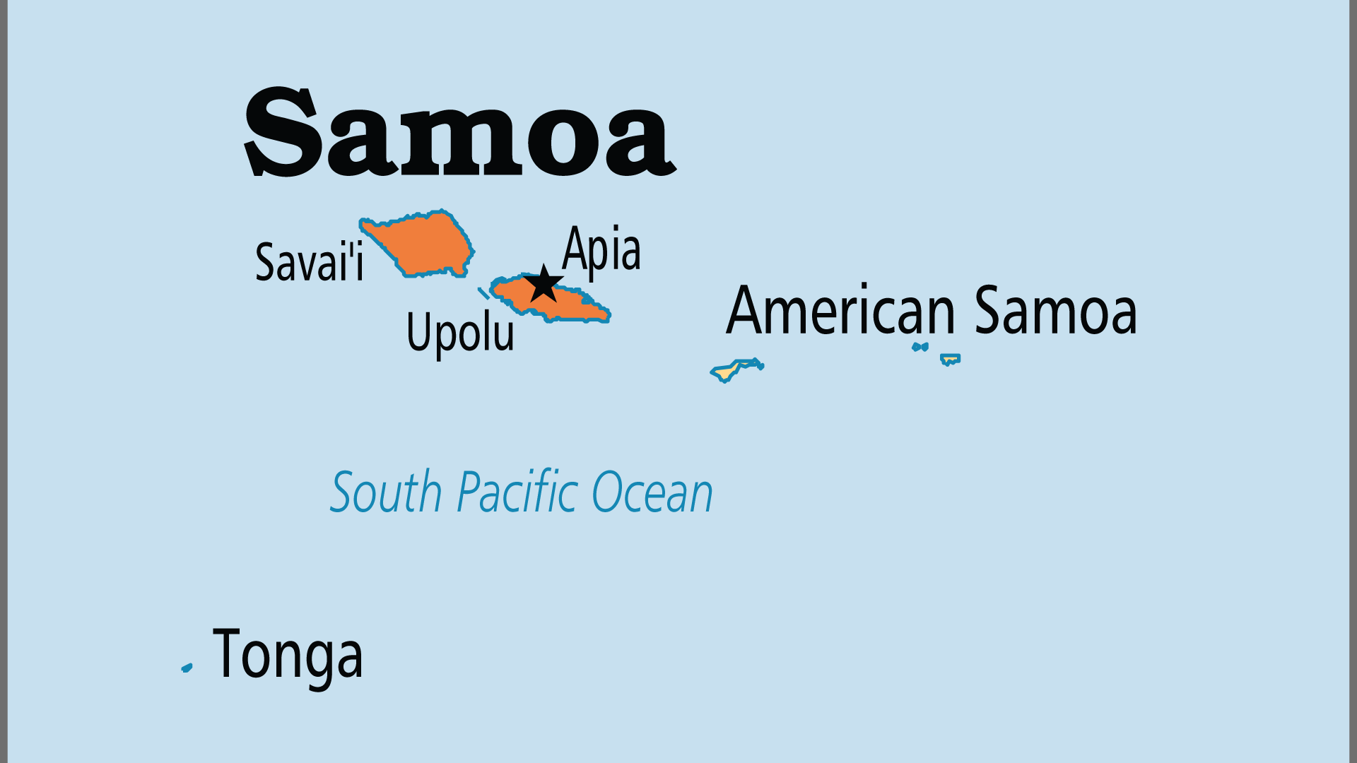
KEY STATS
Capital: | Apia
Population: | 219,307
Official Language: | Samoan; English
Life Expectancy: | 72.8 yrs (124th/236)
HDI Ranking: | 111/193
% Christian: | 96.6 %
% Evangelical: | 18 %
People Groups: | 6
% Unevangelized: | 0 %

Slide 4

FOR PRAYER
Samoans have been Christian for over a century, and every village has at least one church. But the traditional class structure and pre-Christian cultural standards were not necessarily transformed by the gospel. Much of the Church suffers from nominalism, and rivalry among denominations does not generate a good spiritual atmosphere. Pride and politics influence church life too much, and the financial demands on a poorer population are heavy. These, coupled with the modern challenges of domestic strife and imported moral vice, make for a society in need of prayer.
Want to know more? Go to www.operationworld.org

