Slide 1




Slide 2


PRAYING FOR
SAINT VINCENT

Slide 3
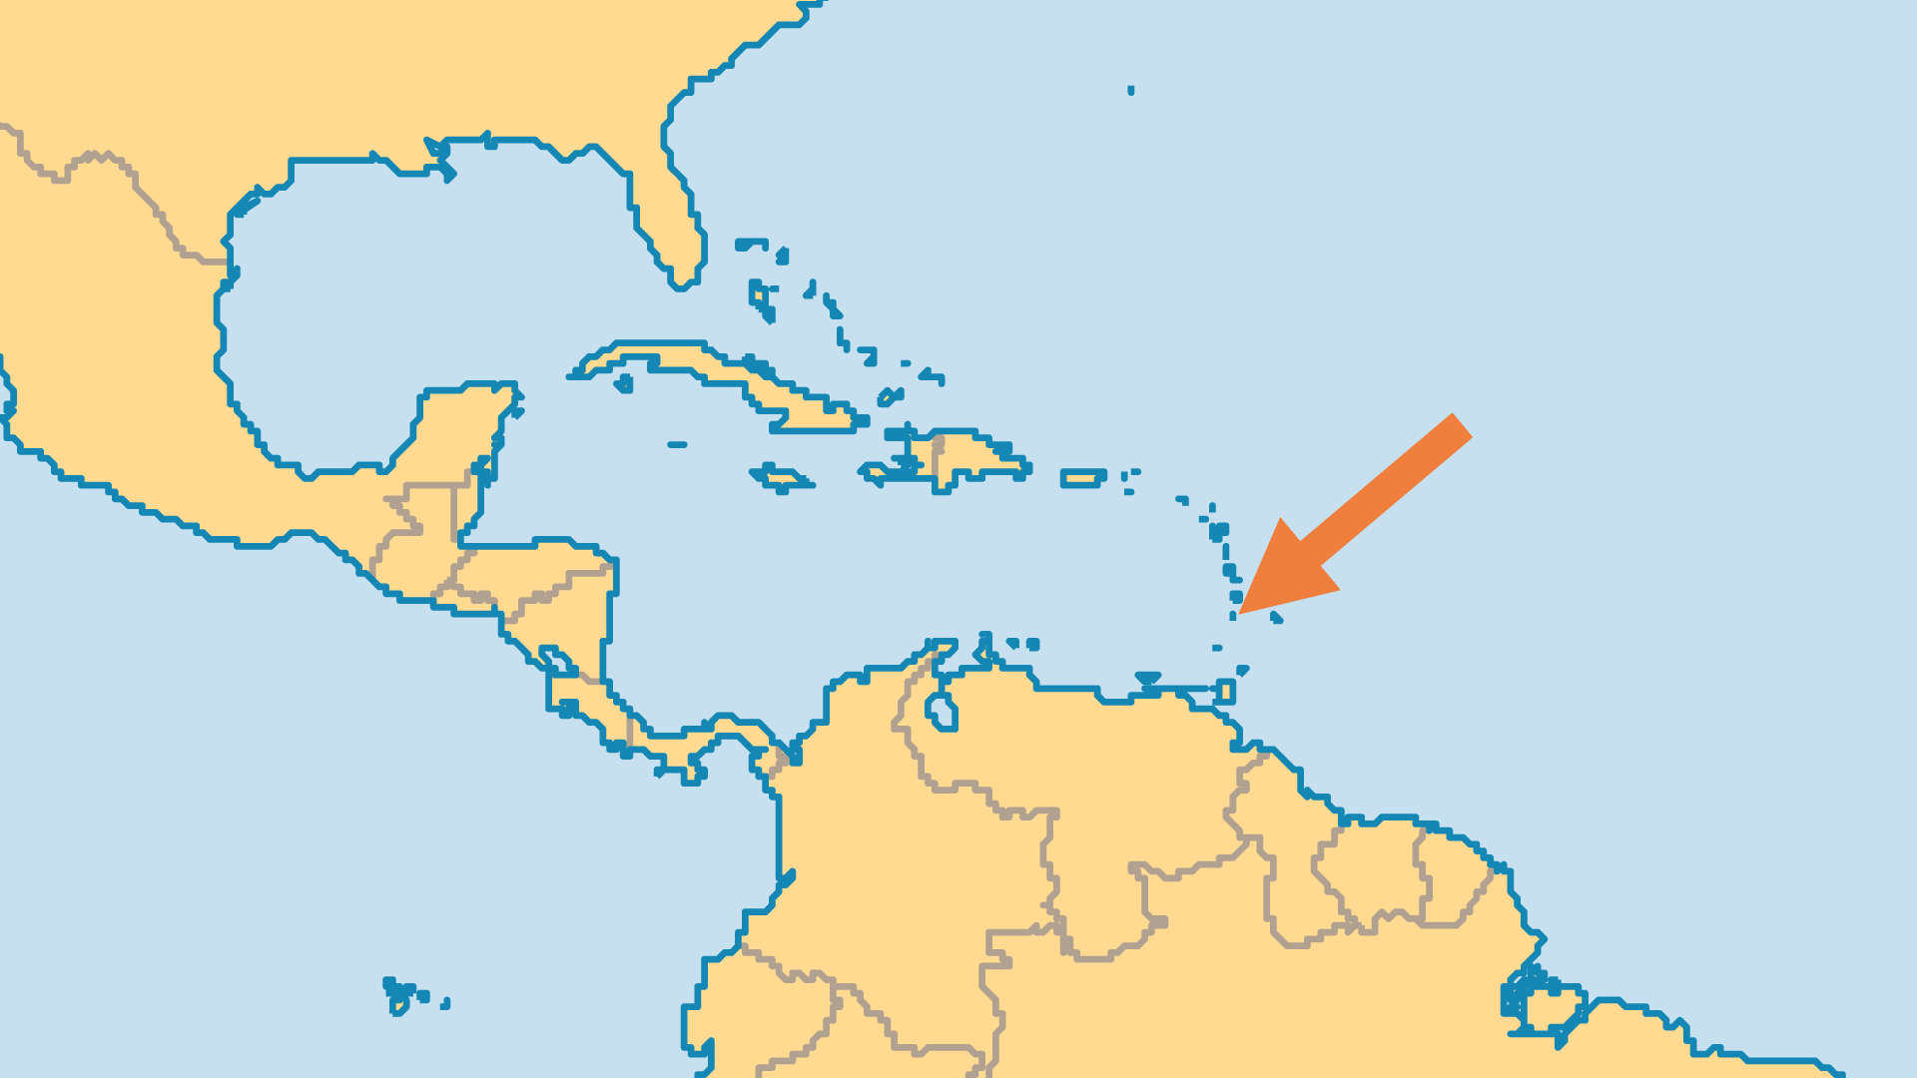
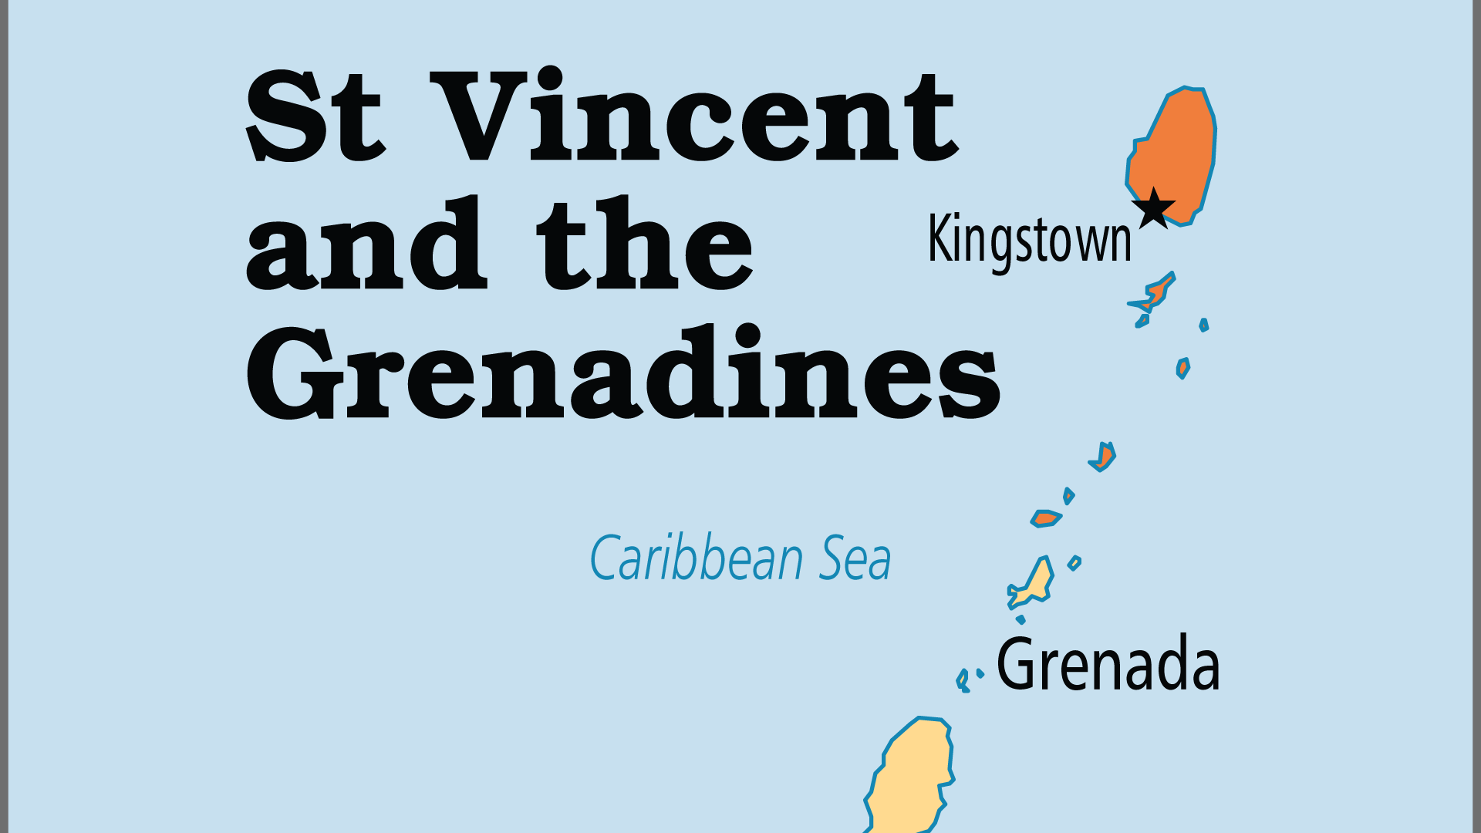
KEY STATS
Capital: | Kingstown
Population: | 99,925
Official Language: | English (official), Vincentian Creole
Languages: | 3
Literacy Rate: | 88 %
HDI Ranking: | 89/193
% Christian: | 90.1 %
% Evangelical: | 39.1 %
People Groups: | 8
% Unevangelized: | 1 %

Slide 4

FOR PRAYER
St Vincent is a religious country, but most are not related to God through a personal faith in Jesus Christ. There is a crisis of holiness, lack of spiritual fruit and growing apathy, especially regarding missions. Pray for revival and for restoration of a biblically-based, Spirit-led Church. The increasing ferocity of the frequent hurricanes brings much destruction; may they be replaced by a fervency of faith in Jesus!
Want to know more? Go to www.operationworld.org

